Slide 1
340B Winter Coalition Conference February 2025
Kate McGree, PharmD, BCGP, CPP

Slide 2
Meeting #1- Opening Remarks/State of 340B
Theme
There is a LOT going on right now; there is a lot of “talk” happening. These are “uncertain times” for sure.
The State of 340B
Many states are taking action to protect the 340B program.
Individual states are introducing 340B bills aimed at contract pharmacy restrictions and a potential rebate mode.
This shows how important the 340B program is to each state.

Slide 3
Opening Remarks/State of 340B
Currently 8 states have successfully passed legislation protecting the 340B program against contract pharmacy restrictions.
An additional 15 states are actively pursuing passing legislation against contract pharmacy restrictions.
The more states that successfully do this= the more states will follow and the more success we will be.

Slide 5
Opening Remarks/State of 340B
These are unprecedented times
Not ever has big manufacturers/Pharma sent representatives to state legislative sessions (happening in Montana right now).
There are multiple attack ads aimed at the 340B program being played across the nation (television, mobile billboards, social media).
ADVOCACY IN EACH STATE IS CRITICAL

Slide 6
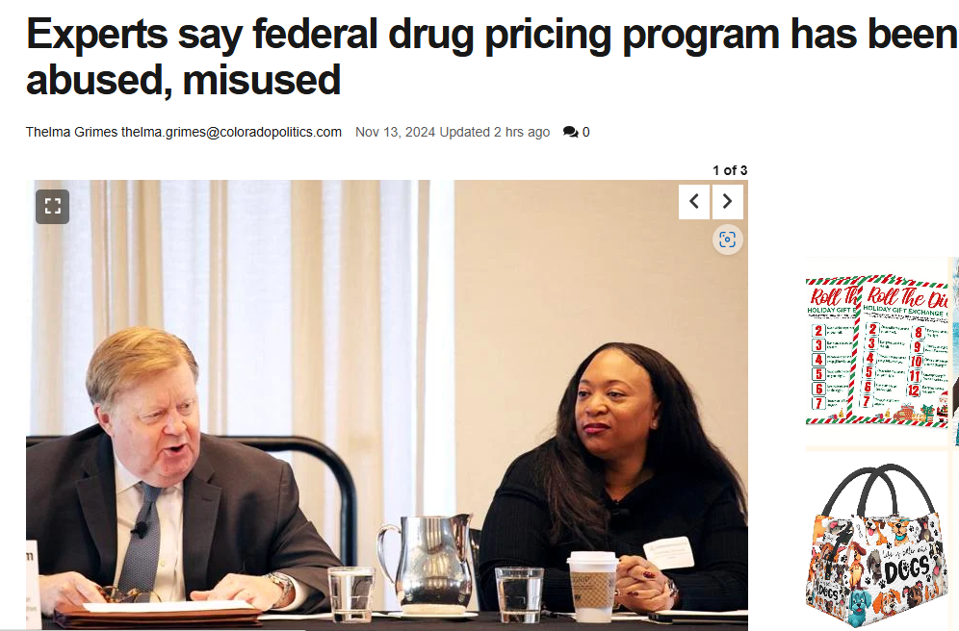

Slide 7
Opening Remarks/State of 340B
The Rebate Fight: “This is what is keeping everyone up at night”
A model where pharmacies purchase all drugs at WAC pricing and wait for a rebate= HUGE FINANCIAL BURDEN FOR ENTITIES
Currently there are 5 drug manufacturers suing HRSA regarding this model. If these manufacturers win, this model will “spread like wildfire” and all manufacturers will follow suit.
It is critical to educate state and federal policy makes on the 340B program. Be able to demonstrate the value of the program and explain the significant negative impact a rebate model would have on your organization.

Slide 8
Inflation Reduction Act and 340B: Impact and Implementation
Inflation Reduction Act (IRA) was enacted in 2022. It establishes price caps for selected Medicare drugs, referred to as the Maximum Fair Price (MFP).
10 drugs have been selected for 2026, 15 drugs will be added in 2027 and 2028, and up to 20 drugs will be added each year thereafter, totaling up to 80 drugs by 2030.
Covered entities are entitled to the lower of the 340B ceiling price or MFP.
Per CMS, no 340B pricing if the 340B price exceeds the MFP.
This could happen for two quarters after a drug’s price is lowered.
CEs would need to purchase these drugs on WAC

Slide 9
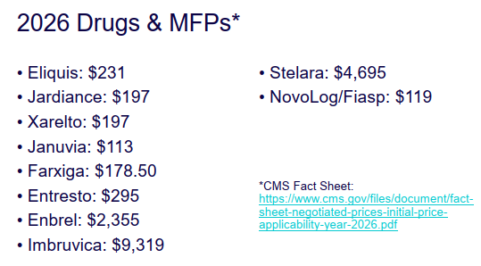

Slide 10
IRA- Be Aware and Plan
Lower 340B Savings- But by How Much?
Medicare reimbursement will be at MFP.
Manufacturers may cut WAC prices to avoid inflationary penalties.
Many MFP drugs were already subject to significant price negotiations, so the net price growth has been low.
This could bring 340B prices to MFP levels. If so, 340B=MFP - 23.1%.
Experts expect change in formularies and higher patient copays
MFP drugs could be excluded from contract pharmacy agreements??

Slide 11
Meeting #3- Inflation Reduction Act and 340B: Impact and Implementation

Slide 12
Inflation Reduction Act and 340B: Impact and Implementation

Slide 13
IRA- What Will Happen?
Denial of MFP refunds to CEs based “reasonable belief” that claim is 340B.
Denial of 340B price unless CEs shared 340B claims data and wholesaler invoices with manufacturers (like ESP).
Will manufacturers rely on 340B modifiers/impose data sharing requirements on CEs that use modifiers?
What if manufacturers pay a CE the MFP on a 340B claim? They can recoup the funds (CEs will need to monitor the receipt of MFP/rebate funds).

Slide 14
IRA and 340B Transparency

Slide 16
IRA- MFP Impact on 340B Covered Entities
MFP will result in reduced reimbursement for negotiated drugs covered by Medicare Part D.
340B Covered Entities will see a decreased financial benefit from using 340B drugs for Medicare beneficiaries.

Slide 17
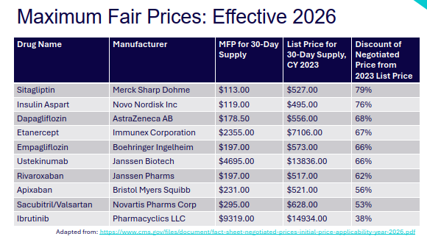
Maximum Fair Prices- Effective 1/1/26

Slide 18
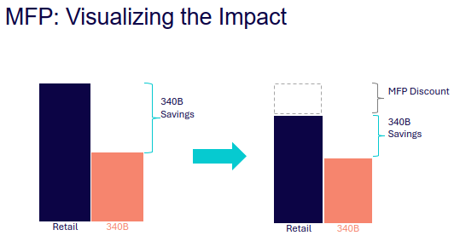
MFP or 340B?
CE may purchase drugs subject to MFP under 340B program or outside of 340B program. Manufacturers are not required to provide both 340B ceiling price and MFP on the same claim.
Medicare Part D reimbursement is based on MFP.
If 340B price is less than MFP, CE will have some savings.

Slide 19
Anticipating Reduced Revenue
Based on the 2026 drug list and MFPs, we calculated potential reduced revenue at both of our in-house pharmacies and at our contract pharmacies.
The potential reduced revenue may be extremely significant.
It is VERY IMPORTANT that at we continue to monitor and start planning for this impact NOW.
This will affect the entire organization.

Slide 20
Rebates- Replacing Upfront 340B Discounts with Rebates
Five manufacturers are suing HRSA to override HRSA’s determination that manufacturers may not implement rebates absent permission by HRSA.
Johnson and Johnson
Sanofi
Bristol Myers Squibb
Eli Lilly
Novartis

Slide 21
Rebates- How Do They Work?
CE purchases drugs at WAC, sends claims data to the manufacturer via a data collection platform, manufacturer determines if the claim is 340B eligible, manufacturer sends the CE a rebate if the claim is determined as eligible.

Slide 22
Rebates- Concern for CEs
Denial of rebates- purchase meds at WAC, offer sliding fee, and have the rebate be denied; will we be able to offer 340B pricing upfront to our sliding fee/cash patients?
Cash flow- purchase medications at WAC and period wait an undisclosed period for a rebate; due to the significant amount of money that would be needed to purchase drugs at WAC, it may compromise services we are able to offer
Manufacturers making their own rules- manufacturers can interpret 340B rules on their own; interpretation of patient definition is unknown; time for submitting claim data is different for each manufacturer; time for rebate to be issued is unknown
Duplicate discounts- who will ensure they are not received (MFP/340B)
Lack of federal regulations: 340B is not funded by federal money, it is manufacturer money

Slide 23
Rebates- Concerns for CEs
Referral Capture- how will manufacturers determine if the prescriber is eligible, determine location restrictions, determine if the provider has an arrangement with the CE? Will a rebate model end referral capture?
CE Capacity: it has been noted that over 24 data points will be need to be submitted for each claim; it is suggested that most CEs will need a minimum of a full FTE to do rebates
Contract Pharmacies: how can this be managed at the contract pharmacies? will it end contract pharmacy arrangements?

Slide 24
Rebates- Manufacturer Arguments
Manufacturers can use any platform they want for giving 340B rebates
The impact the IRA will have
There is no difference between rebate and replenishment models
Abuse of the 340B program/lack of integrity of the 340B program

Slide 25
FQHS Focused Information
Things are “WILD”
“We are in danger”
It is a time of great uncertainty, chaos, confusion; pharmacy used to be easy
Concern that Pharma is giving into the IRA with a trade off to cut the 340B program (agreement with the new republican administration)

Slide 26
FQHC Focused Information
Numerous states have enacted bills to protect against contract pharmacy restrictions and rebate models.
Montana does not have a 340B bill protecting against contract pharmacy restrictions or rebates.
The overall theme is to GET ACTIVE and ADVOCATE within each state.
REMEMBER WHO WE SERVE

Slide 27
What the New Congress and Trump Administration Might Mean for Health Policy and 340B
340B Congressional Developments
340B PATIENTS Act
SUSTAIN 340B Act
340B ACCESS Act

Slide 28
340B PATIENTS Act
First introduced on September 11, 2024.
Brings contract pharmacy back to pre-2020 for all covered entities and prohibits manufacturers from imposing conditions.
Establishes civil monetary penalties for manufacturers’ contract pharmacy violations.
Will be reintroduced soon!

Slide 29
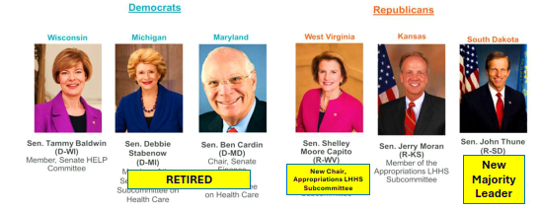
SUSTAIN 340B Act
Supporting Underserved and Strengthening Transparency, Accountability, and Integrity Now and for the Future of 340B Act.
Would address contract pharmacy restrictions, discriminatory payer restrictions, patient definition, child sites, transparency, duplicate discounts, mandatory sliding fee scales, government oversight, and other issues.
Written by the “Gang of 6”, could be a “game changer”
Not introduced in 2024; senators working to regroup/potentially release a draft bill

Slide 30
340B ACCESS Act
Focuses on hospital changes, but some restrictions would apply to grantees.
Limitations on the use of contract pharmacies, codifies a new patient definition.
Places limits on use of telehealth to qualify a prescription.
It did not move in 2024 and there is currently no projected movement.

Slide 31
Other Congressional Developments
Rebates
Reporting
Medicaid Managed Care
Illegal Immigration
Drug Shortages

Slide 32
New Leaders
Vocal critics of the 340B program.
Advocacy is everything!

Slide 33
Federal Health Policy in 2025
“Separating the Signals from the Noise”

Slide 34
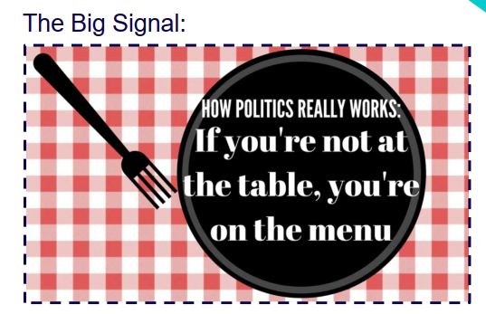
Signals
Signal: GET BIG TAX CUTS DONE
Signal: WILLINGNESS TO ADD TO THE DEFICITS AND DEBT, BUT HOW MUCH?
Signal: The above will be very hard and painful to do!
Signal: Health spending, especially Medicaid, targeted for major savings

Slide 35
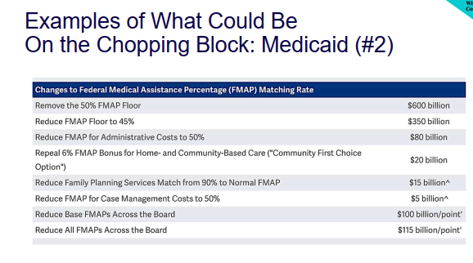
What Could Be On the Chopping Block?

Slide 36
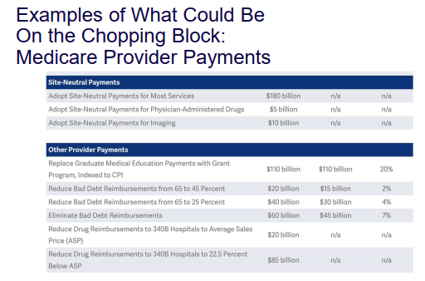
What Could Be On the Chopping Block?

Slide 37
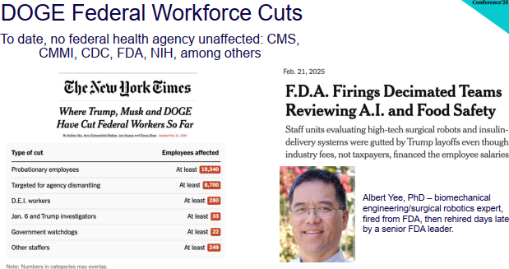
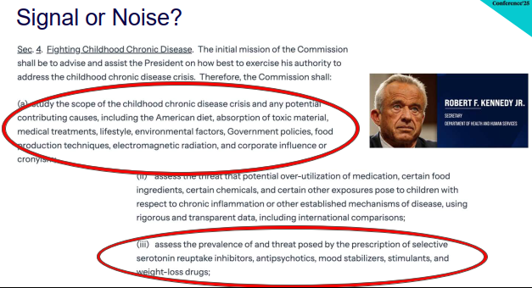

Slide 39
“340B is not a Pharmacy Program, it is a Health Center Program”

Slide 40
Future of Healthcare Economics
There are 5 forces that are shaping the future of healthcare
Quality
Prevention 2.0
Cures
Access
Innovation

Slide 41
Future of Healthcare Economics
1. Quality
There is variation in healthcare quality. Improvements are happening; much of the variation in quality occurs in those that serve minority patients and rural healthcare settings
Example: to improve quality, consider using companion diagnostics using biomarkers to avoid using medications that will not work.
2. Prevention 2.0
Use science versus prevention techniques to prevent disease. Example, look at genetics to prevents diseases instead of behavior changes.
We many not be able to prevent a disease, but early detection is key. Many of our current diagnostic tests are from 1920-1960 (mammogram, colonoscopy)
Think about liquid biopsy to look for cancers in the blood (look for cancer DNA in the blood). May be able to detect many cancers that are “hidden”.

Slide 42
Future of Healthcare Economics
3. Cures
Goal is to eliminate disease (ex Hep C medications). There are some curative treatments available, but cost and access are barriers. Treatments must be available, or they are no good.
Example: Use stem cells to replace non-functioning beta cells in the pancreas; science cures Type 1 diabetes.
4. Access
Insured versus uninsured
5. Innovation
The fear is that the Inflation Reduction Act will cut manufacturer innovation. With cuts in revenue, the incentive for innovation of new medicines will be decreased resulting in fewer new drugs coming to market.

