Slide 1
2021 Montana Marketplace Plans
October 29, 2020

Slide 2
Agenda
Welcome
Announcements
Guest speakers:
- Blue Cross Blue Shield of Montana
- Mountain Health COOP
- PacificSource
Questions

Slide 3
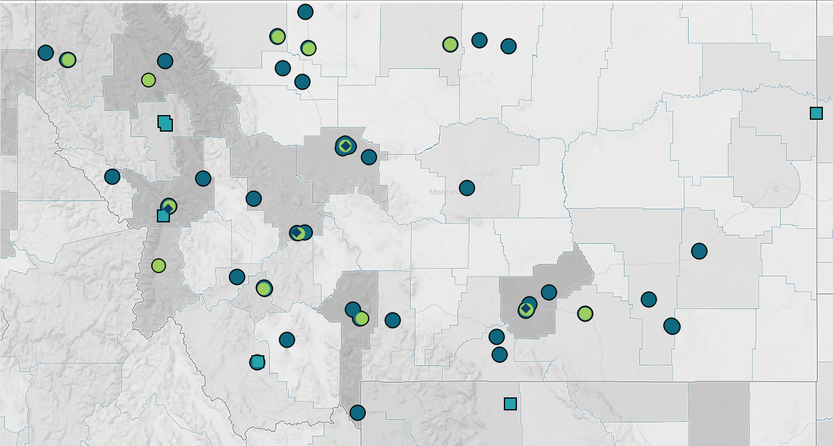
MPCA & Cover Montana
The Mission of the Montana Primary Care Association is to promote integrated primary healthcare to achieve health and well-being for Montana’s most vulnerable populations.
The Vision of MPCA is health equity for all Montanans.
MPCA values integrity, collaborations, and innovation.
The Montana Primary Care Association is the support organization for Montana’s 14 Community Health Centers and 4 of our Urban Indian Centers. MPCA centers serve over 117,500 patients across Montana.
Cover Montana was developed in 2014, after the first open enrollment period. MPCA facilitates Cover Montana and hosts the www.covermt.org website.

Slide 4
Announcements
Do you need Cover Montana materials?
- 1 pager (front and back)
- OE 8 Posters
Let us know and we’ll mail them to you!

Slide 6
Increasing Statewide Capacity
The goals: Improve access to information, provide local referrals, and use the Montana Navigation program to back up the local efforts.
- New Cover Montana Help Line: 1(844) 682-6837, 1(844) MT-COVER
- Live Chat function on the Cover Montana website
First Choice Services is providing the Help Line and chat support.
What can the help line and chat do?
- Answer questions
- Provide referrals to local assisters
- Refer to the Montana Navigator program to those who want to enroll immediately or for those who don’t have a local assister.
Notes:
Ask Jeremy to say a few words. Jeremy Smith runs the Montana Navigator program.

Slide 7
How is the help line going to work?
Scenario A:
Mattie Montanan calls the help line. They live in Billings and need help during Open Enrollment.
Mattie wants to meet with someone face-to-face, so the help line will refer Mattie to an assister in Billings who is currently providing face-to-face assistance.
There are multiple Billings organizations providing enrollment assistance, the help line will figure out if there is an organization that Mattie already works with and trusts, but will also work to ensure that it is a hot-line transfer, if possible.
Scenario B:
Mattie Montanan’s cousin calls the Help Line. They live in Harlowton. There are no enrollment assisters in Harlowton. They don’t want to meet anyone face-to-face and want to do a phone enrollment.
The help line may transfer them to a local assister, if the cousin prefers to work with someone “locally.”
The help line may also refer to Montana Navigator to enroll the cousin immediately
Notes:
Is it just going to overwhelm me? Are they just going to steal all my clients?

Slide 8
2021 Marketplace Plans
October 29, 2020
A Division of Health Care Service Corporation, a Mutual Legal Reserve Company, an Independent Licensee of the Blue Cross and Blue Shield Association.

Slide 9
BCBSMT 2021 On- and Off-Exchange Product Offering
Net-work | Plan Name† | ON or OFF Exchange | New or Renewing | Deduct-ible | OPX** | Coins | PCP Office Visit | Pref Generic (Tier 1‡) | Non-Pref Generic (Tier 2‡) | Pref Brand (Tier 3‡)
Blue Preferred PPO | Blue Preferred Bronze PPO 301 | Both | Renewing | $8,550 | $8,550 | 0% | 0% | 0% | 0% | 0%
 | Blue Preferred Bronze PPO 302* | OFF Only | Renewing | $5,200 | $6,900 | 30% | 30% | 20% | 25% | 30%
 | Blue Preferred Bronze PPO 201 | Both | Renewing | $3,200 | $8,550 | 50% | $25 | 0% | 10% | 20%
 | Blue Preferred Bronze PPO 202* | Both | Renewing | $4,000 | $6,900 | 30% | 30% | 20% | 25% | 30%
 | Blue Preferred Bronze PPO 502* | OFF Only | NEW | $5,000 | $6,900 | 50% | 50% | 20% | 25% | 30%
 | Blue Preferred Silver PPO 306 | OFF Only | Renewing | $4,500 | $8,550 | 50% | $25 | $5 | $15 | $50
 | Blue Preferred Silver PPO 308 | Both | Renewing | $8,550 | $8,550 | 0% | 0% | $10 | $15 | $50
 | Blue Preferred Silver PPO 203 | Both | Renewing | $800 | $8,550 | 50% | 40% | 20% | 25% | 30%
 | Blue Preferred Gold PPO 204 | Both | Renewing | $750 | $8,550 | 30% | $10 | $5 | $10 | $50
Blue Focus POS | Blue Focus Bronze POS 205 | Both | Renewing | $4,700 | $8,550 | 50% | $40 | 0% | 10% | 20%
 | Blue Focus Bronze POS 302 | OFF Only | Renewing | $5,200 | $6,900 | 30% | 30% | 20% | 25% | 30%
 | Blue Focus Silver POS 306 | OFF Only | Renewing | $4,500 | $8,550 | 50% | $25 | $5 | $15 | $50
 | Blue Focus Silver POS 206 | Both | Renewing | $4,200 | $8,550 | 50% | $25 | $5 | $15 | $50
 | Blue Focus Gold POS 207 | Both | Renewing | $300 | $8,550 | 40% | 20% | 10% | 20% | 30%
For Training
Purposes Only
* HSA plan ** Out of Pocket Maximum (includes deductible) ‡ All RX coinsurance percentages are subject to the deductible
This information is preliminary in nature and is being shared for educational and training purposes only. It may not be used for any other purposes, including marketing.

Slide 10
PY 2021 Portfolio Changes Summary
MEDICAL & DENTAL QHPs
PRESCRIPTION & PHARMACY
We increased our $0 offerings on some plans:
$0 copays on PCP office visits
$0 deductibles on 94% CSR Silver plans
Blue Preferred Bronze PPO 502: New off-exchange HSA plan with $0 copays on expanded preventive drug list
Sam’s Club is no longer an in-network pharmacy
No longer a preferred or non-preferred pharmacy
Will be considered out-of-network
For Training
Purposes Only
SUPPLEMENTAL PRODUCTS
NETWORK
No major changes
No major changes
This information is preliminary in nature and is being shared for educational and training purposes only. It may not be used for any other purposes, including marketing.
Notes:
Only the NEW Blue Preferred Bronze PPO 502 off-exchange HSA plan covers the preventive Rx at $0 for those conditions explicitly called out as preventive.
For details on the applicable conditions and subsequent prescriptions, see the following:
https://www.irs.gov/pub/irs-drop/n-19-45.pdf
https://www.irs.gov/newsroom/irs-expands-list-of-preventive-care-for-hsa-participants-to-include-certain-care-for-chronic-conditions

Slide 11
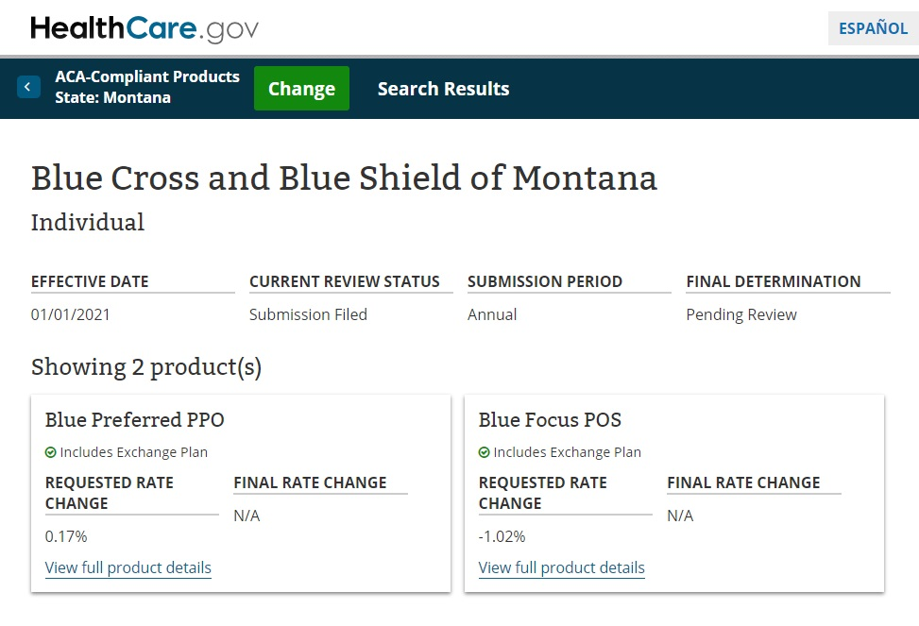
Rate Changes
Proposed rates are basically flat overall.

Slide 12
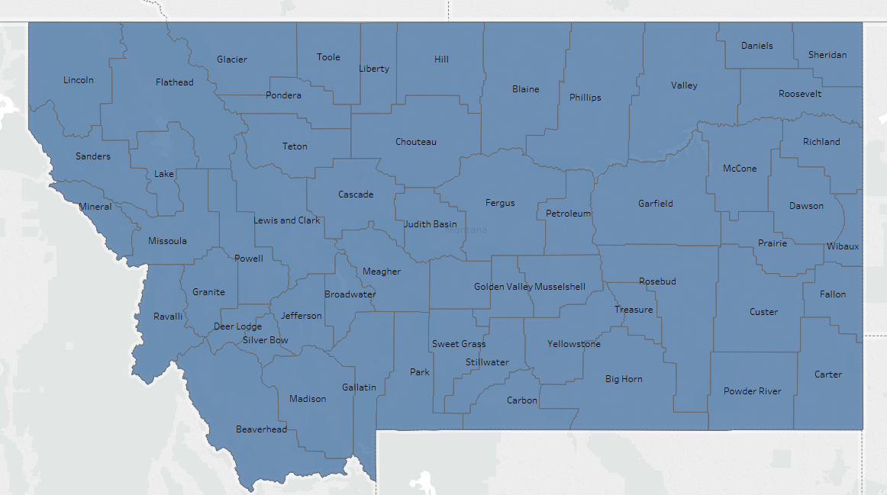
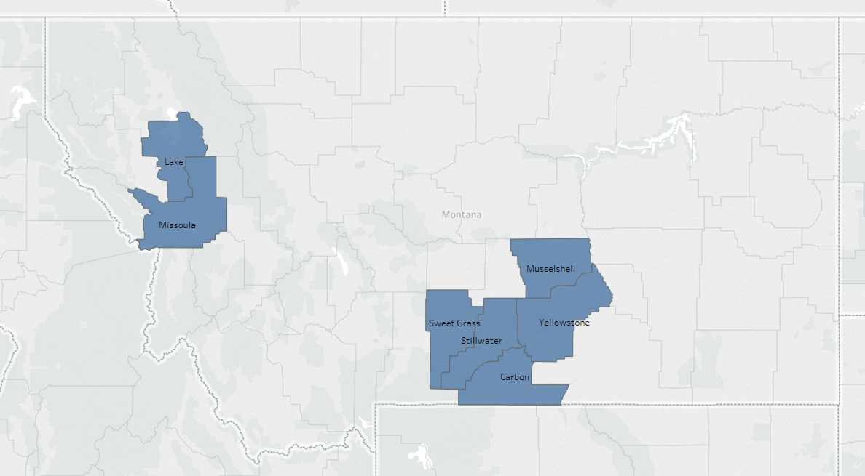
BCBSMT Retail Provider Networks
Blue Preferred PPO (PPO)
Existing statewide network
On and Off Exchange
Metallic Plans: Gold, Silver, Bronze, Catastrophic
Blue Focus POS (BLC)
Existing network in Billings and Missoula
On and Off Exchange
Metallic Plans: Gold, Silver, Bronze
Network includes approximately
60 hospitals and 8,400 professionals
Existing Service Area
Network includes approximately
8 hospitals and 1,020 professionals

Slide 13
Telemedicine
Temporary Benefits
Permanent Benefits
Virtual Visits powered by MDLIVE
Notes:
Note that each plan may use a different term:
Montana: telemedicine

Slide 14
Telemedicine Benefits
Temporary Benefits for 2020 Plan Year Due to Public Health Emergency
We have temporarily lifted cost-sharing and expanded coverage for clinically appropriate medical and behavioral health services delivered via telemedicine with local providers as well as Virtual Visits powered by MDLIVE through December 31, 2020.
The billing codes covered could include professionals as well as facilities.
For these services, members won’t pay copays, coinsurance or deductibles.

Slide 15
Telemedicine Benefits
Permanent Benefits for 2021 Plan Year
Covid-19 has brought about an unprecedented increase in telemedicine demand. Providers are reporting 50-175x the number of telemedicine visits prior to Covid-19.
Member costs for telemedicine visits are the same as in-person visits.
Telemedicine visits include visits with PCPs, specialists and behavioral health professionals.
Members will be able to access their medically necessary, covered benefits through providers who deliver services through telemedicine.
Members will have to contact providers to determine if they offer telemedicine visits.
We will cover telemedicine codes consistent with the permanent code list from CMS and the American Medical Association (AMA).
We will continue to follow applicable state and federal requirements.

Slide 16
Virtual Visits powered by MDLIVE
Non-emergency medical consults 24/7/365 by video
Behavioral health consults 24/7/365 by video
Utilizes MDLIVE’s national network of physicians, typically not “local” physicians
English and Spanish speaking physicians available. Other languages available via translation services
Single sign-on to the MDLIVE portal from Blue Access for Members, Digital Member Hub and mobile app
Integrated with Provider Finder
Warm transfers from Health Advocates, 24/7 Nurseline and customer service to MDLIVE
Virtual Visits powered by MDLIVE are included with Blue Preferred PPO plans, but not included with Blue Focus POS plans
Examples of Non-emergency Medical Needs | Examples of Behavioral Health Needs
Sinusitis Allergies Cold and flu Ear ache Fever Pink eye | Depression and anxiety Marital problems Child behavior and learning issues Financial hardship Coping with loss and grief Stresses of everyday life
Disclaimer: Access to certain transparency products may not be available for all plans.

Slide 17
Pharmacy 2021 Changes
Sam’s Club Pharmacies Moving Out of Network
Sam’s Club will no longer be a Preferred or In-Network Pharmacy for 2021
Members will need to switch to an in-network pharmacy
Additionally, some independent pharmacies may no longer be Preferred or may no longer be in-network
Montana
Albertsons
Independent Pharmacies
Walgreens
Walmart

Slide 18
Pharmacy 2021 Changes
HDHP and HSA Preventive Drug Program
High Deductible Health Plan (HDHP) and Health Savings Account (HSA) Preventive Drug Program is a benefit designed to support preventive drug coverage, when a HDHP and HSA are in place for select plans
The Blue Preferred Bronze PPO 502 plan is designed to reduce out-of-pocket costs for members using select preventive drugs
Deductible, copay and coinsurance will be waived ($0 member share) for select plans
Categories include:
Anticoagulants/Antiplatelets
Depression (Selective Serotonin Reuptake Inhibitors [SSRIs])
Diabetic Medications
Diabetic Supplies
High Blood Pressure
High Cholesterol
Osteoporosis
Notes:
Only the NEW Blue Preferred Bronze PPO 502 off-exchange HSA plan covers the preventive Rx at $0 for those conditions explicitly called out as preventive.
For details on the applicable conditions and subsequent prescriptions, see the following:
https://www.irs.gov/pub/irs-drop/n-19-45.pdf
https://www.irs.gov/newsroom/irs-expands-list-of-preventive-care-for-hsa-participants-to-include-certain-care-for-chronic-conditions

Slide 19
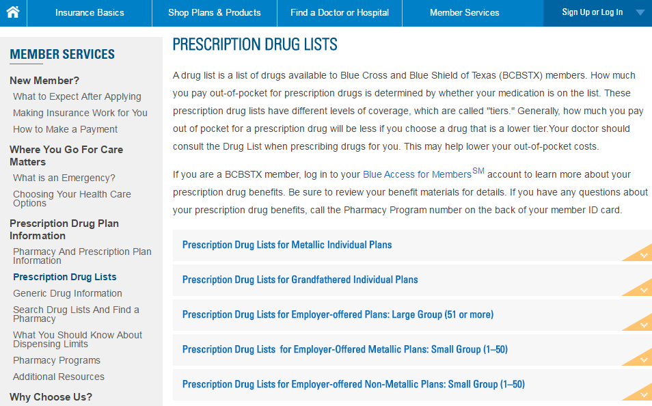
Prescription Drug Lists
The drug lists can be accessed from each of our public websites
Plan year 2021 drug lists will be available no later than Nov. 1, 2020
Select drug list for Metallic Individual Plans
The drug list has instructions on how to use the list and search for a specific drug
Also includes information about the following:
Dispensing Limits, Prior Authorization, Step Therapy
Member Pay the Difference
Specialty Drugs
Notes:
Each state will have their own drug list, however Illinois will have two drug lists – a Non-HMO and a HMO list due to the capitation agreements

Slide 20
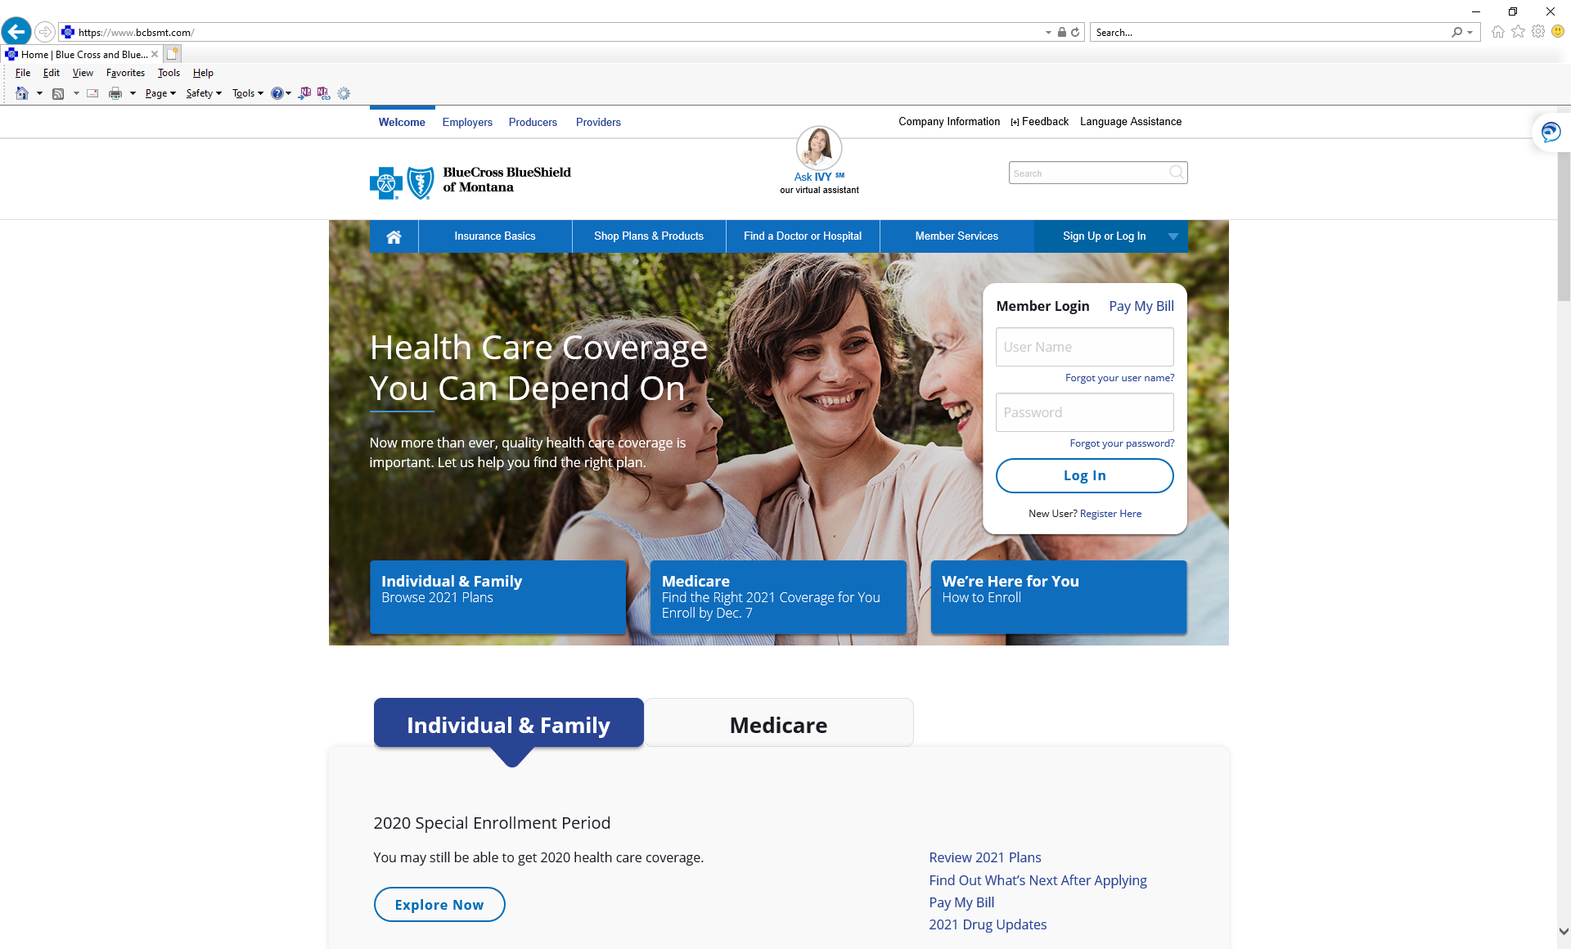
Enrolling in a BCBSMT Plan

Slide 21
Initial Premium Payment Deadlines
OFF EXCHANGE Initial Payment Deadline | ON EXCHANGE Initial Payment Deadline
The initial premium payment due date is either 30 calendar days from the first payment request or the effective date of the policy whichever is LATER The 30-calendar-day period begins the day we send the payment deadline letter. If the payment deadline isn’t met, the application is withdrawn. If the applicant pays by the deadline, the effective date remains Jan. 1, 2021. | The initial premium payment due date is either 30 calendar days from application receipt or the effective date of the policy whichever is LATER The 30-calendar-day period begins the day we receive the application. If the payment deadline isn’t met, the application is withdrawn. If the applicant pays by the deadline, the effective date remains Jan. 1, 2021.

Slide 22
Questions?
Rhonda Nordahl
Rhonda_Nordahl@bcbsmt.com
Office: (406) 437-6317
Cell: (406) 431-0489

Slide 23
WHEREVER YOU'RE GOING,
WE'VE GOT YOU COVERED.
Individual - Employer Plans - Medicare Supplements

Slide 24
WE'RE MOUNTAIN HEALTH CO-OP. CREATED FOR, GOVERNED BY, AND PROUDLY SERVING PEOPLE JUST LIKE YOU.
We believe in quality over quantity. There is strength in being locally owned. Our ideas on what it means to be an all-for-one and one-for-all CO-OP stretch further than any corporate tagline ever could.
Come as you are, whoever you are. We're Mountain Health CO-OP, we belong to you, and you belong here.

Slide 25
MEMBERSHIP
Idaho
Bronze
Cat
Gold
Silver
3,355
30%
55
75%
2,406
22%
3,886
18%
No BOR
Montana
Bronze
Cat
Gold
Silver
11,579
73%
136
81%
1,825
64%
5,130
74%
No BOR

Slide 26
Montana Individual Rates
Rate Change
Product
2020 Rate
2021 Rate
CO-OP Plus Gold
$407.50
$400.01
-1.8%
CO-OP Plus Silver
$388.93
$366.64
-5.7%
CO-OP Plus Bronze
$263.80
$270.04
2.4%
Connected Care Gold
$410.74
$411.38
0.2%
Connected Care Silver
$389.12
$382.05
-1.8%
Connected Care Bronze
$265.18
$278.95
5.2%
Connected Care Bronze Plus
$282.24
$292.65
3.7%
Connected Care Silver Option 2
$377.23
$375.15
-0.6%
Connected Care Catastrophic
$239.28
$231.16
-3.4%
Connected Care Expanded Bronze
$278.42
$284.84
2.3%

Slide 27
2021 PRODUCTS AND BENEFITS
We believe in whole body health. Each member has a reimbursement credit for annual dental and vision exams.
Members have access to board certified doctors wherever they go, 24/7 via their phone, tablet or computer.
*Group plans vary
The CO-OP covers travel expenses for members in need of certain out-of-state care.
The CO-OP's pharmacy program offers hundreds of drugs at zero cost for members.
We proudly cover 100% of preventive check-ups and screenings.

Slide 28
VALUE-BASED PREVENTIVE DRUG LIST FOR 2021
Provides NO Cost Share Drugs Before Deductible
For ALL Plans in all Three States (MT, ID, and WY)
Added More Drugs at No Cost, Including Drugs for
Cardiovascular Disease
Diabetes (Including Many Insulins)
Asthma/COPD
Depression
Osteoporosis

Slide 29
Open 24/7.
Cost-Effective - Copay for Urgent Care for Traditional Plans (Currently $0, due to COVID-19)
Urgent Care Can Treat Conditions Such as
Bladder Infections, Bronchitis, Fevers, Pink Eye, Rash, Sinus Problems, Stomachaches
Behavior Health Care (15-50 Minute Visits)
Urgent Care - Less Than 3 Minutes
Behavioral Health - Less than 24 Hours
No Crisis Care
Providers Can Order Scripts & Labs
Repeat Provider Services
To Access, Download the Doctor On Demand App

Slide 30
ADULT VISION EXAMS
Members Pick their Providers
Tip: Call the Provider to Request the Cost of the Exam to Make Sure Their $60 Reimbursement Goes Farther
Members go to Their Appointments and Pay Directly, Making Sure to Get a Copy of Their Receipt
The Member Then Submits Their Receipt Along with the Claim Form, Which is Available at www.mountainhealth.coop, and submit via
Mail, to University of Utah Health Plans, PO Box 45180, Salt Lake CIty, UT 84145-0180
Fax, to 801-281-6121, or
Email, to uuhp@hsc.utah.edu
This benefit is paid as part of your medical benefit plan with the CO-OP. If you have other vision coverage, this benefit will not coordinate with that coverage.

Slide 31
New!
Need Your teeth
cleaned?
$100 Maximum
Includes Cleaning, Exam, and Fluoride (No X-Rays)
Implemented for all Plans
We've got you covered.
Now offering dental exam reimbursements.
mountainhealth.coop

Slide 32
You belong here.

Slide 33
PacificSource
2021 Product Training

Slide 34
Our Mission
To provide better health, better care, and better cost to the people and communities we serve.

Slide 35
Members: At the Center of Everything We Do
98%
99.78%
13
12
days
Employer
Satisfaction
(Employer Satisfaction Survey)
Claims
Turnaround
(Claims Monthly Turnaround Report)
Claims
Accuracy
(Random Audit Results Report)
Call
Answer Speed
(Call Volume Report)

Slide 36
Products

Slide 37
Navigator Products Attributes
Navigator gives you a more integrated approach to care—helping members get the right care, at the right time, in the right place. It’s care that’s coordinated to simplify the member experience, improve access to care, and promote member engagement through shared decision-making within an accountable network of providers.
Product Attributes
Member experience
Provider contracting attributes
Plan design
Provider network
Pricing and marketability

Slide 38
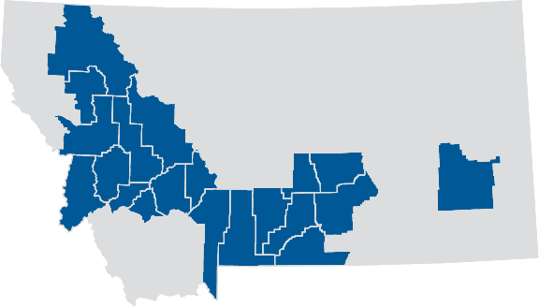
Navigator is Offered in Specific Counties
Navigator is only offered in specific counties where we have been successful in working with our major delivery systems and providers to achieve quality outcome goals.
Navigator Counties include:
Flathead
Lake
Lewis and Clark
Missoula
Musselshell
Park
Sweet Grass
Stillwater
Wheatland
Yellowstone
New for 2021
Broadwater
Custer
Deer Lodge
Gallatin
Granite
Jefferson
Powell
Silver Bow
Ravalli

Slide 39
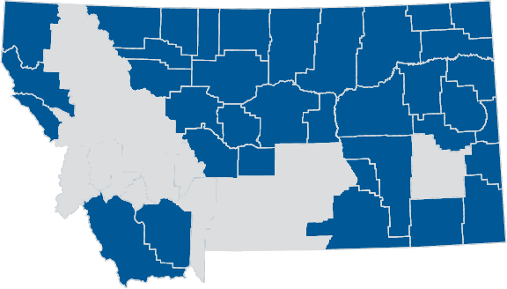
Voyager Products
Voyager products are sold in counties where a Navigator products are not available

Slide 40
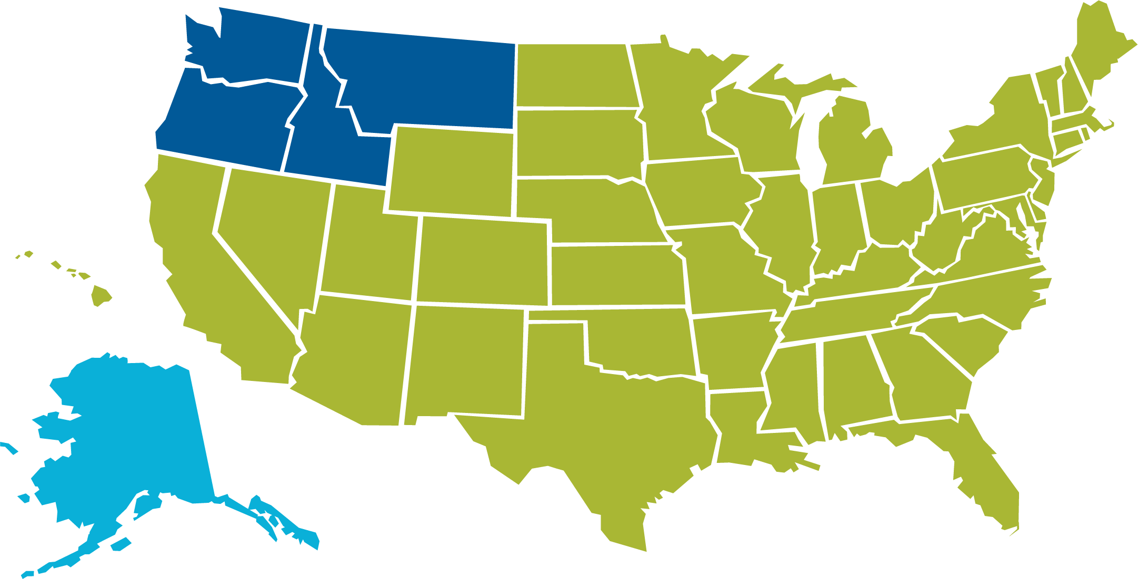
Nationwide Provider Network
We partner with more than 92,000 participating providers.
Voyager / Navigator Network
Large region-wide PPO network.
Covers all of Oregon, Idaho, Montana and Washington
First Health Network
FirstChoice Network
Travel networks available when members travel outside their Voyager / Navigator service area.

Slide 41
Individual Products
On Exchange
Off Exchange

Slide 42
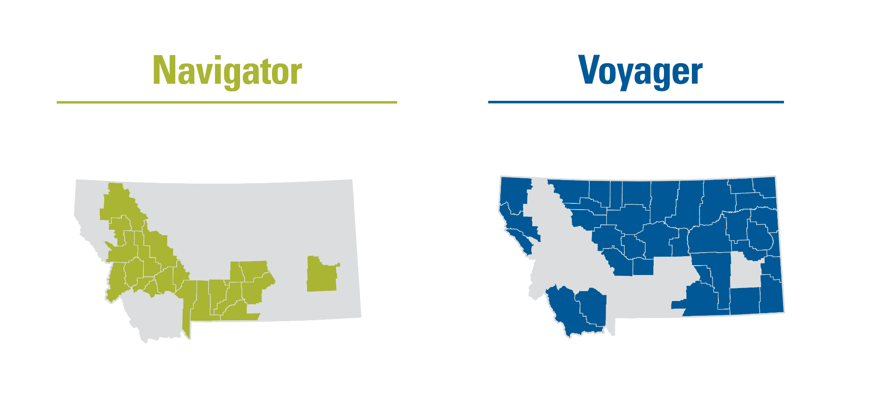
Individual Product Sales Areas

Slide 43
On & Off Exchange Plans
Plan name | Deductible | Out-of-pocket | Copay OV/Spec | Coinsurance | Rx structure
Bronze HSA 6900 | $6,750 $6,900 | $6,750 $6,900 | After deductible 0% | After deductible, 0% | After deductible 0%
Silver HSA 3500 | $3,500 | $6,750 | After deductible 25% | After deductible, 25% | After deductible 25%
Gold 1500 | $1,500 | $5,000 | After deductible, 10% | After deductible, 10% | $15 / $60 / $100 / $250
Bronze 7000 | $7,000 | $8,150 $8,550 | $35 / after deductible 40% | After deductible, 40% | After deductible 40%
Silver 5000 | $5,000 | $8,150 | $35 / $70 | After deductible, 30% | After deductible 30%

Slide 44
Off Exchange Only
Plan name | Deductible | Out-of-pocket | Copay OV/Spec | Coinsurance | Rx structure
Silver 4000 | $4,000 | $7,000 | $35 / $70 | 30% | After deductible 30%
Silver 3000 | $3,000 | $8,150 | $35 / after deductible 40% | 40% | $15 / $60 / $100 / $250

Slide 45
What is silver loading?
Cost share reduction plans offer lower deductibles, copays, and out of pocket limits for those that qualify based on income.
The government would pay the difference between the standard plan and the CSR plan, however that is no longer happening.
To account for the difference carriers are rate loading the premium on silver plans sold on the exchange.
HC.gov has some good resources on explaining CSR plans.

Slide 46
First Dollar Benefits
$500 accident benefit
$35 PCP/Mental Health copay on our Bronze 7000 and Silver 5000 plans (on and off exchange)
$35 PCP/Mental Health copay on Silver 4000 and Silver 3000 (off exchange only)
Silver 3000 has first dollar Rx copays (off exchange only)
$150 annual Health Education Benefit
Kids vision exams and hardware
Preventive care services and Preventive Rx

Slide 47
Pediatric and Family Dental Plans
Plan Name | Class I coinsurance | Class II coinsurance | Class III coinsurance | Deductible | Annual Max
Dental Choice 0-20-50 1000 | No deductible, 0% | After deductible, 20% | After deductible, 50% | $50 Individual $150 Family | Adult annual Max $1,000
Dental Choice 0-20-50 1500 | No deductible, 0% | After deductible, 20% | After deductible, 50% | $50 Individual $150 Family | Adult annual Max $1,500
Kids Dental Choice 0-20-50 | No deductible, 0% | After deductible, 20% | After deductible, 50% | $50 Individual $150 Family | $350 Individual $700 Family Max OOP
All plans offered on and off the marketplace.
Adult services: 6-month exclusion for Class II services and 12-month exclusion for Class III services

Slide 48
Dental Updates
Change frequency limitation for amalgam and composite fillings from one time per calendar year per surface per tooth to one filling per surface per tooth every 24 months
Increased UCR from the 85th to 90th percentile

Slide 49
Pharmacy
Notes:
Clinical integration

Slide 50
Partnership with CVS Caremark
Pharmacy Network
The CVS Health National Network is specifically designed to provide maximum geographic coverage at marketplace-competitive rates and fees.
As one of the largest PBMs in the nation, we can utilize their strength, size, and market presence to ensure that their National Network and competitive pricing ultimately benefits both our clients and their members.
A nationwide network of more than 68,000 participating retail pharmacies

Slide 51
2021 Pharmacy Updates
Individual products are moving from MAC A to MAC B
Truvada for PrEP added to ACA
True Accumulation Program
Amounts paid by manufacture coupon/discount programs will not accumulate towards members DED/OOP

Slide 52
Value-added Benefits

Slide 53
Value-added Programs
Teladoc ®
Active&Fit Direct TM program
Assist America ®
24-Hour NurseLine
Quit For Life® tobacco cessation
Café Well
Weight Watchers® (WW ®)
HealthKicks! (wellness for kids)
Health Education Classes
PacificSource Prenatal Program

Slide 54
Additional Accident Benefit
Included on all Individual and Small Group plans; available on Large Group plans.
Support for an active lifestyle.
First $500 of an accidental injury within 90 days.
Caused through external and accidental means.
“Accident” means an unforeseen or unexpected event-causing injury that requires medical attention.
Independent of disease or infirmity.
Does not include musculoskeletal sprains or strains obtained in the performance of physical activity.

Slide 55
Teladoc® | Additional Access to Care
Access Anytime Provide 24/7, on-demand access to board-certified providers by video, phone, or mobile app. | Services Offered Behavioral health and general medical coverage available. | Treat Health Issues Diagnose, treat, and prescribe medications (if necessary) for common health issues.

Slide 56
Teladoc® Fees
Type of Appointment | 2020 Fees | 2021 Fees
General Medicine | $45 | $55
Licensed Therapist | $80 | $90
Initial Psychiatrist Visit | $160 | $220
Ongoing Psychiatrist Visit | $90 | $100
For copay style plans, the Teladoc copay is $10. For all other plans they pay the fees listed above.
For telehealth cost-share information, see the benefits in our plan summaries.

Slide 57
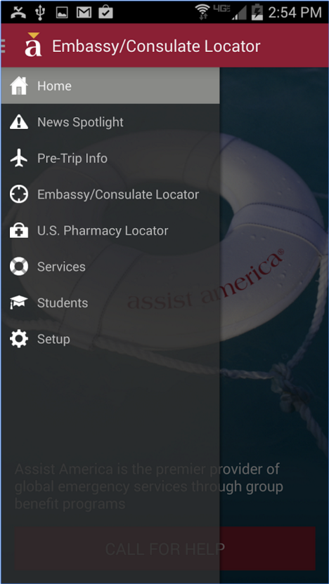
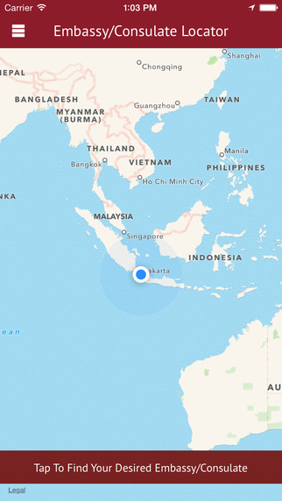
Assist America Mobile App
Help at your fingertips!

Slide 58
CaféWell—Support for Better Health
Secure health engagement portal for health and wellness resources, support, and guidance.
Create a personalized plan based on your health goal.
Access a variety of activities, wellness challenges, expert health coaching, and more.

Slide 59
Health Education Classes
Members and their dependents are eligible for a $150 per plan year reimbursement for taking part in a course on any of these health education topics:
First aid
CPR
Prenatal classes
Parenting
Heart health
Nutrition – when connected with a chronic condition

Slide 60
Online Tools
InTouch
myPacificSource Mobile App
Online Enrollment Portal

Slide 61
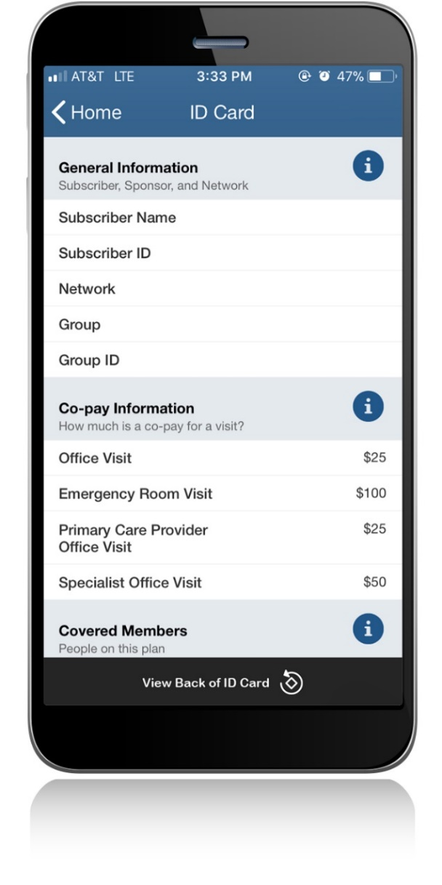
24/7 Member Access with myPacificSource
Member ID card
Provider directory
Benefits
24-Hour NurseLine

Slide 62
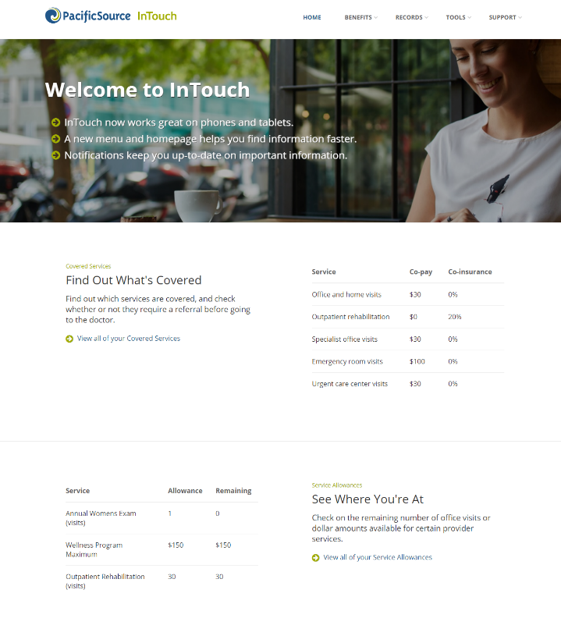
Secure online access, 24/7, with InTouch for Members
Members can use InTouch to:
Review coverage and preauthorization information
View explanation of benefits
Request a temporary ID card
Go paper-free
Access CaféWell

Slide 63
Open Enrollment

Slide 64
Individual Open Enrollment
MARKETPLACE: For New and Renewal, follow all enrollment and payment parameters set by the Marketplace.
DIRECT: Deadline to submit applications for January 1, 2020, effective date is December 15, 2019.
Paper applications must be received (not just postmarked) by 5:00 p.m., December 15, 2019.
Fax number, P.O. Box, and email address are on the application.
Electronic applications submitted through agent iStore must be received in the system by midnight, December 15, 2019.

Slide 65
Where to go for help during open enrollment?
Call PacificSource assistors at (855) 330-2792
Email questions to individual@pacificsource.com

Slide 66
What our members are saying

Slide 67
Customer Satisfaction The survey says…
“Of all the health insurance companies I have had over the years, PacificSource is clearly a cut above the rest. All my concerns and questions are answered easily and my providers have mentioned how easy PacificSource is to deal with.” (Member did not leave their name)
“Thank you. It's how health insurance should be: clear what's covered and good quality of providers on your panel.” – Kara L.
“Very happy with our plan! Keep up the good work! Definitely best experience we've ever had with a health plan!” (Member did not leave their name)
“Love you! Best experience ever. Our broker described PacificSouce as the Maserati of plans and he was right.” – Erin M.
“I have been very pleased with both the personal service when I call customer service and with the online program, InTouch.” – Karen G.
Source: Monthly customer satisfaction surveys

Slide 68
Questions

Slide 69
Thank you for joining us and please reach out with questions
Olivia Riutta
oriutta@mtpca.org (406) 880-3374

