Slide 1
Alcohol Withdrawal
The Do’s and Don’ts of Outpatient Management
Megan Zawacki, PA-C
Assistant Director of Addiction Medicine
St. Peter’s Health

Slide 2
Disclosures
None.
But I do hate benzodiazepines…

Slide 3
Objectives
Recognize the effects of alcohol on the brain and body
Become familiar with different screening tools
Recognize the signs and symptoms of withdrawal
Develop a comfort with medications used to manage withdrawal
Recognize higher-risk withdrawal issues

Slide 4
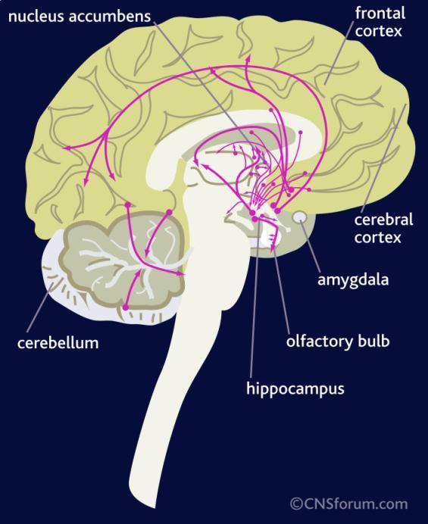
A quick A&P lesson
GABA
GABA receptors, when bound by GABA, INHIBIT excitation in the CNS
Calming effect on the brain
Glutamate
Primary excitatory neurotransmitter in the CNS
STIMULATES the brain and body
Important for learning, memory, mood regulation, metabolism, motor function, sensory processing, and neuroplasticity
Notes:
GABA: gamma amino butyric acid; neurotransmitter. Chronic ethanol use induces an insensitivity to GABA such that more inhibitor is required to maintain a constant inhibitory tone.
Glutamate: amino acid, excitatory. Ethanol inhibits glutamate-induced excitation. The brain will adapt by increasing the number of glutamate receptors in an attempt to maintain a normal state of arousal. Cessation of alcohol or a reduction from chronically elevated concentrations results in unregulated excess excitation.

Slide 5
Notes:
Don’t Panic. This entire slide is just to remind us all of this one point… To increase GABA, we should avoid alcohol. Patients consuming a lot of alcohol will have depleted levels of GABA as well as an insensitivity to GABA.
The GABA receptor complex has highly specific binding sites for ethanol

Slide 6
Alcohol Effects on the Brain
Increases GABA effect in the brain
Calm, less anxious at LOW levels
Decreases the effect of Glutamate
Decreases alertness
Frontal Lobe disturbance
Low impulse control
Short-term memory disturbances
Blackouts
Cerebellar changes
Walking and balance changes, increased risk of falls

Slide 7
Alcohol effects: Short Term
Diuresis
Inhibition of anti-diuretic hormone
Inhibition
Slowing of the pre-frontal cortex
Muscle relaxation
Vasodilation
Skin flushing, fluctuations in blood pressure

Slide 8
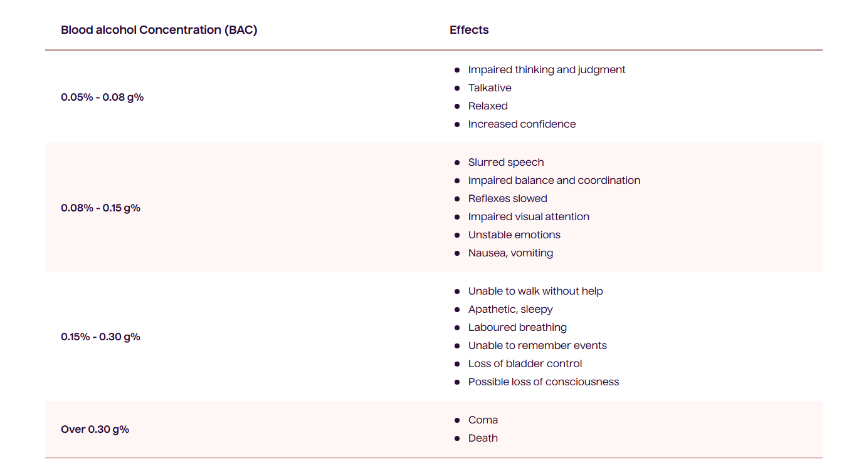
Notes:
Chronic ethanol use induces an insensitivity to GABA so more inhibitor is required to maintain a constant inhibitory tone. As alcohol tolerance develops, the individual retains arousal at alcohol concentrations that would normally produce lethargy or even coma in relatively alcohol-naïve individuals.

Slide 9
Alcohol Effects: Long Term
Brain/CNS
Altered GABA function
Tolerance, dependence, withdrawal symptoms
GI Track
Decreases absorption of vitamins and nutrients
Especially thiamine and magnesium
Liver inflammation/damage
Pancreas inflammation
Circulatory System
Dysrhythmias, Anemia
Immune System
Cancer
Liver, stomach, mouth, head/neck, breast, colon
Notes:
According to Up To Date: symptoms and signs of withdrawal can develop with abstinence after as little as a few weeks of consistent, heavy alcohol use

Slide 10
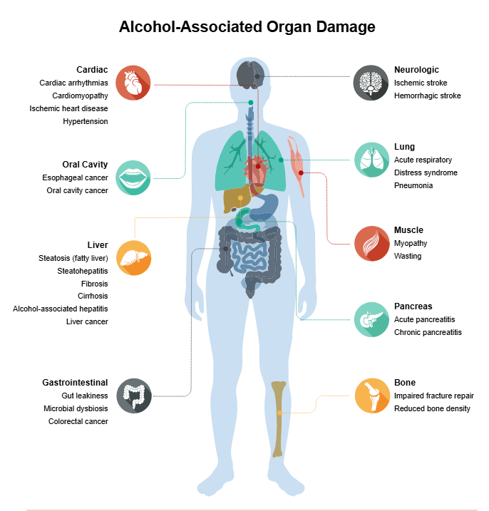

Slide 11
Health Benefits of Alcohol
…
Notes:
So now that we have a refresher on the basics of alcohol, lets think about how we are addressing alcohol use.

Slide 12
How are we asking about alcohol use?

Slide 13
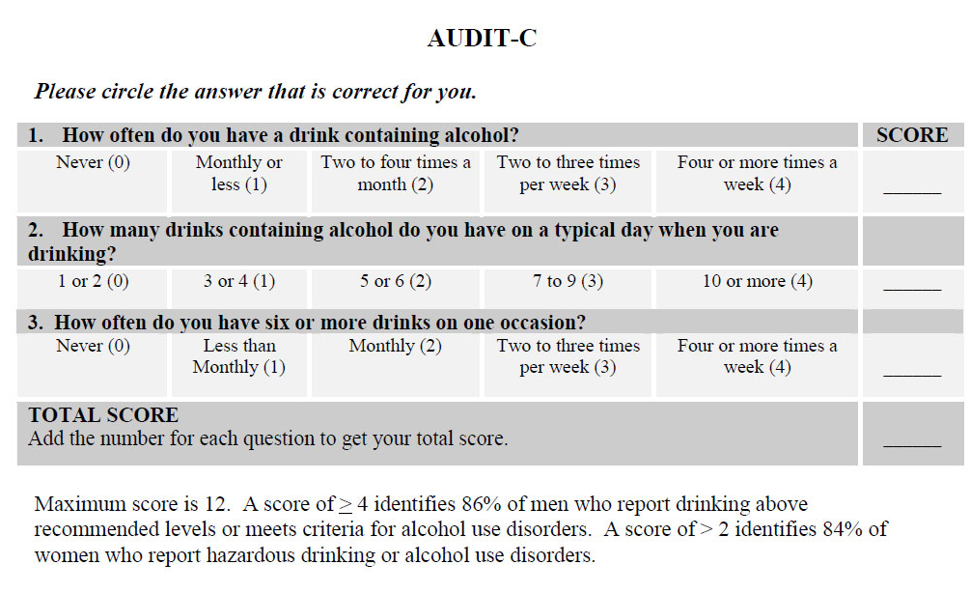
Screening tools
SBIRT
Notes:
Quick screening, maybe used annually
Appreciate that the SBIRT includes other substances

Slide 14
Patient 1 (Jane)
45 yo female, presenting for annual WWE.
C/O peri-menopausal symptoms, including weight gain, poor sleep, night sweats
Dx HTN, Obesity (Class 1, BMI 31)
NO history of substance use disorders
Anticipatory Guidelines:
Pap and HPV screening, colonoscopy, mammogram, labs
What else?
PHQ 9/GAD 7, STOP-BANG, AUDIT-C
Results
PHQ 9 score is 15 (moderate/severe depression) GAD 7 score is 3 (minimal to mild symptoms)
STOP-BANG shows she is HIGH risk for sleep apnea

Slide 15
Patient 1
Score?
And now what do we do?
Notes:
She gave herself between 0 and 1 on the amount. I always round up!
Her score is elevated, so lets do a more in-depth screening…

Slide 16
AUDIT
More in-depth
Also asks about history of treatment (though specific for alcohol treatment)
May be more accurate with depictions of standard drink sizes
More time-consuming
Notes:
New score 12 or 16

Slide 17
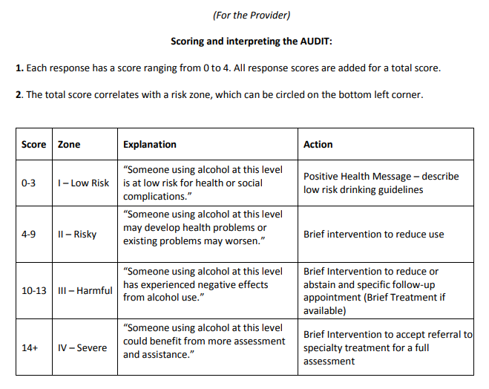
Notes:
Patient’s new score is 12, but since YOU are expressing concern, actually a 16….

Slide 18
Patient 1
Recognizes that many of her complaints could be alcohol related.
She is agreeable to a 1 month trial of No Alcohol
Notes that she feels shaky on the morning of Day 2 without alcohol, so typically doesn’t go more than 1-2 days without any alcohol for the past few years
None of our screening questions so far have assessed her risk of withdrawal!
Get a good history of how long after Last Drink do symptoms develop, any trips to the ER/hospital stays
Most importantly, a history of seizure-like activity!

Slide 19
How are we Assessing Withdrawal
Notes:
Most of my patients are coming to me, ready to stop using alcohol, but not everyone is IN withdrawal by the time they come see me.

Slide 20
PAWWS: Prediction of Alcohol Withdrawal Severity Scale
Notes:
NOTE: Maximum score = 10. This instrument is intended as a screening tool. The greater the number of positive findings, the higher the risk for development of alcohol withdrawal syndromes (AWS). A score of ≥4 suggests high risk for moderate to severe AWS; prophylaxis and/or treatment may be indicated.

Slide 21
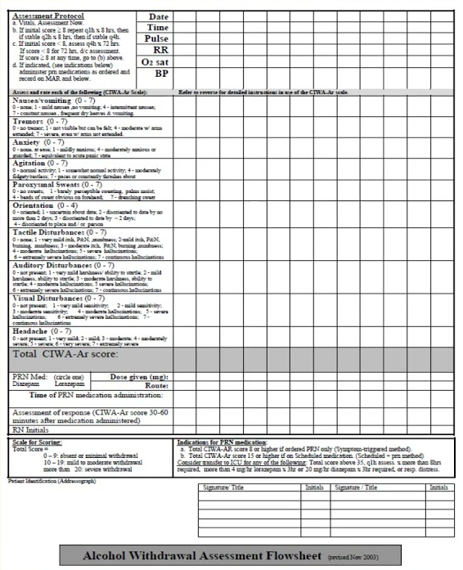
CIWA: Clinical Institute Withdrawal Assessment
Pros
More Common (for now)
Specificity
Cons
Varies by Staff
Subjective
(Patient Complaints)
Time Consuming
Notes:
When a patient is already complaining of withdrawal, we use these!
Interpretation:
<8 indicates mild withdrawal
<15 indicates moderate withdrawal
15 or above indicates severe withdrawal, with possible impending DTs
0-7 scale, except for orientation

Slide 22
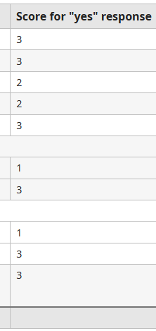
SEWS: Severity of Ethanol Withdrawal Scale
Pros
Vital Signs
Observable symptoms
Cons
Newer/Less familiar Protocol
Quicker
Notes:
Allows for faster time to medication (reduced by a day)
Can be done on patients that aren’t able to respond (i.e. ICU)
SEWS is about a decade newer than CIWA, and is being implanted more and more
Interpretation:
<5 is lower risk of withdrawal
6-11 is moderate risk for withdrawal
12 or more is high risk

Slide 23
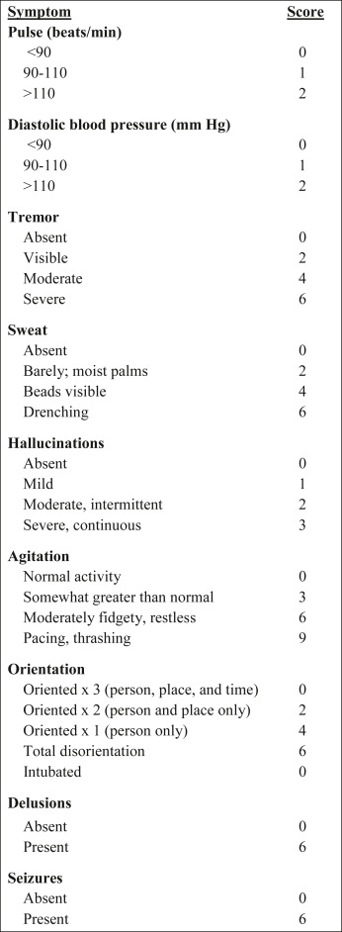
MINDS: Minnesota Detox Scale
Similar to the CIWA
Still very subjective
… Seizures?

Slide 24
RASS: Richmond Agitation-Sedation Scale

Slide 25
Patient 2 (Mike)
50 yo male, presenting for evaluation and treatment for alcohol use disorder
30+ years of heavy alcohol use, intermittent periods of sobriety
Has gone to inpatient treatment 3 times, most recently 5 years ago
Reports a history of DT’s anytime he goes into withdrawal
Recently has been drinking 10+ standard drinks throughout the day
Waking in the night with night sweats and tremors, so drinks in the night
Waking in the morning with severe tremors (hands only)
At this time, last drink was about an hour before the appointment, experiencing anxiety, nausea.
Vitals: BP 156/95, HR 110, Temp 99.0F
PHQ 9: 15 (insomnia, anhedonia, appetite changes, mood, concentration, NO SI)
GAD 7: 10 (nervous, worrying, restless, irritable)
Exam: Appears anxious, restless, sweating, tongue fasciculations
Notes:
Fasciculations of the tongue, or lingual fasciculations

Slide 26
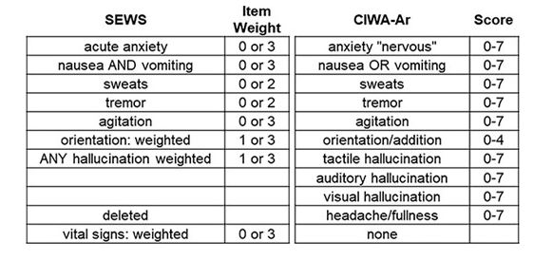
So what is our patient’s score?
Notes:
CIWA: 12
SEWS: 13

Slide 27
Consider the Following:
We don’t use breathalyzers or blood alcohol levels to assess withdrawal status.
Depending on a patient’s drinking patterns, these methods cannot dictate when a patient will develop withdrawal symptoms or how severe withdrawal symptoms will be.
History and physical exam need to be the deciding factors!
Typically, symptoms develop WITHIN 4 hours of last alcohol use…
UNLESS they have been attempting to wean themselves down
OR they are drinking nonstop
Notes:
Let me repeat that: We do not use breathalyzers or BALs to assess WITHDRAWAL STATUS.
If my patient tells me they had a drink before the got off the elevator for today’s appointment, will they be at risk for withdrawal right now? It all depends on when was the last drink before that one!

Slide 28
Comparing Withdrawal
Patient 3 (Kate)
Patient 4 (Cat)
30 something female
Drinking daily
Last drink was 1 hour ago
Has been drinking 6 standard drinks daily, but only in the afternoon/evening
Does wake up shaky, but doesn’t need alcohol to get through the morning
30 something female
Drinking daily
Last drink was 1 hour ago
And the last drink before that was an hour before… And the hour before that… And the hour before that….
Has to drink throughout the night to prevent shakes and nausea/vomiting
Notes:
Ask the patient about their experiences with the symptoms- they are the experts, and they typically know exactly when the symptoms will start.

Slide 29
Categorizing the Withdrawals
Major
Severe
Tremor (hands, tongue)
Anxiety
Nausea/Vomiting
Insomnia
Delirium Tremens
Seizures

Slide 30
Delirium Tremens AKA DTs, Alcohol Withdrawal Delirium
Profound global confusion
Agitation
Disorientation
Hallucinations
Fever
Hypertension
Diaphoresis
Autonomic hyperactivity (tachycardia and hypertension)
Can progress to cardiovascular collapse.
Notes:
Remember that symptoms develop in the setting of acute reduction or abstinence from EtOH

Slide 31
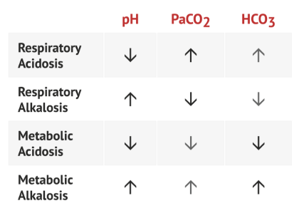
DTs
Only occurring in about 5% of patients that develop alcohol withdrawal
Symptoms typically start between 48-96 hours after last alcohol use
Can last up to 5 days
Patients have increased cardiac index, oxygen delivery, and increased oxygen consumption
Patients hyperventilate
Rebound effect from respiratory depression from alcohol?
Arterial pH rises due to hyperventilation
This leads to respiratory alkalosis
Which leads to decreased cerebral blood flow

Slide 32
Alcohol Hallucinosis
Hallucinations that develop within 12 to 24 hours of abstinence
Typically resolve within 24 to 48 hours
(which is the earliest point at which DT typically develops)
Usually visual
Auditory and tactile phenomena have been described
Patients are aware that they are hallucinating and often very distressed.
In contrast to DT:
NOT associated with global clouding of the sensorium
Only with specific hallucinations
Vital signs are (usually) NORMAL

Slide 33
Patient 5 (Fred)
60 yo male, currently in-patient at detox unit
On Day 2
Started on medication protocol, vital sign monitoring every 4 hours
BP 140/95, HR 101, Temp 99.3 F,
Tremulous for the past 24 hours, improving with medications
Asking for the remote to the TV in his room…
Does he have:
A: Alcohol Hallucinosis
B: Delirium Tremens

Slide 34
Wernicke-Korsakoff Syndrome
Neuropyschiatric disorder caused by severe thiamine (B1) deficiency
Confusion and Disorientation
Memory loss
Confabulation
Eye problems: Double Vision, Nystagmus, Eyelid drooping
Gait disturbances and Ataxia
Tremors
Hallucinations
Most commonly associated with chronic alcohol abuse
Other conditions:
Malnutrition
Eating Disorders
Gastric Surgery

Slide 35
Wernicke-KorsaKoff
Wernicke’s Encephalopathy
Karsakoff Syndrome
Early stage
Disorientation, confusion
About 80% will have this symptom only
Unsteadiness
Nystagmus
Requires early intervention
B1 treatment
Chronic stage
Often irreversible
Memory changes
Anterograde amnesia
Confabulation
Personality changes

Slide 36
Brain Changes with WKS
Less brain volume
Larger cavities within the brain

Slide 37
… and now what do we do?
First of all, prevent withdrawal seizures
Secondly, prevent long-term complications
Third, manage the symptoms
Anxiety
Sleep
Nausea/vomiting
Tremors
Cardiac
Heart palpitations
Tachycardia, Hypertension

Slide 38
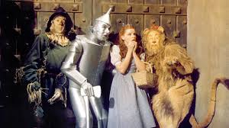
The Treatments
Benzos, Anticonvulsants, Anti-emetics, OH MY!

Slide 39
Positive Allosteric Modulators
The GABA-positive allosteric modulators in clinical practice fall under 5 categories:
Benzodiazepines
Barbiturates (phenobarbital)
Ethanol
Non-benzodiazepine/sedative Hypnotics (the so-called Z drugs, zolpidem, zopiclone, and zaleplon)
Induction Anesthetics (such as etomidate, propofol, midazolam, and thiopental)
Generally, these drugs will cause sedation, anticonvulsant, anxiolytic, and muscle relaxant effects.
Notes:
With our treatments, we are looking for this… A positive allosteric modulating effect.

Slide 40
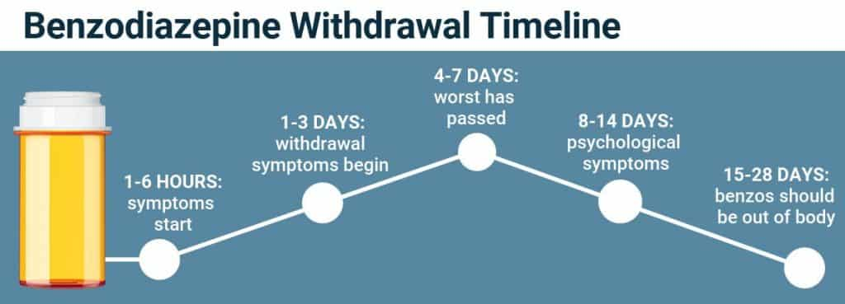
Benzodiazepines
Full disclosure: I hate these.
They act as a depressant
Risk of bi-phasic withdrawals
Initial withdrawal 1-7 days after last dose
Peak withdrawal 14 days after last dose
Resolution 3-4 weeks after last dose
Avoid Alprazolam and Diazepam
They have lower efficacy, and the move faster across the blood-brain barrier, contributing to the “high” sensation

Slide 41
Lorazepam
Quick acting
Can be dosed at the onset/recurrence of symptoms
Treats underlying anxiety
Can reinforce panic attacks…
Short courses don’t need to be tapered
Notes:
This crosses the blood-brain barrier quickly, which makes it effective, but also releases dopamine, which makes it potentially problematic! When the brain learns that making you feel anxious results in taking a fast-acting benzo, that effect gets reinforced! The brain loves dopamine, and it also loves efficiency…

Slide 42
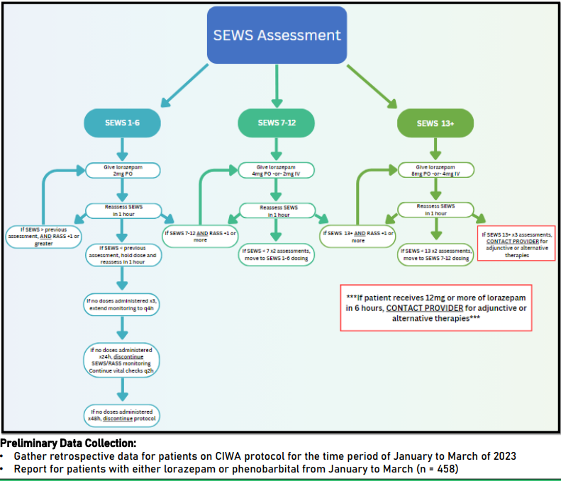
Notes:
Here is what a lorazepam, symptom driven treatment protocol may look like. Frequent reassessments are needed.

Slide 43
Clonazepam
Longer acting
Dose every 12 hours
Can replace other benzodiazepine use (Rx or otherwise) in the setting of alcohol withdrawal
“Safer” for longer-term use
Usually tapered

Slide 44
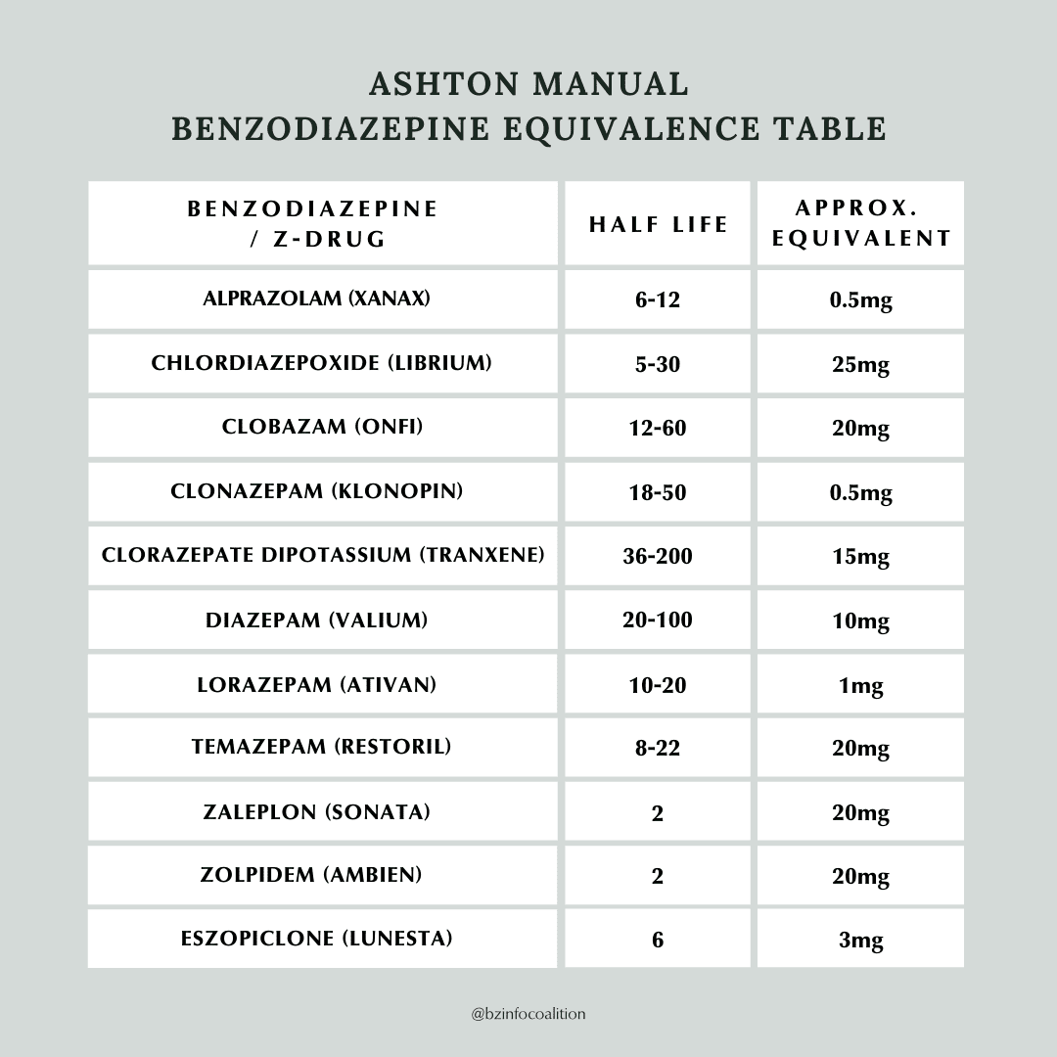

Slide 45
Librium
Needs a loading dose
Scheduled or symptom-based dosing
Typically 25-50 mg per dose
Usually tapered
Notes:
Enough about these… Lets talk about what I actually use in clinic

Slide 46
GAbapentin
Instructions:
I’m so glad you came in today! We are going to get through this!
Lets start with gabapentin: Take 800 mg every 8 hours, on a strict schedule, for the next 3 days.
If this is too sedating, you can break them in half for a 400 mg dose.
The lower dose may need to be taken a little more frequently- monitor your symptoms, and take the other ½ tablet ANY TIME between the 8 hours. Call or message me with an update if this happens!
We will see you in 2 days, but don’t hesitate to reach out if you need something sooner!
YOU’VE GOT THIS!
600 or 800 mg tablets
Dose every 8 hours
Highly adjustable
Also helps with anxiety and cravings
Well-tolerated
Short courses don’t need a taper
Notes:
There are some recommendations to start off on a very high dose, like 1200 mg per day, then drop by 300 mg per day, going from every 6 hours to every 8 hours. This is very complicated, and forces providers to Rx large quantities of 300 mg capsules. Since there is an abuse potential with this medication, I recommend as few tablets as possible. I usually send #12…

Slide 47
Divalproex/Valproate (Depakote)
Instructions:
We are going to have you start the Depakote this evening. Refrain from using any alcohol for the 2 hours before you take the medication.
It can be very sedating, so hopefully it will help you get a full night of sleep!
If you wake up tomorrow feeling shaky, you can take another dose.
Check in with us tomorrow with an update, and we will discuss adjusting your dose if needed.
Otherwise, we will see you in 2 days.
250 mg XR
A little less forgiving with sedation
Can help with mood
Start with 1 tablet, typically QHS
Can add 2nd dose at any point if needed
Better choice if the patient hasn’t stopped drinking yet…
Caution: Hepatotoxicity risk

Slide 48
Anti-Emetics
Ondansetron
Promethazine
Dissolvable
Constipating
Injectable option
Sedating

Slide 49
Are You suffering from: High Blood Pressure? Anxiety? Tremors? Do We have options for YOU!
Propranolol
Clonidine
Beta-blocker
Max dose is 320 mg per day
But up to 640 mg may be used
Low dose, frequently, for elevated blood pressure, tachycardia/palpitations
Also treats underlying essential tremor
Centrally acting alpha-agonist
Max dose 2.4 mg per day
BUT should only be increased by 0.1 mg/day in weekly intervals!
Start with once a day, with an option to take 2nd dose in 12 hours
Treats concurrent anxiety
Notes:
Often patients assume they are experiencing prolonged withdrawal symptoms, but it is actually an unmasked essential tremor.
Lets talk about some other treatment points…

Slide 50
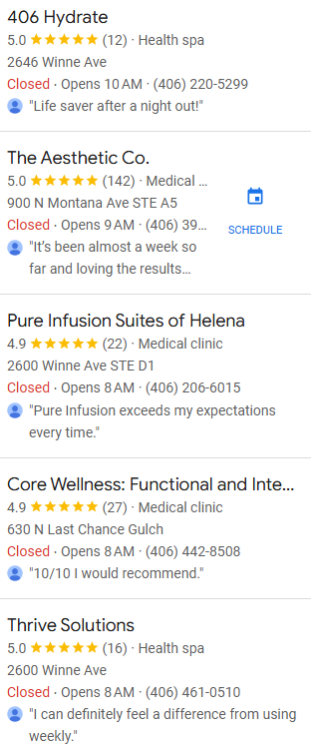
A banana Bag!
Notes:
What’s this?!
Luxury, on demand IV fluids for your hangover needs!

Slide 51
Supplemental Care
Vitamin B1
Parenteral for patients with a poor nutritional status for 3-5 days
Oral supplementation for those with adequate nutrition or to be continued after 3-5 days of parenteral treatment
300 mg daily
BBRAT Diet
Bananas, Broth, Rice, AppleSAUCE, and Toast
Electrolyte drinks
Sleep hygiene
Trazodone, Hydroxyzine

Slide 52
Beyond Out Patient…
Phenobarbital
Dosed in the ER, then patients are allowed to leave without further intervention
Self-tapering due to long half-life
Patients may test positive for up to a month!
Benzodiazepines
If patients can’t tolerate other options, it’s time to be at the hospital

Slide 53
AfterCare: Cravings
Acamprosate
TID dosing
Limited supply at this time
Naltrexone
Once daily
Often too activating to be used in acute withdrawal, but could be started prior to withdrawal to help reduce use for harm reduction
Available in oral and injectable formulations
Cost of injectable is $2000 monthly
Contact Alkermes representative for samples!

Slide 54
Aftercare: Anxiety
Mood
Hydroxyzine
Anxiety
Insomnia
Itching
Nausea
Can be dosed OFTEN
10 mg, up to every 2-4 hours, double dose if needed
Max dose is 50 mg, every 6 hours
Buspirone
Anxiety
Cravings
Recommend TID dosing, but BID dosing is still effective
Minimal side effects
Serotonin Syndrome

Slide 55
AfterCare: Depression
Wellbutrin
SSRI/SNRI
Norepinephrine-dopamine reuptake inhibitor (NDRI)
Increasing dopamine in the brain, which helps in early recovery
Very stimulating, so may need to be avoided in acute withdrawal
Typically, faster acting is better, but all help with serotonin
Caution with history of bipolar disorder!

Slide 56
AfterCare: Sleep

Slide 57
AfterCare: Sleep
Discuss sleep hygiene
Dark room, cool temperature, white noise
AVOID SCREEN TIME FOR AN HOUR BEFORE BEDTIME
Hydroxyzine
10-50 mg, 30 min before bedtime
Better for falling asleep, not staying asleep
Trazodone
SARI
50 mg, 30 min before bedtime
Increasing the dose doesn’t always equal better effect!
Notes:
serotonin receptor antagonists and reuptake inhibitors (SARIs)

Slide 58
Final Thoughts
Be comfortable with a Withdrawal Scale
The SEWS is probably better, though!
Detoxification is difficult, but never impossible
Be flexible in your treatment plan and have close follow up so you can adapt to the patient’s needs quickly
Have lots of options, and never rely on a single treatment plan
Have support on multiple fronts
Clinical, mental health, social support
Detox is NOT treatment! It’s just the second step…
The first step was the patient coming to you for help, and you can do it!

Slide 59
Resources
Cleveland Clinic
https://my.clevelandclinic.org
Clinician Tools: SBIRT for Substance Abuse
https://www.sbirt.care/tools.aspx
Guidelines for the Treatment of Alcohol Problems
https://alcoholtreatmentguidelines.com.au
Medical Council on Alcohol
https://academic.oup.com
MD Calc
National Health Institute
The Recovery Village
https://www.therecoveryvillage.com
UK
https://www.rcpsych.ac.uk
Up To Date

Slide 60
Questions?
Thank you so much!

