Slide 1
Safe Tapering of Benzodiazepines: Insights from the Joint Clinical Practice Guideline on Benzodiazepine Tapering
Montana Primary Care Association June 3, 2025

Slide 2
Presenters/Disclosures
Brian Hurley, M.D., M.B.A., FAPA, DFASAM
No financial conflicts of interests
Brian is the Immediate Past President of the American Society of Addiction Medicine, so comments on topics involving ASAM may be biased towards ASAM

Slide 3
Attribution
This slide deck was developed by the following addiction physicians working with the staff of the American Society of Addiction Medicine using material generated by ASAM’s Guideline Writing Committee
Emily Brunner, MD, DFASAM
Chinyere Ogbonna, MD, MPH
Tricia Wright, MD, MS, FACOG, DFASAM

Slide 4
Learning Objectives
Apply the key clinical takeaways for safely tapering benzodiazepines based upon the Joint Clinical Practice Guideline for Benzodiazepine Tapering.
Recognize strategies for patient engagement and shared decision-making during BZD tapering.
Identify complications associated with rapid BZD discontinuation and how to prevent them.

Slide 5
Audience Poll
What is your professional background?
Physicians
Addiction physician
Family medicine physician
Psychiatric specialist physician
Advanced practice professional
Nurse practitioner
Physician associate
Mental health professionals
Counselor,
Social worker
Therapist
Peer professionals
Notes:
Emily

Slide 6
Audience Poll
How many patients have you successfully treated?
0-20
21-100
100+
Notes:
Emily

Slide 7
Benzodiazepine Use in the U.S.
BZDs are approved by the US Food and Drug Administration (FDA) to manage a wide range of conditions, including acute conditions (eg, panic and acute anxiety, alcohol withdrawal, seizures) and common chronic conditions (eg, anxiety disorders, primary insomnia).
Long-term BZD use is associated with increased risk of physical dependence and withdrawal and ongoing risk of adverse events such as falls, motor vehicle accidents, and cognitive impairment.
Notes:
Emily

Slide 8
Rationale for Tapering Guideline
Clinicians are asking for guidance
Patients are reporting a desire for better treatment
In 2020, A Black Box Warning was placed on benzodiazepines, due to the risk of serious problems while on the medication and the risk of serious withdrawal symptoms that can last months when discontinued abruptly
Notes:
Emily

Slide 9
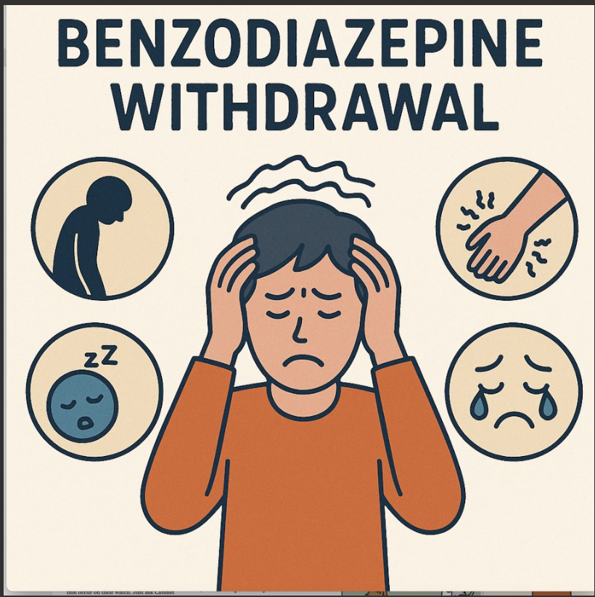
Avoiding Misapplication
As observed with the 2016 CDC Guideline for Prescribing Opioids for Chronic Pain, clinical practice guidelines can have unintended consequences
Rapid BZD discontinuation or dose reduction can cause life-threatening withdrawal symptoms (e.g., seizures, delirium) and destabilization of mental health conditions
BZDs should not be discontinued abruptly in patients who are likely to have developed physical dependence.
Notes:
Emily

Slide 10
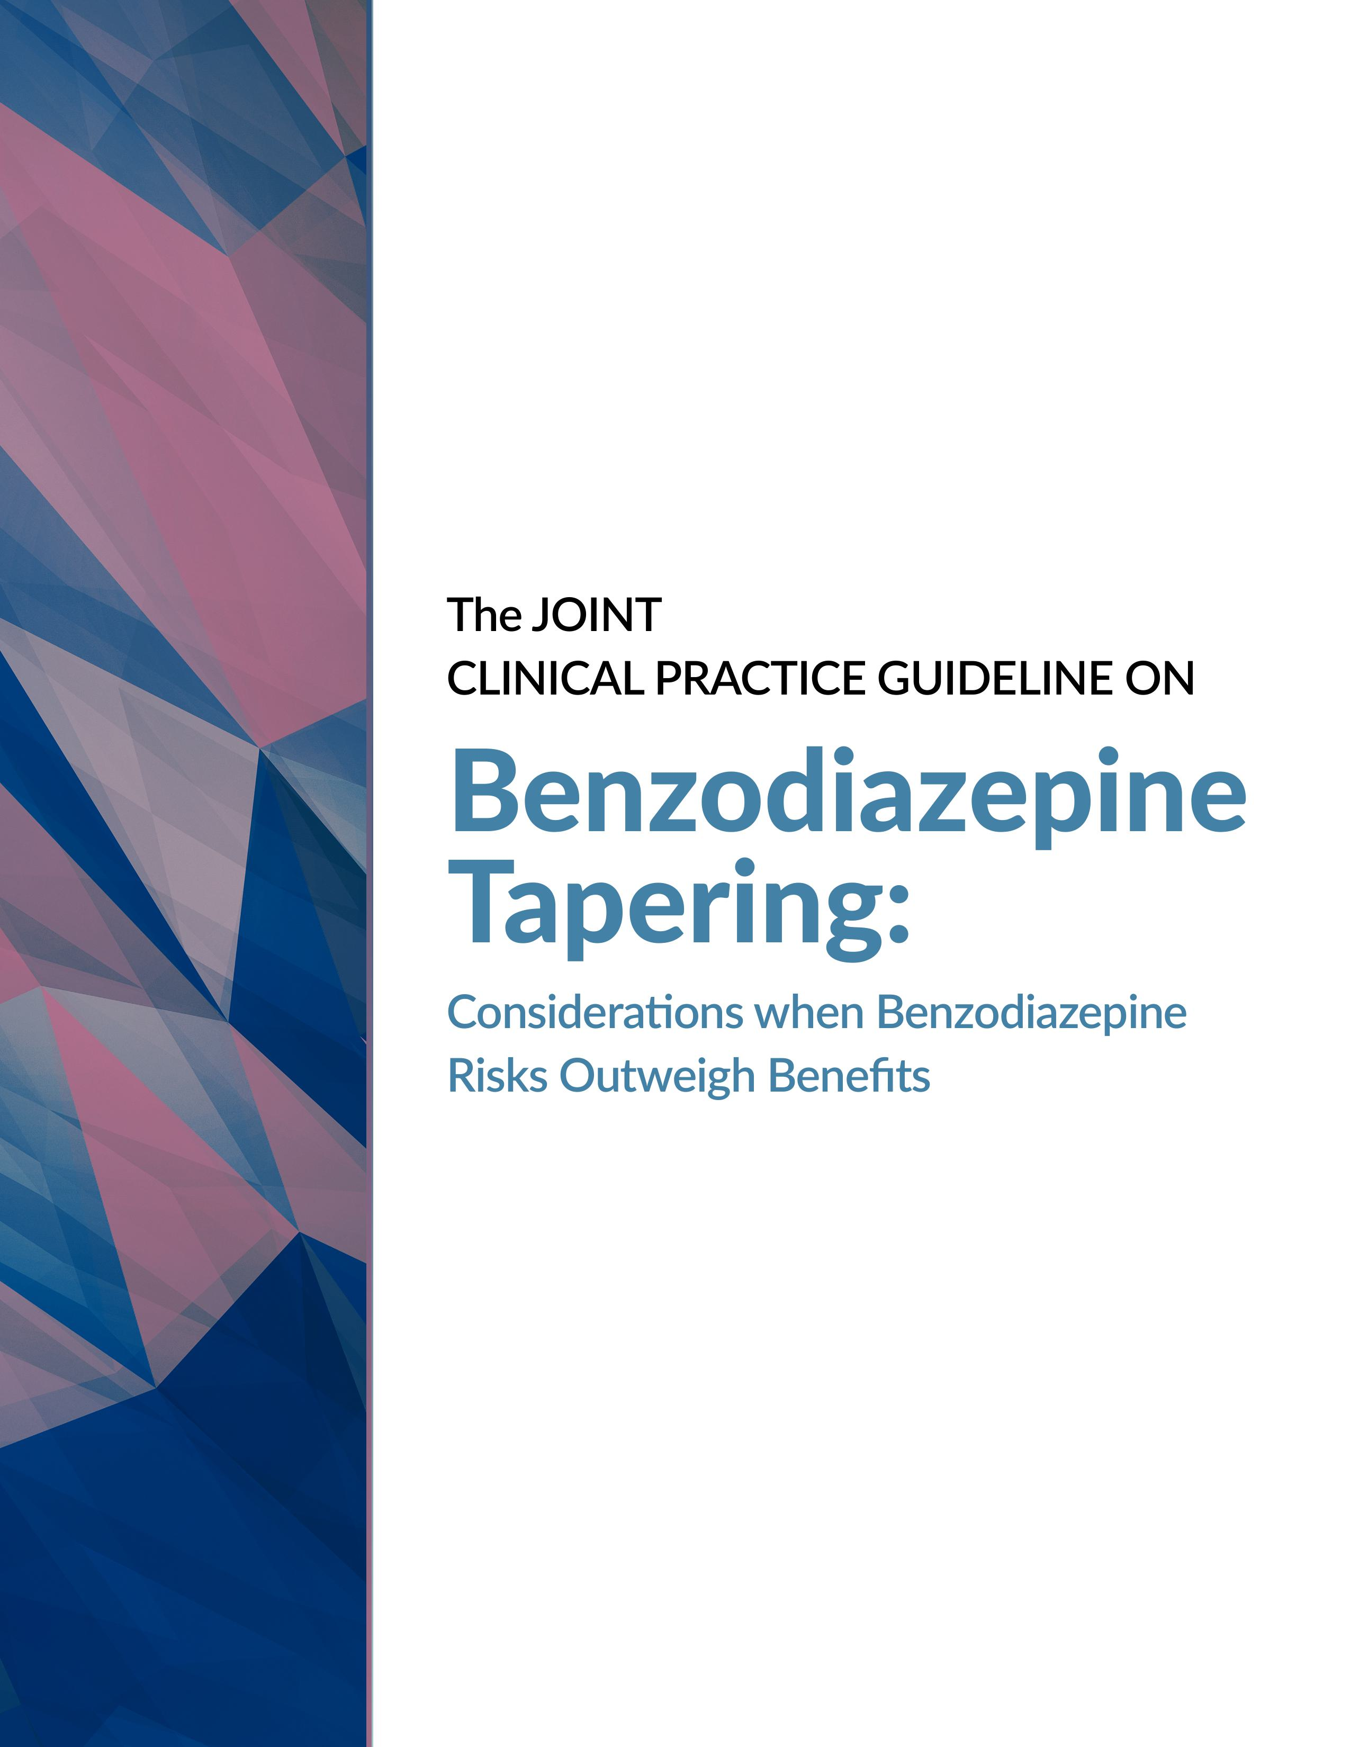
Joint Clinical Practice Guideline on Benzodiazepine Tapering
https://www.asam.org/quality-care/clinical-guidelines/benzodiazepine-tapering
Notes:
Emily

Slide 11
Partner Organizations
Notes:
Emily

Slide 12
Intended Audience for Guideline
Clinicians—including behavioral health professionals, physicians, advanced practice providers, and pharmacists—who prescribe BZDs or provide or support treatment for indications for which BZDs are often prescribed.
Clinicians who practice in diverse settings such as primary care offices, ambulatory care clinics for a broad range of specialty clinicians, EDs, hospitals, and outpatient, and residential addiction and mental health treatment settings.
Some recommendations only apply to specific settings (e.g., inpatient treatment, medically managed settings).
Note: These guidelines are not meant to apply to palliative and end-of-life care.
Notes:
Emily

Slide 13
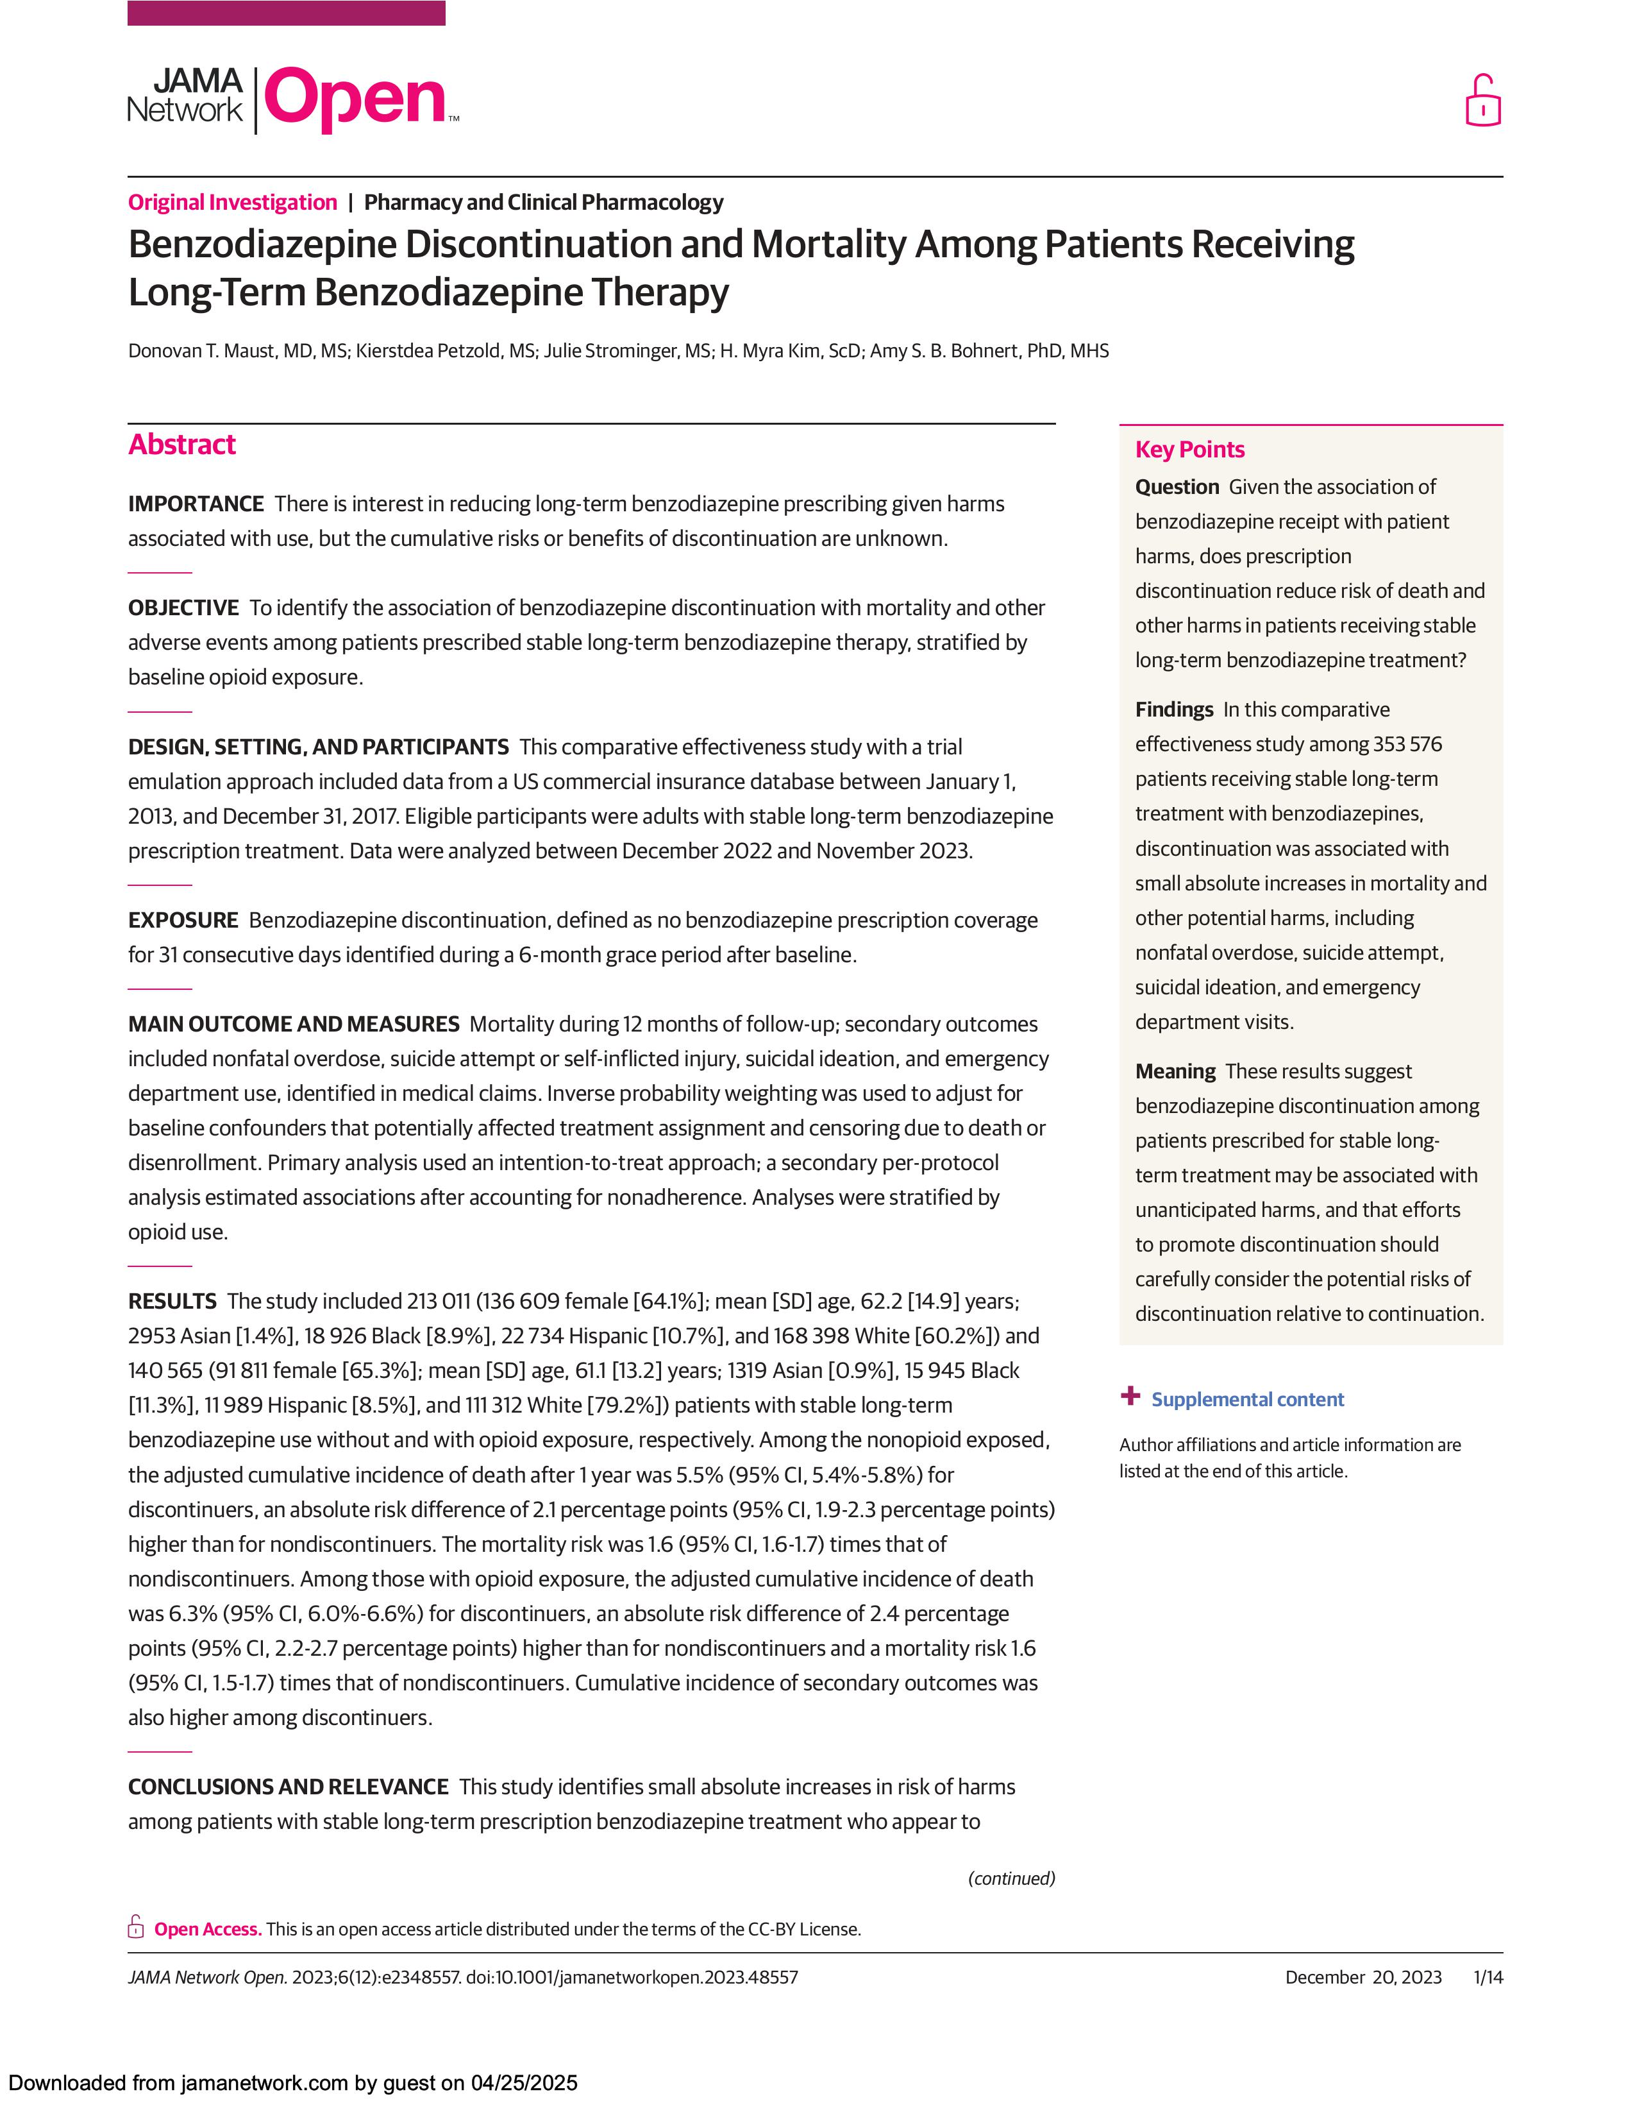
Potential Risks of Discontinuation
Recent retrospective cohort study of U.S. commercial healthcare claims database of adults with long-term BZD prescription
Mortality risk of people who discontinued medication was 1.6 times that of people who did not discontinue
However, authors were not able to analyze why clinicians discontinued the BZD, or how the medication was discontinued (e.g., rate of tapering or discontinuation), which would be important to put the findings into context
Maust DT, Petzold K, Strominger J, Kim HM, Bohnert ASB. Benzodiazepine Discontinuation and Mortality Among Patients Receiving Long-Term Benzodiazepine Therapy. JAMA Netw Open 2023;6:e2348557.
Notes:
Emily

Slide 14
Potential Risks of Discontinuation
Main findings of this study were correlational, not causal
Many confounders limited the ability to interpret the results of the study
Dr. Maust was on the guideline committee; this study was discussed extensively and it was determined that while important, this study did not negate the overall literature, which generally points to risks for long-term BZD use that outweigh benefits
Maust DT, Petzold K, Strominger J, Kim HM, Bohnert ASB. Benzodiazepine Discontinuation and Mortality Among Patients Receiving Long-Term Benzodiazepine Therapy. JAMA Netw Open 2023;6:e2348557.
Notes:
Emily

Slide 15
Partnering with Patients
Patient-centered
Focus on education re BZD risks and benefits
Discuss alternative options for symptom management
The recommendations in this Guideline should be interpreted in the context of shared decision-making with patients. In other words, when a recommendation says, “clinicians should consider,” it should be understood to include “in partnership with the patient.”
Notes:
Tricia

Slide 16
Recommendation for Partnering with Patients
Clinicians should develop the BZD tapering strategy in coordination with patients and their care partners in a shared decision-making process whenever possible (Clinical Consensus, Strong Recommendation).
Implementation Considerations:
Clinicians can consider utilizing educational resources when developing BZD tapering strategies with patients.
Clinicians can consider utilizing a motivational interviewing (MI) framework, which is patient-centered and seeks to involve patients in resolving ambivalence to change.
Notes:
Tricia

Slide 17
Recommendations for Considerations for Tapering Benzodiazepines
Clinicians should ideally assess the risks and benefits of ongoing BZD prescribing at least every 3 months for each patient taking BZD medications (Clinical Consensus, Strong Recommendation).
At a minimum, clinicians should assess the risks and benefits with each new BZD prescription or BZD prescription renewal (Clinical Consensus, Strong Recommendation).
Clinicians should review the information in the relevant prescription drug monitoring programs (PDMP) as part of the risk–benefit assessment (Clinical Consensus, Strong Recommendation).
Notes:
Tricia
Of note, let's be clear this is not based on specific evidence

Slide 18
Potential Benefits and Risks of Continued BZD Use and BZD Tapering
+ Potential Benefits | - Potential Risks
BZD Use | BZD Use | BZD Taper
Effectiveness in managing a patient’s mental and physical health condition(s) Related functional improvements Quality of life improvements | Oversedation, including consideration of use with other sedating medications, alcohol, or other drugs Falls and related injuries Memory and cognitive impacts Motor vehicle accidents Medical safety concerns (e.g., medication interactions) Impacts on co-occurring mental and physical health conditions Disrupted sleep patterns Diversion Substance use disorder Overdose Fetal harm Suicidality | Withdrawal symptoms including severe or complicated withdrawal (e.g., seizures, delirium) Recurrence of the condition for which BZD was prescribed Impacts on co-occurring mental and physical health conditions Protracted withdrawal Transition to illicit BZD use
Notes:
Tricia

Slide 19
Risk for Clinically Significant BZD Withdrawal
Duration of BZD Use | Frequency of BZD Use | Total Daily BZD Dose | Risk for Clinically Significant Withdrawal | Need for taper? LOW HIGH
Any | ≤3 days per week | Any | Rare
<1 month | ≥4 days per week | Any | Lower risk, but possible
1–3 months | ≥4 days per week | Low‡ | Lower risk, but possible
1–3 months | ≥4 days per week | Moderate§ to high** | Yes, with greater risk with increasing dose and duration
≥3 months | ≥4 days per week | Any | Yes, with greater risk with increasing dose and duration
‡ A low daily dose is estimated as 10 mg diazepam equivalents or less (e.g., ≤0.5mg clonazepam, ≤2mg lorazepam, ≤1mg alprazolam). See Appendix H for BZD dose equivalents. § A moderate daily dose is estimated as 10-15mg diazepam equivalents (e.g., 0.1-1.5mg clonazepam, 2-3mg lorazepam, 1-2mg alprazolam). See Appendix H for BZD dose equivalents. ** A high daily dose is estimated as 15mg diazepam equivalents (e.g., 0>1.5 mg clonazepam, >3mg lorazepam, >2mg alprazolam). See Appendix H for BZD dose equivalents.
Notes:
Tricia

Slide 20
How to think about risks and benefits?
Risks and benefits exist along a continuum.
Before you can consider the benefits, what is the condition that is being treated?
When determining the balance of risks and benefits, clinicians should consider the following:
How significant are the potential benefits?
Could alternative interventions achieve similar benefits?
How significant are the potential risks?
What are the risks of the alternative interventions?
How effectively can the risks be managed?
How imminent are the risks?
Notes:
Tricia

Slide 21
Physical Dependence vs Substance Use Disorder
Physical Dependence: A biological phenomenon that develops in response to repeated use of a medication.
Substance Use Disorder: A chronic disease associated with functional changes to the brain circuits that mediate stress, decision-making, and behavior reinforcement.
National Survey on Drug Use and Health suggests just 1.5% of people who use BZDs met criteria for a BZD use disorder.
Notes:
Tricia

Slide 22
Recommendations for Considerations for Tapering Benzodiazepines
Clinicians should avoid abruptly discontinuing BZD medication in patients who are likely to be physically dependent on BZDs and at risk for BZD withdrawal (Low Certainty, Strong Recommendation).
Tapering is indicated for patients who are likely to be physically dependent when the risks of BZD medication outweigh the benefits (Low Certainty, Strong Recommendation).
Clinicians should consider either discontinuation or a short taper for patients who are unlikely to be physically dependent when the risks of BZD medication outweigh the benefits (Clinical Consensus, Strong Recommendation).
Notes:
Tricia

Slide 23
Recommendations for Considerations for Tapering Benzodiazepines
If the BZD medication is discontinued without a taper in patients who are unlikely to be physically dependent, clinicians should counsel patients to report the emergence of withdrawal and/or rebound symptoms (Clinical Consensus, Strong Recommendation).
If significant symptoms emerge, clinicians can consider using medications for symptom management or restarting the BZD medication and initiating a taper (Clinical Consensus, Conditional Recommendation).
Notes:
Tricia

Slide 24
Implementation Considerations
There is potentially a large population of patients who would benefit from BZD tapering:
~2 million older adults in the US taking BZD for >120 days.
The healthcare system is ill-prepared to manage BZD tapering on a large scale.
We must not abandon these patients.
Healthcare systems should consider how to triage those who would benefit most from tapering.
Avoid measuring success based on prescribing data alone. Focus on patient-centered outcomes (e.g., adverse events, functionality, mental and physical health outcomes).
Notes:
Tricia

Slide 25
Group Discussion
Fred R.: 59-year-old male, otherwise healthy, “inherited patient” who has been taking 2 mg clonazepam twice daily for an unknown number of years.
What other information would you want to know?
Is this someone who would be a candidate for tapering?
Notes:
Tricia

Slide 26
Recommendations for the Tapering Process
Clinicians should generally consider dose reductions of 5% to 10% when determining the initial pace of the BZD taper. The pace of the taper should typically not exceed 25% every 2 weeks (Clinical Consensus, Strong Recommendation).
Clinicians should consider the lower end of the dose reduction range (ie, 5%) for the first reduction to assess a patient’s initial response, unless there are imminent safety concerns
For patients who are likely to have strong physical dependence (eg, those who have been taking a high dose for more than a year), clinicians should consider a slower taper.
For the first reduction, consider the lower end of the dose reduction range (eg, 5%).
For further reductions, clinicians should adjust based on patients’ initial response, considering reduction of 5% to 10% every 6–8 weeks, or slower as appropriate.
Clinicians can consider the higher end of the dose reduction range (ie, 10-25%) for patients who are unlikely to have significant physical dependence but for whom tapering is indicated
Notes:
Chinyere

Slide 27
Recommendations for the Tapering Process
Clinicians can consider transitioning patients without contraindications to a comparable dose of a longer-acting BZD medication for the taper (Clinical Consensus, Conditional Recommendation).
Notes:
Chinyere

Slide 28
Recommendations for the Tapering Process
Clinicians should tailor tapering strategies to each individual patient and adjust the taper based on a patient’s response (Clinical Consensus, Strong Recommendation).
Implementation Considerations:
Clinicians should consider pausing or slowing the pace of the taper and/or making smaller dose reductions for patients experiencing significant symptoms related to the BZD taper.
The BZD tapering process can be more difficult for patients as they approach the point of discontinuation. Clinicians should proactively consider smaller dose reductions and/or slowing the pace of dose reductions as the taper progresses.
Notes:
Chinyere

Slide 29
Recommendations for the Tapering Process
Clinicians should evaluate patients undergoing tapering for signs and symptoms related to the BZD taper with each dose reduction (Clinical Consensus, Strong Recommendation).
Implementation Considerations:
Clinicians should monitor patients for symptoms of withdrawal and recurrence with each dose reduction. Virtual or telephonic check-ins can be leveraged for this purpose
Notes:
Chinyere

Slide 30
Recommendations for Adjunctive Interventions
Clinicians should offer patients undergoing BZD tapering behavioral interventions tailored to their underlying conditions (eg, CBT, CBT-I) or provide them with referrals to access these interventions (Low Certainty, Strong Recommendation).
Clinicians should first consider pausing or slowing the pace of the BZD taper when patients experience symptoms that significantly interfere with the taper (eg, sleep difficulty, anxiety). However, clinicians can also consider use of adjunctive medications (Clinical Consensus, Conditional Recommendation).
Notes:
Chinyere

Slide 31
Group Discussion
Fred returns to the office for a follow up visit.
Discuss importance of patient engagement, shared decision making
Would this patient be a candidate for an extended taper process?
Notes:
Chinyere

Slide 32
Recommendations for Management of Severe or Complicated Withdrawal
Clinicians should manage patients experiencing severe or complicated withdrawal in inpatient or residential medically managed settings (eg, residential withdrawal management program) with:
Monitoring for signs and symptoms of BZD withdrawal, including regularly measuring vital signs and using structured assessment tools (Clinical Consensus, Strong Recommendation)
Assessments for seizure risk, managed as appropriate (Clinical Consensus, Strong Recommendation)
Notes:
Chinyere

Slide 33
Recommendations for Management of Severe or Complicated Withdrawal
Tapering with very long-acting agents such as phenobarbital:
Can be considered for BZD withdrawal management in inpatient settings (Low Certainty, Strong Recommendation).
Should only be conducted by or in consultation with clinicians experienced in the use of these agents for the purpose of BZD withdrawal management (Clinical Consensus, Strong Recommendation).
Implementation Considerations: When tapering with very long-acting agents, discharge planning should include an outpatient follow-up appointment, ideally within 7 days.
Clinicians should assess patients for ongoing signs or symptoms related to discontinuation of the BZD, including re-emergence of symptoms for which the BZD was originally prescribed.
Clinicians should consider medications and/or behavioral interventions to address ongoing signs or symptoms related to discontinuation of the BZD.
Notes:
Chinyere

Slide 34
Other Population Considerations
Patients co-prescribed BZD and opioids
Patients with BZD or other substance use disorders
Patients with co-occurring psychiatric disorders
Older Adults
Patients who are pregnant or lactating
Notes:
Switch back to Tricia

Slide 35
Recommendations for Patients Co-Prescribed BZD and Opioids
Because patients co-prescribed BZDs and opioids are at increased risk of respiratory depression, clinicians should assess the risks and benefits of continued BZD prescribing at least every 3 months or with every related clinical encounter or prescription renewal, whichever is more frequent (Clinical Consensus, Strong Recommendation).
Clinicians should offer to provide or prescribe opioid overdose reversal medication (eg, naloxone) for all patients co-prescribed BZDs and opioids (Clinical Consensus, Strong Recommendation).
Clinicians should consider additional strategies for mitigating risk, including using the lowest effective doses of BZD and opioid medications and optimizing non-opioid interventions (Clinical Consensus, Strong Recommendation).

Slide 36
Implementation Considerations for Patients Co-Prescribed BZD and Opioids
Prior to initiating a BZD taper for patients who are co-prescribed BZDs and opioids, clinicians should seek to coordinate care with other clinicians who are prescribing BZDs or opioids to a given patient. This may entail obtaining releases or other agreements for clinicians to contact other prescribers and/or consulting the PDMP.
Clinicians should conduct risk–benefit assessments more often when patients have additional risk factors for adverse events related to concurrent BZD and opioid use. Additional risk factors may include but are not limited to having an SUD, a bipolar disorder, or schizophrenia and/or taking fentanyl, morphine, or methadone.

Slide 37
Recommendations for Patients with BZD or Other Substance Use Disorder
Clinicians should consider more frequent assessments of the risks and benefits of continued BZD prescribing for patients with co-occurring SUDs and/or other co-occurring addictions (eg, behavioral addictions) compared with the general guidance in Recommendation #1 (Clinical Consensus, Strong Recommendation).

Slide 38
Recommendations for Patients with BZD or Other Substance Use Disorder
When tapering BZD medication in patients with SUD, clinicians should manage the underlying SUD concurrently with the BZD taper (Clinical Consensus, Strong Recommendation).
Clinicians should not use BZD prescribing or tapering considerations as a reason to discontinue or disrupt a patient's medications for SUD treatment, including buprenorphine and methadone (Clinical Consensus, Strong Recommendation).

Slide 39
Recommendations for Patients with BZD or Other Substance Use Disorder
When tapering BZD medication in patients with SUD, clinicians should manage the underlying SUD Following the taper, clinicians should continue to monitor and treat any underlying SUDs or refer patients to an appropriate level of care for continuing care (Clinical Consensus, Strong Recommendation).

Slide 40
Recommendations for Patients with BZD or Other Substance Use Disorder
Clinicians should offer patients harm reduction services or provide them with referrals to access these services (Clinical Consensus, Strong Recommendation).
Clinicians should offer to provide or prescribe opioid overdose reversal medication (eg, naloxone) and provide or refer patients for related education (Clinical Consensus, Strong Recommendation).
Clinicians can consider providing or referring patients to community services for drug checking or other safe use supplies (eg, fentanyl test strips, xylazine test strips, sterile syringes) and related education (Clinical Consensus, Conditional Recommendation).

Slide 41
Group Discussion
Sharon: 45 year old female with alcohol use disorder. Currently abstinent, but takes lorazepam 1mg 4-5 times/week for panic attacks
What other information would you want to know?
What would your initial approach to this patient be?

Slide 42
Recommendations for Patients with Co-Occurring Psychiatric Disorders
Clinicians should optimize evidence-based treatment for any psychiatric disorder prior to the taper or concurrently if clinically indicated (Clinical Consensus, Strong Recommendation).
Clinicians can consider offering patients with psychiatric disorders behavioral interventions (eg, CBT, CBT-I with sleep hygiene education) or providing them with referrals to access these interventions

Slide 43
Recommendations for Patients with Co-Occurring Psychiatric Disorders
Clinicians should strongly consider tapering BZD medication in patients with posttraumatic stress disorder (PTSD; Clinical Consensus, Strong Recommendation).
The VA recommends clinicians avoid prescribing BZDs to patients with PTSD, as they are ineffective for treatment of the core symptoms of PTSD and PTSD-related sleep disturbance

Slide 44
Recommendations for Patients with Co-Occurring Psychiatric Disorders
Clinicians should monitor sleep closely during BZD tapering in patients with mood or psychotic disorders, particularly for patients with bipolar disorder as sleep disturbance can trigger episodes of mania (Clinical Consensus, Strong Recommendation).
If patients with a mood and/or psychotic disorder experience significant sleep disturbance, clinicians should pause the taper until the symptoms resolve due to the risk for destabilization (Clinical Consensus, Strong Recommendation).

Slide 45
Group Discussion
Case: 35 y/o male veteran with severe PTSD taking 2mg alprazolam TID
What other information would you want to know?
How would you approach this patient?

Slide 46
Older Adults
BZD use associated with risk of falls and cognitive impairment
Adverse effects associated with BZD use have generally been shown to outweigh marginal, short-term benefits in older adults
Polypharmacy is also a significant concern among older adults

Slide 47
Recommendation for Older Adults
Clinicians should generally taper BZD medication in older adults unless there are compelling reasons for continuation (Clinical Consensus, Strong Recommendation).
Implementation Considerations:
Goal of tapering may be discontinuation of the BZD, or reducing the dose to where the risks no longer outweigh the benefits
Care should ideally be coordinated between the clinician managing the BZD taper and other clinicians managing conditions that may be impacted by BZD prescribing or the taper

Slide 48
Patients who are Pregnant or Lactating
BZD use during pregnancy carries risk to the fetus, however untreated anxiety, mood, and sleep disorders also associated with risk
BZD tapering can be done safely during pregnancy, however ACOG notes:
“[I]t is also critical to consider the risks of a taper for the pregnant individual and the fetus. For example, if attempts to taper the benzodiazepine precipitate re-emergence of anxiety, the benefits of continuation may outweigh the risks.”

Slide 49
Recommendations for Patients who are Pregnant or Lactating
Clinicians should weigh the risks and benefits for the maternal–fetal dyad when considering continued BZD prescribing or tapering for pregnant patients (Clinical Consensus, Strong Recommendation).
Implementation Considerations:
Monitor patients closely for emerging psychiatric symptoms, which may evolve more rapidly during pregnancy/postpartum period

Slide 50
Recommendations for Patients who are Pregnant or Lactating
For infants who have been exposed to BZD in utero and are at risk for neonatal withdrawal, clinicians should:
Encourage breastfeeding, which can reduce neonatal withdrawal symptoms (Clinical Consensus, Strong Recommendation).
Communicate with the infant’s healthcare provider (with parental consent) regarding exposure to BZDs (Clinical Consensus, Strong Recommendation).

Slide 51
Benzodiazepine Tapering Webinar Series
Topic | Date and Time
Considerations for Benzodiazepine Tapering | April 7, 2025 @ 12PM ET
Benzodiazepine Tapering for Older Adults | May 5, 2025 @ 12PM ET
Considerations for Tapering Benzodiazepines in Primary Care | May 19, 2025 @ 12PM ET
Addressing Benzodiazepine Tapering Challenges | June 2, 2025 @ 12PM ET
Scan to Register!
Notes:
Scan the QR code for additional resources

Slide 52
Other Resources
Provider Pocket Guide
Short guide: How to Help Taper Your Patients From Benzodiazepines
Guide for Patients: Tapering Benzodiazepine Medications
Quick-reference Tables and Charts:
BZD Dose Equivalents
Pharmacokinetic Properties
Pregnancy Considerations
Patient Pocket Guide (Coming Soon)
Patient Infographics (Coming Soon)
Microlearning Videos (Coming Soon)
Resources
Notes:
Scan the QR code for additional resources

Slide 53
Questions?
Brian Hurley, M.D., M.B.A., FAPA, DFASAM
bhurley@ucla.edu
Interested in more?
Come to:
ASAM Annual Meeting
(San Diego in April 2026!)
http://www.asam.org
Northwest Society of Addiction Medicine
4th Monday of the month http://www.nwasam.org
AAAP Annual Meeting
(San Francisco, CA Nov 2025!)
http://www.aaap.org

