Slide 1
Montana Drug Overdose Data
Sandra Biller, MS
Addiction Medicine Network and Pain Conference
June 4, 2025

Slide 2
We’re going to cover:
About the data
What data sources cover drug overdose?
What are the limitations to the data?
What we know about drug overdose in Montana
Trends and key findings
Using drug overdose data
How the state uses drug overdose data
Discussion
Share experiences and challenges with your peers

Slide 3
Substance use
Many people use substances without experiencing an overdose
Unintentional overdose
Some unintentional overdoses happen to non-substance users, like someone who accidentally takes too much of their pain medication
Deaths
*not to scale
Where I focus
Patterns observed for one subset of substance use (deaths, for example) don’t represent all substance users.

Slide 4
Overdose data
Hospital Systems
Montana Hospital Discharge Data
Syndromic Surveillance
EMS
ODMAP
Death certificates
State Unintentional Drug Overdose Reporting System (SUDORS)
Related, but not overdose data: Montana Prescription Drug Registry

Slide 5
Montana Hospital Discharge Data System (MHDDS)
About
Emergency department and hospitalization data
Based on billing data
Represents ~85% of MT hospital discharges
MHDDS data is provided courtesy of participating Montana Hospital Association (MHA) members
ICD-10-CM codes identify overdose-related hospital visits
Limitations
Does not include data from the U.S. Veterans Administration, Indian Health Service, or Montana State Hospital
How to access
General data available publicly on the EMSTS Injury and Overdose Indicators dashboard
Additional data can be requested using our EMSTS data request form
Non-overdose-related questions: contact Hospital Systems Epidemiologist Vanessa Whattam, syndromic@mt.gov

Slide 6
Montana Hospital Discharge Data System (MHDDS)
Statewide age-adjusted nonfatal hospitalization rates per 100,000 population by year. MT residents only.
2024 rates are preliminary and subject to change.

Slide 7
Montana Hospital Discharge Data System (MHDDS): 2023 to 2024
ED visits:
-5% unintentional
-17% opioid
Hospitalizations:
+18% unintentional
-10% opioid
MT residents only

Slide 8
Montana Hospital Discharge Data System (MHDDS)
Hill, Lake, and Silver Bow counties have the highest unintentional drug overdose and opioid overdose ED visit rates from 2019-2023.
Unintentional drug overdose
Opioid overdose
Age-adjusted nonfatal ED visit rates per 100,000 population by county, 2019-2023. MT residents only.

Slide 9
Syndromic Surveillance (ESSENCE)
About
A web-based syndromic surveillance system designed for the early detection of disease outbreaks, suspicious patterns of illness, and public health emergencies
Data from ED patient records uploaded every 24 hours
Sometimes contains narrative information from chief complaint and triage notes field
Pre-set syndrome definitions for different types of drug overdoses available for querying
Captures 96-99% of ED visits
Limitations
Data is preliminary
Substantial variability in completeness and quality of data
How to access
Not publicly available, but people working for a public health agency can request access: contact Hospital Systems Epidemiologist Vanessa Whattam, syndromic@mt.gov

Slide 10
EMS Data
About
EMS patient encounters as required by Montana statute
Data typically available within 24 hours of the event
Uses a suspected opioid overdose syndrome to identify potential opioid overdoses
Limitations
There may be multiple records per event if multiple EMS agencies respond to the same incident
Completeness and quality of records may vary
Overdose syndrome may not catch all overdoses or catch non-overdoses
How to access
NEW! Opioid overdose and naloxone administration data available on the EMS dashboard
Additional data can be requested using our EMSTS data request form

Slide 11
EMS Data
EMS incidents:
-8% suspected opioid overdose
(2023 v. 2024)
Possible increase?
Count of opioid overdose-related 911 responses by ground transporting EMS agencies, quarterly, 2018-2025
Count of opioid overdose-related 911 responses by ground transporting EMS agencies, yearly, 2023-2024

Slide 12
EMS Data
2 in 5 suspected opioid overdose EMS calls documented naloxone administration in the medication fields.
This is how we need naloxone documented to run further analyses.
Another 1 in 5 suspected opioid overdose EMS calls documented naloxone in the narrative only.
The rest did not have naloxone administration documented.
There are many reasons why naloxone might not be used – for example, sometimes naloxone might not be necessary because the patient is awake by the time EMS arrive.
Based on 2024 EMS data

Slide 13
ODMAP
About
Near real-time geographic tracking of suspected opioid overdoses
Data can come from EMS records, law enforcement, emergency departments, tribes, public health
Alert system can inform local partners of a potential overdose spike
Limitations
Underreporting of incidents not involving EMS
EMS overdose syndrome may not catch all overdoses or catch non-overdoses – requires data verification
Spike alerts limited to the past 24 hours
How to access
DPHHS staff and contracted partners can gain access through the state agency account
Other agencies can create their own accounts by working with Overdose Response Strategy (ORS) partners

Slide 14
Death Certificates
About
Overdose deaths are identified through ICD-10 codes
Deaths can be categorized by drug category and intent
All deaths are required to have a death certificate, so data generally represents the population
Limitations
Not all deaths undergo toxicology to identify drugs involved in cause of death
ICD-10 codes limit identification of specific drugs involved in a death
Varying quality in coroner/medical examiner documentation
Finalized data is usually available about six months after calendar year-end
How to access
General data available publicly on the EMSTS Injury and Overdose Indicators dashboard
10-year drug overdose death surveillance report
Additional data can be requested using our EMSTS data request form

Slide 15
Death Certificates
Drug overdose deaths often involve fentanyl, methamphetamine, or multiple drugs.
Age-adjusted overdose death rates per 100,000 population by year and type of drug

Slide 16
Death Certificates: 2023 to 2024
PRELIMINARY
Overdose Deaths:
-16% unintentional
-25% opioid
2024 data is preliminary and based on data pulled 5/22/2025. Numbers are subject to change.

Slide 17
Death Certificates
American Indians have a drug overdose death rate about 3x higher than the state rate.
Silver Bow, Lake, and Yellowstone counties each have drug overdose death rates higher than the state rate.
Age-adjusted overdose death rates per 100,000 population, 2019-2023, by demographic and county

Slide 18
SUDORS
About
State Unintentional Drug Overdose Reporting System
Covers drug overdose deaths of unintentional and undetermined intent
Includes data from death certificates, coroner reports, law enforcement, toxicology, etc.
Provides rich contextual information regarding drug overdose deaths
Limitations
Varying data quality/completeness, dependent on availability of evidence and coroner/medical examiner documentation
Finalized data is usually available about six-nine months after calendar year-end
How to access
General data available publicly on the EMSTS SUDORS Dashboard
Additional data can be requested using our EMSTS data request form

Slide 19
SUDORS

Slide 20
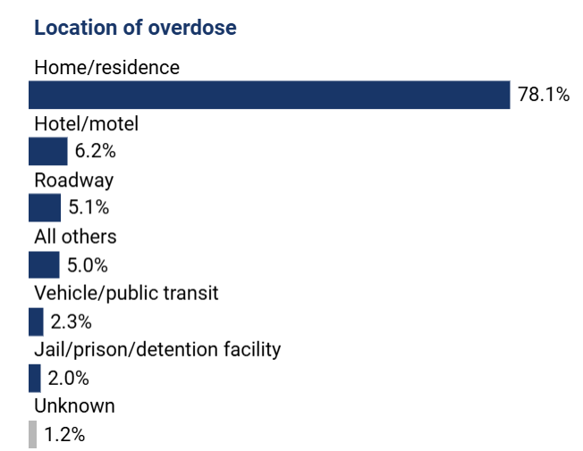
SUDORS
Most overdose deaths occur in a home or residence without bystanders present.

Slide 21
Montana Prescription Drug Registry (MPDR)
About
Montana’s version of a prescription drug monitoring program (PDMP)
Tracks prescriptions categorized as controlled substances, including:
Opioids for pain management
Benzodiazepines for the treatment of anxiety and seizures
Stimulants prescribed for attention deficit hyperactivity disorder
PDMPs provide prescribers information on their patient’s current and past medications to prevent overprescribing or prescribing dangerous combinations of drugs.
Limitations
Some data available quarterly, detailed analyses available every other year
How to access
Quarterly reports available on the MPDR website
Montana Prescribing Trends 2021-2023
Additional data can be requested using our EMSTS data request form

Slide 22
Montana Prescription Drug Registry (MPDR)
Opioid and benzodiazepine prescribing rates declined from 2021 to 2023, while stimulant prescribing rates increased.
Prescribing rates:
-9% opioid
+21% stimulant
-10% benzodiazepine
+11% buprenorphine
Age-adjusted prescribing rates per 100 Montanans for opioids, stimulants, benzodiazepines, and buprenorphine
*The opioid prescribing rate excludes buprenorphine, which is shown separately.

Slide 23
How does DPHHS use overdose data?
Identifying focus areas and populations
Funding is limited
Not all populations or regions experience the same risk of overdose
Focus on areas and groups with greatest need
Planning interventions and communication
What activities are needed, and where? (example: naloxone distribution)
Does work with certain populations need to include specific partners?
Where would more tailored interventions or messaging be beneficial?

Slide 24
Question Break

Slide 25
Discussion Questions
How have you used overdose data previously?
What challenges do you experience with using overdose data?
What kind of overdose data do you wish you had available to you?
Or is there data you wish you had available more quickly?
After this session, what is one thing you plan to do differently in your work?

Slide 26
Contact
Sandra Biller
sandra.biller@mt.gov
https://dphhs.mt.gov/publichealth/EMSTS/data

Slide 27
Resources from slides
Name | Type | Topic | URL
Injury and Overdose Indicators Dashboard | Dashboard | Deaths, ED visits, Hospitalizations | https://dphhs.mt.gov/publichealth/EMSTS/InjuryandOverdoseIndicators
SUDORS Dashboard | Dashboard | Deaths | https://dphhs.mt.gov/publichealth/EMSTS/SUDORS-Dashboard
EMS Dashboard | Dashboard | EMS incidents | https://dphhs.mt.gov/publichealth/EMSTS/EMSDashboard
Drug Overdose Deaths in Montana 2014-2023 | Report | Deaths | https://dphhs.mt.gov/assets/publichealth/EMSTS/Data/DrugOverdoseDeaths_2014-2023.pdf
Montana Prescribing Trends 2021-2023 | Report | Prescribing | https://dphhs.mt.gov/assets/publichealth/EMSTS/Data/PDMP_Report_2024.pdf
MPDR statistics | Report | Prescribing | https://boards.bsd.dli.mt.gov/pharmacy/mpdr/
Opioid Data FAQ | Background information | All | https://dphhs.mt.gov/assets/publichealth/EMSTS/opioids/OpioidOverdoseDataFAQsADA.pdf
Data request form | Form | All | https://dphhs.mt.gov/publichealth/EMSTS/data-request

