Slide 1

MONTHLY WEBINAR
April 2026
Tierney Queen-Stewart
Director of Cover Montana

Slide 2

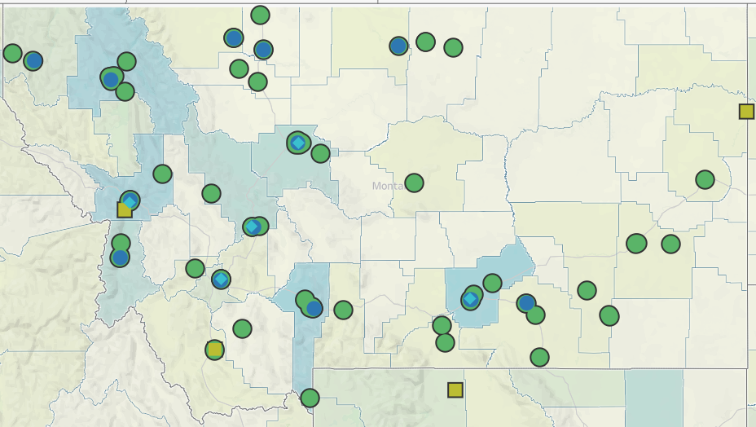
Our Mission is to promote integrated primary healthcare to achieve health and well-being for Montanans.
Notes:
MPCA is a membership organization (13 CHCs, 5 UIO’s) serving about 125,000 Montanans. MPCA works to support our member health centers in providing comprehensive primary care services including medical, dental, behavioral, and what we in the health center world call “enabling services.” Since the very first health centers in rural Mississippi and central Boston, the health center model is built upon the idea that people lives (where they live, where they work, if they have access to food, if they make a living wage) impact health and health outcomes. CHCs receive grants from HRSA the Health Resources and Service Admin, there are some specific requirements of the 330 grants which are in contradiction with a lot of the EOs we are seeing.

Slide 3
Agenda
Welcome and Introductions
Medicaid Updates and Eligibility Reminders
Community Engagement and Exemptions
What’s Next?
Notes:
Introduce yourself in the chat, if questions come up throughout the presentation, put them in the chat, we will stop and answer what we can before we go into breakout rooms.

Slide 4
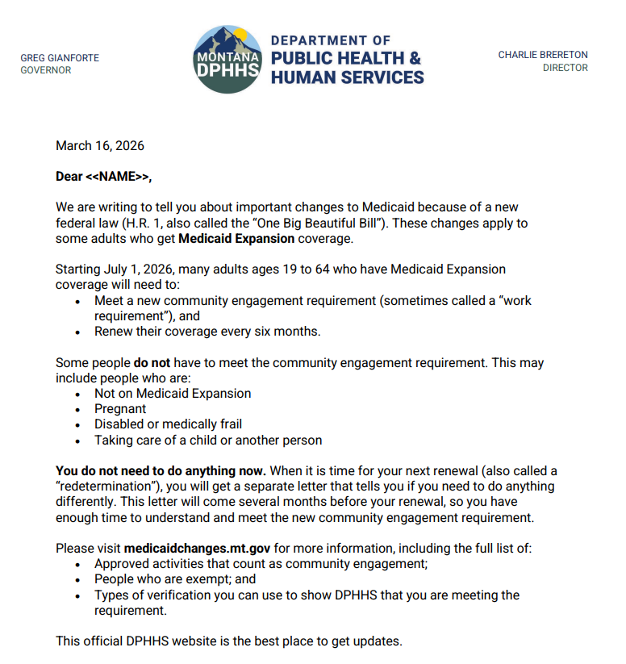
Medicaid Member Communications
Universal notice sent in March
Sent broadly, not specific to impacted households
Do not have to meet timely notice requirements

Slide 5
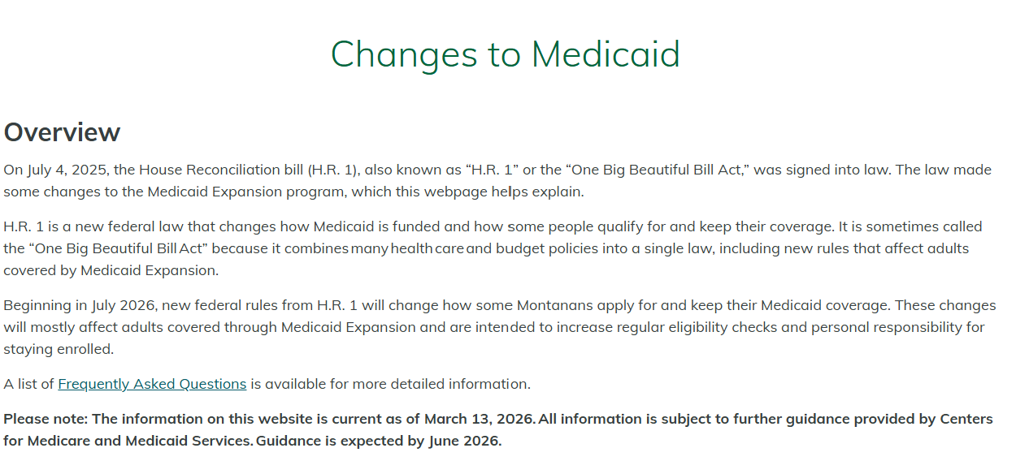
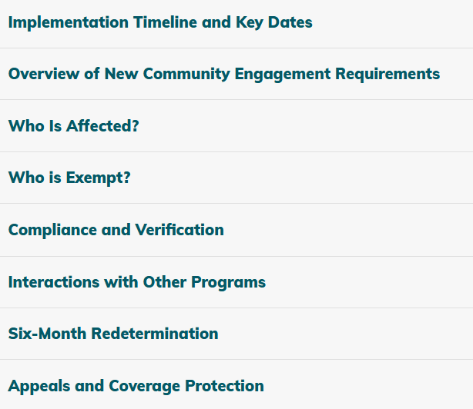
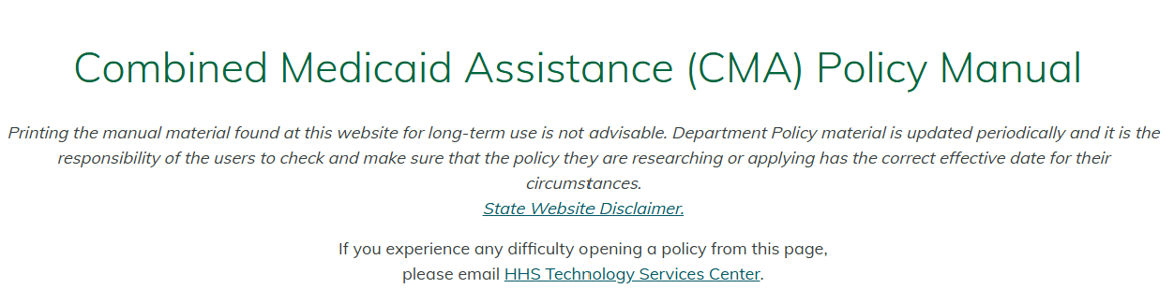
DPHHS Website Updates
Notes:
Changes to Medicaid
FAQs
Combined Medicaid Assistance (CMA) Policy Manual

Slide 6
Medicaid
MAGI
ABD (Medicare)
Waivers
ACA Adult Expansion
HMK
HMK+
Pregnancy
Newborn
PCR
Med Needy
Categorically Needy
MSP
SSI
MWD
Big Sky
HCBS
Plan First
SDMI
Developmental Disabilities

Slide 7
Adult Medicaid Programs
ACA Adult Medicaid – “Expansion”
19-64 years old
Up to 138% of FPL for household size
Not enrolled in Medicare, receiving SSI, pregnant
Parent Caretaker Relative
Eligible child up to 19 years old in their home
Pregnancy Medicaid
Reported pregnancy
Up to 24% of FPL - $643 for HH of 4
Up to 157% of FPL

Slide 8
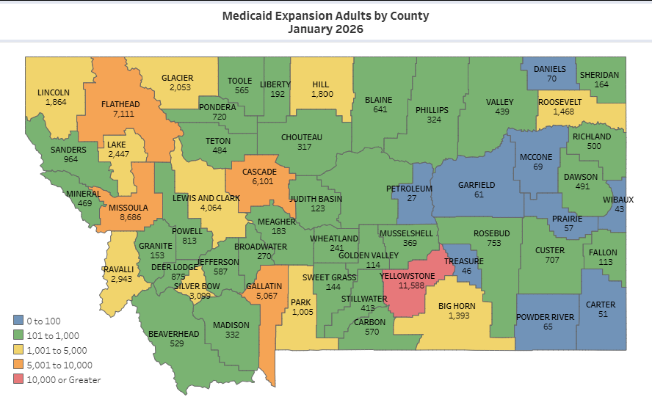
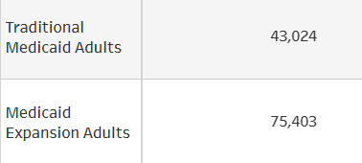
Medicaid Enrollment

Slide 9
Verification and Documentation
Age
Citizenship and Immigration Status
Disability Status
Health Coverage Information
Household and Residence
Identity
Income
+
Community Engagement

Slide 10
Verification Process
Ex parte
Document request – Due in 15 days
Review verification
Eligibility Determination
Request verification extensions before the due date – email, in person, on the PAHL
Encourage documentation of what is already occurring – time logs, hour reports
Provider and exemption documentation – to come

Slide 11

Now – July 1, 2026
Redeterminations
Community Engagement Requirements

Slide 12
Six Month Redetermination
Most Medicaid programs redetermine eligibility annually, reassess when changes are reported
HR1 requires redetermining eligibility for Medicaid expansion group (adults 19-64) every 6 months starting January 1, 2027
Other Medicaid groups retain existing redetermination schedule
Children, ABD Medicaid, etc.
Households with people in multiple programs could be impacted
Children and postpartum coverage still have 12 month continuous eligibility
Notes:
May require documentation or verification every 6 months.

Slide 13
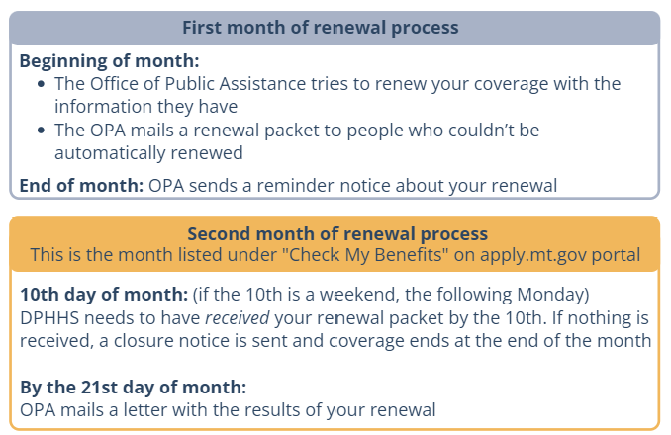
Timeline
July 1, 2026 – DPHHS plans to implement new six-month renewal cycle
Renewal is a two-month process
First cases will begin renewal in July and be due at the end of August
Will align renewals with other benefits whenever possible (SNAP, TANF, etc)

Slide 14
Community Engagement (CE) Requirements
Non-exempt 19–64-year-olds up to 138% of FPL (Adult Medicaid), must complete 80 hours per month
Community Engagement – must show 30 days prior to enrollment or be exempt
Notes:
When estimating state work requirements, of the 65,000 enrollees, only about 13,000 were subject to work requirements, the rest were exempted for some reason: already working, going to school, were in a high-poverty county, were medically frail, pregnant, already exempt from TANF/SNAP work requirements, or experiencing chronic homelessness.

Slide 15
CE Activities
Work
Hourly or salaried job
Self-employment
Contract or seasonal work
Gig work
Community Service or Volunteering
Nonprofit or charity
Church
Neighbor or personal connection
Oversight requirement
School, Internships
Workforce or Vocational Training

Slide 16
CE Exemptions
American Indians and Alaska Natives
Children 18 and younger
Adults 65 and older
Pregnant people and postpartum
Parents or caregivers of children 13 and younger
Parents or caregivers of people with disabilities
Disabled veterans
Medicare-eligible people
Incarcerated or recently released

Slide 17
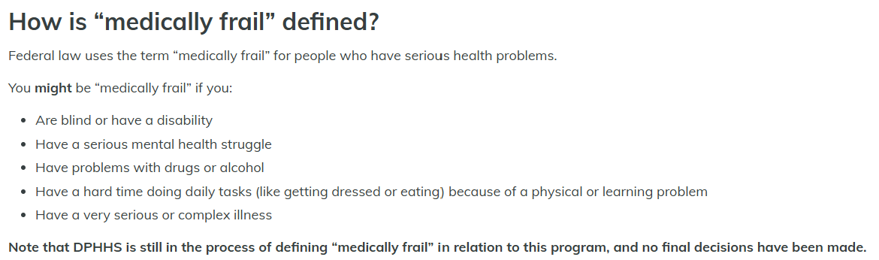
Exemptions TBD
Medically Frail
People enrolled in treatment programs for substance use disorders

Slide 18
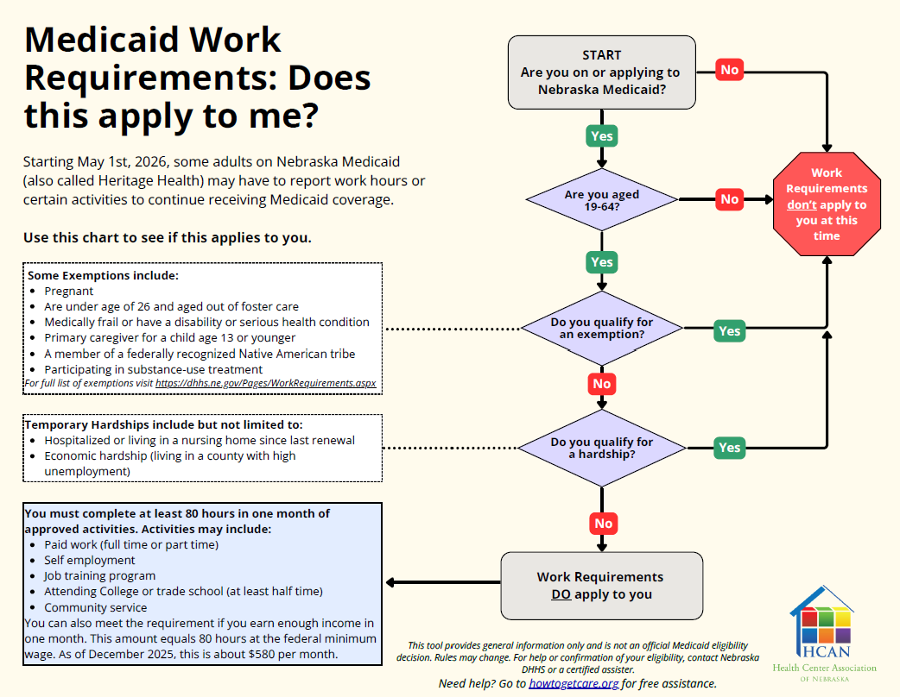
Screening
Exempt from completing CE
Exempt from reporting CE
Avoid “you don’t have to do anything”
“This doesn’t apply to you”

Slide 19
Exemptions
65,255 Medicaid Expansion enrollees
52,451 exempt
12,804
Already employed, in education, or vocational programs
Enrolled tribal member
Parent/caregiver of child under 13
Meeting requirements for SNAP/TANF
Short-term or good cause exemptions – housing insecurity, DV
Medically frail
Pregnant or on postpartum coverage
Participating in substance use disorder treatment
Medicaid Expansion Work Requirements, DPHHS 2025
Notes:
Montana is aiming for implementation in 2026, before the federal requirements. There were some improvements from the initial draft, but MT submitted the waiver to the feds last week. Federal comment period. DPHHS predicts around 13,000 Montanans will be subject to work requirements. Large exemptions include counties with high poverty designations (including tribal communities), people already working or in school, and population factors. While it is promising that much of the population will be exempted, the systems, processes, and support for exemptions is where we anticipate challenges.

Slide 20
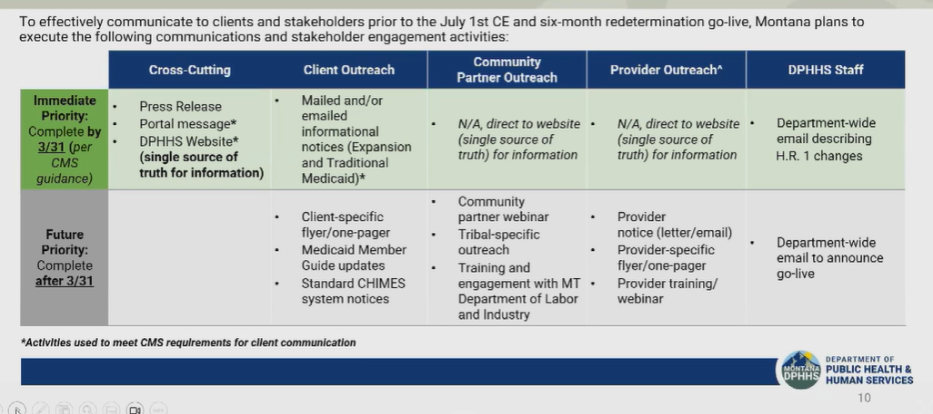
Member Notice & Communication
Starting March 31, 2026 – Mail plus one other contact method monthly
https://archive.legmt.gov/content/Committees/Interim/2025-2026/CFHHS/Meetings/March_9_10_2026/1-DPHHS-Update-Slides.pdf
Notes:
Text, website, electronic means, calls

Slide 21
Implementation
July – September 2026
After September 2026
New applications that do not meet CE requirements will be denied. Renewals after this month that do not meet requirements will be given notice and closed after 30 days.
First disenrollments for not meeting CE requirements during renewal
CE assessed for renewals and new applications during this time. Those who do not meet requirements will be approved and will not be disenrolled – referred to Helplink
January 1 2027
Notes:
Olivia will be prepared

Slide 22
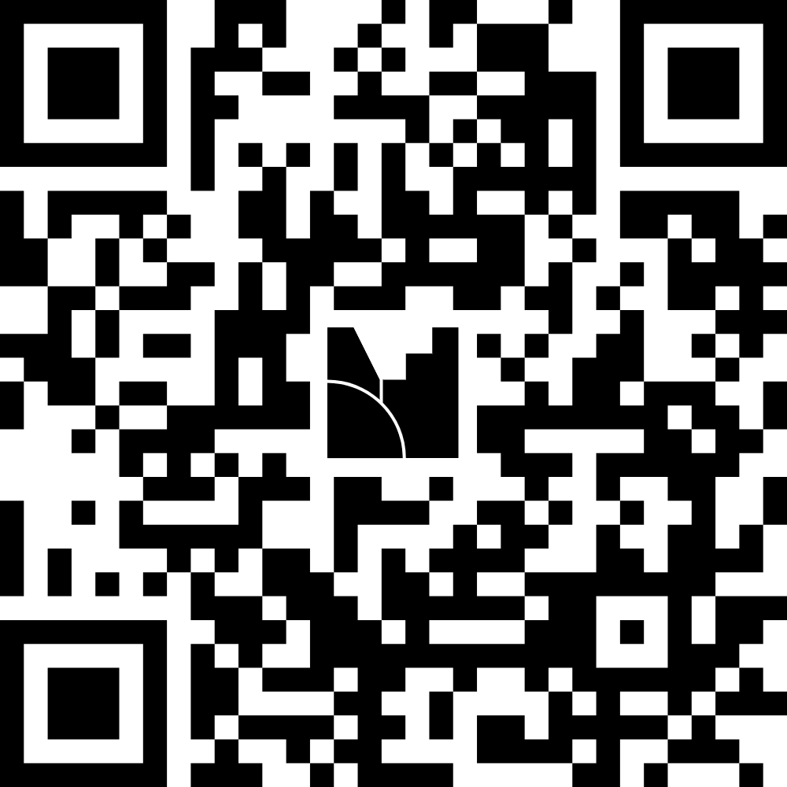
Questions & Feedback
Mentimeter Questions
Survey

Slide 23

What Comes Next?
Notes:
Start this slide at :45!

Slide 24
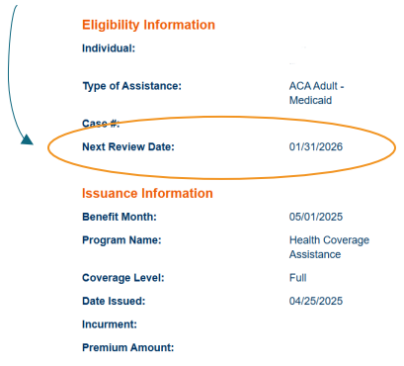
Help Patients and Clients
1. Make sure the OPA has the most up-to-date contact information for all people enrolled in Medicaid and Healthy MT Kids on an ongoing basis: Medicaid Change of Address Form: DPHHS (accessgov.com)
2. Help patients create accounts on apply.mt.gov (SSP), link their cases and sign up to receive notification via both email and mail
3. Locate upcoming renewal dates for patients and clients in SSP during appointments – focus on those with renewals in July-September of 2026

Slide 25
What’s Next?
DPHHS Partner Webinar
Provider Outreach
Community Assister Portal Implementation

Slide 26
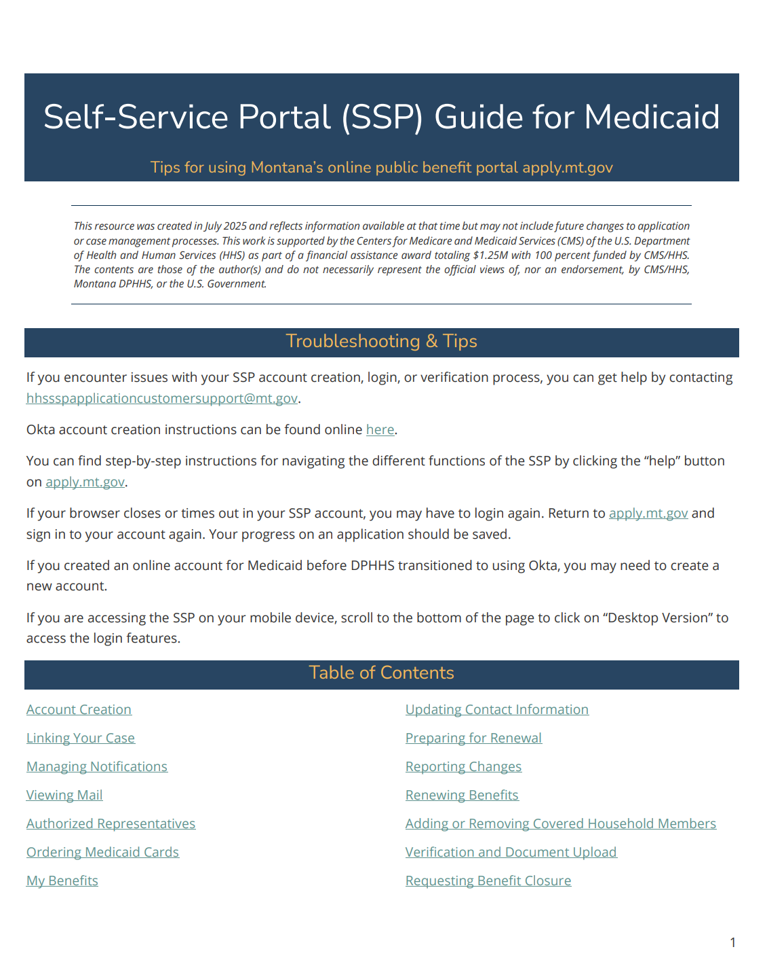

Trainings & Resources
Cover Montana Monthly Webinar – May 21st @ 11:00 AM
Medicaid Trainings – MPCA Resource Library
MAGI 101
MAGI 201
Resources
SSP Guide
Updated outreach materials – to come!
Future trainings on:
Appeals
SNAP/Medicaid

Slide 27

Questions?

Slide 28
Community Assister Portal
Coming in May 2026 – Enhanced SSP Functionality
Increased access to online applications, case information, renewals, and case management
Review case statuses
View mail and requests for information
View action items for cases
Submit new applications and renewals
Update contact information
Upload documentation*

Slide 29

Stay engaged
Cover Montana Annual Virtual Summit
Email updates
Monthly Cover Montana Webinars
Trainings for teams/sites
Olivia: oriutta@mtpca.org, (406) 880-3374
Tierney: tstrandberg@mtpca.org, (406) 595-2725

Slide 30
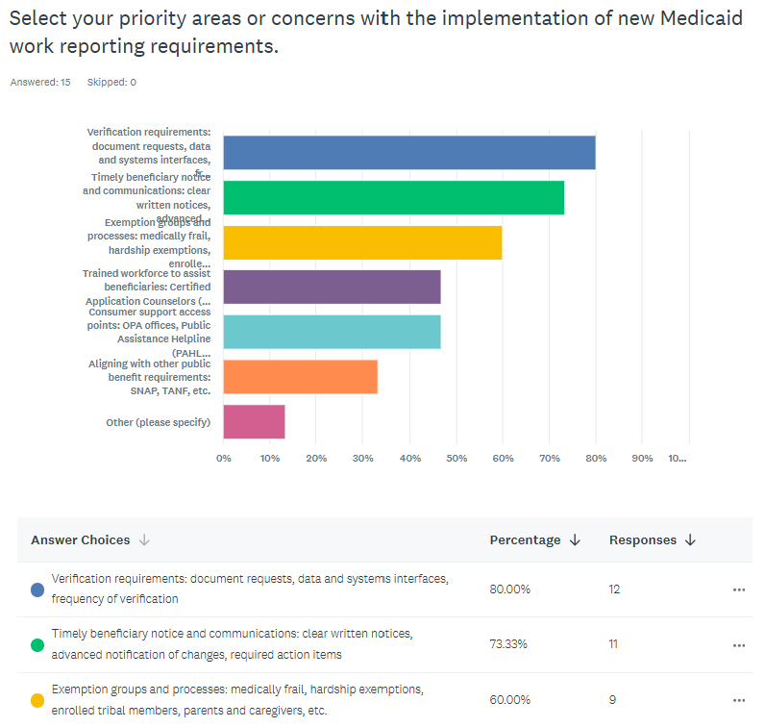
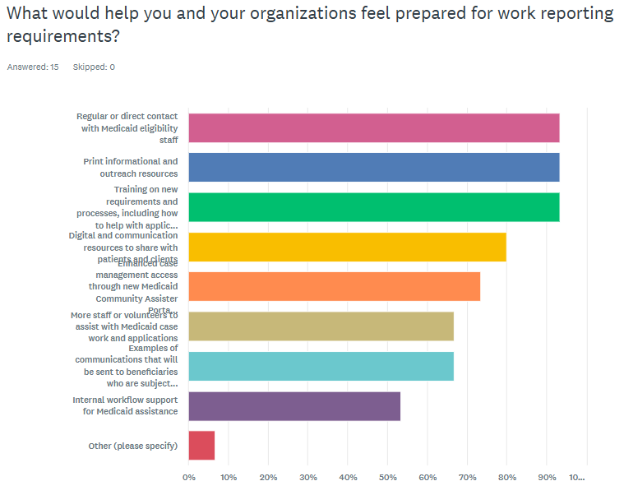
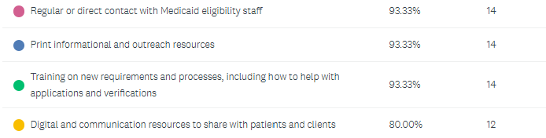

Slide 31
