Slide 1

MONTHLY WEBINAR
August 2026
Tierney Queen-Stewart
Director of Cover Montana

Slide 2

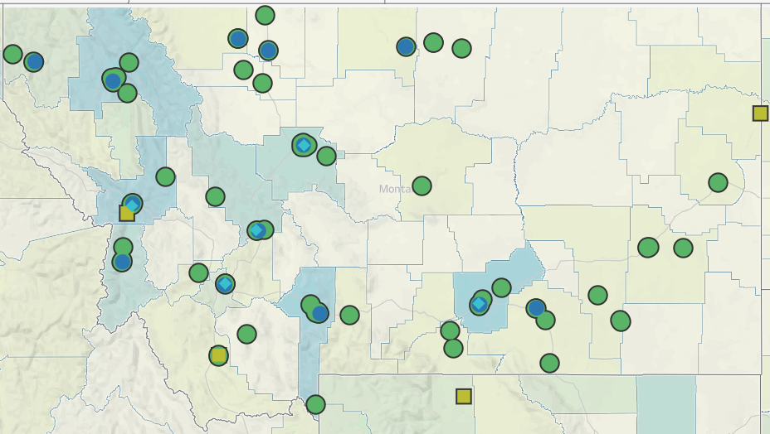
Our Mission
is to promote integrated primary healthcare to achieve health and well-being for Montanans.
Notes:
MPCA is a membership organization (13 CHCs, 5 UIO’s) serving about 125,000 Montanans. MPCA works to support our member health centers in providing comprehensive primary care services including medical, dental, behavioral, and what we in the health center world call “enabling services.” Since the very first health centers in rural Mississippi and central Boston, the health center model is built upon the idea that people lives (where they live, where they work, if they have access to food, if they make a living wage) impact health and health outcomes. CHCs receive grants from HRSA the Health Resources and Service Admin, there are some specific requirements of the 330 grants which are in contradiction with a lot of the EOs we are seeing.

Slide 3
Agenda
New Outreach and Informational Materials
Mentimeter Q&A
2026 Cover Montana Summit
PY2027 Rate Filing Requests
Medicaid Updates and Reminders
Notes:
Introduce yourself in the chat, if questions come up throughout the presentation, put them in the chat, we will stop and answer what we can before we go into breakout rooms.

Slide 4

Annual Summit – Save the Date
Registration available – agenda and session details coming soon!

Slide 5
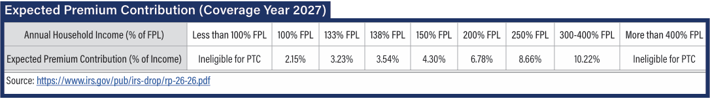
Marketplace Plans and Rate Filings
Mountain Health Coop
Connected Care* – 28.88%
Rocky Mountain – 16.45%
*29 / 276 national highest rate increase requested
Blue Cross Blue Sheild
Blue Preferred PPO – 16.23%
Blue Focus POS* – 26.20%
*75 / 276 national highest rate increase requested
Notes:
Mussellshell, Carbon, Yellowstone, Sweetgrass counties. Benchmark silver plan also informs a lot of the out of pocket premium costs.

Slide 6
Medicaid Updates

Slide 7
Medicaid and the FFM
Now – Oct. 1
CE not assessed for Medicaid applications through the FFM
Oct. 1 – Jan. 1
No change to FFM application, assess CE after application transfer
Starting Jan. 1
CE integrated into FFM application and determinations

Slide 8
New DPHHS Information on HR1 Policies
More detail on exclusions
Non-citizen changes – October 1
LPRs (green card) – 5 year ban and 40 work quarters
Specified excluded individuals
Exceptions
Short-term hardship – not implementing disaster or unemployment at this time
Cuban/Haitian entrants (not TPS)
COFA Migrants
Retroactive Period – January 1
Adult Medicaid - 3 months to 1 month
All other Medicaid programs - 3 months to 2 months
HMK?

Slide 9
DPHHS Forms and Process Updates
Appendix A and B not required at application
Wet signature requirement
Medically Frail Guidance

Slide 10
Primary Care Montana (PCMT)
If members want to retain their PCP from Passport, no action required
Passport eliminated effective July 1
New primary care case management program for eligible Medicaid members
Uses the Montana Healthcare Programs Customer Access Portal – ICAP

Slide 11
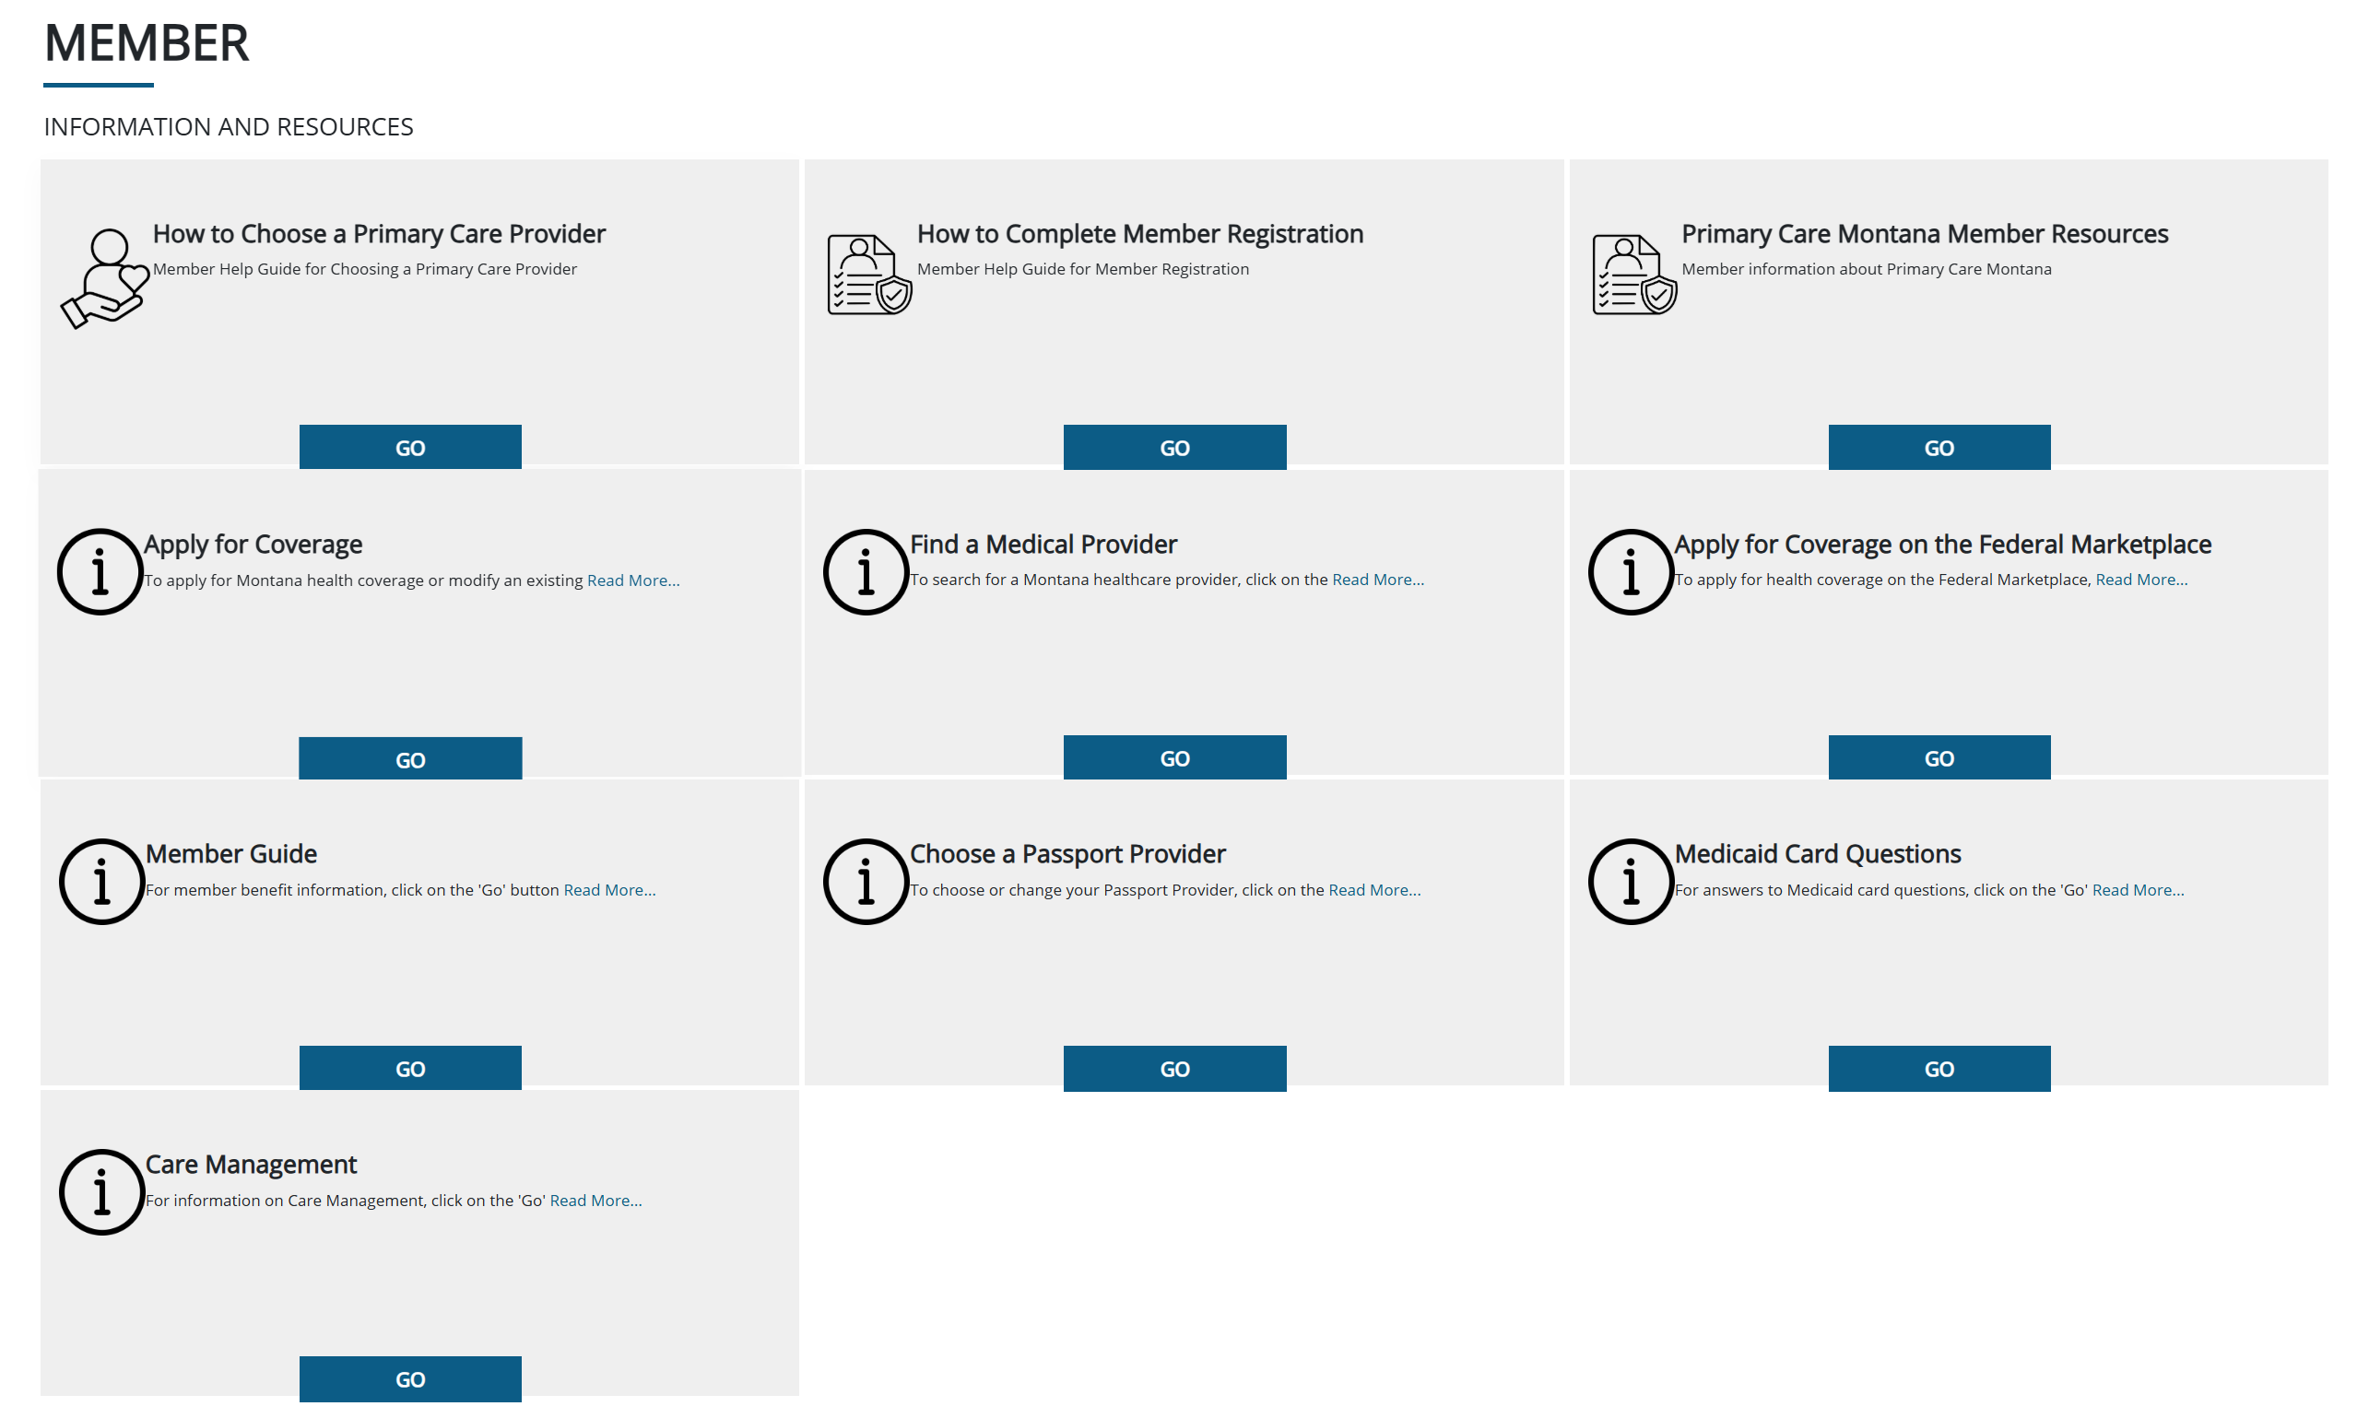
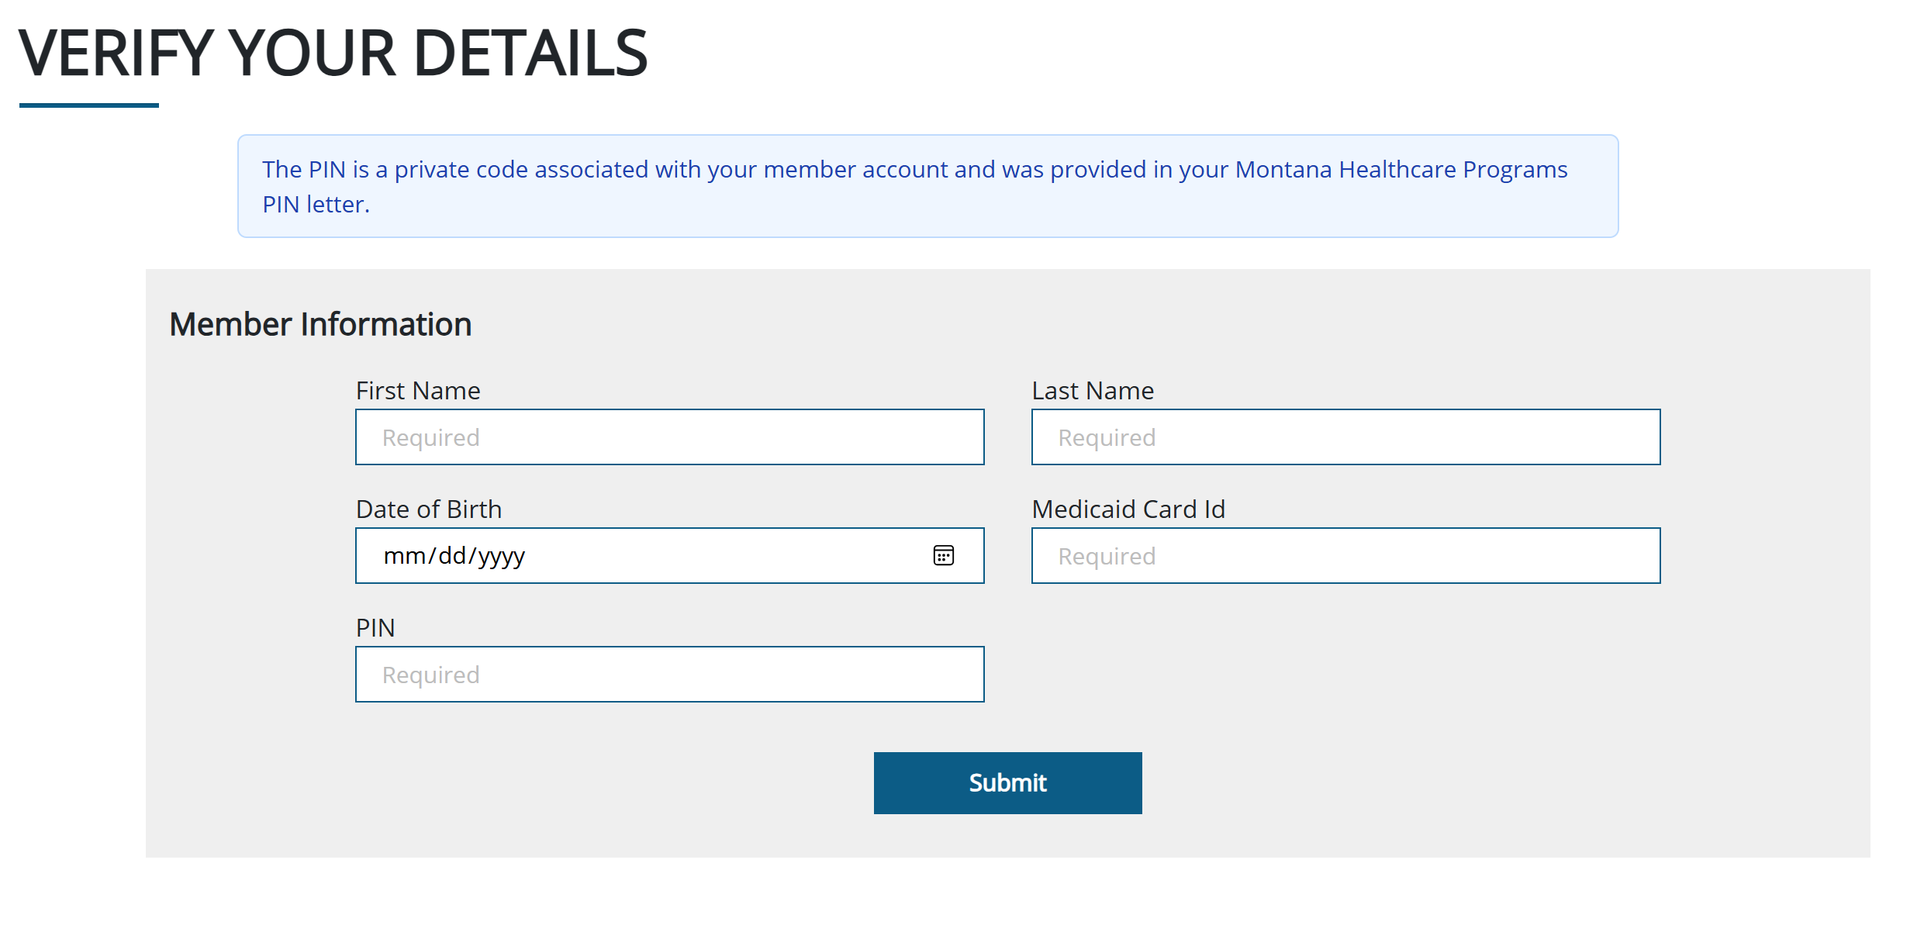
ICAP Portal & Member Resources
PCMT and member questions directed to Member Benefits line not the PAHL

Slide 12
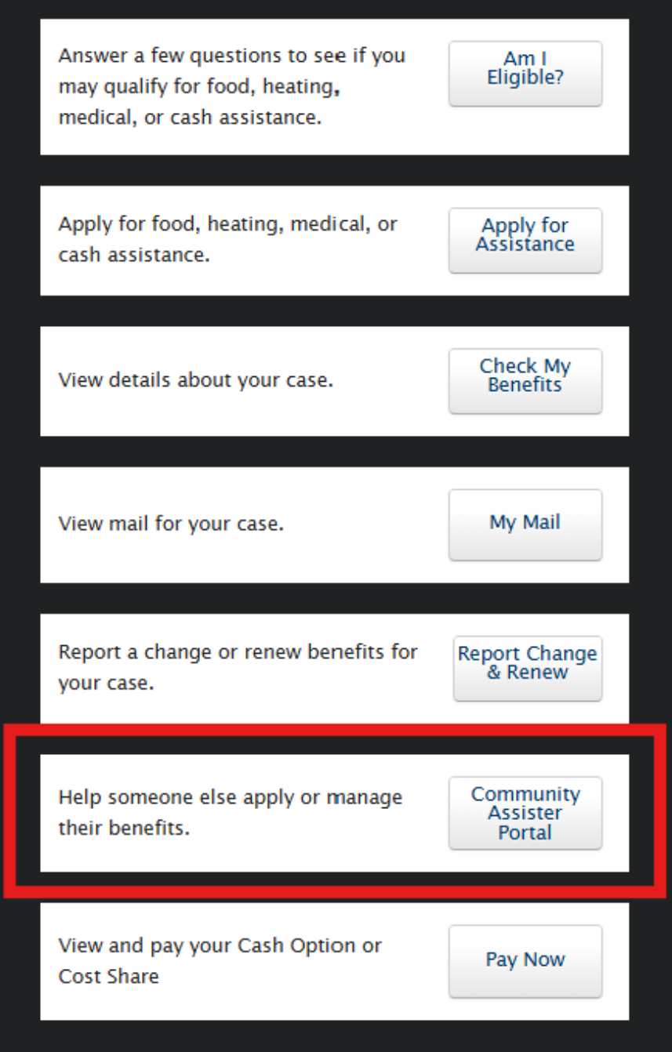
Community Assister Portal Reminders
Resolved unlinking SSP accounts when accessing Assister Portal
Codes are included only on “about your case” notice currently on:
  Applications
  Renewals
Working on other code generation process
New applications do not require codes – does not save in the Assister Portal after submission
Code can be used multiple times by different Assisters if not expired (2 notices)
Has anyone experienced how an application or renewal submitted through the CAP appears in a client’s SSP account?

Slide 13
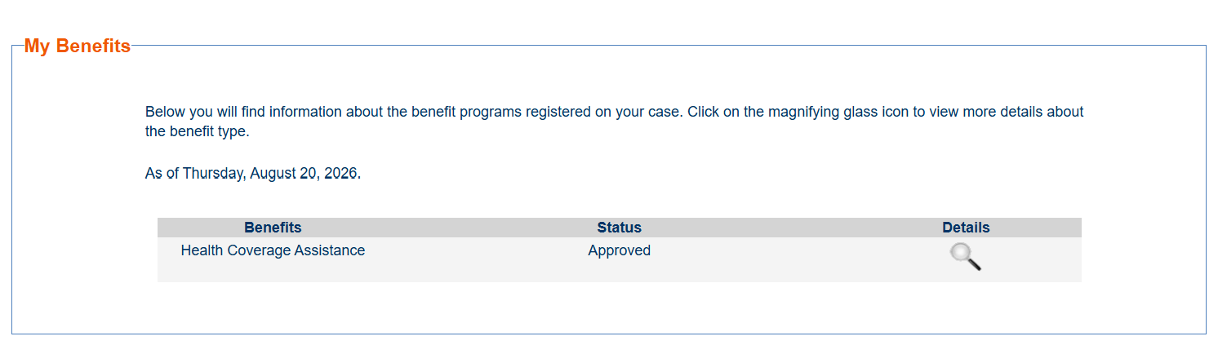

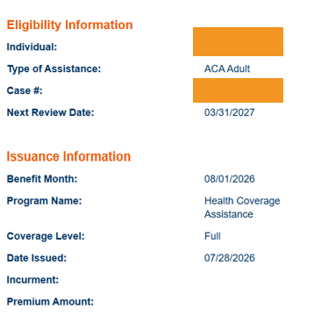

Renewal Dates
Case Selection ->
My Benefits ->
Next Review Date, Type of Assistance
Anywhere else people have found renewal dates?

Slide 14
Case Numbers
How are people currently helping patients and clients locate case numbers for pending cases?
Approved cases?

Slide 15
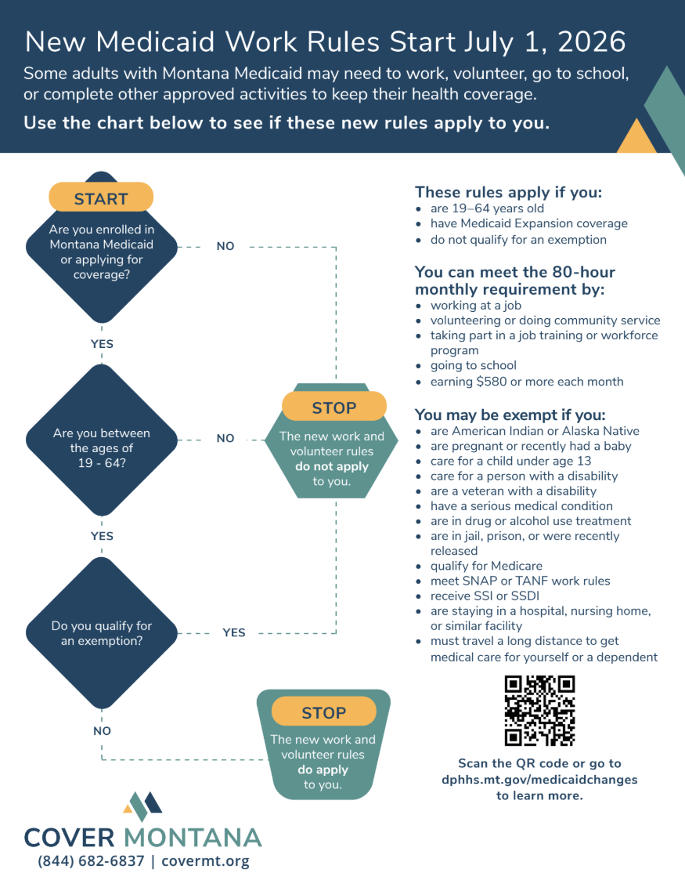
Cover Montana Resources
Interactive flowchart
Informational flyer/poster
Small informational card
Postcard
AI/AN Exclusion Resource

Slide 16
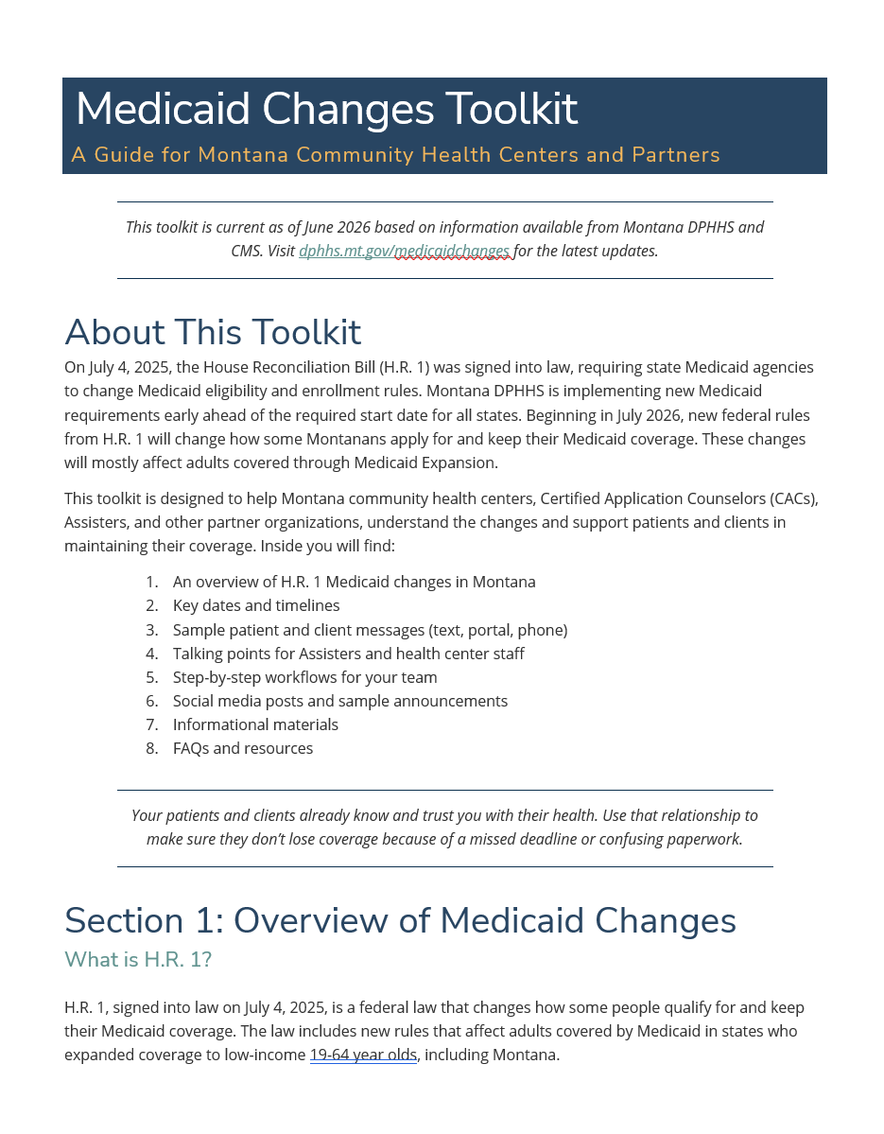
Digital Toolkit
Patient and public messaging toolkit
Key dates
Short message templates – text, EHR message, email
Social media templates
Assister and staff talking points
Resources
Explanation of changes
FAQs

Slide 17
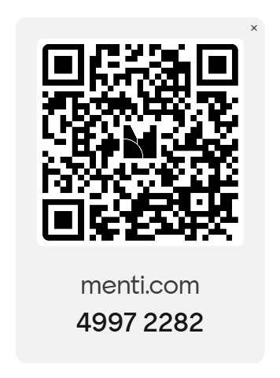
Mentimeter Q&A

Slide 18
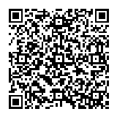

Questions?
Tierney Queen-Stewart,
Director of Cover Montana
Montana Primary Care Association
tstrandberg@mtpca.org
406-595-2725

