Slide 1

MONTHLY WEBINAR
December 2025
Tierney Queen-Stewart
Director of Cover Montana

Slide 2
AGENDA
Introductions
eAPTC Policy Update
Questions & Resources
Coverage Effectuation Scenarios
OE Data and Trends
Benefit Advisory Council Update - Olivia

Slide 3

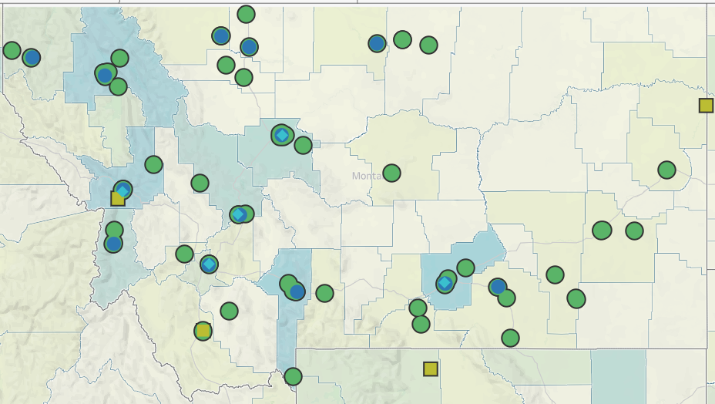
Our Mission is to promote integrated primary healthcare to achieve health and well-being for Montanans.
Notes:
MPCA is a membership organization (13 CHCs, 5 UIO’s) serving about 125,000 Montanans. MPCA works to support our member health centers in providing comprehensive primary care services including medical, dental, behavioral, and what we in the health center world call “enabling services.” Since the very first health centers in rural Mississippi and central Boston, the health center model is built upon the idea that people lives (where they live, where they work, if they have access to food, if they make a living wage) impact health and health outcomes. CHCs receive grants from HRSA the Health Resources and Service Admin, there are some specific requirements of the 330 grants which are in contradiction with a lot of the EOs we are seeing.

Slide 4
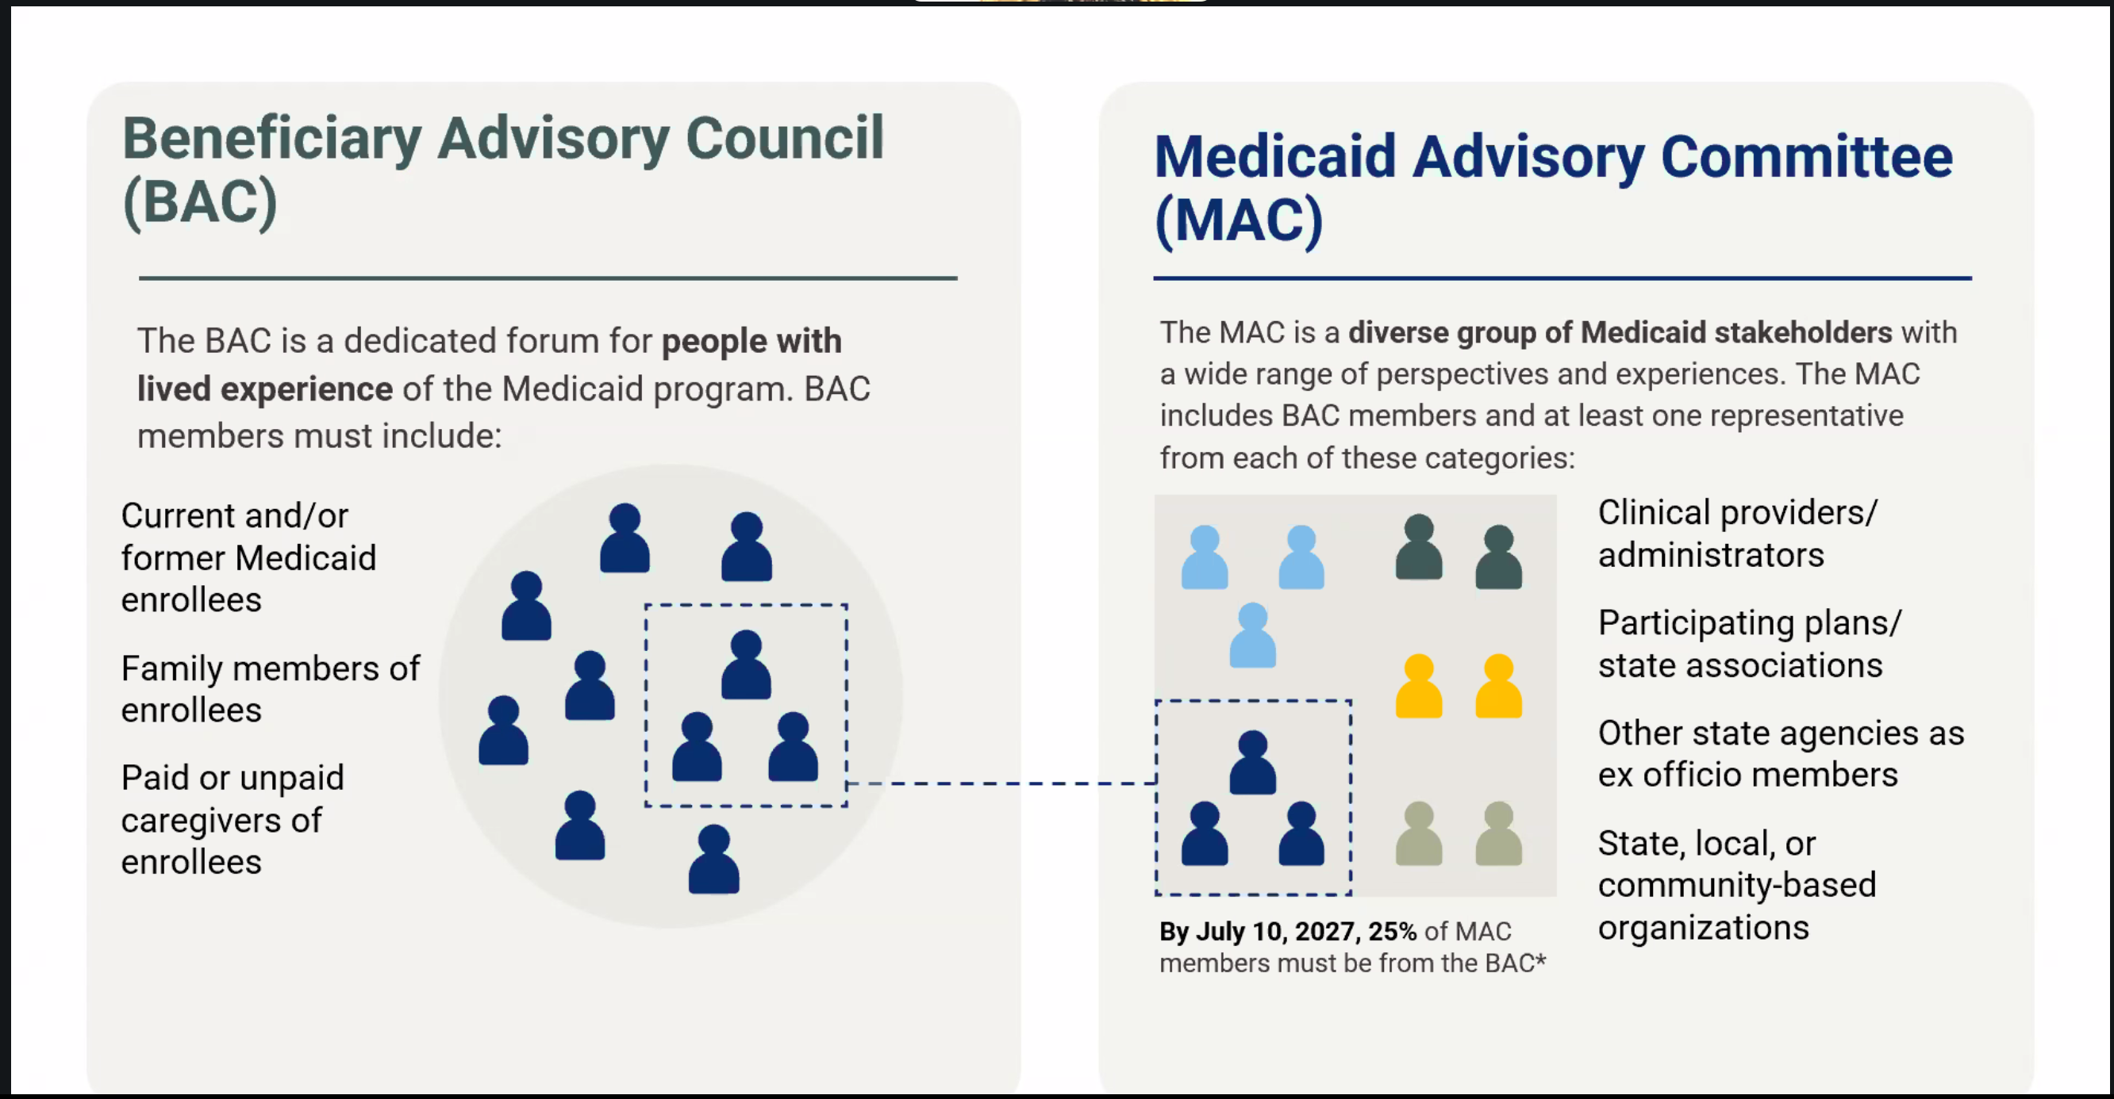

Slide 6
1/3 OF MONTANANS WERE AUTOMATICALLY RE-ENROLLED LAST YEAR

Slide 7
COVER MONTANA OE TAKEAWAYS

Slide 8

1 in 5 people who contacted Cover Montana helpline for enrollment help since November 1st didn’t enroll because of cost
Almost 90% of Montana enrollees had APTC or CSRs in 2025 – 69,185

Slide 9
EAPTC POLICY UPDATE
Government shutdown ended on November 15th without eAPTC extension
Senate proposals to extend eAPTC for 3 years failed to cross 60 vote threshold
Other proposals include direct payments to consumers, HSA contributions, and more
House passed healthcare legislation yesterday that does not include eAPTC extension – would allow small businesses to offer their own plans, crack down on PBMs, and fund a different kind of subsidy. Unlikely to pass the Senate when they return in 2026

Slide 10
MOST IMPACTED BY EAPTC EXPIRING
400% of FPL and above
$63,000 individual
$85,000 couple
$130,000 HH of 4
55+ Consumers
12,428 enrollees in 2025 were 400%+ of FPL
19,712 were age 55-64, the largest age category

Slide 11




Impact of expiration of eAPTC on Montana communities
Family of four (45, 41, 8, and 5 years old)
$120,000 annual income
Enrolled in a Blue Focus Silver plan for 2025, paying ≈ $720 per month for the entire family
Same plan would cost them ≈ $972 for 2026,
$250 more per month than this year for the same coverage
Cheapest plan would be $33/month
Notes:
311% of poverty

Slide 12

OE TIMELINE

Slide 13
AUTOMATIC RE-ENROLLMENT
December 16th – Enrollees who did not actively enroll will be reassessed for eligibility and enrollment using available information
Uses tax data and prior year application information to determine eligibility for APTC and CSRs and to enroll in the same plan
Higher likelihood of incorrect application information, enrollment without APTC or CSRs, or enrollment into a different plan
Consumers can update application, change plans, or terminate coverage between December 16 – 31 or until January 15 if they have paid the first premium

Slide 14
COVERAGE EFFECTUATION
Plans are tentative until the first premium is paid – the “binder payment”
For most people this must be paid by January 1st
For $0 premiums, coverage is effectuated by completing the enrollment process with the insurance company and the Marketplace sends the enrollment information*
Missed payments after the binder payment for consumers with APTC enter a three-month grace period to pay monthly premiums – plan is cancelled after three months
*End of the month enrollments can take a few days for the carrier to have record of the new plan*
Make sure people have a plan to pay their first premium prior to the coverage start date

Slide 15
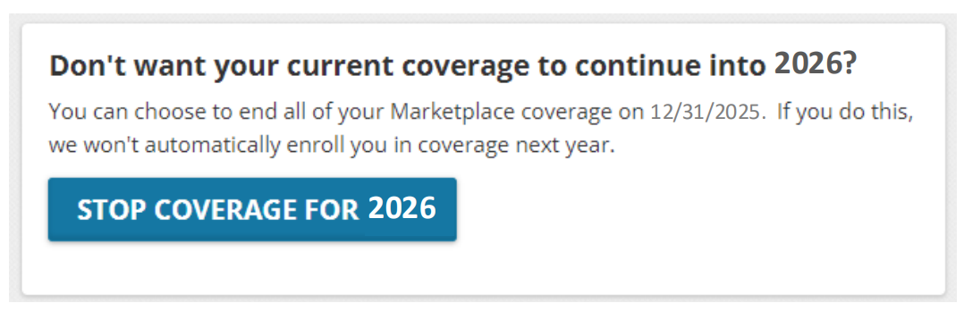
TERMINATING COVERAGE
Consumers can end their 2026 plan if they enrolled or were auto re-enrolled prior to December 31
Coverage can be terminated at any point in the year, but premiums that were paid will not be returned, and consumers will not be able to enroll again unless they are eligible for an SEP
If people are cancelling coverage for some household members but not all – call FFM Call Center to terminate!

Slide 16
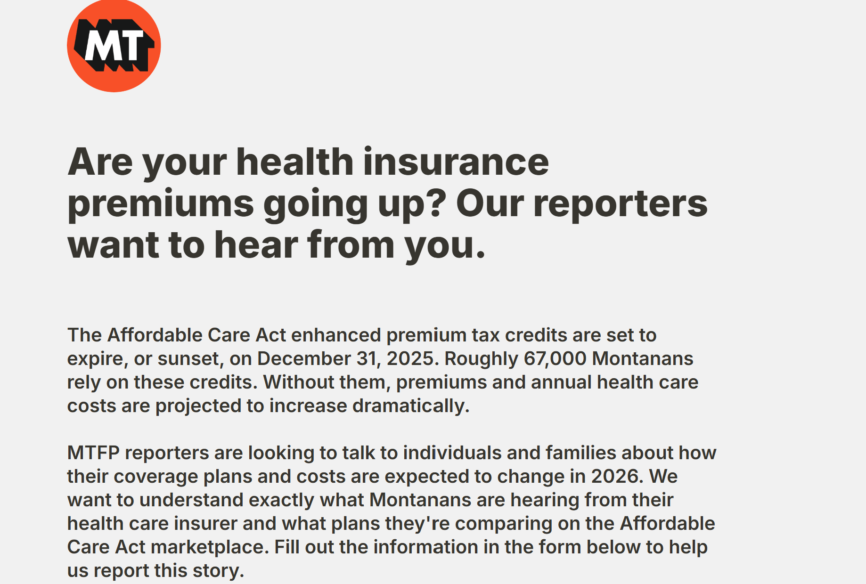
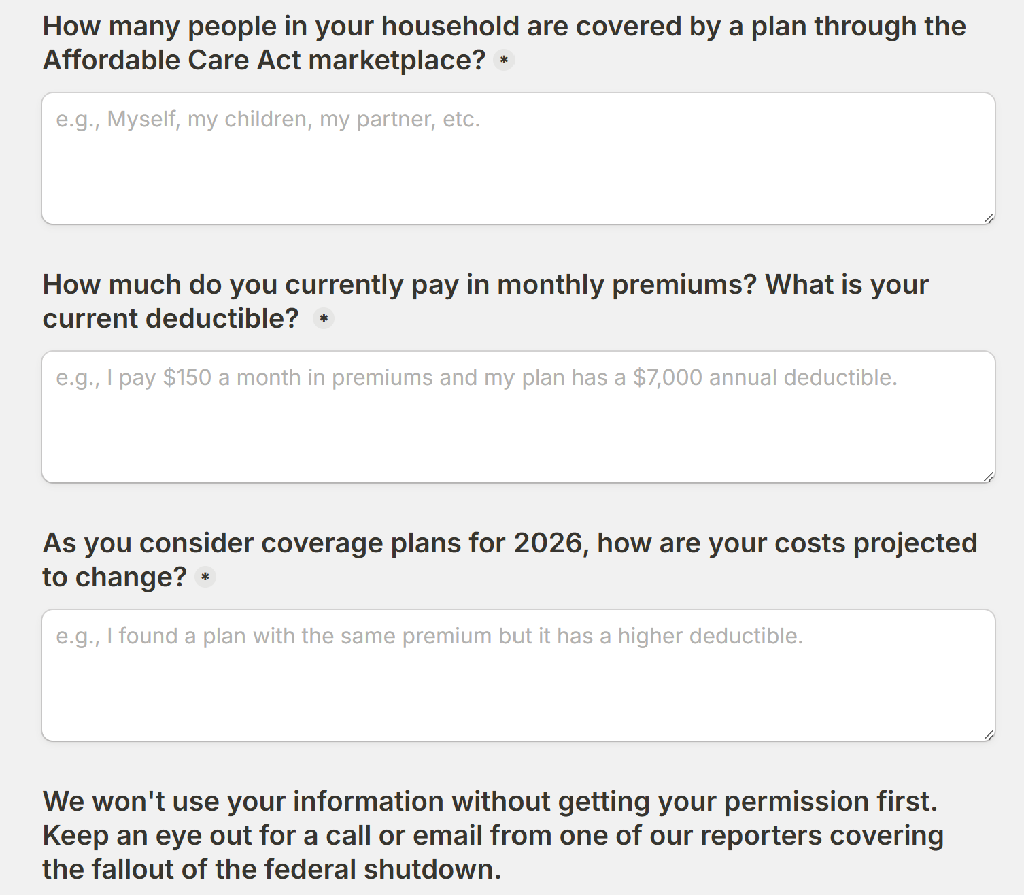
MONTANA FREE PRESS FORM

Slide 17
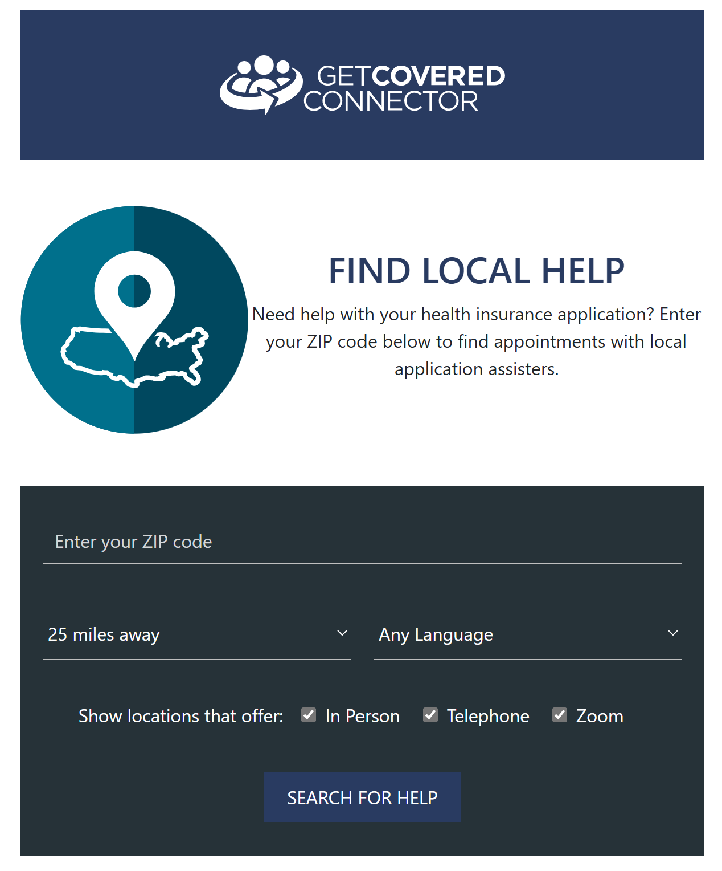
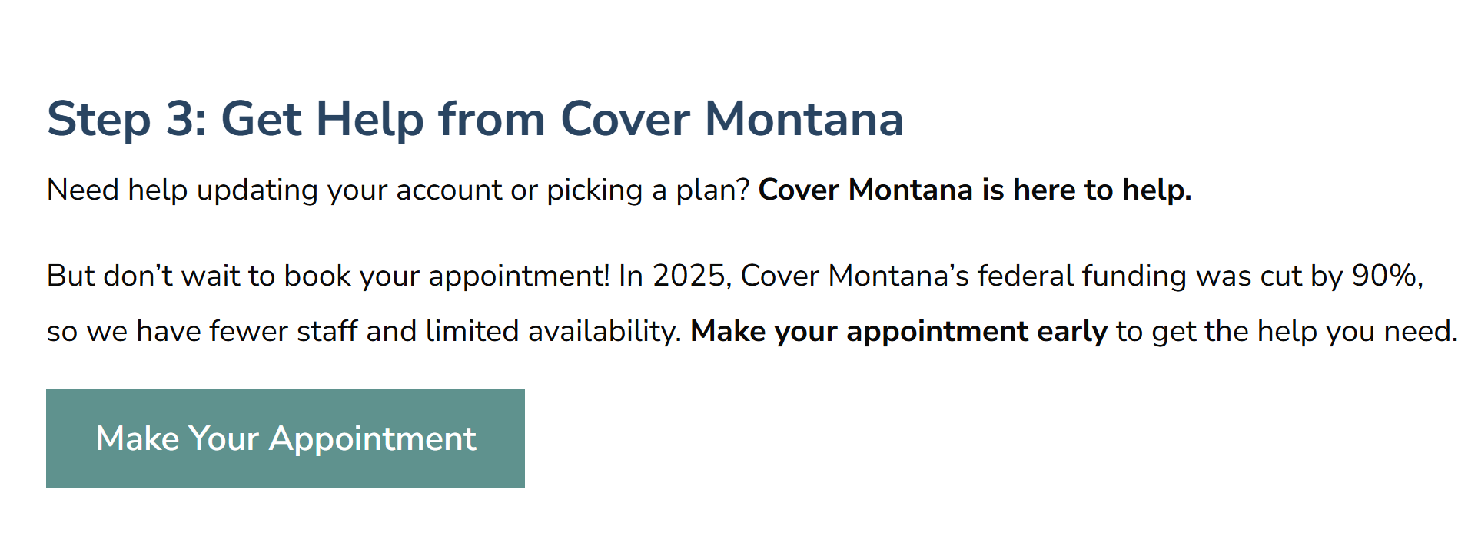
VIRTUAL NAVIGATOR APPOINTMENTS & LOCAL HELP

Slide 18

UPCOMING TRAININGS
Cover Montana Monthly Webinar – January 15th @ 11:00 AM
Immigrant Enrollment Policy Changes
HR1
Medicaid
Marketplace/APTC
Public Charge
Find this previous Webinar on MPCA website

Slide 19
Questions?
Tierney Queen-Stewart, Director of Cover Montana
tstrandberg@mtpca.org
406-595-2725

Slide 20
Targeted Patient Outreach & Assistance
Income – between 138% -200%, 400%+
Payer – private insurance, non-group
Diagnosis, chronic conditions
Age – 55+
Notes:
Using EHRs/DRVs – How do you report enrollments for UDS?

