Slide 1

MONTHLY WEBINAR
February 2026
Tierney Queen-Stewart
Director of Cover Montana

Slide 2

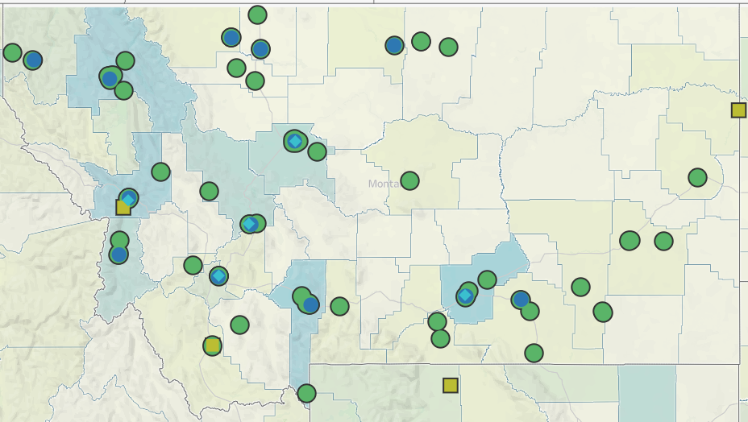
Our Mission is to promote integrated primary healthcare to achieve health and well-being for Montanans.
Notes:
MPCA is a membership organization (13 CHCs, 5 UIO’s) serving about 125,000 Montanans. MPCA works to support our member health centers in providing comprehensive primary care services including medical, dental, behavioral, and what we in the health center world call “enabling services.” Since the very first health centers in rural Mississippi and central Boston, the health center model is built upon the idea that people lives (where they live, where they work, if they have access to food, if they make a living wage) impact health and health outcomes. CHCs receive grants from HRSA the Health Resources and Service Admin, there are some specific requirements of the 330 grants which are in contradiction with a lot of the EOs we are seeing.

Slide 3
AGENDA
Hellos!
Tax Reminders for Assisters
Questions & Resources
Policy Updates

Slide 4
POLICY UPDATES
Proposed Federal Rule
- Notice of Benefit and Payment Parameters for 2027
Medicaid Work Requirements
Rural Health Transformation Funds (RHTP)

Slide 5
2027 PROPOSED RULE
Released on February 9, 2026 – in public comment period until March 13th
Would make sweeping changes to Marketplace plans for PY2027
Expected to decrease Marketplace enrollment in 2027 by 2 million people

Slide 6
PROPOSED RULE INCLUDES
Increasing access to catastrophic plans and raising the MOOP for those plans to between $12,000-$15,600 for an individual and $24,000-$31,2000 for family
Proposes multi-year catastrophic plans, up to 10 years
Change definition of “eligible noncitizen” to align with changes in HR1
New pre-enrollment verifications, re-proposes provisions from previous rule on APTC failure to reconcile
Eliminate standardized plans and low-income SEP (150%)
Implements CSR reporting and verification requirements
Notes:
Note on catastrophic – anticipated to lower premiums with higher annual costs. Most healthy people still choosing Bronze over catastrophic. Nationally 54,000 people enrolled in catastrophic for 2026 vs. 3 million bronze selections. Low income SEP currently not eligible for APTC, would eliminate it entirely.

Slide 7
MEDICAID WORK REQUIREMENTS
1115 Waiver submitted by Montana DPHHS to HHS was denied
MPCA coordinating to get information and details about implementation, will host future training and provide materials
DPHHS moving forward with intent to implement July 1, 2026 through state plan amendment (SPA)
Notes:
COFA includes Marshall Islands, Micronesia, Palau

Slide 8
65,255 Medicaid Expansion enrollees
52,451 exempt
12,804
Exemptions:
Poverty-designated counties
Already employed, in education, or vocational programs
“Medically frail”
Meeting requirements for SNAP/TANF
Short-term or good cause exemptions
Medicaid Expansion Work Requirements, DPHHS 2025
Notes:
Montana is aiming for implementation in 2026, before the federal requirements. There were some improvements from the initial draft, but MT submitted the waiver to the feds last week. Federal comment period. DPHHS predicts around 13,000 Montanans will be subject to work requirements. Large exemptions include counties with high poverty designations (including tribal communities), people already working or in school, and population factors.

Slide 9
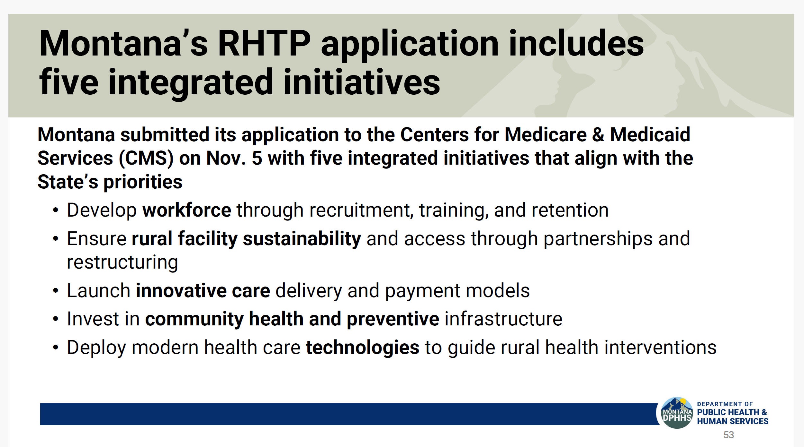

Slide 10
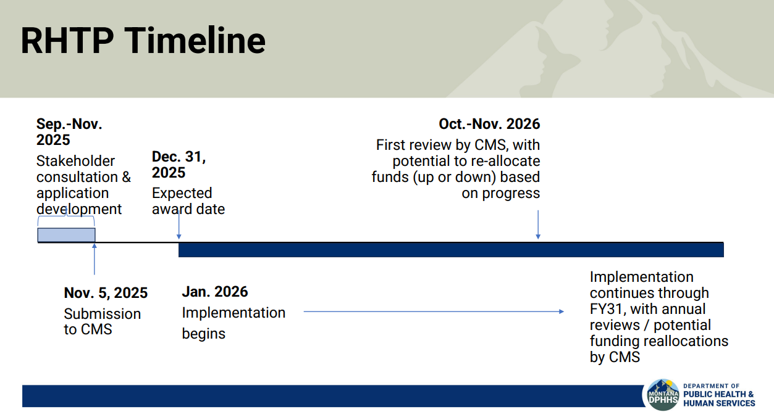

Slide 11
TAX SEASON REMINDERS FOR ASSISTERS & CONSUMERS
Households who received APTC during the year are required to file taxes and reconcile even if their income does not meet the filing threshold
1095 A forms will be mailed to households and available in Marketplace accounts
Form 8962 is used for people who do not take APTC or had changes during the year

Slide 12
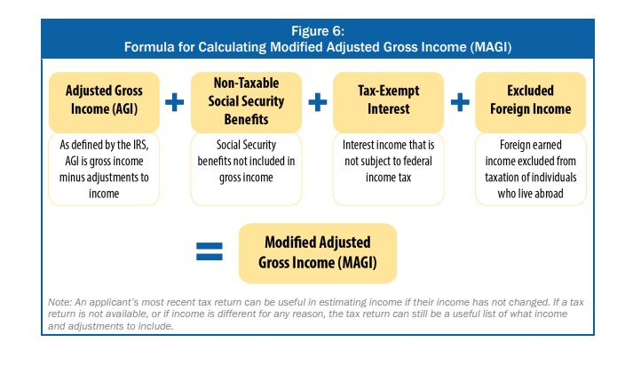
APTC RECONCILIATION
Previous APTC eligibility and reconciliation rules are still in effect for 2025 – 400%+ and less than 100% of FPL
Generally, people filing Married Filing Separately will not be eligible for APTC
Household MAGI at time of filing used to determine if they received the correct amount of APTC for that year
Assisters cannot give tax advice but can give information about how it impacts eligibility

Slide 13
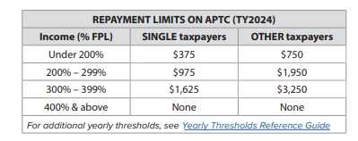
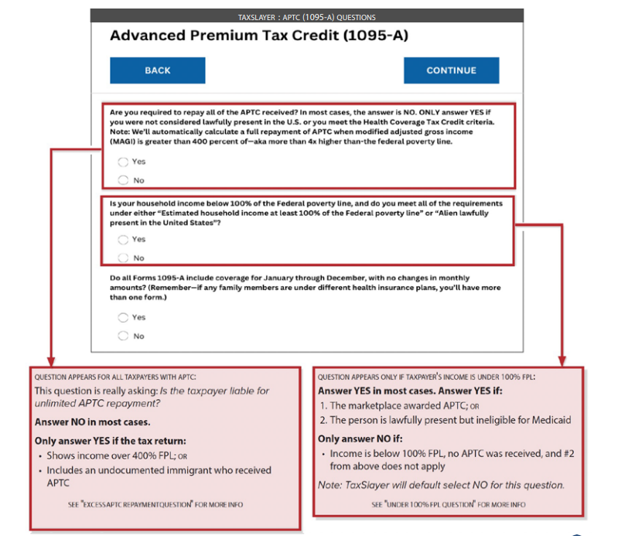
APTC REPAYMENT
Variance of APTC paid gets added or subtracted from refund at tax filing
APTC repayment caps in effect for tax year 2025 but removed for 2026 – next tax year consumers will owe back all excess APTC received that year
If people received CSRs throughout the year but were above income limits at tax filing there is not a repayment requirement

Slide 14
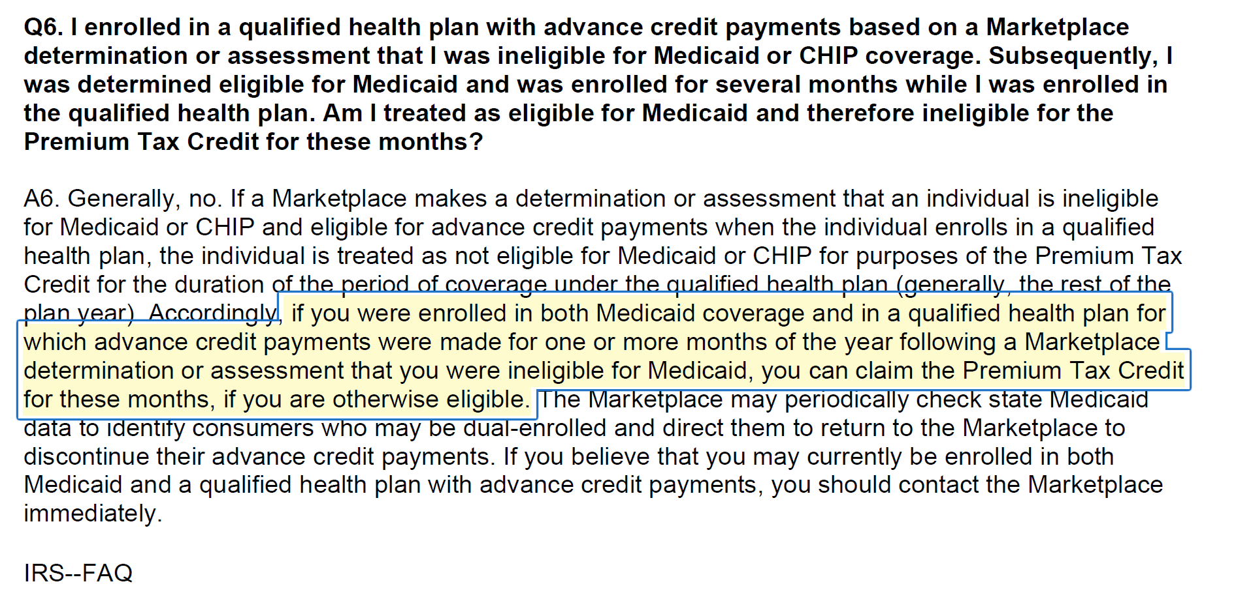
TAX FAQs
Consumers whose martial status changed during a tax year use the status on the last day of the tax year
Closely consult tax rules for people with spouses or tax household members outside the United States
Households who received APTC and were enrolled in Medicaid during the same months are generally protected from repayment

Slide 15
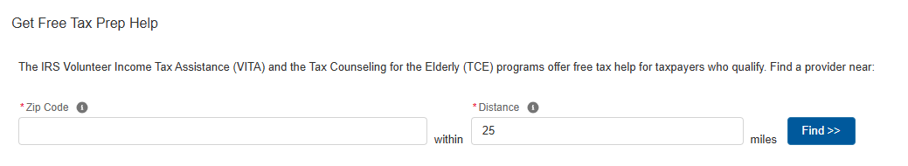
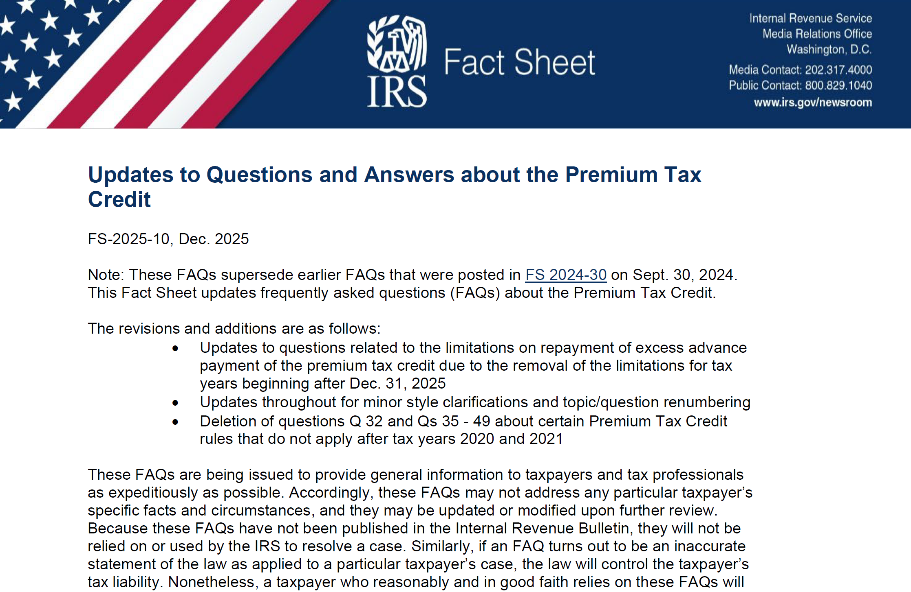
TAX HELP & RESOURCES
VITA – up to $69,000 MAGI
Assister information
Beyond the Basics
Updated IRS FAQ
Information for clients/patients

Slide 16
UPCOMING TRAININGS
Cover Montana Monthly Webinar – March 19th @ 11:00 AM
Medicaid Changes – Updates and Brainstorm
Medicaid Assister Portal
DPHHS HR1 Medicaid Changes
Work Requirement Implementation
Information sharing and input from you about what you need to help patients and clients through these changes!

Slide 17
Questions?
Tierney Queen-Stewart, Director of Cover Montana
tstrandberg@mtpca.org
406-595-2725

