Slide 1

MONTHLY WEBINAR
January 2026
Tierney Queen-Stewart
Director of Cover Montana

Slide 2
AGENDA
Questions & Resources
OE Data Review
Health Coverage Access Changes for Immigrants
SEP Survey

Slide 3

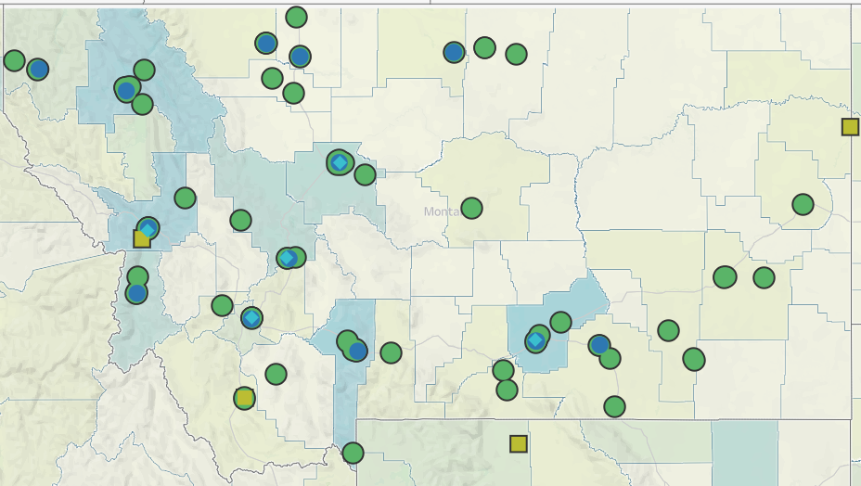
Our Mission is to promote integrated primary healthcare to achieve health and well-being for Montanans.
Notes:
MPCA is a membership organization (13 CHCs, 5 UIO’s) serving about 125,000 Montanans. MPCA works to support our member health centers in providing comprehensive primary care services including medical, dental, behavioral, and what we in the health center world call “enabling services.” Since the very first health centers in rural Mississippi and central Boston, the health center model is built upon the idea that people lives (where they live, where they work, if they have access to food, if they make a living wage) impact health and health outcomes. CHCs receive grants from HRSA the Health Resources and Service Admin, there are some specific requirements of the 330 grants which are in contradiction with a lot of the EOs we are seeing.

Slide 4

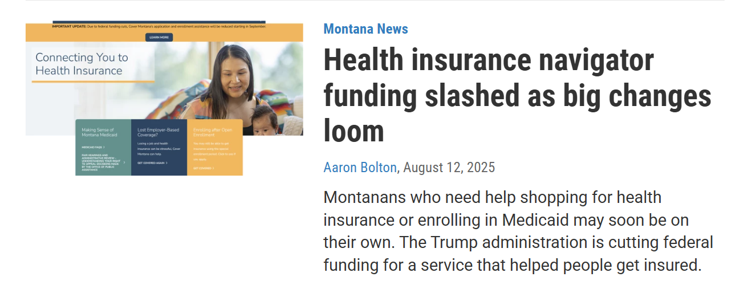
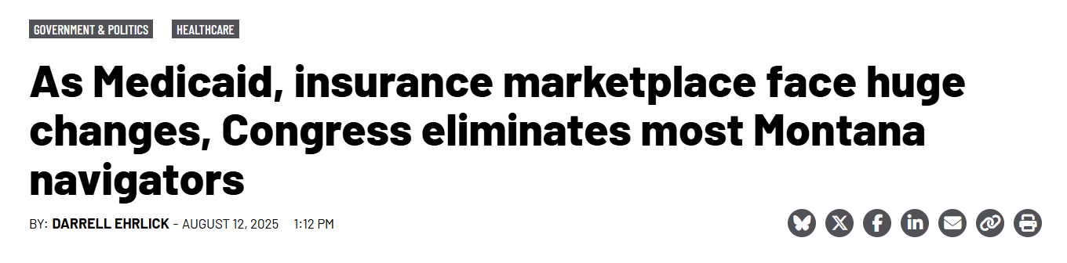
Statewide training and technical assistance to enrollment Assisters
Federal Navigator grantee since 2021
Helpline provides phone and virtual assistance to the public
Resources, local help directory, and health coverage updates available on covermt.org
This work is supported by the Centers for Medicare and Medicaid Services (CMS) of the U.S. Department of Health and Human Services (HHS) as part of a financial assistance award totaling $125,000 with 100 percent funded by CMS/HHS. The contents are those of the author(s) and do not necessarily represent the official views of, nor an endorsement, by CMS/HHS, or the U.S. Government.

Slide 5
Notes:
Data as of January 3. Down 2500 enrollees, 3% of total enrollment. What’s not in this data is effectuation information, expect people may drop off throughout the year

Slide 6
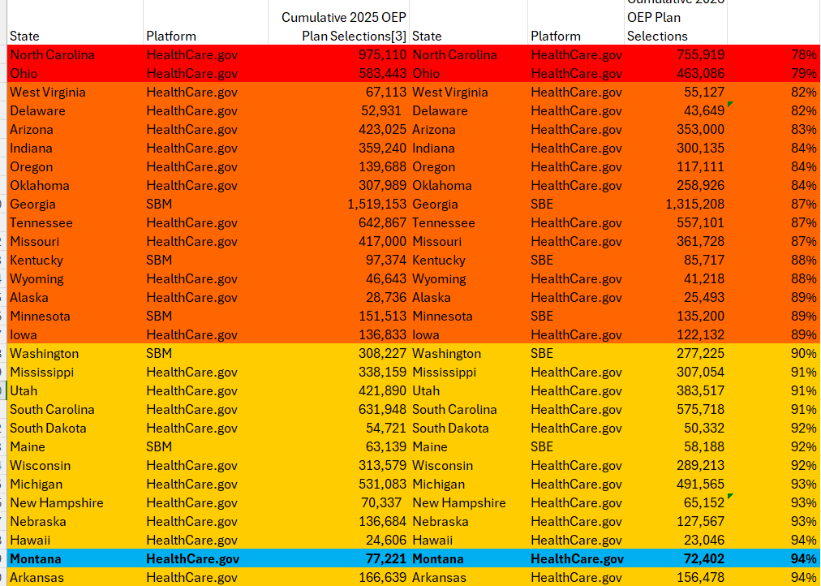
MONTANA VS OTHER STATES
11 states with same or higher enrollment in 2026 than 2025, all but two have SBM

Slide 7
HEALTH COVERAGE ACCESS CHANGES FOR IMMIGRANTS
Timeline of changes from HR1 and other federal policies
- Marketplace and APTC eligibility
- Medicaid and HMK
Public Charge
For immigration and eligibility basics, see prior MPCA training

Slide 8
DISCLAIMERS AND REMINDERS
Dynamic and fast changes
Legal advice
Federal and funding requirements
Experts – NILC, Protecting Immigrant Families, Beyond the Basics

Slide 9
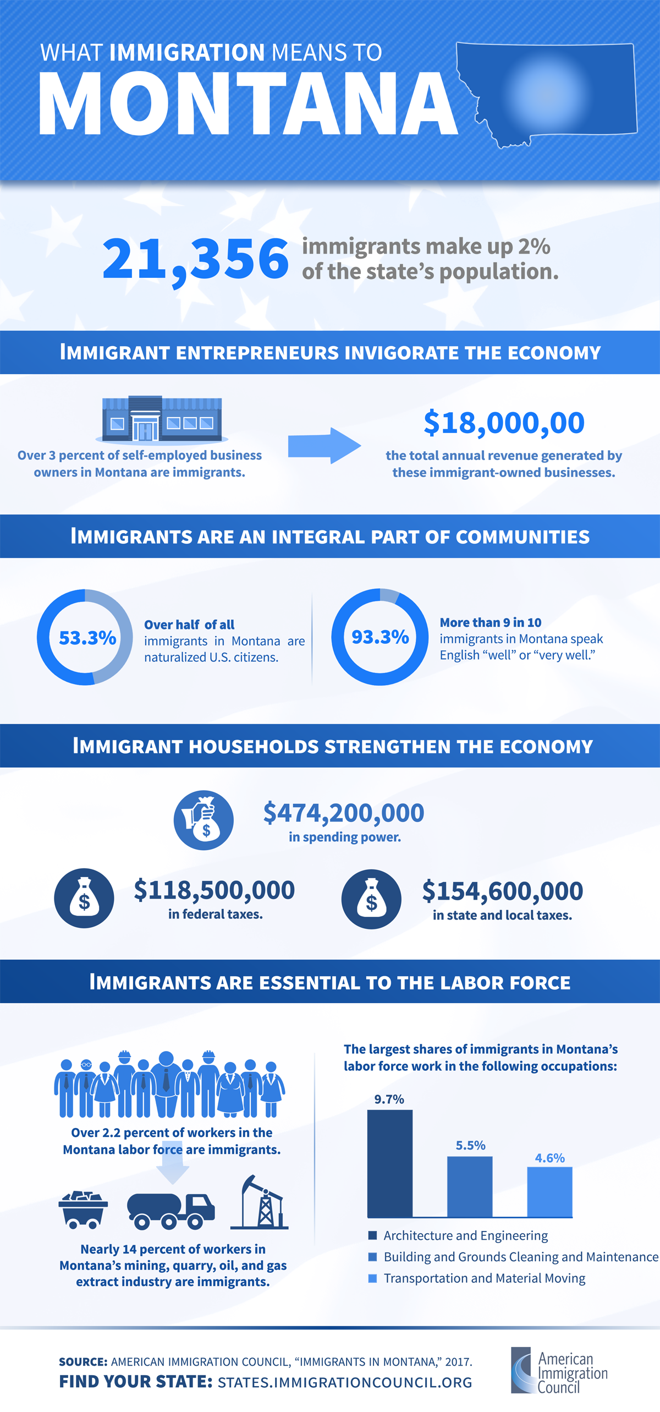

Slide 10
CHANGES ALREADY IN EFFECT
DACA recipients ineligible for Marketplace coverage and APTC
1/1/2026 - Lawfully present immigrants below 100% of FPL ineligible for APTC
Medicare eligibility for lawfully present immigrants limited to LPRs, Cuban and Hatian entrances, and COFA migrants
Notes:
COFA includes Marshall Islands, Micronesia, Palau

Slide 11
CHANGES TO COME
10/1/26 – Medicaid eligibility for many lawfully-present immigrants ends*
1/4/2027 – Medicare terminated for lawfully present immigrants who are not LPRs, Cuban and Haitian entrants, or COFA migrants
12/31/26 – APTC for many lawfully-present immigrants ends
Refugees, Asylees, Humanitarian Parolees, etc.
Only LPRs, Cuban and Haitian entrants, COFA migrants eligible for APTC
Other statuses and non-immigrant visa holders may enroll in Marketplace coverage at full price
Notes:
Medicaid eligibility ending means that the feds will stop providing federal matching funds. Some states may choose to keep paying for those people to be eligible in their state but not across states

Slide 12
MEDICAID
SSN Identity and Alien Status requirements
ICE and CMS can now legally receive federal Medicaid data including names, contact information, locations, etc.
May include applications that were denied and Emergency Alien Medicaid recipients
Notes:
COFA includes Marshall Islands, Micronesia, Palau

Slide 13
PUBLIC CHARGE
Assessment that DHS makes when deciding admissibility outcomes – is this person likely to become primarily dependent on the government for support in the future.
Does not apply to people who are not in immigration process or planning to apply in the future. Primarily applies to people requesting admission to the US or changing status.
One factor in immigration status approval for:
Some visa applicants
Adjustment of status (change to LPR)
Non-immigrants in the US
Notes:
If someone already has LPR status or does not plan to pursue it does not apply to them

Slide 14
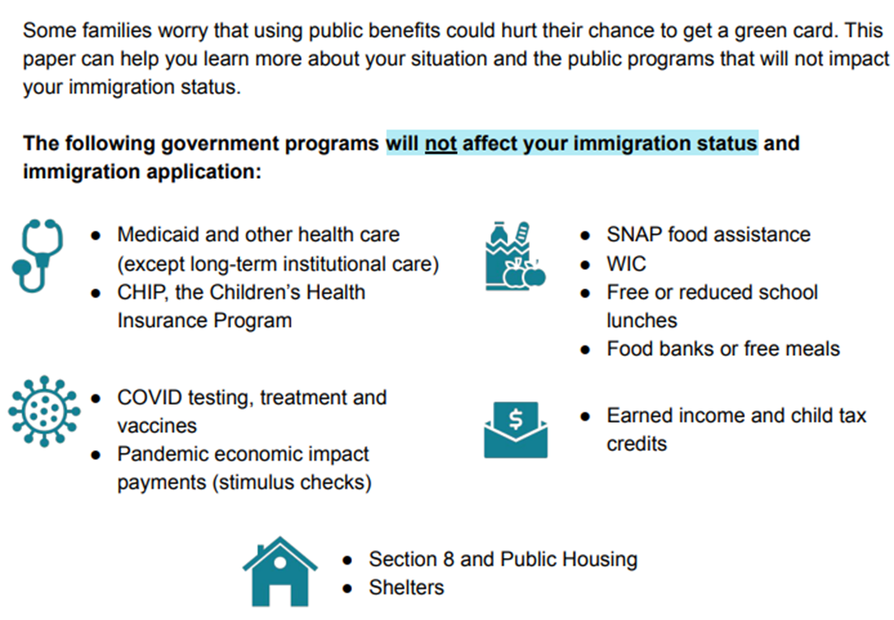
CURRENT RULE
Does not apply to humanitarian immigrants and parolees
Benefits subject to this rule include TANF (cash benefits) and long-term care
Excludes many public benefits, including Medicaid, CHIP, SNAP, WIC, LIHEAP, Unemployment

Slide 15
CURRENT STATE
Prior Public Charge rule is currently in effect
November 2025 – Administration proposed to rescind the existing public charge rule, comment period has ended
Expect a decision in the coming months

Slide 16
EXPECTED CHANGES TO PUBLIC CHARGE
Administration requested not to release a full written list of benefits that would be subject to public charge – “sub regulatory guidance”
Will likely include Medicaid, CHIP, SNAP, etc.
May include family member utilization of benefits not just applicant

Slide 17
FEDERAL PUBLIC BENEFIT
May have included receiving care at FQHC/UIO
States filed an injunction in 2025 and there has been no further action on this

Slide 18
WHAT DO WE DO?
Help provide accurate information and resources to assess risks
Lean on experts
Connect people to additional supports
Think about the information you are collecting, why, and how you are storing it

Slide 19
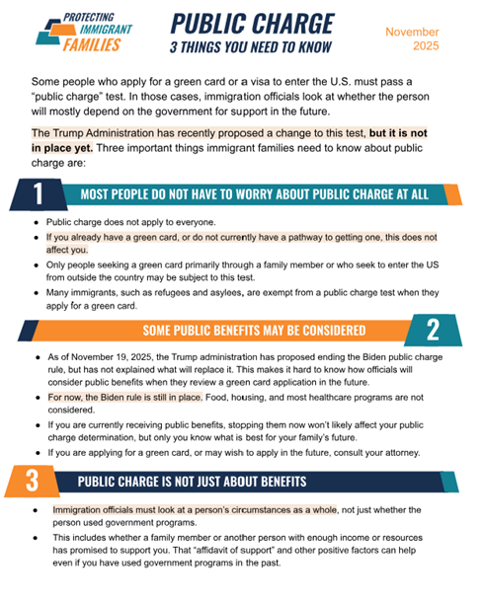
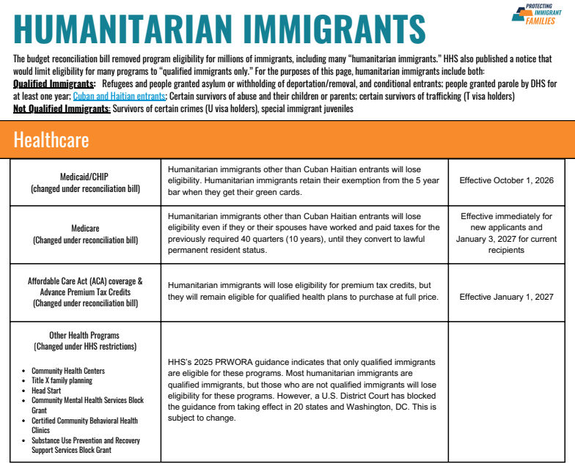
RESOURCES
Laws
USCIS
MCA, Montana Medicaid Policy Manuals
Helper information
NILC
BTB
Information for clients/patients
PIF

Slide 20
Questions?
Tierney Queen-Stewart, Director of Cover Montana
tstrandberg@mtpca.org
406-595-2725

Slide 21
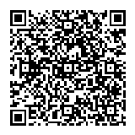
SPECIAL ENROLLMENT PERIOD (SEP) POLL
Notes:
https://s.zoom.us/m/bPFbmX9ZN

