Slide 1

Cover Montana Webinar – July 2025
Olivia Riutta, Director of Population Health
Tierney Queen-Stewart, Director of Cover Montana

Slide 2
Agenda
CDO and CAC Overview
Outreach & Enrollment Updates
Welcome & Announcements
Questions
Notes:
Please put your name, role, and organization into the chat so we can see who is in this virtual room.

Slide 3
Who Are We?
Montana Primary Care Association (MPCA)
& Our Members
14 FQHC’s
5 Urban Indian Organizations
Over 120,000 Montanans served by members
Cover Montana
In-person Navigators
Helpline – 844 682-6837
Website – www.covermt.org
6 across Montana
Collaborate with assisters at clinics throughout the state
Supports members in:
Quality/Data
Workforce
IBH/SUD
Social Needs
Founded in 2014
This work is supported by the Centers for Medicare and Medicaid Services (CMS) of the U.S. Department of Health and Human Services (HHS) as part of a financial assistance award totaling $1.25M with 100 percent funded by CMS/HHS. The contents are those of the author(s) and do not necessarily represent the official views of, nor an endorsement, by CMS/HHS, or the U.S. Government.
Notes:
MPCA is a membership org of FQHC and UIOs
We work to help our members provide accessible, qualify, comprehensive primary care
Since our inception, that work has included work on patient level social need, including enrollment in health insurance and access to care
We started Cover Montana in 2014, began mostly working to train and support enrollment folks at CHC, hospitals, etc, but in 2021 we received a federal Navigator grant from CMS and have our own team of Navigators across the state and a dedicated phone team.
Introduce Rachel –
We have done enrollment work for a long time and we have been tracking Medicaid unwinding and the redetermination process well before Montana started the process, and worked to make sure that our capacity was helping

Slide 4
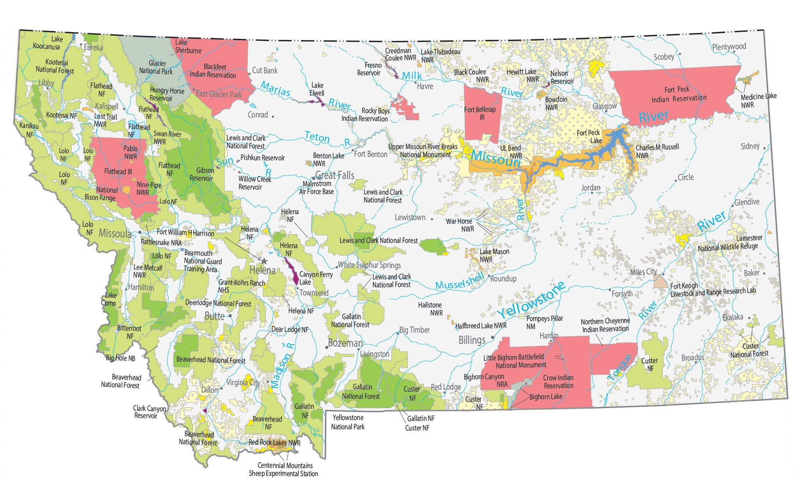
Where are Navigators Located?
Annie Carlson
Kalispell & Northwest
Montana
Rachel Pauli
Missoula & Western Montana
Tiffany Klein
Miles City & Eastern Montana
Julie Burrows
Helena & Central Montana
Armanda Garcia
Billings & Southeast Montana
Kelsey McDonough
Bozeman & Southwest Montana

Slide 5
Outreach and Enrollment Changes
HR1
1115 Waiver
Marketplace Integrity Rule
Enhanced APTC Expiring
Impacts to health coverage eligibility and enrollment
Notes:
Patients and consumers are going to have questions and need support because any one of these changes.

Slide 6
Montana DPHHS 1115 Waiver
July 18: 1115 Waiver available – begin public comment period
July 29: Virtual Tribal consultation
July 31: Hybrid public meeting
August 1: Virtual public meeting
August 18: Public comment period ends
Notes:
Tribal consult: Tribal government, health, UIOs, IHS. Index.

Slide 7
1115 Highlights
Non-exempt 19–64-year-olds up to 138% of FPL (Adult Medicaid), 80 hours per month
  Standard exemptions, short-term, good cause exemptions available
Community Engagement – must show 30 days prior to enrollment or exemption
  Community service and volunteering
  Work, training, internships, etc.
  Education and vocational programs
Cost-sharing requirements – disenrolled after 90 days of failure to pay premium (with exceptions)
  Premiums (2% of aggregate hh income, increasing by 0.5% each year up to 4%)
  Copayments included in HR1

Slide 8
Marketplace Integrity Rule
Final rule released on June 20th
CMS hosted a stakeholder webinar on June 30th, webinar recording and slides available in REGTAP
Includes:
  OEP changes to November 1 – December 15 for PY2027, not PY2026
  Removes 150% of FPL SEP and requires additional documentation and advanced verifications for some other SEPs
  Changes rules on past-due premium payments, failure to reconcile APTC, and de minimus thresholds
  Implements $5 premiums for auto-enrolled consumers paying $0 with APTC for their monthly premium until applications are updated
  Changes allowable EHB services and immigrant/non-USC access to coverage

Slide 9
HR1 (Reconciliation/BBB)
Codifies many of the Marketplace Integrity Rule provisions into law
Medicaid:
  Work requirements
  Delays implementation of CMS rule process simplifications and improvements until 2035
  More frequent redeterminations
  Cost sharing requirements
Marketplace:
  Removes repayment caps for APTC
  Ends silver-loading
  Requires pre-enrollment verification
  Does not extend enhanced APTC

Slide 10
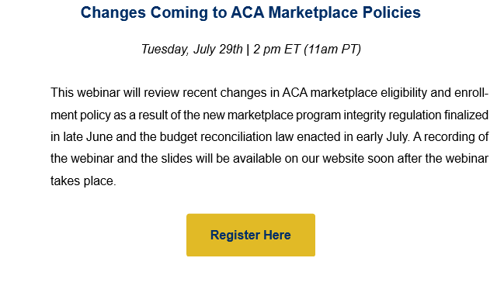
Beyond the Basics Training
Next Tuesday the 29th!
Cover Montana training to follow this fall

Slide 11
Outreach and Enrollment Changes
HR1
1115 Waiver
Marketplace Integrity Rule
Enhanced APTC Expiring
Increased patient and consumer need for enrollment support
Notes:
Any one of these things would be a lot, all of them rolling out at the same time. Patients and consumers are going to have questions and need support because any one of these changes.

Slide 12
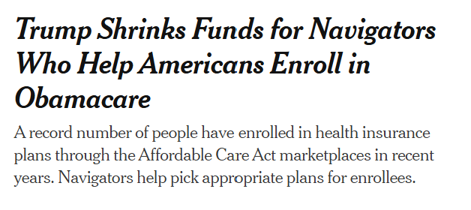
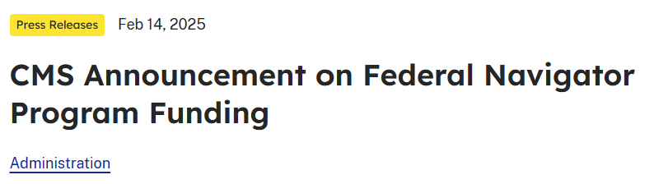
Cover Montana Navigator Program
Notes:
We have known since February that the Trump administration intended to roll back the size of the Navigator grants. Last month, MPCA learned that our grant was being cut by 90% so our capacity to provide enrollment assistance will be drastically reduced starting next month.

Slide 13
Program Changes
Navigators employed through end of August
Starting September 1st, only phone and virtual assistance available through MPCA’s website (appointments) and the help-line (real time enrollment assistance)
Cover Montana no longer has the capacity to help with Montanan Medicaid applications or case troubleshooting (limited capacity for complex case assistance)
Notes:
We have known since February that the Trump administration intended to roll back the size of the Navigator grants. Last month, MPCA learned that our grant was being cut by 90% so our capacity to provide enrollment assistance will be drastically reduced starting next month.

Slide 14
What Cover MT can continue to do:
Marketplace enrollment (but we’ll be limited)
Track changes to outreach and enrollment
Provide monthly Cover Montana webinars and the Cover Montana Virtual Summit
Training and technical assistance to our partners who are screening, referring, and providing enrollment assistance (for Medicaid and the Marketplace)
Limited media capacity to share public information about changes to outreach and enrollment

Slide 15

Questions? Comments?

Slide 16

Thank you
Notes:
I want to thank our team for all of their incredible work over the past four years. Cover Montana has been around for a long time, but this was the first time we had a call center and folks dedicated to doing outreach and enrollment. We said, send your folks to us, and you did, thank you. It has been an honor to do this work, at a time of COVID and Medicaid unwinding and incredible need from consumers who were trying to stay covered. We are deeply saddened that we can’t continue our work, with this incredible team, as we are embarking on yet again another huge shift in access and insurance.

Slide 17
Building Outreach & Enrollment Capacity
Notes:
Given that our capacity in reducing, at a time of increasing need, it is imperative that we look to build our capacity to do this work by training those within organizations, to provide more outreach and enrollment. This is an unfunded project.

Slide 18
Medicaid Assistance Without CDO Status
Apply for multiple programs
Complete renewals or report changes
Receive email notifications, upload documents
Add people to active cases
Using the SSP (apply.mt.gov) and Provider Portal
Notes:
TS MAGI Medicaid trainings, Presumptive eligibility is an important tool for those who work at qualified entities….(can do this without being a CAC)

Slide 19
CDO/CAC Status
Strengths
Weaknesses
Access to FFM application
  Determination state
  Mixed-eligibility households
  Simpler interface
Additional training/TA
Some protections in a clearly defined role
Steep learning curve for Marketplace enrollment
Staff capacity and focus
Isolation within organizations
Continual process and policy changes

Slide 20
Becoming a CDO
Certified Application Counselor Designated Organization (CDO)
Can be health centers, hospitals, public health sites, community-based organizations, tribal entities, and more
CDO application through CMS now open year-round
Submitted by someone with organizational approval for contracts, Organization Senior Official (OSO)
CMS has a great CDO resource page: https://www.cms.gov/marketplace/in-person-assisters/programs-procedures/certified-application-counselor-program

Slide 21
Identifying Potential CAC Staff
Outreach program staff
CHWs
Financial assistance staff
Patient registration
Roles that help clients/patients apply for other benefits (SNAP, sliding scale, etc)
Other ideas?
Notes:
While it hasn't been common in Montana, other states have a robust volunteer CAC structure.

Slide 22
CAC Training & Licensing
CDO/CAC Certification Timeline:
Organizations should sign up to become a CDO before September 2025
The CDO assigns a CAC number that is used to complete the federal training.
Individuals complete the CAC training after the new training is released in September 2025
Once you complete your federal requirement, you apply for a Montana license for a nominal fee through the Commissioner of Securities and Insurance.
Notes:
AD Banker is no longer required for CACs.

Slide 23
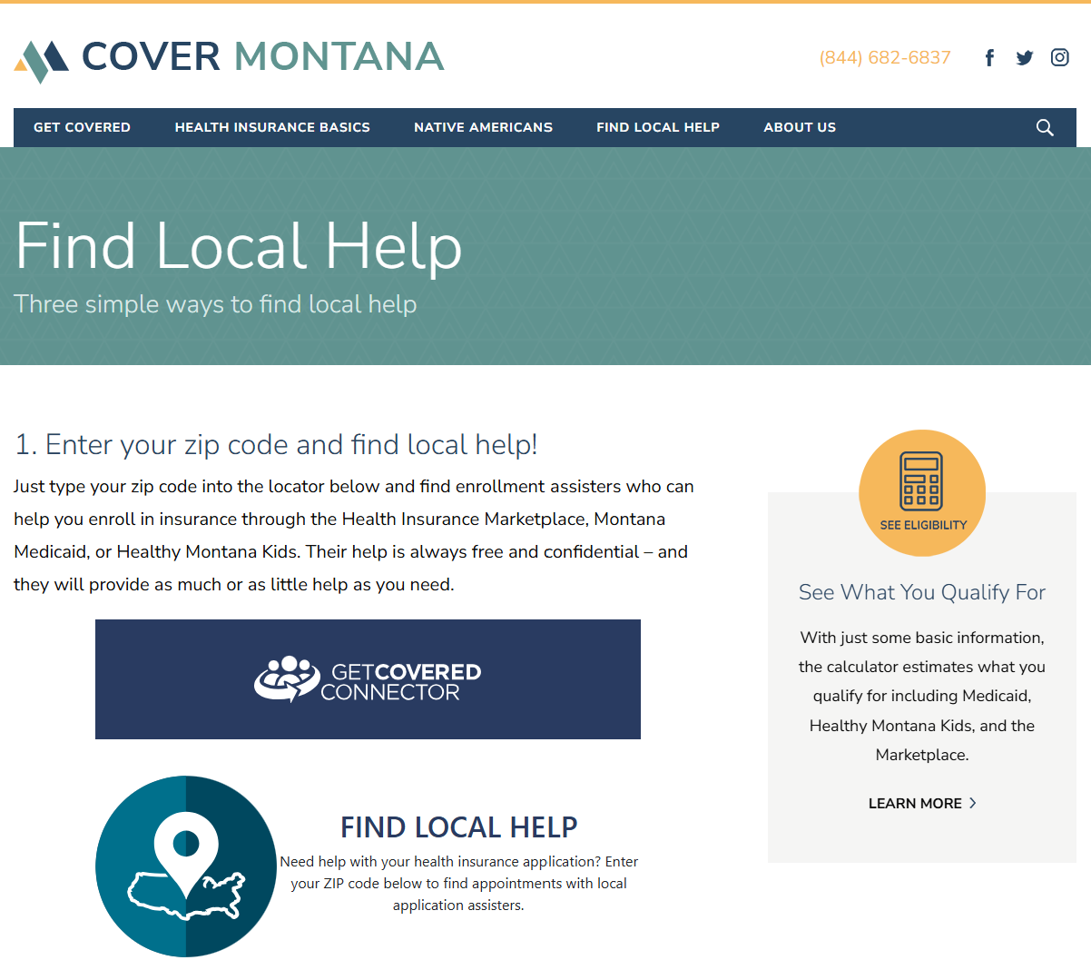
Can you help your community enroll?
Make sure your info is correct on Find Local Help!

Slide 24
Assister Training Reminders
2026 Assister certification training (MLMS) “go dark” on August 14th
Training available through CMS, national TA partners, and Cover MT
All Assisters will take new user MLMS training once it is available for PY2026
Notes:
Back to Tierney

Slide 25
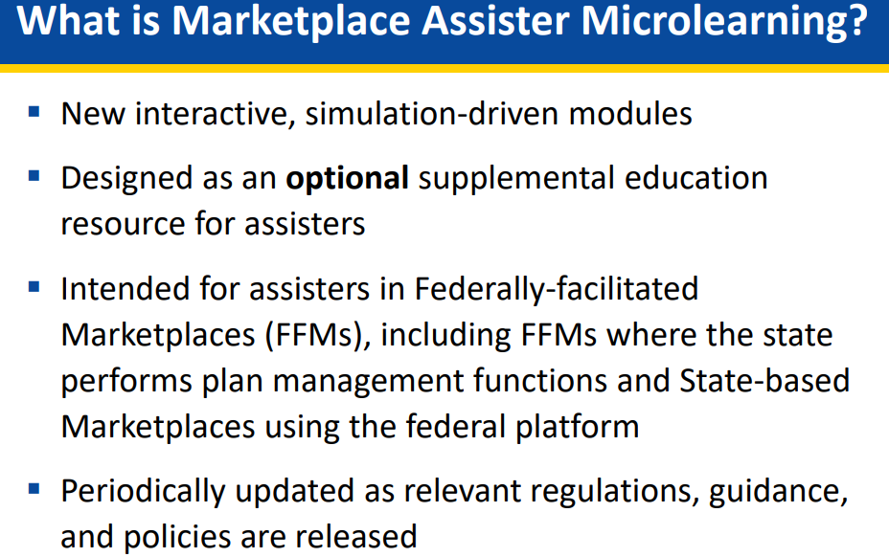
CMS Assister Microlearning Modules
Account creation
Life changes
Income
Other application questions
Application walkthrough
Post-enrollment assistance

Slide 26

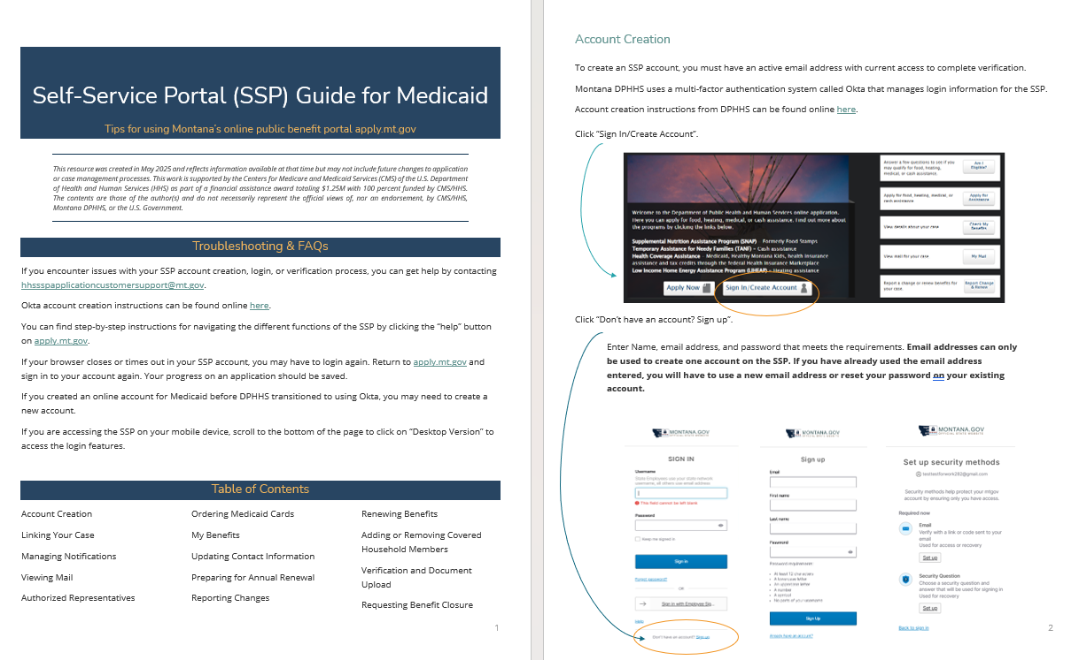
Updated Cover Montana guides
Available soon in the MPCA Resource Library
Medicaid tips for pregnancy and adding children
New SSP Guide for Medicaid
Self-employment Income Guide
Prescription Benefit programs

Slide 27

Upcoming Trainings and Webinars
Registration available soon on the MPCA website!

Slide 28
QUESTIONS?

