Slide 1

MONTHLY WEBINAR
July 2026
Tierney Queen-Stewart
Director of Cover Montana

Slide 2

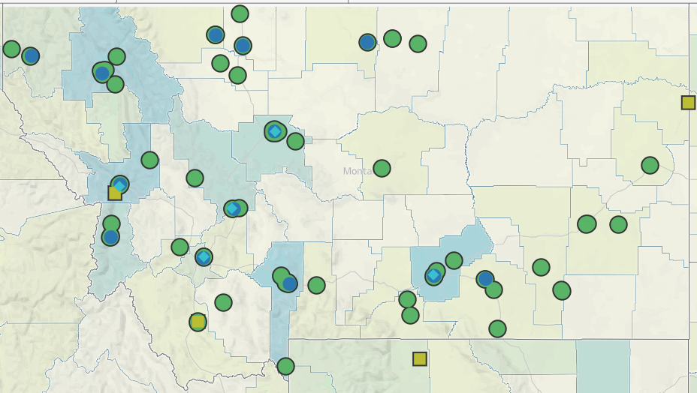
Our Mission
is to promote integrated primary healthcare to achieve health and well-being for Montanans.
Notes:
MPCA is a membership organization (13 CHCs, 5 UIO’s) serving about 125,000 Montanans. MPCA works to support our member health centers in providing comprehensive primary care services including medical, dental, behavioral, and what we in the health center world call “enabling services.” Since the very first health centers in rural Mississippi and central Boston, the health center model is built upon the idea that people lives (where they live, where they work, if they have access to food, if they make a living wage) impact health and health outcomes. CHCs receive grants from HRSA the Health Resources and Service Admin, there are some specific requirements of the 330 grants which are in contradiction with a lot of the EOs we are seeing.

Slide 3
Agenda – More Medicaid!
Assister Training Go Dark Reminder
New Outreach and Informational Materials
Presumptive Eligibility
Questions
CE Listening Sessions
Medically Frail Updates
DPHHS Medicaid Updates
Application Changes
Community Assister Portal
Income Verification
Notes:
Introduce yourself in the chat, if questions come up throughout the presentation, put them in the chat, we will stop and answer what we can before we go into breakout rooms.

Slide 4
FFM Training “Go Dark”
Marketplace Assister training for PY2026 will be removed on August 12
Changes for PY2027 will be made and available before the training deadline

Slide 5
Medicaid Updates

Slide 6
Presumptive Eligibility
Community Engagement PE Process — Medicaid Expansion group
DPHHS hosted stakeholder webinar June 30th, posted in “Webinars” section of changes website
1
Screen Financial Eligibility
Confirm the Medicaid Expansion group: ages 19–64 and income up to 138% FPL.
2
Assess Community Engagement
Applicant attests to an exclusion, or to 80 hours of qualifying activities the prior month.
3
Process PE Determination
If compliant and all other criteria are met, approve presumptive eligibility.
4
Submit Full Application
Remind the member to file a complete Medicaid application within 30 days.
Intersects with short-term hardship exemptions:
Inpatient stay or institutionalized
Traveling outside community for medical care
CE exclusions and compliance do not require documentation at time of PE determination – self-declaration is accepted

Slide 7
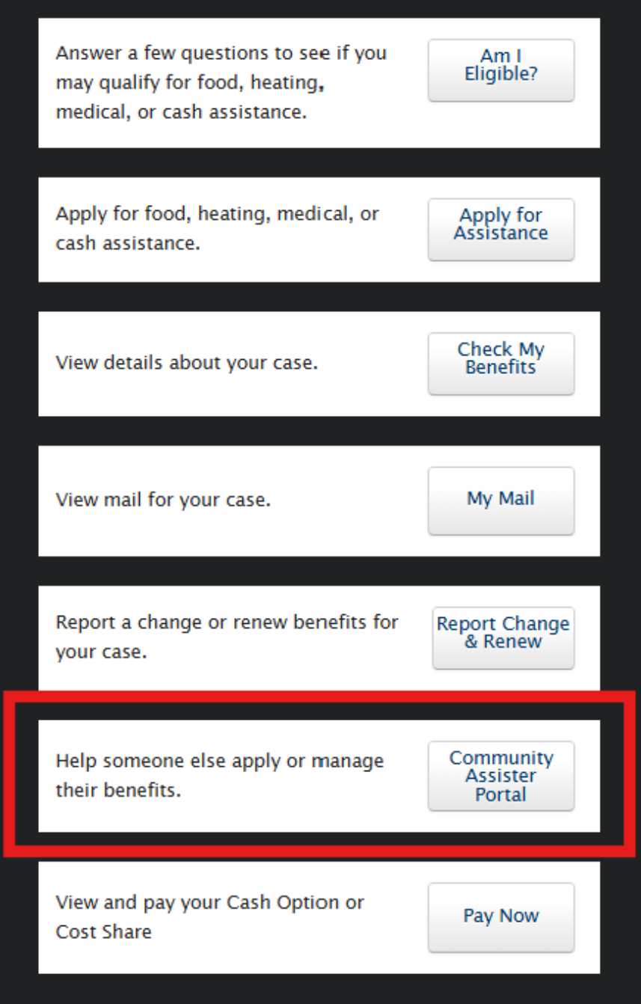
Community Assister Portal Updates
Resolved unlinking SSP accounts when accessing Assister Portal
Codes are included only on “about your case” notice currently on:
  Applications
  Renewals
Working on other code generation process
New applications do not require codes – does not save in the Assister Portal after submission
Code can be used multiple times by different Assisters if not expired (2 notices)
Are people using the Assister Portal? How is it going?

Slide 8
Income Verification for CE
Work and CE compliance is verified first through income - greater than or equal to $580/month meets CE requirements
Income less than $580 for the month - income reported should be divided by $7.25 to calculate hours toward the 80-hour requirement through a combination of activities
Ex. Person has $400 in monthly countable income/7.25 = 55 hours, would show 25 hours of other qualifying CE activities to meet requirements in Appendix A form
If the monthly income threshold is met, it may be applied to the entire household. For income less than $580, income must be attributed per adult in the filing unit, then divided by 7.25 to calculate hours toward the 80-hour requirement.

Slide 9
Self-Employment and CE
Self-employed people need to provide verification of income to meet CE requirements. This is income received for the month or months under review (12 month period)
If reported average income $580+ over 12 months – in compliance with CE
Income less than $580 for the month, the income reported should be divided by $7.25 to calculate hours toward the 80-hour requirement
Written statement regarding the number of hours per week/month they are actively working on their business is required
Self-employed but no income requires signed documentation of the number of hours per week/month they are actively working on their business

Slide 10
Medicaid Application Changes - SSP
Some CE exclusion and activity information gathered in existing application, including:
Tribal member
Income
Eligible for different Medicaid program
Caregiver of child in household 13 and under
Pregnant
Medicare-eligible

Slide 11
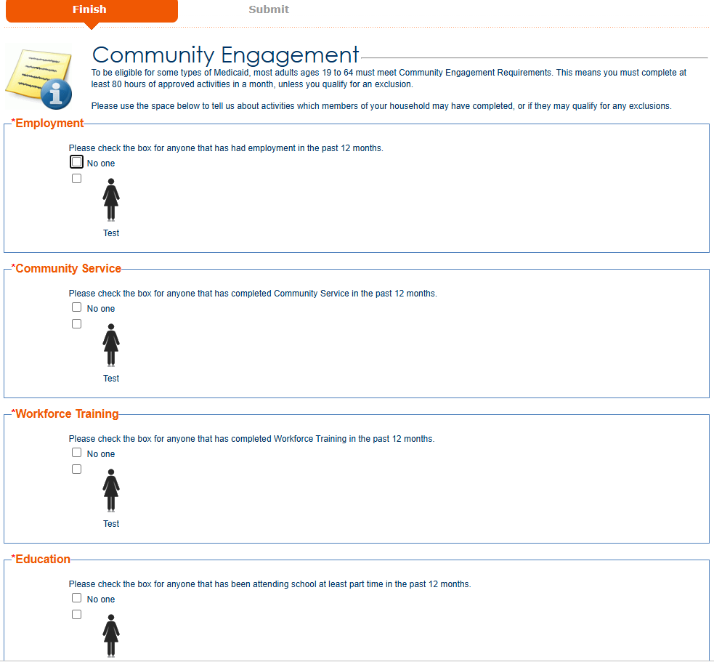
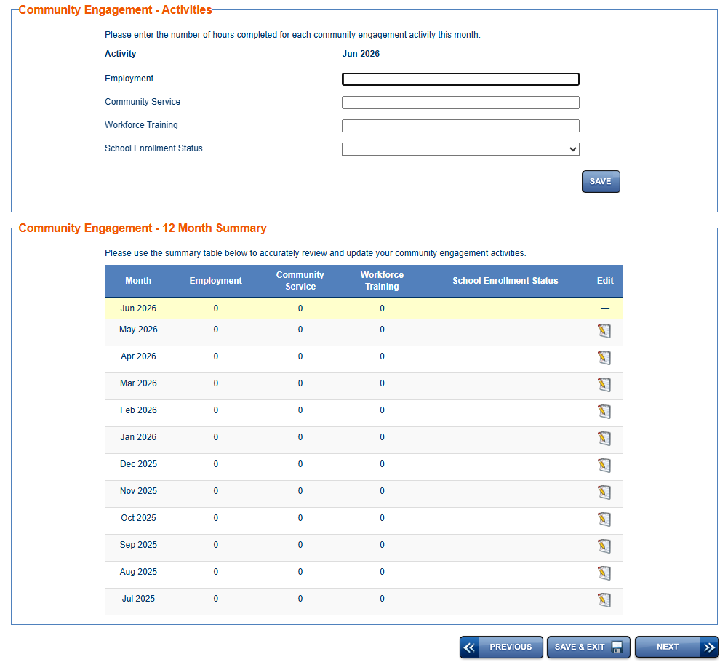
New CE Questions and Monthly Log
If no one is selected on first screen, you will not be able to edit the monthly log

Slide 12
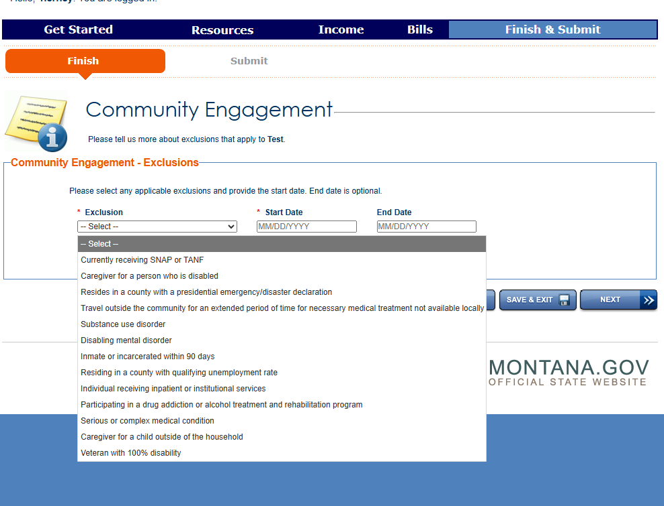
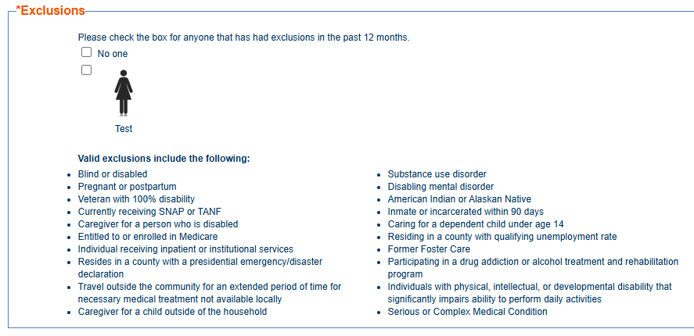
CE Exclusions
Does not require proof at application submission – see Verification Matrix for documents that might be requested
Notes:
“Only need to verify one exclusion” – DPHHS works through hierarchy themselves. Clients/patients should report all that apply but should not have to verify all exclusions. Forms available online and mailed to clients, has anyone seen forms digitally integrated? Fillable PDFs?

Slide 13
Medically Frail
“Individual whose physical, mental, or other behavioral health condition significantly impairs the individual’s ability to comply with the community engagement requirement”
+ Unable to do CE
Substance use disorder
Disabling mental disorder
Physical, intellectual, or developmental disability
Serious or complex medical condition
Blind

Slide 14
Medically Frail Updates
Self-declaration will be accepted at application and renewal – provider documentation accepted by not required
List of conditions released – FAQ, “Who is Excluded”
Coming this fall:
DPHHS developing interface to integrate claims data
Process to request Medical Frailty exclusion for a condition not on the list
No signature, provider license information, or work readiness assessment required on self-declaration forms
Notes:
On July 1

Slide 15
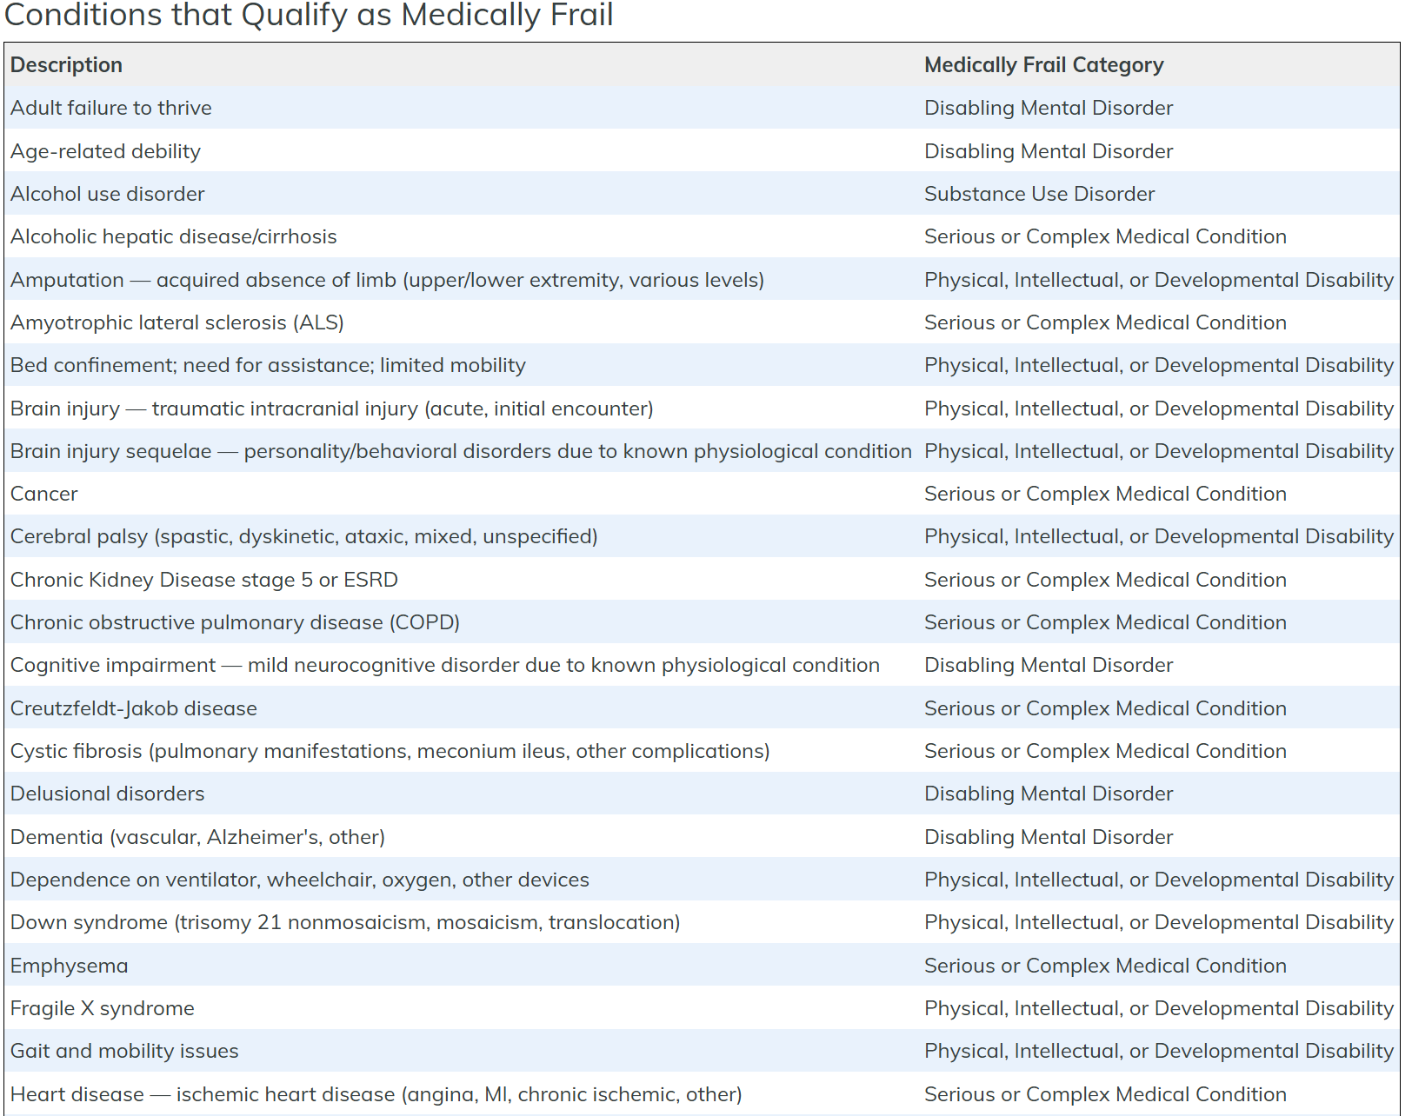
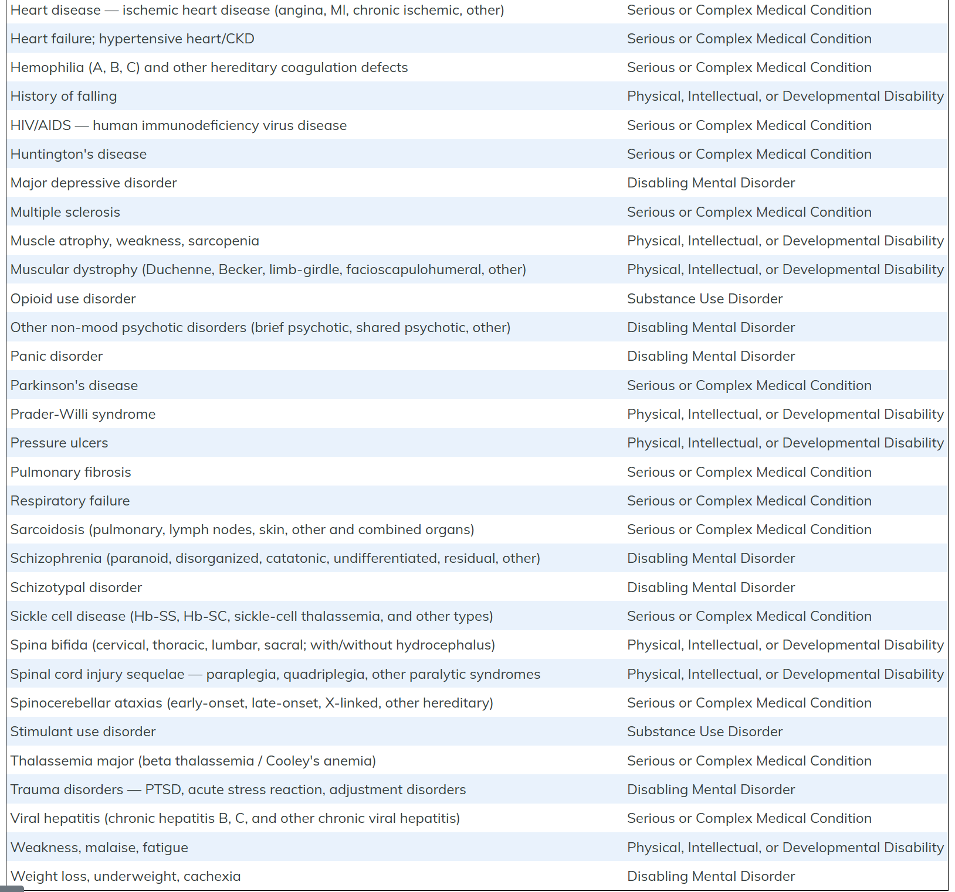
Medically Frail Conditions

Slide 16
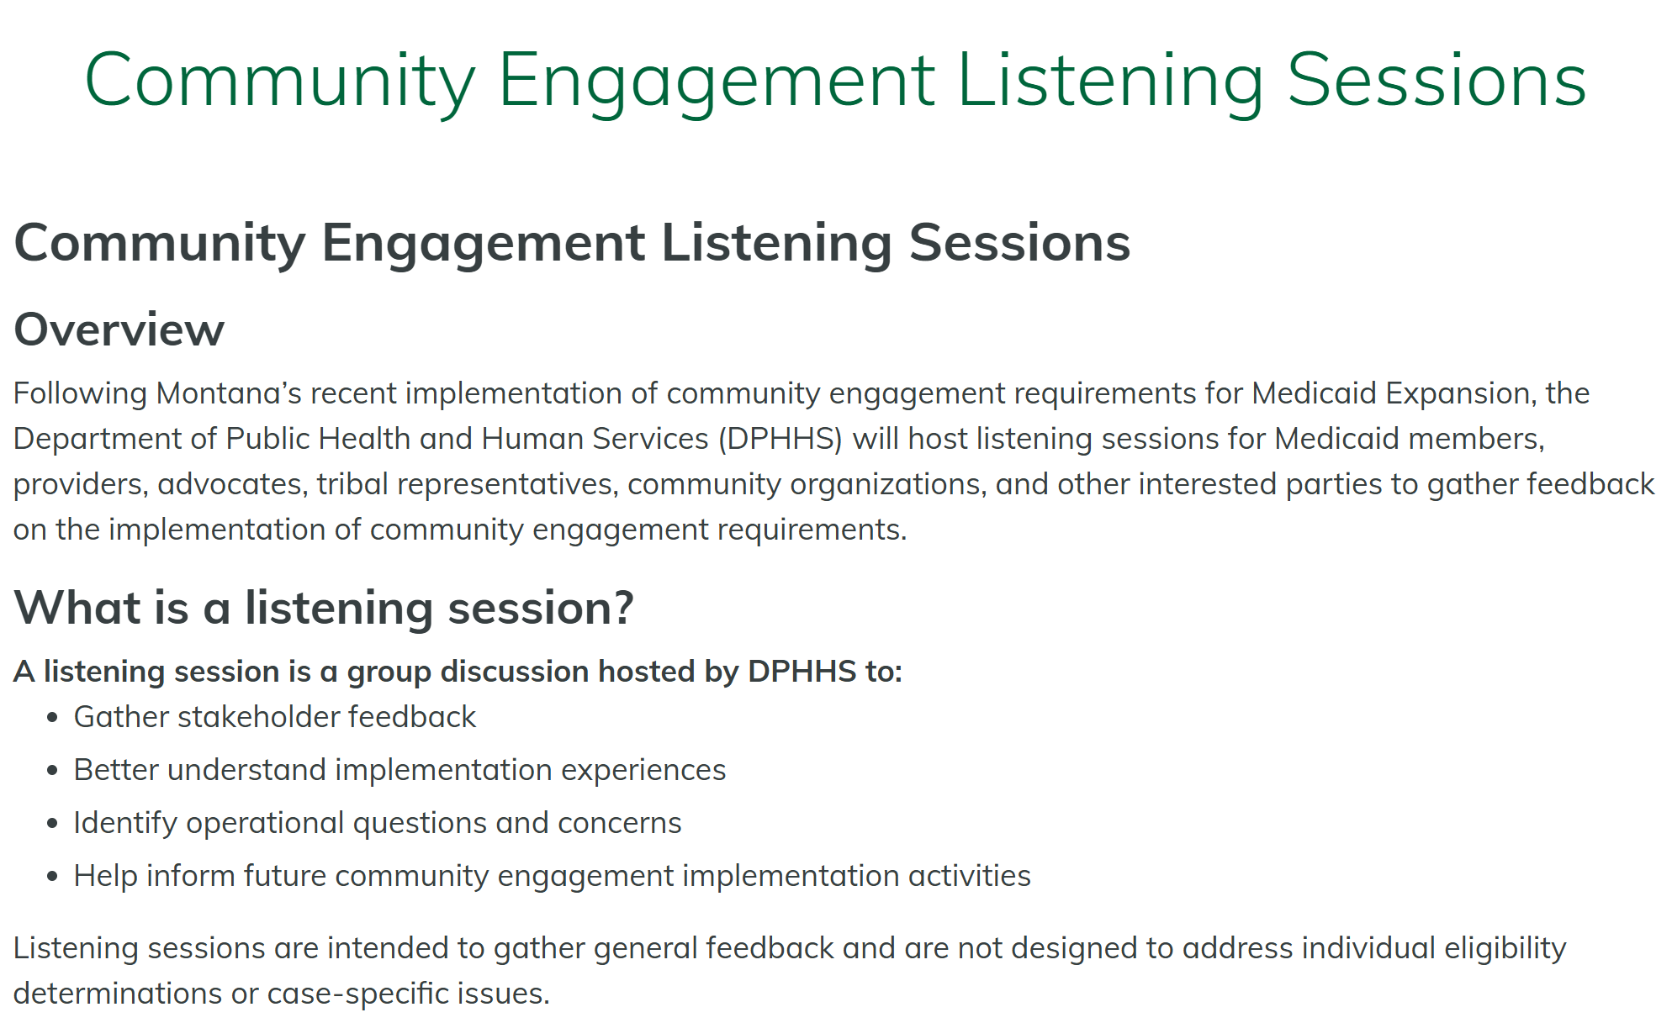
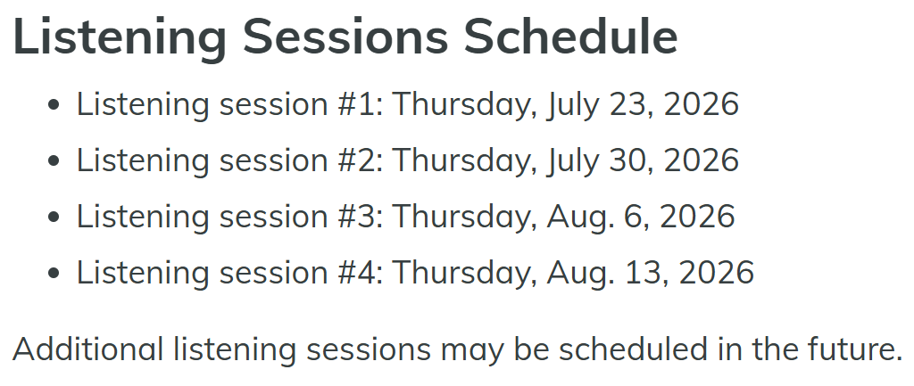
DPHHS CE Listening Sessions
Notes:
Community Engagement Listening Sessions
MT DPHHS CE Stakeholder Listening Sessions: Feedback Form

Slide 17
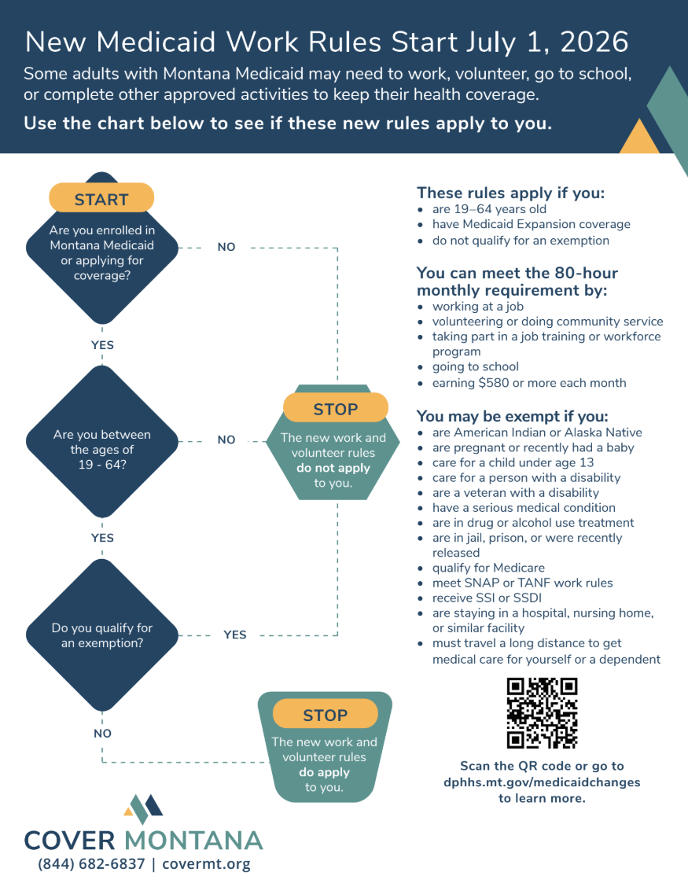
Cover Montana Resources
Interactive flowchart
Informational flyer/poster
Small informational card
Postcard
AI/AN Exclusion Resource

Slide 18
Finalizing Messaging Toolkit
Patient and public messaging toolkit
Key dates
Short message templates – text, EHR message, email
Social media templates
CAC talking points
Resources
Explanation of changes

Slide 19
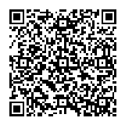

Questions?
Tierney Queen-Stewart,
Director of Cover Montana
Montana Primary Care Association
tstrandberg@mtpca.org
406-595-2725

