Slide 1

MONTHLY WEBINAR
June 2026
Tierney Queen-Stewart
Director of Cover Montana

Slide 2

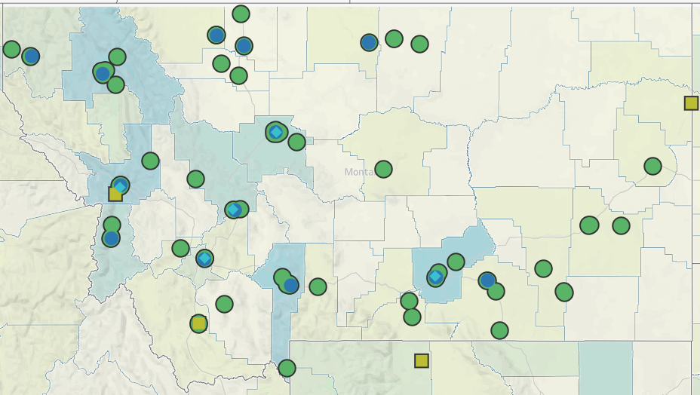
Our Mission
is to promote integrated primary healthcare to achieve health and well-being for Montanans.
Notes:
MPCA is a membership organization (13 CHCs, 5 UIO’s) serving about 125,000 Montanans. MPCA works to support our member health centers in providing comprehensive primary care services including medical, dental, behavioral, and what we in the health center world call “enabling services.” Since the very first health centers in rural Mississippi and central Boston, the health center model is built upon the idea that people lives (where they live, where they work, if they have access to food, if they make a living wage) impact health and health outcomes. CHCs receive grants from HRSA the Health Resources and Service Admin, there are some specific requirements of the 330 grants which are in contradiction with a lot of the EOs we are seeing.

Slide 3
Agenda – Medicaid!
CMS and DPHHS Updates
Community Assister Portal
CE Activities – Forms & Documentation
Questions
Exclusions – Forms & Documentation
Notes:
Introduce yourself in the chat, if questions come up throughout the presentation, put them in the chat, we will stop and answer what we can before we go into breakout rooms.

Slide 4
CMS Interim Final Rule
Released June 1
Guidance for state Medicaid agencies to implement required changes from HR1
Defined
CE activities with examples
Exclusions
Verification requirements

Slide 5
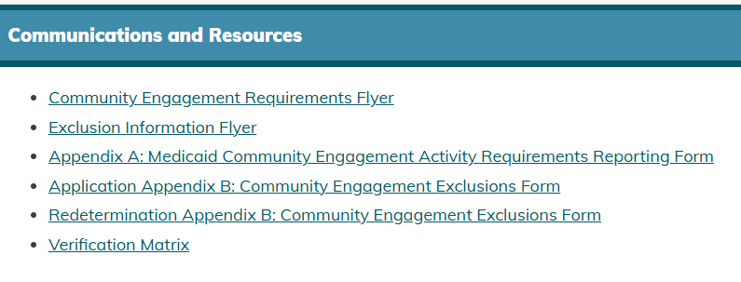
Montana DPHHS Updates
Verification Matrix
Final forms
  CE Activity logs
  Exclusion form packet
Community Assister Portal

Slide 6
CE Activities
Work
Paid work
Education
Volunteering
Organization with certifying person
Vocation, Job Training
Self-employment
Gig work
Seasonal work
$580+ per month in MAGI income – earned and unearned
Halftime enrollment or more = compliant
Halftime or less = counts credit hours
Log hours performed
Non-partisan
Must benefit community, not individual
Workforce readiness
Job-seeking countable if formal and less than half of reported hours
HelpLink referrals
Unpaid or in-kind
Enrollment status includes regular breaks and vacations

Slide 7
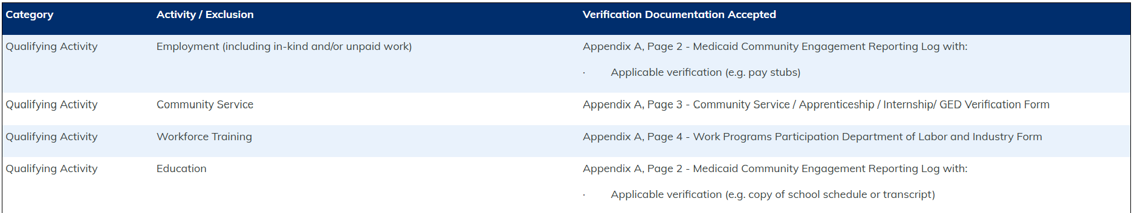
CE Activity Documentation
HCS494 - Medicaid Community Engagement Activity Requirements Reporting Form (Appendix A)
Employers, organizations with volunteers, educational institutions, workforce training programs – how is this currently documented? Can people easily access that information?

Slide 8
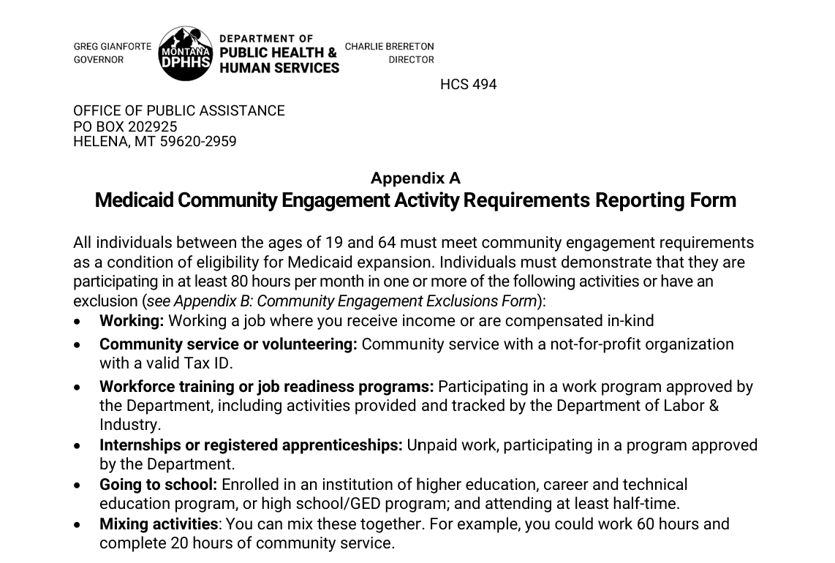
CE Forms

Slide 9
Exemptions, Exclusions, Exceptions, oh my!
Specified Excluded Individual
American Indians and Alaska Natives*
Mandatory Exception
Under 19
Short-term Hardship Exception
Aged out of foster care
Currently incarcerated
Medically Frail
Meeting TANF or SNAP work requirements
Parent or caretaker of a child 13 and younger or a disabled person
Participating in SUD treatment
Pregnant or postpartum (12 months)
Disabled veteran
Medicare-eligible
Enrolled in or eligible for other Medicaid program groups
Incarcerated within last three months
Receiving inpatient or institutional services
Individual or dependent traveling outside community for necessary medical services
Lives in a county with high unemployment or disaster declaration**
Not subject to CE
Subject to CE but given exception
Subject to CE but given exception

Slide 10
Medicaid Eligibility Process + CE
Medicaid Application or Renewal
No – Specified Excluded Individual
Yes
Current eligibility determination
Does CE Apply?
Deemed in compliance
$580+ of income
Halftime school
Demonstrates CE – 80 hours
Does not meet – denied or disenrolled
Exclusion
Mandatory Exception
Short-term Hardship Exception

Slide 11
Medically Frail
“Individual whose physical, mental, or other behavioral health condition significantly impairs the individual’s ability to comply with the community engagement requirement”
+ Unable to do CE
Substance use disorder
Disabling mental disorder
Physical, intellectual, or developmental disability
Serious or complex medical condition
Blind

Slide 12
States Will
Determine conditions that are considered serious and complex
Create lists of diseases, diagnoses, disorders, or other health conditions to help define these categories – ICD-10 codes
Use claims and encounters data
Limits use of self-attestation for medical frailty beginning in 2028

Slide 13
Verification Matrix and Exclusion Forms
HCS495 – Community Engagement Exclusions (Appendix B)
  Summary form
  Self-declaration form
  Medical frailty
  Caregiver declaration
Existing data
DPHHS form
DPHHS form + documentation

Slide 14
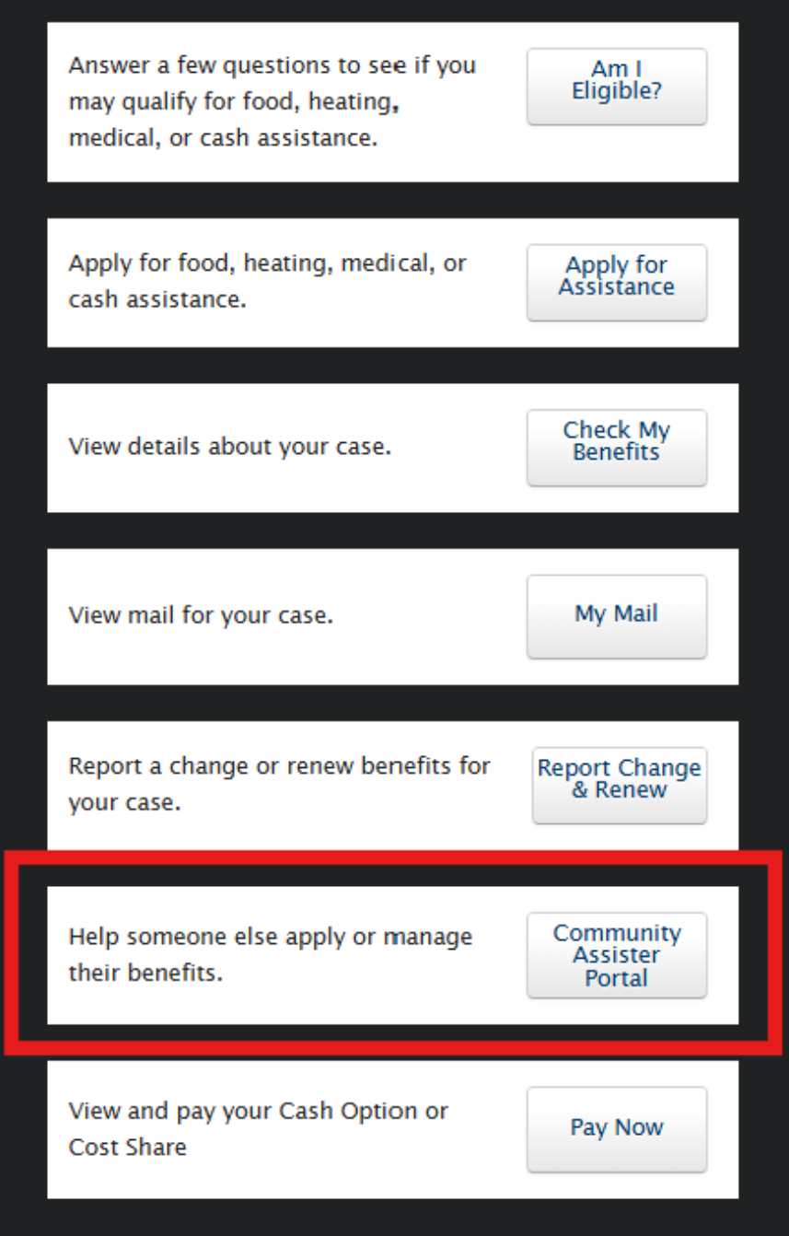
Community Assister Portal
Added to the public-facing self-service portal (SSP) not the provider or claims portal that healthcare facilities use to check if a patient is active or inactive
Requires the Assister to have their own SSP account
If you have currently linked cases in your SSP account and you access the Community Assister Portal, those cases will no longer be linked!

Slide 15
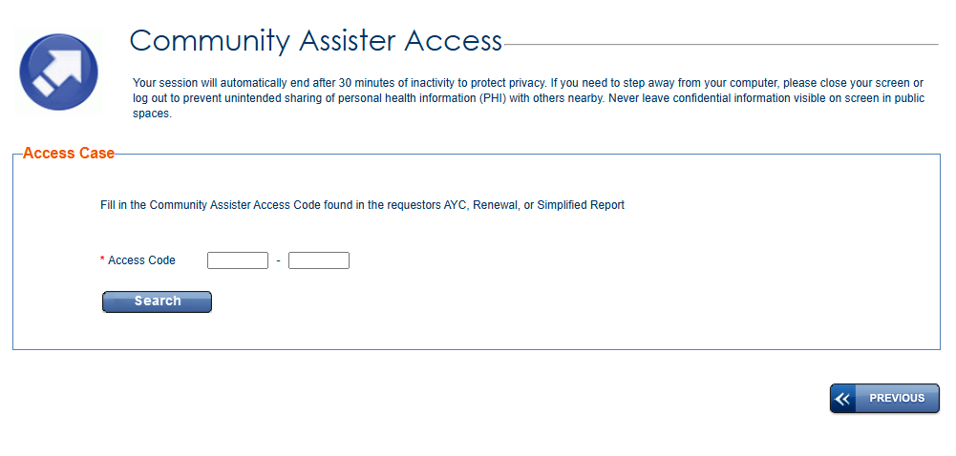
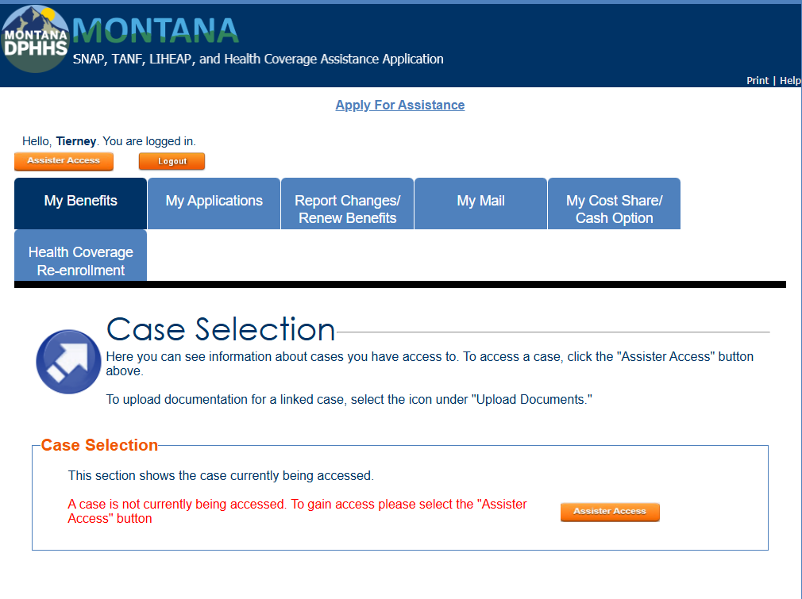
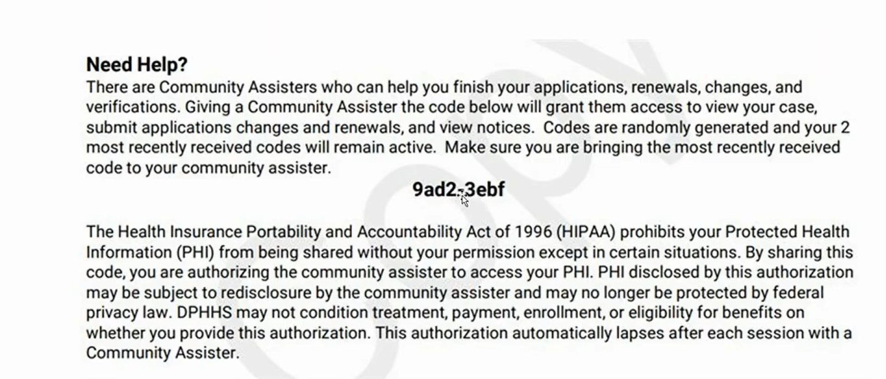
Access Codes

Slide 16
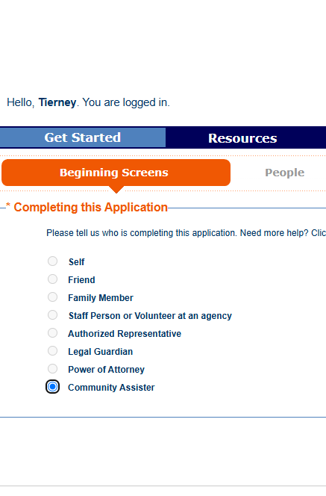
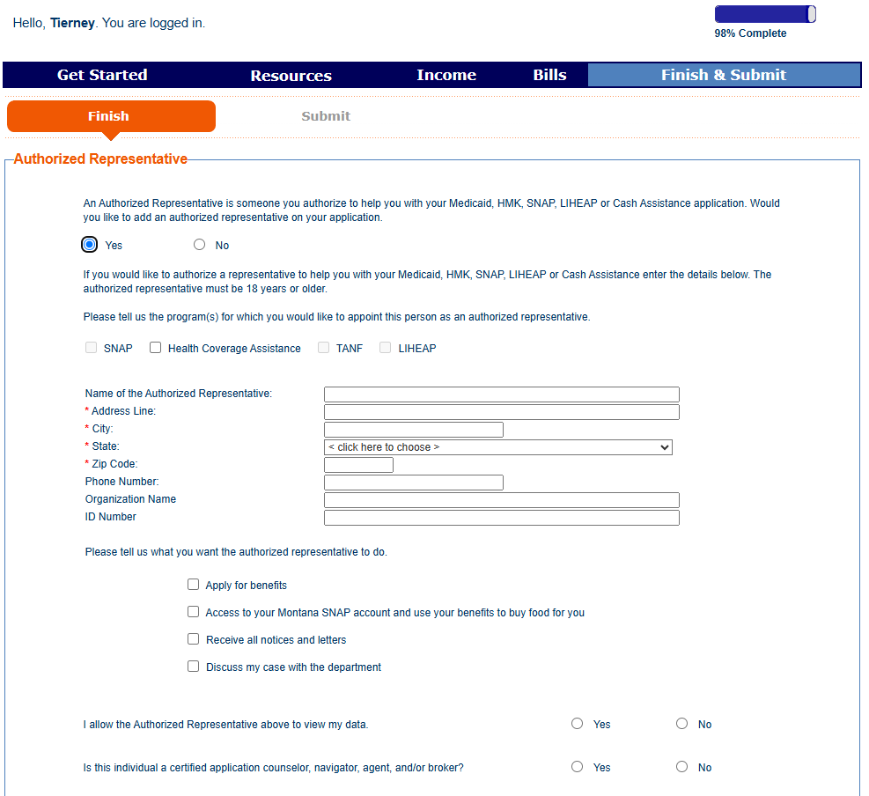
New Applications

Slide 17
Ongoing Questions
If a patient has not received an “about your case” notice, renewal form, or simplified report, is there any way to get a code to link their case?
01
Codes will be the same for two concurrent notices and then change – can they be used more than once by different Assisters?
02
When did they add access codes to notices?
03
Will this “Need Help” section be included on notices for all Medicaid programs moving forward?
04

Slide 18

Cover Montana Resources – to come!
Patient and public messaging toolkit
Key dates
Short message templates – text, EHR message, email
Social media templates
CAC talking points
Resources
Interactive flowchart
Informational flyer/poster
Small informational card
Explanation of changes
+ Updated Cover Montana website

Slide 19
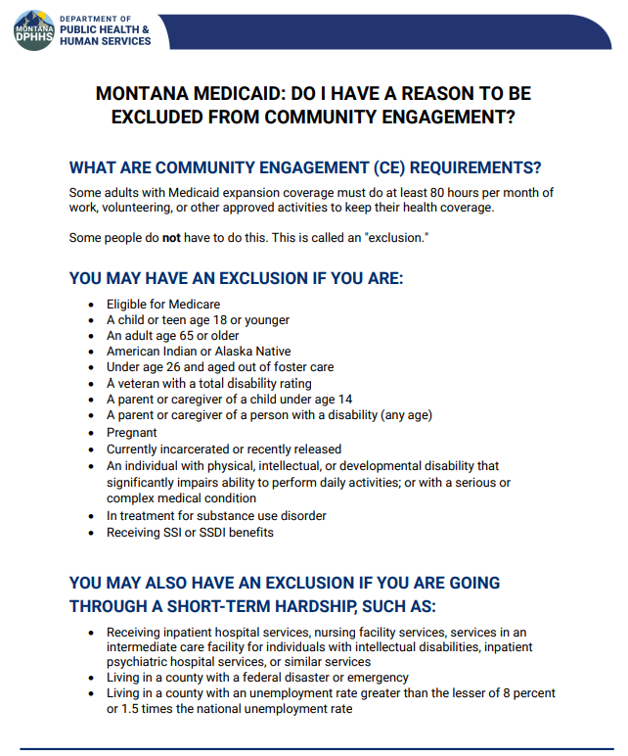
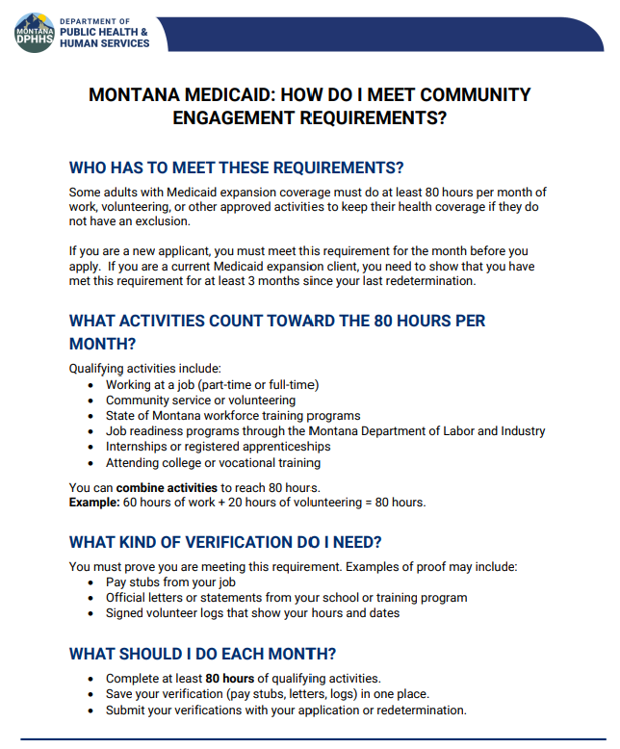
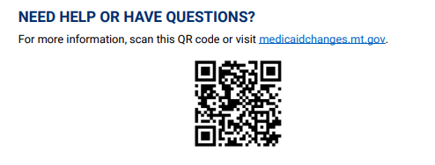
DPHHS Informational Flyers
Notes:
Changes to Medicaid
FAQs
Combined Medicaid Assistance (CMA) Policy Manual

Slide 20

Coming Up
Email newsletter first week of July
Webinar – July 16 @ 11:00 AM
Application updates
  Paper applications
  SSP
  Healthcare.gov

Slide 21
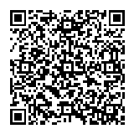

Questions?
Tierney Queen-Stewart,
Director of Cover Montana
Montana Primary Care Association
tstrandberg@mtpca.org
406-595-2725

