Slide 1

MONTHLY WEBINAR
May 2026
Tierney Queen-Stewart
Director of Cover Montana

Slide 2
Agenda
Welcome and MPCA News
Marketplace Changes – PacificSource, NBPP
Medicaid Updates – Stakeholder Webinars, SPA, Informational Flyers
Questions
Notes:
Introduce yourself in the chat, if questions come up throughout the presentation, put them in the chat, we will stop and answer what we can before we go into breakout rooms.

Slide 3

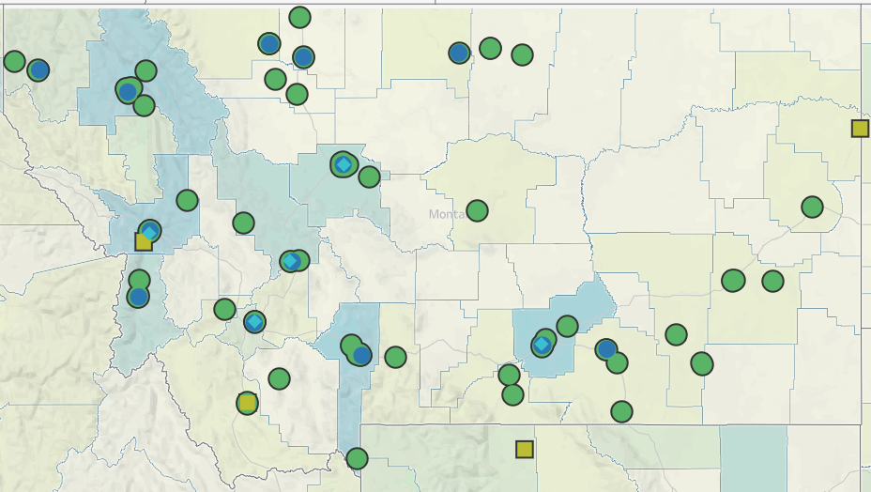
Our Mission
is to promote integrated primary healthcare to achieve health and well-being for Montanans.
Notes:
MPCA is a membership organization (13 CHCs, 5 UIO’s) serving about 125,000 Montanans. MPCA works to support our member health centers in providing comprehensive primary care services including medical, dental, behavioral, and what we in the health center world call “enabling services.” Since the very first health centers in rural Mississippi and central Boston, the health center model is built upon the idea that people lives (where they live, where they work, if they have access to food, if they make a living wage) impact health and health outcomes. CHCs receive grants from HRSA the Health Resources and Service Admin, there are some specific requirements of the 330 grants which are in contradiction with a lot of the EOs we are seeing.

Slide 4

MPCA News
Olivia Riutta will become next MPCA CEO on June 1st!
Congratulations and gratitude to Cindy Stergar who is retiring tomorrow after a long career serving Montana’s health centers!
MPCA submitted NCC for the 2026-2027 Navigator grant year this month – no major program changes

Slide 5

Marketplace Changes

Slide 6
PacificSource Leaving Montana Marketplace
What’s happening
What to tell enrollees
Current coverage stays in effect through December 31, 2026
PacificSource will contact impacted members before changes take effect
Members will need to shop for new plans during OE2027
Assister action steps
Clients can use “see plans and prices” to compare current other plan offerings and networks
Check provider networks – members may need to switch doctors
PacificSource customer service: 888-977-9299
PacificSource will end offering plans by end of 2026
Montana goes from 3 marketplace carriers to 2
Approx. 42,000 members affected, 11,000 individual members

Slide 7
Impacts
Less competition and fewer choices for consumers
01
PacificSource requested lowest rate increases for PY2026
02
15% of individual market enrollees directly impacted
03

Slide 8
CMS 2027 Notice of Benefit and Payment Parameter (NBPP)
Catastrophic plan changes
More verification requirements and fewer SEPs
Less plan regulation

Slide 9
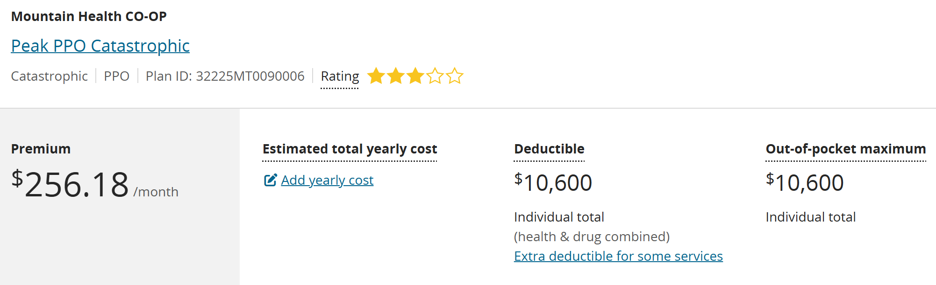
Catastrophic Plans
30%
Higher OOPM
Out-of-pocket maximum can be 30% above the 2026 annual limit
Expanded Hardship Exemption
Now available to adults 30+
For those not eligible for APTC/CSR (below 100% or above 400% FPL)
10
Year Terms
Catastrophic plans can now span up to 10 consecutive years
Notes:
Carriers have to create these options and choose to offer them! 3200 Montanans chose catastrophic plans last year, much higher than .36% of all enrollees nationwide – may see an increase here

Slide 10
Verifications and SEPs
3 of 4
FFM SEP applications
will require manual verification
Low-Income SEP Eliminated
No longer available for enrollees at or below 150% FPL
Data Matching Issues (DMI)
• Households estimating income as PTC eligible but data shows below 100% FPL
• Households where IRS has no tax data
Fail-to-Reconcile
Enrollees who did not reconcile the previous tax year are ineligible for premium tax credits

Slide 11
Plan Requirement Changes
Eliminates standardized (easy pricing) plans
Bronze OOPM increased to $15,600 for individual and $31,200 for family
Non-network plans can be sold on the FFM
Notes:
65% of Montanans chose Bronze plans last year, more than 20% above the national average

Slide 12
Marketplace Enrollment Decline
OE SIGNUPS
24.3M → 23.1M
5% decline in plan selections
DROPPED AFTER OE
21%
Up from 12% in 2025
AVG PREMIUM INCREASE
58%
$113 → $178/month
Effectuated enrollment could fall to ~17.5 million (down from 22.3M in 2025) – a potential 21% decline
Montana
73,255
Plan selections for 2026
▼ 5% from 77,221 in 2025
3 → 2
Marketplace carriers for 2027
PacificSource exiting
Further attrition expected
as enrollees face higher premiums without enhanced tax credits
Sources: CMS 2026 OE Report, KFF, Montana CSI

Slide 13
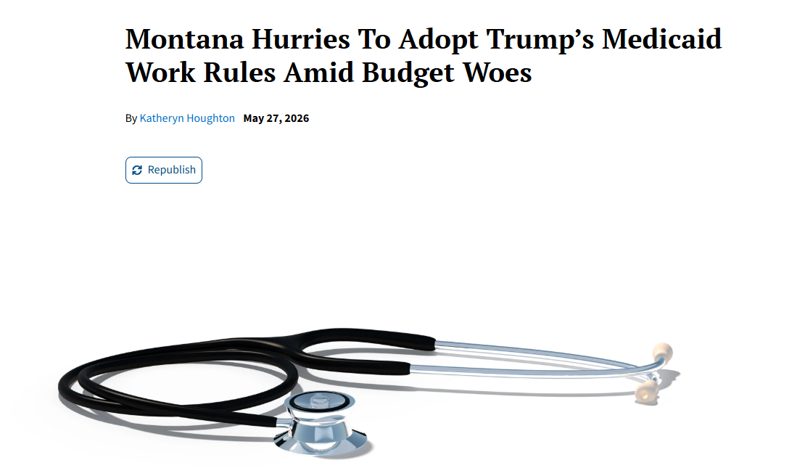
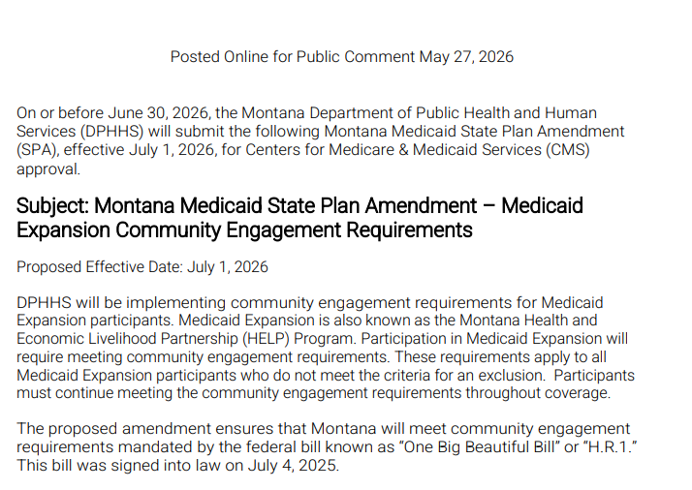
Medicaid Updates
State Plan Amendment posted yesterday!
Public comments due June 27th
Notes:
Montana Hurries To Adopt Trump’s Medicaid Work Rules Amid Budget Woes - KFF Health News

Slide 14
Webinar Highlights & New Information
Community Engagement
Volunteering activities and hours will be certified by a staff member – must provide TIN
Self-employment and gig work still being defined
Exclusions
DPHHS working to integrate claims data from members to use diagnostic codes for exclusions
Notes:
Changes to Medicaid

Slide 15
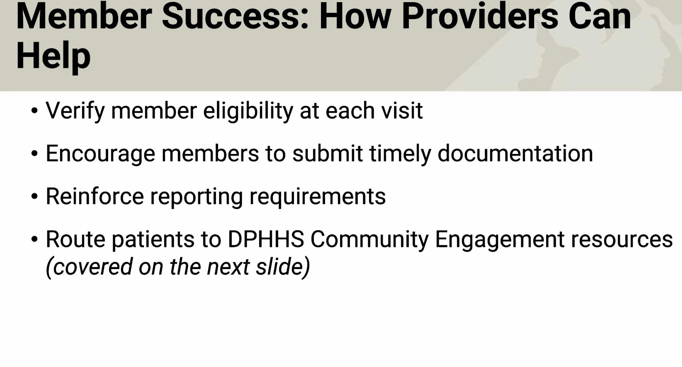
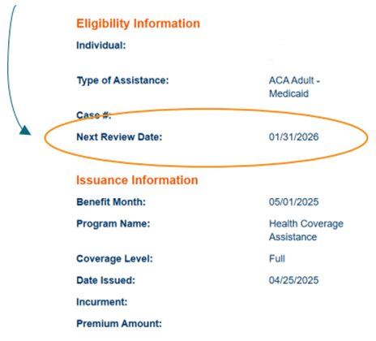
Medicaid Provider Updates
No change to information visible in provider portal
Medicaid program
Renewal dates

Slide 16
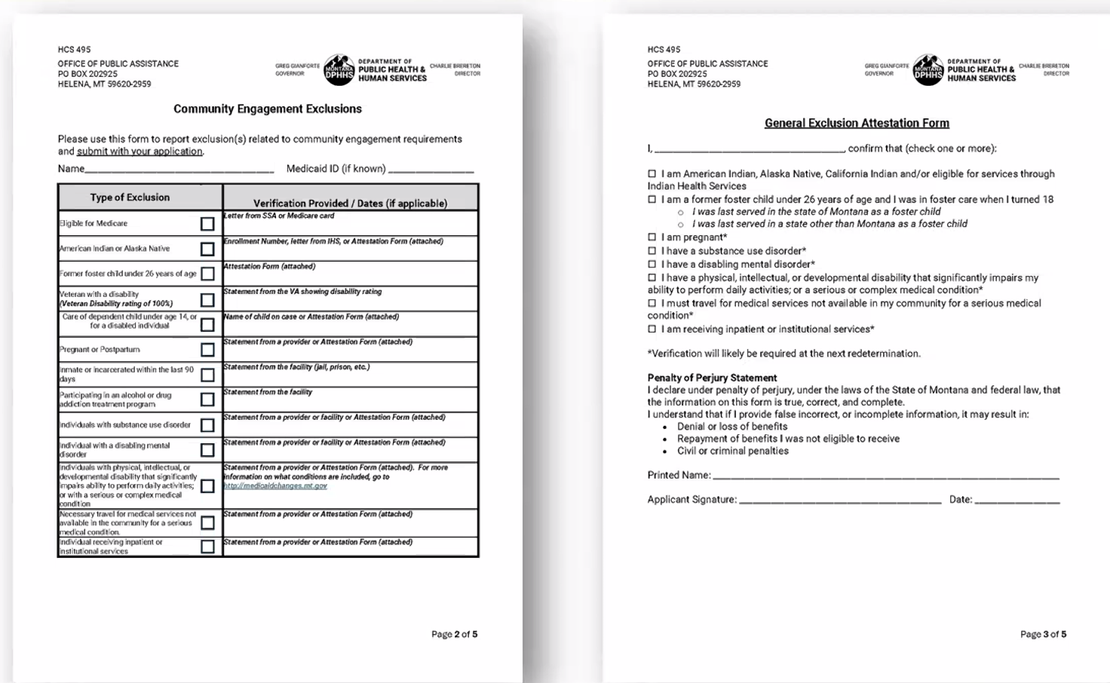
Notes:
“statement from provider”

Slide 17
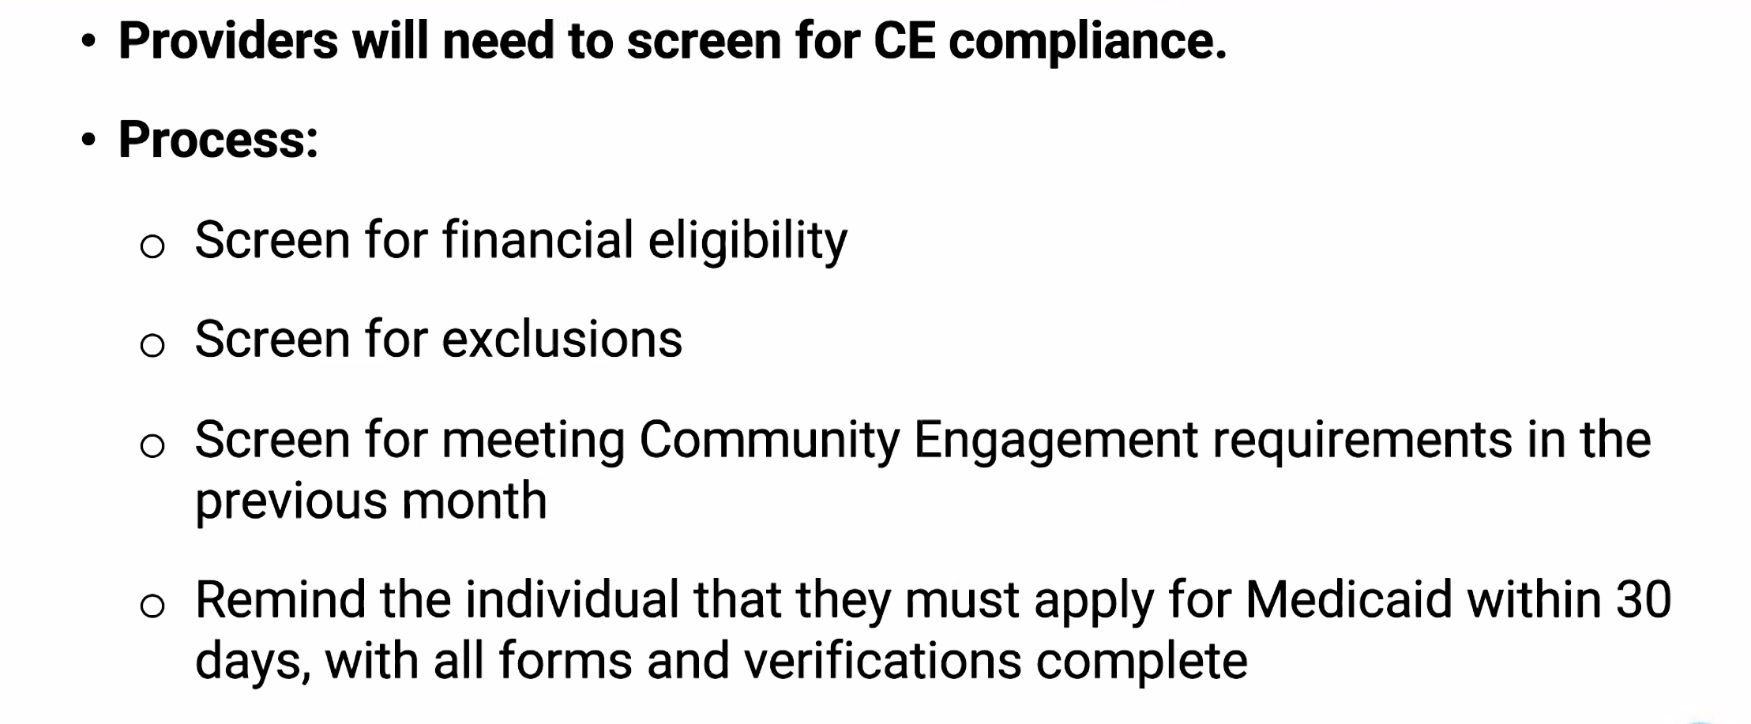
PE and New Requirements

Slide 18
Community Assister Portal
Final training materials being developed – available soon
Clients will designate community assister and level of access
Time-bound and limited
Unsure if it will be linked to provider portal or SSP

Slide 19
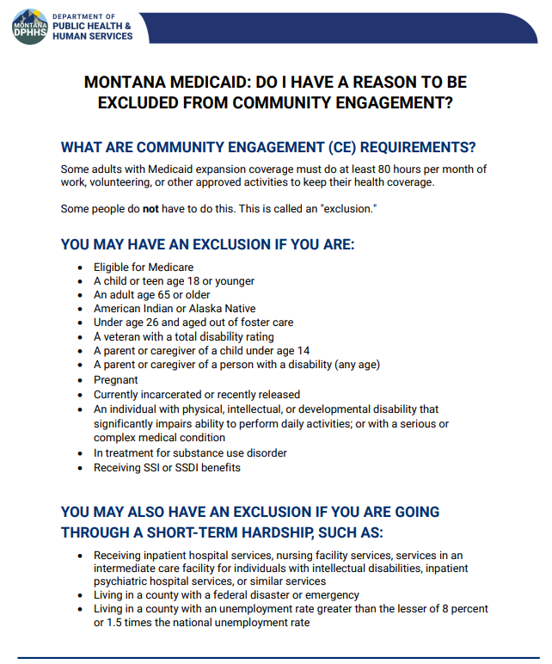
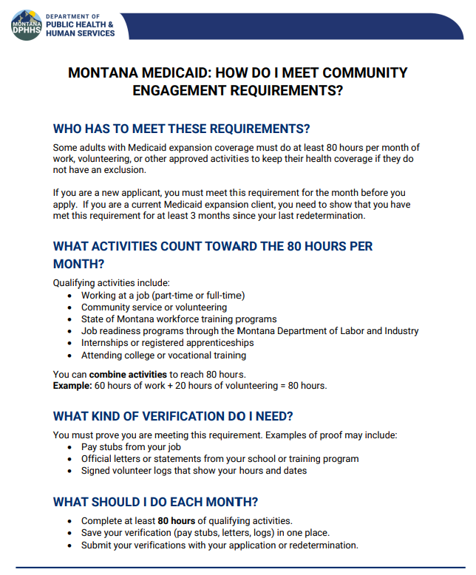
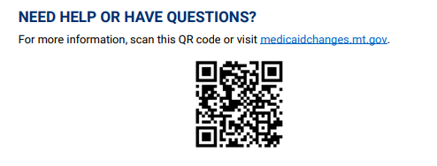
DPHHS Informational Flyers
Notes:
Changes to Medicaid
FAQs
Combined Medicaid Assistance (CMA) Policy Manual

Slide 20
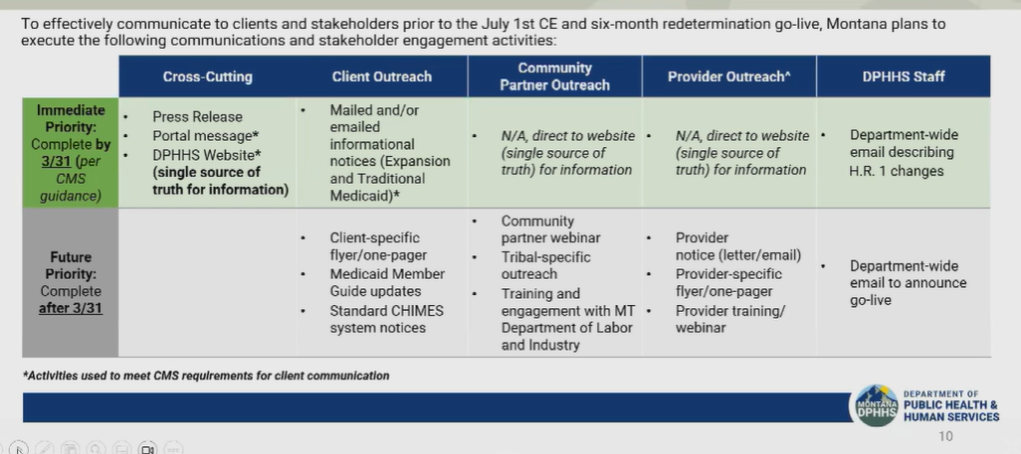
Member Notice & Communication
Starting March 31, 2026 – Mail plus one other contact method monthly
https://archive.legmt.gov/content/Committees/Interim/2025-2026/CFHHS/Meetings/March_9_10_2026/1-DPHHS-Update-Slides.pdf
Notes:
Text, website, electronic means, calls

Slide 21
Implementation
July – September 2026
October 1 2026
New applications that do not meet CE requirements will be denied. Renewals after this month that do not meet requirements will be given notice and closed after 30 days.
First disenrollments for not meeting CE requirements during renewal
CE assessed for renewals and new applications during this time. Those who do not meet requirements will be approved and will not be disenrolled – referred to Helplink
January 1 2027
Notes:
Olivia will be prepared

Slide 22
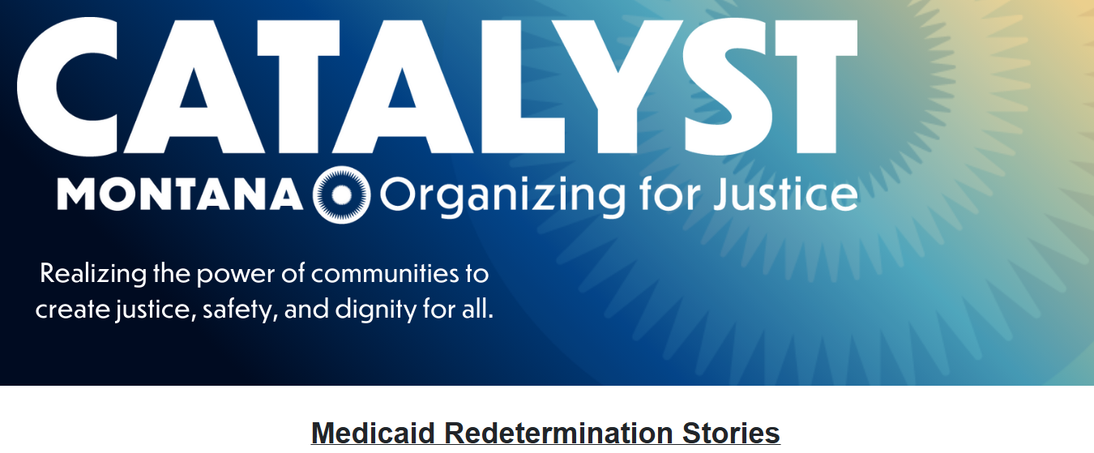
Medicaid Storytelling
Notes:
Share your story - Medicaid & SNAP Redetermination

Slide 23
Help Patients and Clients
1. Make sure the OPA has the most up-to-date contact information for all people enrolled in Medicaid and Healthy MT Kids on an ongoing basis: Medicaid Change of Address Form: DPHHS (accessgov.com)
2. Help patients create accounts on apply.mt.gov (SSP), link their cases and sign up to receive notification via both email and mail
3. Locate upcoming renewal dates for patients and clients in SSP during appointments – focus on those with renewals in July-September of 2026

Slide 24

Questions?
Next Cover Montana webinar
June 18th @ 11:00 AM

