Slide 1
From Concept to Compliance: Driving Value Through Chronic Care Management
July 30, 2025

Slide 2
AGENDA
DAY 1
DAY 2
1‣ | The Purpose & Value of CCM
2‣ | Who can bill for CCM
3‣ | Implementation, Management & Compliance
4‣ | Navigating billing codes, CMS updates and reimbursement guidelines
5‣ | Business Case for CCM
6‣ | Align CCM with your health center’s strategic goals

Slide 3
BUSINESS CASE FOR CHRONIC CARE MANAGEMENT

Slide 4



BUSINESS CASE FOR CHRONIC CARE MANAGEMENT
Chronic Care Management Benefits
Care Coordination Quality of Life
Access to Care Patient Satisfaction Healthcare Savings
Achieving Healthcare Goals
@NACHC
WWW.NACHC.ORG | 4

Slide 5
New Revenue Generation
Medicare Reimbursement for CCM Services
$60–$75 per patient per month (depending on complexity and region)
Smaller scale: $150,000–$350,000 annual revenue for managing 250 patients

Slide 6














STAFFING CARE TEAMS
Define
Define Standards
Distribute
Distribute Task
Update
Update Job descriptions
Train
Train Staff
Monitor
Monitor Task Performance
Hardwire/Software
Hardwire/Software Accountability into Personnel System
Educate
Educate Patients
@NACHC
WWW.NACHC.ORG | 6

Slide 7
BUSINESS CASE ASSUMPTIONS
MEDICARE PAYOR MIX FOR CHCS
PERCENTAGE OF MEDICARE PATIENTS ELIGIBLE FOR CCM
ESTIMATE ON NUMBER OF MONTHS BILLED
@NACHC
WWW.NACHC.ORG | 7

Slide 8

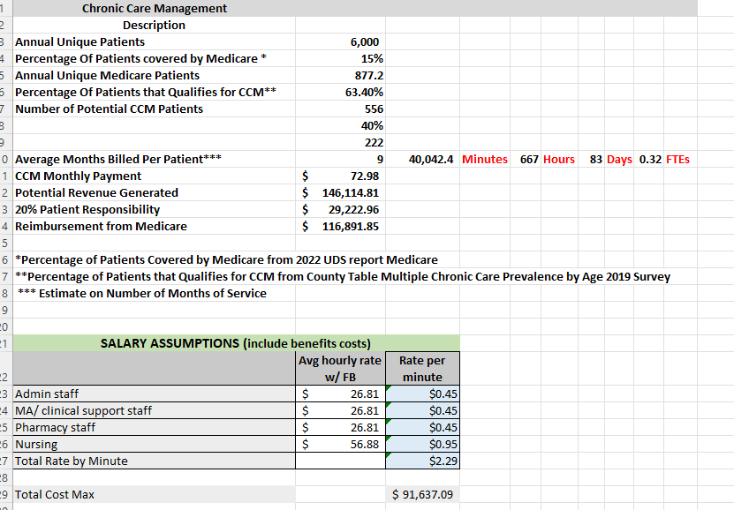
BUSINESS CASE SPREADSHEET
@NACHC
WWW.NACHC.ORG | 8

Slide 9
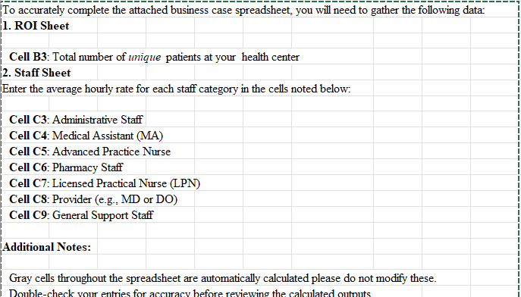
Instructions on Filling Out the Business Case Spreadsheet

Slide 10
Align CCM with Your Health Center’s Strategic Goals and Resources

Slide 11
Align CCM with Strategic Goals
CCM isn’t an isolated program. It can support broader FQHC priorities
CCM supports CMS billing compliance & CMS-approved quality goals
Start small: Pilot with 10–20 patients
Link metrics to QAPI/Board reports for scaling
Notes:
CCM aligns with CMS billing compliance and supports the CMS-approved quality goals: better outcomes, lower costs, enhanced patient experience, improved staff satisfaction, and equity. Start small by piloting with 10–20 patients and connect CCM metrics to QAPI or Board reports to show value and scale wisely.
For example, it helps centers prepare for value-based care arrangements by improving chronic disease management outcomes and reducing total cost of care.
Start Small: Pilot with 10-20 patients. Track metrics like:
Number of enrolled patients’ Monthly billing revenue
Reduction in no-show rates or ER visits
Share these metrics in QAPI meetings or with your Board to demonstrate impact and build buy-in for scaling the program

Slide 12

Example
Tying CCM metrics to your UDS Quality Improvement Plan. Can result in improved A1C control in diabetic patients by 10% and this data can be used to justify expanding CCM staffing
This Photo by Unknown Author is licensed under CC BY

Slide 13
Poll question
What's your top priority for a CCM pilot?
What is one additional service you see on the horizon once your CCM program matures?

Slide 14
Key Takeaways
CCM = Revenue + Better Outcomes + Operational Alignment
Start small, ensure compliance, and scale sustainably
You can launch your first CCM pilot program in 30 days with the right workflow and team
Notes:
CCM is both a revenue generator and a mission-driven program that supports FQHC priorities. Start small to build momentum, ensure compliance from the beginning, and scale strategically. You can take action within the next 30 days to launch a pilot CCM program at your health center.
Be audit-ready!!!

Slide 15
Navigate Billing, Coding, and CMS Updates

Slide 16

Navigate Billing, Coding, and CMS Updates

Slide 17
Add-on codes and G0511
For CY 2025, FQHCs must report individual services codes for general care management services, including any add-on codes, starting January 1, 2025.
FQHCs requiring additional time to configure their systems may continue reporting G0511 until September 30, 2025, at which point compliance with individual service codes is mandatory.

Slide 18
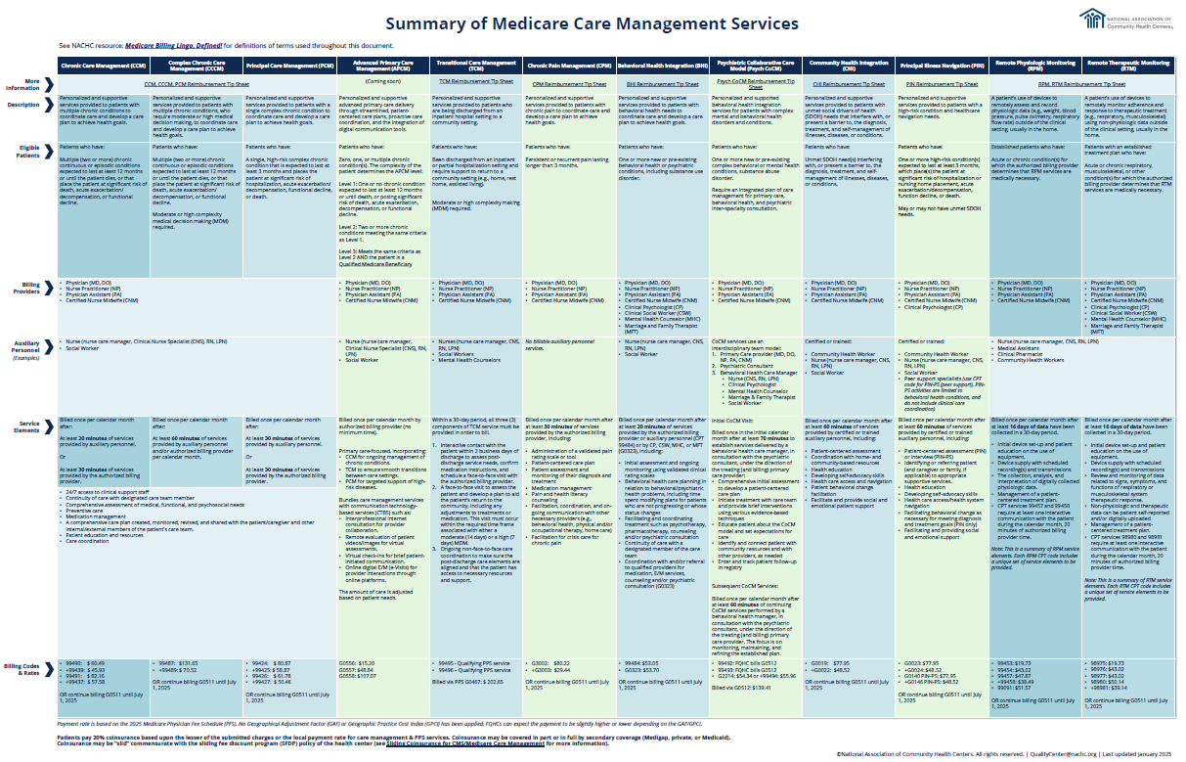
Additional Care Management Opportunities
Medicare Care Management Services:
Chronic Care Management
Complex Chronic Care Management
Principal Care Management
Transitional Care Management
Chronic Pain Management
Behavioral Health Integration
Psychiatric Collaborative Care Model
Community Health Integration
Principal Illness Navigation
Remote Physiologic Monitoring
Remote Therapeutic Monitoring
Advanced Primary Care Management
Summary Includes:
Description
Eligible patients
Authorized billing providers
Examples of auxiliary personnel
Service elements
Billing codes and rates

Slide 19
Advanced Primary Care Management
GPCM1 (G0556): APCM services provided by clinical staff and directed by a physician or other qualified health care professional who is responsible for all primary care.
  Billed at $15.20/month.​
GPCM2 (G0557): APCM services for a patient with multiple (2+) chronic conditions expected to last 12+ months.
  Billed at $48.84/month.​
GPCM3 (G0558): APCM services for a Qualified Medicare Beneficiary with multiple (2+) chronic conditions expected to last 12+ months.
  Billed at $107.07/month.
Additional Requirements:​
APCM services cannot be billed concurrently by the same practitioner or another practitioner within the same practice for the same patient with these other services: ​
  Chronic Care management (CCM),​
  Principal Care Management (PCM),​
  Transitional Care Management (TCM),​
  Interprofessional consultation,​
  Remote evaluation of patient videos/images, virtual check-in, and e-visits.

Slide 20
To bill for APCM services, health centers must: ​
Get patient consent​
Conduct an initiating visit (paid separately) for new patients​
Provide 24/7 access and continuity of care​
Provide comprehensive care management​
Develop, implement, revise, and maintain an electronic patient-centered comprehensive care plan​
Coordinate care transitions between and among providers and settings​
Coordinate practitioner, home-based, and community-based care​
Provide enhanced communication opportunities​
Conduct patient population-level management​
Measure and report performance:​
  Report the Value in Primary Care MIPS Value Pathway (MVP), or​
  Participate in a Medicare Shared Savings Program Accountable Care Organization (ACO), Realizing Equity, Access, and Community Health (REACH) ACO, Making Care Primary model, or Primary Care First model.

Slide 21
Key Resources
CCM ROI Calculator
Summary of Medicare Care Management Services
APCM Reimbursement Tips

Slide 22
EHR Workflows
AthenaOne
  CCM & PCM Workflows
  TCM Workflow
NextGen
  CCM & PCM Workflows
  TCM Workflow
eCW
  CCM & PCM Workflows
  TCM Workflow

Slide 23
QUESTIONS?

Slide 24
Monitor Care Management Program Outcomes as Part of Your Health Center's Quality Improvement Plan
Consider measuring: ​
  The number of patients in each care manager's panel ​
  Each care manager’s panel size over time to view ‘net’ changes​
  Panel size by program (if you have more than one care management program, or by payor if you have multiple value-based contracts)​
  Each care manager’s panel size by program over time to view ‘net’ changes​
  Patient enrollments and disenrollments by month​
  Patient disenrollments by reason​
  The number of high-risk patients enrolled in care management​
  The number of CCM eligible patients enrolled in care management​
  The number of completed Care Management encounters​
  The number of billed CCM encounters​
  The impact on UDS quality measures​
  Progress on patient care management goals
Incorporate measures into your health center's QI Plan, and use data to scale your care management program, meet the needs of your patient population, and balance staffing/care team responsibilities.
View Examples

Slide 25

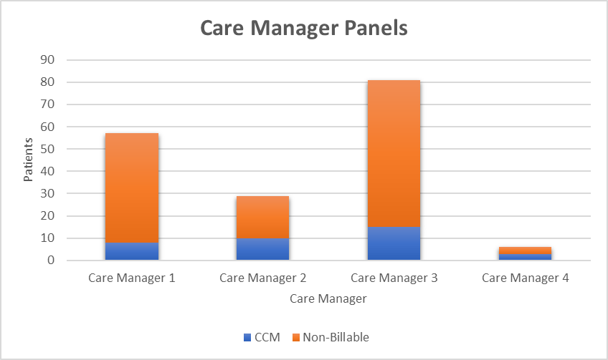
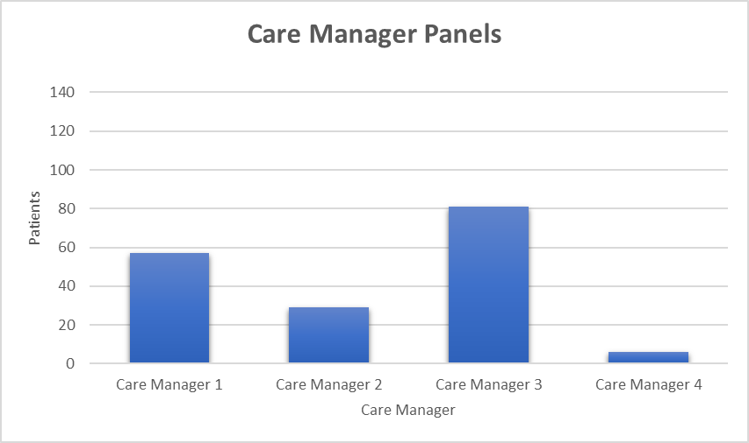
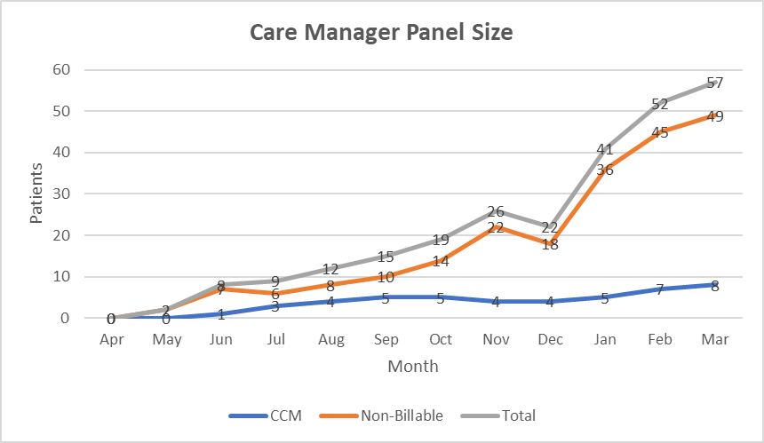
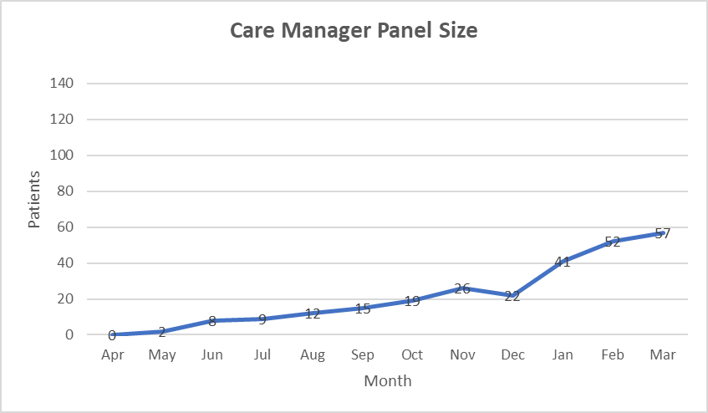
Keep in mind when setting goals or calculating potential revenue for care management, it takes time to build a patient panel.
DATA EXAMPLES
For CCM, this data can be used to set goals and predict potential program revenue.

Slide 26
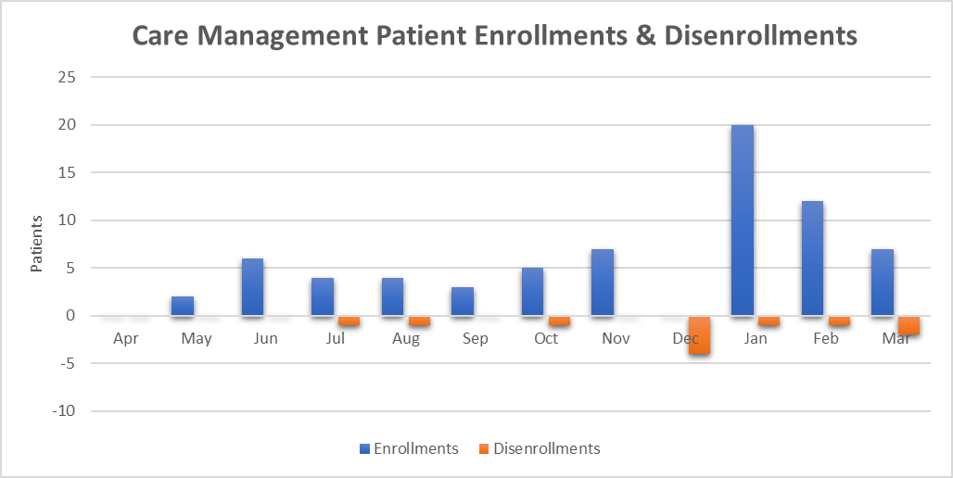
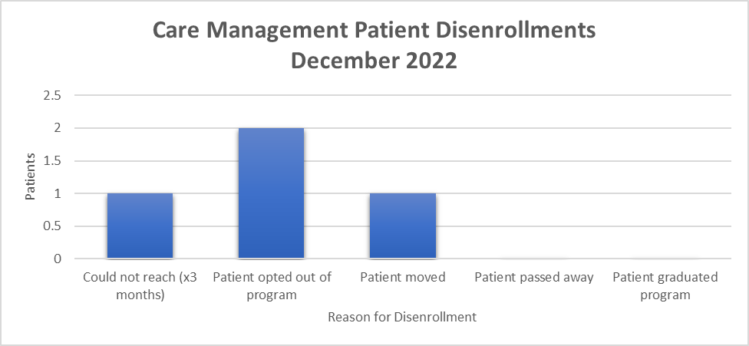
This perspective gives a higher level of insight into how a care manager is building and retaining their panel.

Slide 27
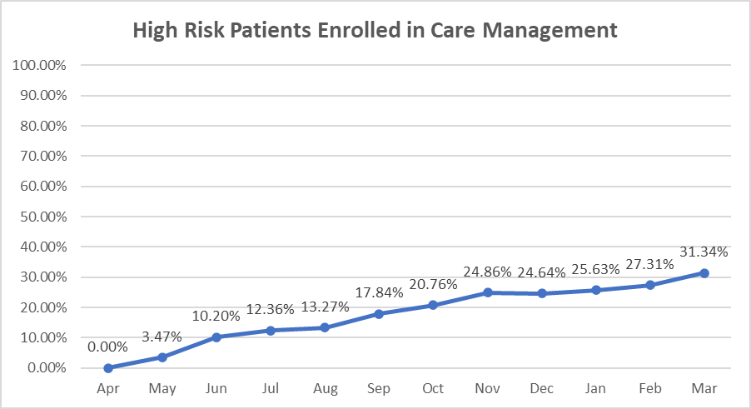
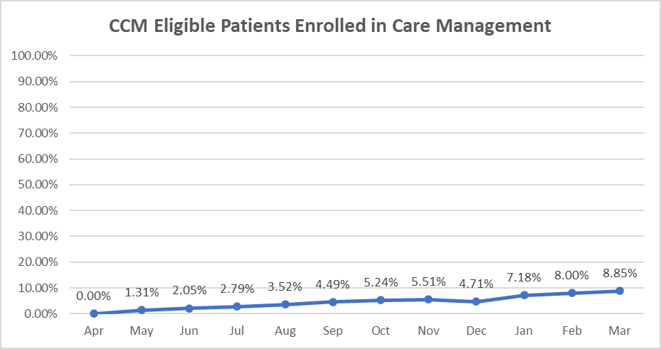
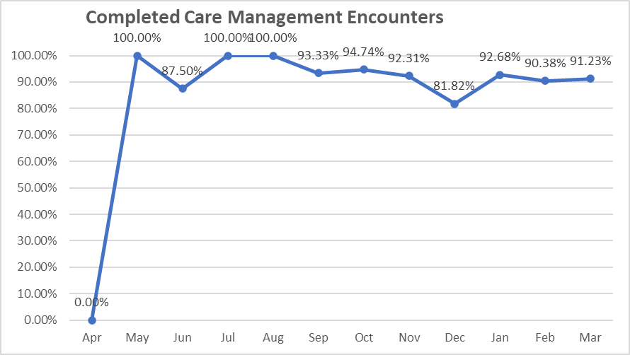
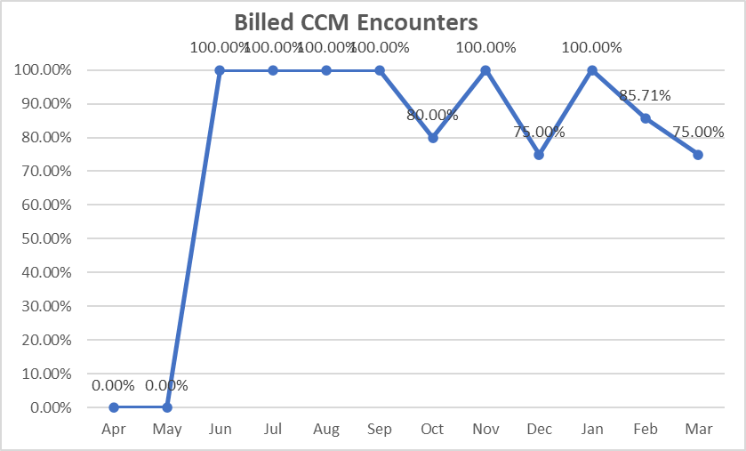
Month | Enrolled | High Risk | Rate
Apr | 0 | 549 | 0.00%
May | 19 | 547 | 3.47%
Jun | 56 | 549 | 10.20%
Jul | 68 | 550 | 12.36%
Aug | 73 | 550 | 13.27%
Sep | 99 | 555 | 17.84%
Oct | 115 | 554 | 20.76%
Nov | 138 | 555 | 24.86%
Dec | 137 | 556 | 24.64%
Jan | 142 | 554 | 25.63%
Feb | 151 | 553 | 27.31%
Mar | 173 | 552 | 31.34%
Month | Enrolled | Eligible | Rate
Apr | 0 | 380 | 0.00%
May | 5 | 382 | 1.31%
Jun | 8 | 390 | 2.05%
Jul | 11 | 394 | 2.79%
Aug | 14 | 398 | 3.52%
Sep | 18 | 401 | 4.49%
Oct | 21 | 401 | 5.24%
Nov | 22 | 399 | 5.51%
Dec | 19 | 403 | 4.71%
Jan | 29 | 404 | 7.18%
Feb | 32 | 400 | 8.00%
Mar | 36 | 407 | 8.85%
This data can be used to figure out how many care managers are needed to care for a patient population.
Month | Panel Size | CM Encounters | Rate
Apr | 0 | 0 | 0.00%
May | 2 | 2 | 100.00%
Jun | 8 | 7 | 87.50%
Jul | 9 | 9 | 100.00%
Aug | 12 | 12 | 100.00%
Sep | 15 | 14 | 93.33%
Oct | 19 | 18 | 94.74%
Nov | 26 | 24 | 92.31%
Dec | 22 | 18 | 81.82%
Jan | 41 | 38 | 92.68%
Feb | 52 | 47 | 90.38%
Mar | 57 | 52 | 91.23%
Month | Enrolled CCM Patients | Billed G0511 | Rate
Apr | 0 | 0 | 0.00%
May | 0 | 0 | 0.00%
Jun | 1 | 1 | 100.00%
Jul | 3 | 3 | 100.00%
Aug | 4 | 4 | 100.00%
Sep | 5 | 5 | 100.00%
Oct | 5 | 4 | 80.00%
Nov | 4 | 4 | 100.00%
Dec | 4 | 3 | 75.00%
Jan | 5 | 5 | 100.00%
Feb | 7 | 6 | 85.71%
Mar | 8 | 6 | 75.00%
This data can be used to ensure care managers have enough 'protected' time to complete care management responsibilities. (Patient engagement is also a factor.)

Slide 28
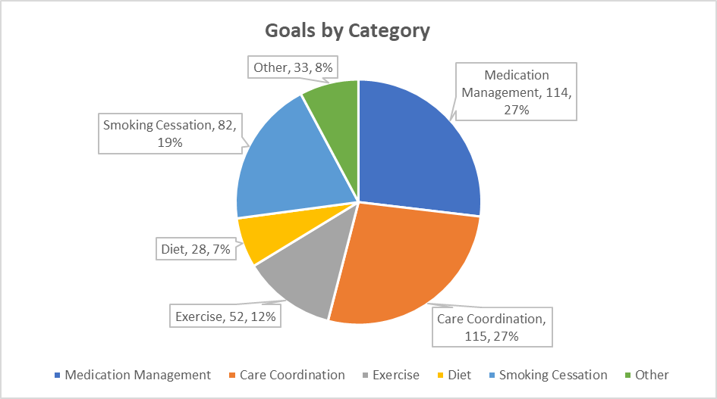
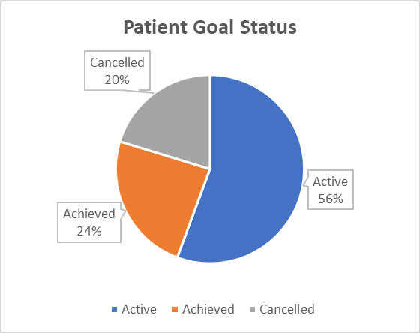
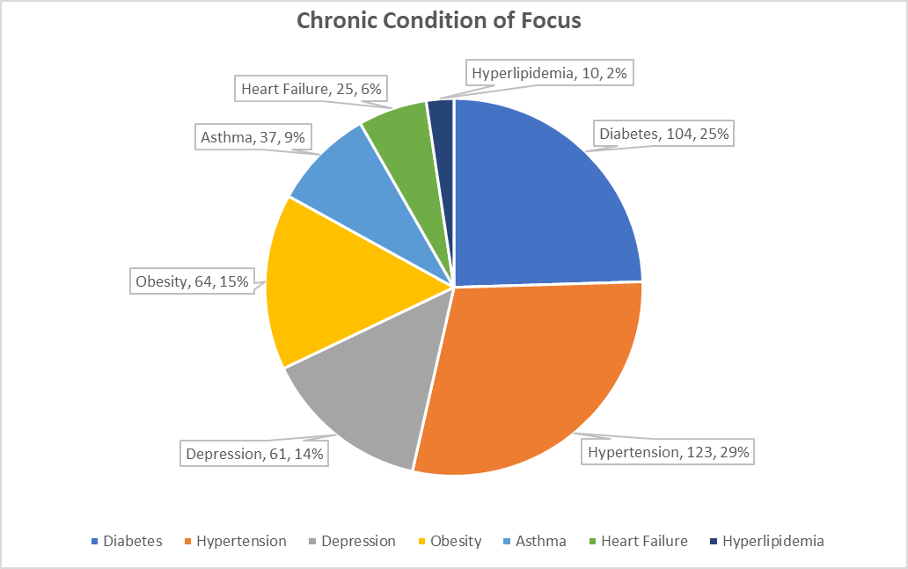
UDS Measure | All Health Center Patients | Care Management Patients (>1yr)
Colorectal Cancer Screening | 71% | 81%
Diabetes A1C Control | 32% | 21%
Hypertension Control | 68% | 77%
Filter to include care management patients who have been enrolled in care management for >6 months or >1 year, and patients who have graduated from a care management program.
Measure the impact of different care plans and interventions.

Slide 29
QUESTIONS?

