Slide 1
Trauma-Informed De-Escalation
Notes:
Co-brand with your organization's logo.

Slide 2
Notes:
A blank slide to use for your organization's mission or values, so you can relate this workshop directly to that.

Slide 3
Notes:
This is a blank slide for you to customize, using a picture of something that will connect you to your participants, and is related to a short (usually under 2 minute) story of what connects you to the content of this workshop. It can be a personal picture (family, etc.) and a story about communication with one of them, or if you prefer less personal, you can use a picture of the outdoors, of an object…the story can be funny, matter of fact, touching, etc.…anything that allows you to show your humanity, and get shoulder to shoulder with your participants (this is also you introducing yourself, if you don't know everyone) This will increase the likelihood they will engage deeply, enjoy the workshop and connect to you and each other- all super important components of effective workshops.
Afterward, this is where you will either have the group do introductions (if you don't know everyone, or they don't all know each other). Having them share something personal, but not too vulnerable, can help connect them to each other.
For example:
Name and years at the organization
Name and three words that describes how they are feeling today
Name and favorite type of ice cream
Name and place they dream of going
Dedicating at least 1 minute per person whenever possible is best; if there are too many people, consider breaking into groups of 4 or 5 in person or in Zoom, and have everyone spend 5 minutes introducing themselves to each other, or If the group is smaller, even 2 minutes per person can 'warm' the whole workshop experience.
If everyone knows each other and you know everyone, this is where you take the same amount of time to do a connecting exercise.
For example:
Any of the above, minus the name
Any of the 'fast' and 'low vulnerability' exercises on the 'relational meetings' document.

Slide 4
Notes:
This is a place holder for a 2-5 minute guided breathing exercise. You can use this slide or another of your choice. See the relational meetings document for more on this.

Slide 5
Notes:
This is a slide to share that the strategies in this workshop are derived from these three organizations.

Slide 6
Types of escalations
Notes:
An introduction slide

Slide 7
Psychosis
Fear, anxiety
Frustration, Anger
Notes:
Main Point: What are examples of escalations? Ask the participant group here to say or chat in more examples is useful.

Slide 8
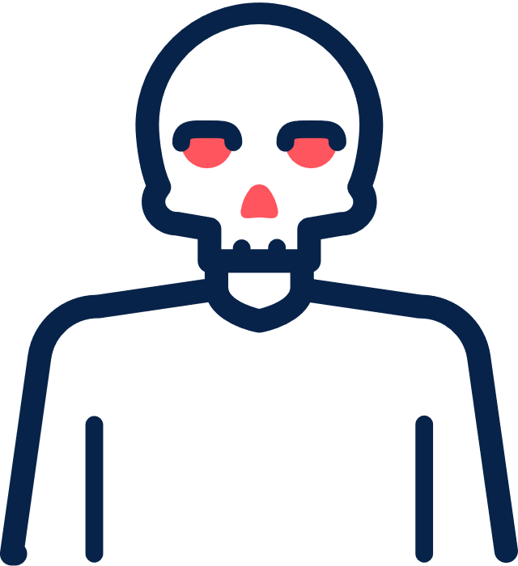
Physically threatening
Verbally hostile
Visibly agitated
Notes:
Calm and nonthreatening: A patient may be frustrated but fail to show overt signs of agitation.
Verbally agitated: A patient may say, “This is ridiculous. I can’t believe I have been sitting in here for 45 minutes,” as he or she paces while waiting for a physician who is running late.
Verbally hostile: A patient may shift from offering phrases of discontent to unkind phrases, e.g., “This doctor is incompetent and this entire practice is a sham.”
Verbally threatening: A patient may demand an apology or threaten to sue.
Physically threatening: A patient may take a fighter’s stance and make a fist.
Physically violent: A patient may attempt to injure providers.

Slide 9
Escalated Behaviors….?
Have increased
Have decreased
About the same
Notes:
Use Mentimeter, Zoom poll, or hand raising if in person. This is a way to get people to engage early on. You can use whatever time period you want, for example, in the last 6 months, in the last year, etc.

Slide 10
We've likely been (or been related to) an escalated patient
Notes:
Main Point: To enhance empathy for 'angry' patients, and recall that we ourselves or a family member has likely been the escalated patient. Add a phot of someone in your life who you know or you suspect has escalated in a public place (store/on the phone/as a patient, etc.). If this feels too personal to you, you can just ask the group if they have someone in their life, or if they themselves have escalated in a store/on the phone/ or at a clinic

Slide 11
Why are escalated behaviors problematic?

Slide 12
Touches on Childhood Experiences
Notes:
Main Point: Adverse Childhood Experiences, which almost all us, our patients and clients have had (and we are better off if we assume everyone in front of us has had), make a lack of empathy in care provision particularly harmful.
TIP: A good slide to ask participants to define, and talk about why it is so important

Slide 13
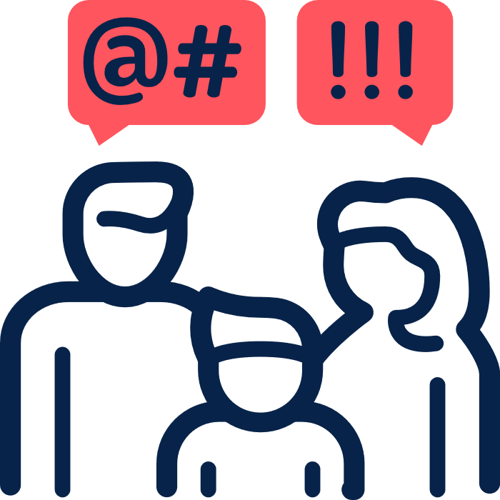
Fright or Flight
(fear or anger)
Re-Traumatization
Mistrust
Notes:
Main Point: To demonstrate that escalations can do harm, especially to staff, or patients who see/hear the escalation, and have trauma in their pasts.

Slide 14
Verbal Abuse
70%
of receptionists
Notes:
This is a slide to sit on for 5-7 minutes. Ask what their experiences are with this.

Slide 15
Risk Factors for Aggressive Behaviors
Chronic Pain or SUD
Protective Empathy
Not feeling heard
Wound to dignity
Notes:
Main points:
Chronic Pain and SUD conditions are only related to escalations because there is so much stigma around these conditions that these folks are more likely to be treated poorly. Re: more likely to have a wound to their dignity.
Many escalations are preventable, as we can lower these risk factors!

Slide 16
The goal of de-escalation is always only emotional and physical safety for everyone
Notes:
The most important foundation for this workshop. I often say 'this sounds super clear, like a 'duh' moment…however, it isn't as easy as it sounds!'

Slide 17
Being Right Explaining Rules Imposing Consequences
Notes:
Main Point: Doing these things while someone is escalated is counterproductive. These three things can be important, however can always be done at a later time, when the person is not escalated. Giving examples of each of these can be helpful, stories here are very helpful to if you have stories that illustrate these. It can be useful sometimes to draw similarities with parenting, as many people related to this- we try not to do these things when kids' have unmanageable feelings too- we don’t' tell a child who throws something at another child in anger that they aren't allowed to do that and will have to leave the birthday party. First we help them de-escalate, back into their pre-frontal lobes; empathize with them, help them name feelings, breath. Later we can share these things in a compassionate way.
Being Right: Explaining to someone repeatedly why you or your organization was not in the wrong when someone is mad. Arguing with someone that what they are saying is not accurate.
Explaining rules: telling someone who is under the influence of substances and being disruptive that they can't come to the organization under the influence; telling someone who kicked over a chair in the waiting room that they are not allowed to kick furniture. It can be helpful to clarify here that this doesn't include drawing boundaries around being yelled at, for example saying to someone 'I'm sorry I will have to hang up if you are not able to lower your voice and stop swearing at me'. These are emotional safety boundaries that we can skillfully engage in when someone is escalated.
Imposing Consequences: Telling someone that they will no longer be allowed as a client at the organization, or other consequences- will typically increase the escalations. This can be done later.

Slide 18
Self-assessment
Notes:
Switching to thinking about ourselves…that all of us have different experiences with anger, and how we respond to it.

Slide 19
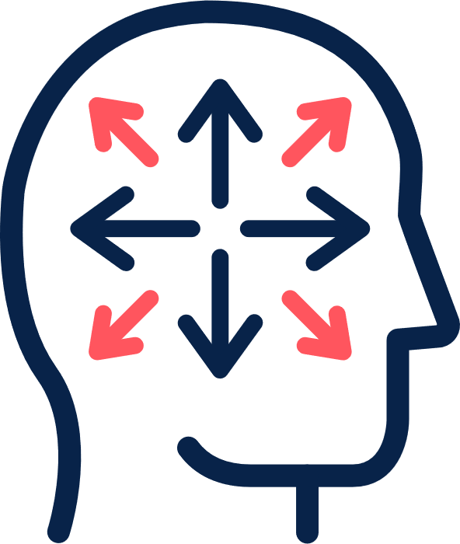
My history
My personality
My skills
Notes:
Main point:
We have our own family histories, different personalities, and perhaps more or less practice with de-escalation (skills).
I often share that if we grew up with an angry parent, or even if the anger sometimes led to violence, we will likely have a faster 'flight or fright' response to an escalated patient. It is important to know ourselves in this way….

Slide 20
What do you know about yourself and your response to anger?
Notes:
Sharing your own answer to this models for others.
If virtual, using Mentimeter can be very helpful to elicit this from participants.
If in a small group with high trust, asking people to share can be useful, virtually or in person.
If in a larger group in person, or a group with lower trust, asking people to think for a minute or two and write down their answers to this can be a way to enhance self awareness that is safer. After the few minutes are up, you can ask if anyone would like to share.

Slide 21
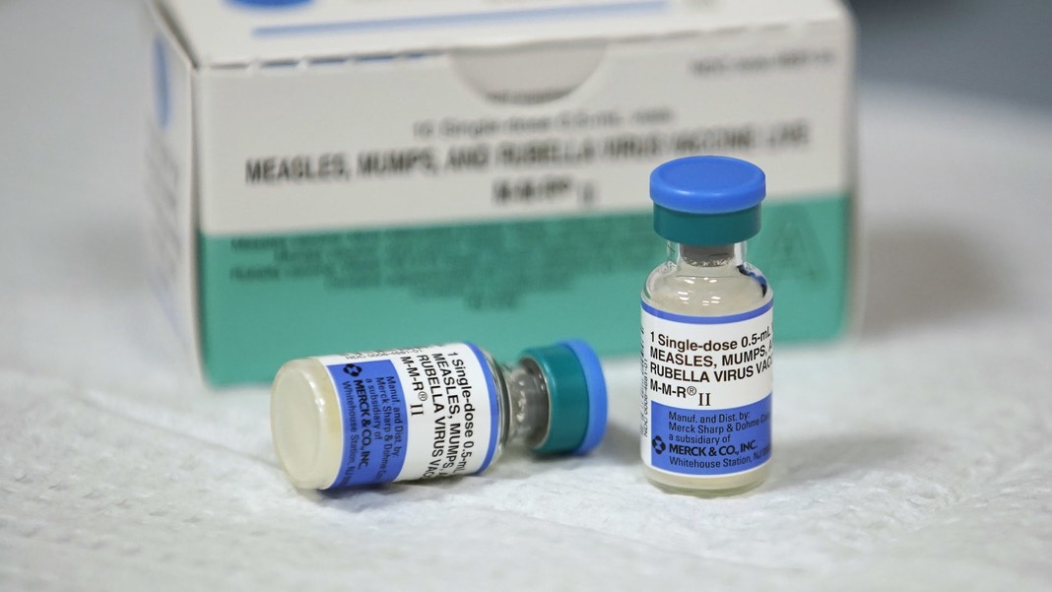
Prevention
Notes:
This might be the most important section of the workshop. It can be tricky to hit this point home, and not 'blame the victim'. We aren't saying escalations are front office's fault…we are instead saying that many many factors contribute to escalations, and we can lower these factors, to lower the number and intensity of escalations.

Slide 22
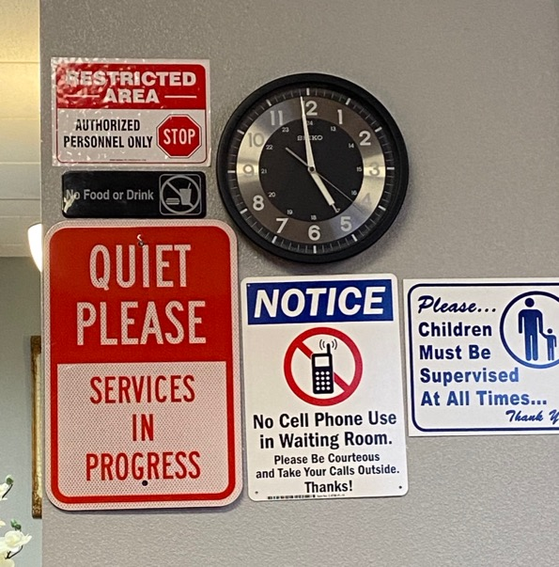
Notes:
This slide is to show that the physical environment can contribute to escalations, or it can be part of prevention. That the waiting room area, when clean, with nice wall art, furniture in good repair, new magazines in good condition, a table and books for children, etc. is less likely to draw escalations. This is in contrast to the picture on the left, or any waiting room that is unkempt, chaotic, poorly lit, with command signs everywhere, which will draw more escalations.
You can take this slide out if it doesn't apply to your organization, for example, if all the clinic waiting rooms are well decorated and tidy. Or, if the waiting rooms do have many problems, command signs, disrepair, etc., but there is no way front office can influence this, then it might be better to take out.

Slide 23
Eye contact
Smile
Greeting
Names
Humor
Compliments
Affirmations
Offerings
Notes:
Main Point: There is an evidence base behind all of these, for preventing de-escalations. These are also core empathic communication skills. When empathy is established with our patients, even if it is the first time they have met us, escalations are much lower. These elements are THE MOST important in the waiting room, as it is the first step in the visit, it is a public space, and it is where patients typically spend the most time. . Giving examples of these and asking participants for examples can be helpful here.

Slide 24
Team Conversations: enhancing support for each other & effectiveness during escalations
Notes:
This is where we talk about the fact that not everyone should do de-escalation. Many people know they are in 'fright or flight' too quickly, meaning they will get mad back, or get so scared it can be traumatizing. We can also say here that many people feel confident about de-escalation, and feel 'good' being the point person. The most important thing is to have a conversation, with your team, about what you want your role to be in de-escalations, so that every one knows this.

Slide 25
What would you share with your team, about your capacity/preferences for de-escalation?
Notes:
Break the participants into small groups, of 3 or 4.
If you have teams at the workshop, break them into their own teams.
Ask participants to reflect on this question, and share with the group. Some guidance:
Let people know they do not have to disclose the 'why' of their answer- they do not have to disclose anything about their history, for example, unless they want to.
Share examples of different things people might share:
For example, share if you are willing to be background support, calling a supervisor, etc.
Share if you feel confident in de-escalations, that you do not mind stepping in when a patient is escalated, on the phone or in person
Share if you do not want to be a part of it at all, that if a patient begins to escalate you would like to leave the room.

Slide 26
Early & Middle Intervention
Notes:
This is when someone is already angry. '
The earlier we can address anger, the better chance we have of avoiding a late-stage escalation.

Slide 27
Cutoff Gaze
Sighs
Pacing
Stare
Irritable Agreement
Repeating
Arguing
Shrugs
Raised voice
Cutoff Gaze
Sighs
Pacing
Stare
Repeating
Shrugs
Irritable Agreement
Notes:
First, we need to recognize they are angry. These are some examples.
Main Point: NEVER IGNORE This. Even if you are not the one to intervene, tell someone else so they can intervene. Intervening as early as possible is super important.

Slide 28
Helping people activate their pre-frontal cortex
Notes:
Main Point: Getting people from their 'angry' brain, to the part of their brain that reasons, that makes good decisions.

Slide 29
Managing Ourselves
Breathing
Self soothing
Empathy hacks
Notes:
Main Points:
Managing ourselves is one of the most important factors in how effective we will be.
Breath deeply to relax
Talk to self, 'it is okay. You will be okay.'
Imagine the escalated person as a child, or remind ourselves that it could be a family member of ours. This helps us stay kind, stay out of anger.

Slide 30
Humanize & Soothe
Use names
Humanize Self
Reflect feelings (focus less on their words)
Offer something
Agree
Apologize
Notes:
This is a good slide to stay on for 10 minutes or so.
Main points: Every one of these has good evidence behind it. Each one of these things can be very effective, however only if we are not angry ourselves. All of these do not have to be used. In the moment when we are dealing with someone who is escalated, we often make decisions on the fly about what we feel will be most effective.
Explanations:
Using names, theirs and ours, brings people into their 'reasoning' brain. If we don’t know their name we can ask them (this momentarily takes them out of their anger brain, just to answer). When we use our names, we humanize ourself to them, making it harder to yell at us.
Expanding on humanizing ourself, to make it harder for someone to yell or argue with us, we can share something personal (but not vulnerable) with them. This takes a bit of skill, because it has to feel natural in the moment ("I'm sorry I would have come sooner, I was talking to my son's school" or " I would feel the same way, my brother has chronic pain, and I know how awful it is not to have medicine"
Avoid reflecting back anything except feelings. Because when people are angry their brain isn't working well, we don't want to explain, defend or respond to exactly what they are saying. Instead we reflect the feeling 'You are frustrated with us", 'You feel really disrespected"
Offering means people need to think about an answer, which puts people in their reasoning brain. We can offer water, a seat, to follow you outside, or to your office (if a supervisor), etc.
Never disagree. No matter what someone says, agree wherever possible (re: we wouldn’t agree with 'You are all idiots!') however we would agree with them that the hold times are ridiculous, that waiting 45 minutes for an appointment is terrible, that not having their medicine at the pharmacy is awful, etc.
Apologize, apologize, apologize. Don't worry about if we are really in the wrong. When we don't just directly say 'I am so sorry about this" people continue to escalate further.

Slide 31
01
Feelings Reflection: "You are angry" or 'Your really frustrated with us"
02
Normalize & Agree: "I'd feel the same way" or "Anyone would be frustrated"
03
Affirm: "I appreciate you sharing this with us" or "thank you so much for keeping your cool. It isn't always easy to do"
Notes:
Examples.

Slide 32
What is your experience in using these strategies?
Notes:
This is back to the same small groups, for discussion. Put slide #30 up when in person, and ask people to go around and share when/if they have used any of these strategies (can be at work or at home), or if when they were angry, someone has done one or more of these with them. We want them digging in to self reflect and notice/identify these strategies.
TIP: Ask that everyone in the group share

Slide 33
Setting Limits
"If you continue to swear at me, I'm so sorry, I'll have to end this phone call"
"If you aren't able to lower your voice, I'm afraid I won't be able to continue this conversation with you."
Notes:
Ending on this note. This is reinforcing that staff are NOT expected to continue to be yelled at or insulted. That we want our staff to end conversations, if after they have done their best with all the strategies we talked about, and the person is still very angry and/or even getting angrier, that they can hang up, walk away, etc.

Slide 34
www.emorrisonconsulting.com
Notes:
This can be an end slide, and/or you can share this website if you think people might want more resources related to this.

