Slide 1

Empathic Communication
Notes:
Co-brand this slide if you'd like, with your organization's logo.

Slide 2
Empathic Communication
Notes:
You can use this for a title slide if you don't want an image.

Slide 3
Notes:
You can add your organization's mission and values here, and connect that directly to the workshop.

Slide 4
Notes:
This is a blank slide for you to customize, using a picture of something that will connect you to your participants, and is related to a short (usually under 2 minute) story of what connects you to the content of this workshop. It can be a personal picture (family, etc.) and a story about communication with one of them, or if you prefer less personal, you can use a picture of the outdoors, of an object…the story can be funny, matter of fact, touching, etc.…anything that allows you to show your humanity, and get shoulder to shoulder with your participants (this is also you introducing yourself, if you don't know everyone) This will increase the likelihood they will engage deeply, enjoy the workshop and connect to you and each other- all super important components of effective workshops.
Afterward, this is where you will either have the group do introductions (if you don't know everyone, or they don't all know each other). Having them share something personal, but not too vulnerable, can help connect them to each other.
For example:
Name and years at the organization
Name and three words that describes how they are feeling today
Name and favorite type of ice cream
Name and place they dream of going
Dedicating at least 1 minute per person whenever possible is best; if there are too many people, consider breaking into groups of 4 or 5 in person or in Zoom, and have everyone spend 5 minutes introducing themselves to each other, or If the group is smaller, even 2 minutes per person can 'warm' the whole workshop experience.
If everyone knows each other and you know everyone, this is where you take the same amount of time to do a connecting exercise.
For example:
Any of the above, minus the name
Any of the 'fast' and 'low vulnerability' exercises on the 'relational meetings' document.

Slide 5

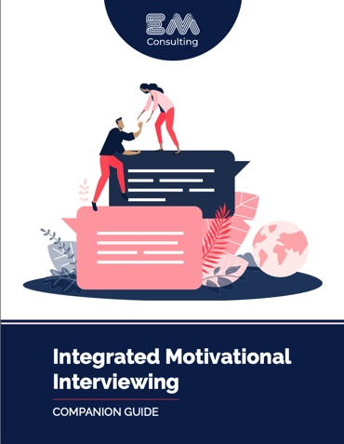
We'd all like to have someone who thinks we're wonderful, encourages us, and loves us unconditionally. We can be with that person all the time because we have that person inside us.
- Cheri Huber
Notes:
This is a place holder for a 2-5 minute guided breathing exercise. You can use this slide or another of your choice. See the relational meetings document for more on this.

Slide 6
Agenda Today
Notes:
This sets expectations about how long the workshop is, if there will be breaks, that there will be practice during the workshop, etc.

Slide 7
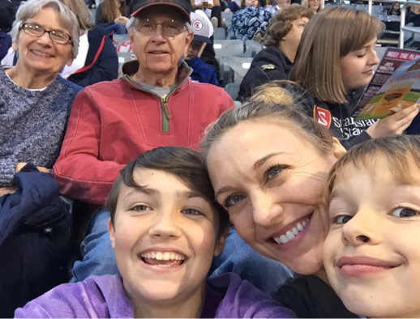
IMI is just as applicable to our relationships with our friends, family, & ourselves
Notes:
This is a slide to hit home this Important point: The strategies and techniques we are going to talk about today are just as applicable to our family and friends as they are to our work with patients/clients.
Why: 1) Adult learners tend not to internalize new information when it is work-only specific (such as new EHR systems, time-cards, etc.). When information is useful both in and out of work, learning tends to go deeper, and is more internalized. Because the communication skills we discuss here are foundationally skillful for any relationship, we want to ensure participants know this early on.
2) Often in workplace we are told we are learning things so we can do a better job for the company, for clients, for the bottom line. In some ways this makes sense when we work in mission driven fields; it does however feel different when we let people know this is also something we are doing because we want to support them, in their lives, outside of work too.
This is a good place to have a picture of your family/friends if you feel comfortable with this, or if it suits you more to have a less personal disclosure, to have a more general picture of children, family, marriage, etc.. If you used a personal picture on the introduction slide, you can refer back to that here, or use another, or use one of a friend, etc.

Slide 8
Empathy is healing & Judgment is harmful
Notes:
Main Point: The basis of everything we are going to talk about, discuss and practice in this workshop is based on this premise. Most of us 'know' this, whether or not we know the details of the research. Position judgment as the opposite of empathy.
Why: 1) To provide a foundational, philosophical thread we will return to again and again. 2) to reinforce that we all have this knowledge already, in some way- to democratize what we are going to be talking about during this workshop- it isn't specialized knowledge from an expert to learners; instead it is a space in which we can all discuss and practice the strategies that operationalize what we already know.

Slide 9
Empathy is the
Communication of…..
Notes:
Main Point: Empathy is and can be defined many different ways.

Slide 10
Compassion
Trauma-informed care
Humility
Understanding
Respect
Perspective-taking
Rapport
Caring
Kindness
Good will
Therapeutic-alliance
Notes:
Main Point: Empathy is defined very broadly for our purposes. In the research we will reference empathy is sometimes referred to in these different ways as well.

Slide 11
Judgment is the
Communication of….
Notes:
Main Point: Similarly, judgment is broadly defined as well

Slide 12

Bias
Condemnation
Stereotyping
Condescension
Stigma
Discounting
Negative attitudes
Notes:
Main Point: Judgment is synonymous with all of these things, broadly.
Sub Point: Language-wise, letting participants know you may be using these terms interchangeably.
Sub Point: Empathy is a social justice issue, as is judgment.
Sub Point: Bias includes both implicit and explicit. Bias includes racism, in all forms, and other areas of bias.
Sub Point: Letting participants know we are going to dive a bit more deeply into this in part 2.
Why: Depending on your field or participant group, some of the words might be more utilized than others- using the language of the group we are talking with is usually most effective.

Slide 13
Think of a time when you or a family member received care and experienced either:
EMPATHY that was helpful to your care
OR
JUDGMENT that was harmful to your care
Notes:
Main point: All of us have experienced empathy and judgment/bias when receiving care.
TIP: One or both of the facilitators share a brief (under 2 minutes) story about experiencing empathy or judgment in care, to model what we are eliciting. If both facilitators share an example, one empathic and one judgment-focused works best.
Why: To elicit participant engagement, invite participant voices into the workshop early on (this is the first explicit invitation to contribute since introductions.
Why: To reduce/dissolve 'othering' in this workshop, by placing ourselves in our 'client/patient' shoes early on in the workshop
Options: Using Mentimeter (in person or on a Zoom workshop) or another similar tool. One of the benefits is that it is anonymous, so people may share more vulnerably. One of the downsides is it is anonymous, so the vulnerability may not help others connect directly to each other. Taking off screen share when virtual, or facilitating a discussion when in person, give everyone a minute to consider after your example, then ask if anyone would like to share their experience. Aim for 3 people to share. Another option is to divide people into groups of three (virtual break outs, or into threes just with those sitting next to each other in an in-person workshop), and ask them to discuss for 5 minutes this question, then bring back to ask for sharing out from volunteers.

Slide 14
What is so important about empathy?
Notes:
Main Point: To forecast the following section- the main reasons why empathy is so deeply important in the helping professions.

Slide 15
Adverse
Childhood
Experiences
Notes:
Main Point: Adverse Childhood Experiences, which almost all us, our patients and clients have had (and we are better off if we assume everyone in front of us has had), make a lack of empathy in a healthcare visit particularly harmful.
TIP: A good slide to ask participants to define, and talk about why it is so important

Slide 16

When communication is not empathic, it causes…
Notes:
Main Point: To share that non-empathic conversation can actually cause harm, especially to those who might have had trauma in the past.

Slide 17
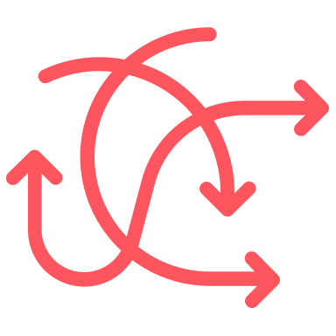


Flight or Fright
(fear or anger)
Re-Traumatization
Mistrust of the clinic
Notes:
Main Point: To demonstrate that communication can and does harm. Non-empathic communication causes real distress and wounding, especially to those who have had trauma in their lives.

Slide 18



Empathy from the front office impacts…
Clinical Outcomes
Quality
of care
Patient/client experience
Notes:
Main Point: Empathy from the healthcare team (including front office!!) impacts all three of these!
TIP: This can be a good time to ask participants what they have seen in their experience that matches with this- either themselves or their clients/patients.
1) Patients are more apt to follow provider recommendations and return for follow ups when they feel empathy from the front office.
2) Quality of care. When less empathy is reportedly felt by clients, there are higher safety errors, worse diagnostic accuracy, more missed symptoms and emotional cues.
3) Empathy is one of the most important factors in client experience/satisfaction. When clients feel judgment/stigma/bias, there are higher client complaints, grievances and litigation. The front office has a HUGE impact on patient experience.
.

Slide 19
Core Empathic Communication Strategies
Notes:
Main Point: This is where the workshops switches to specific strategies. Communicating empathy comes naturally to most of us; many of us have been intentionally practicing as well for years. I like to say there that if participants leave, affirmed and reinforced that they are engaged in a high level of evidenced based communication, that is a great outcome! If people are interested in any research, you can direct them to www.emorrisonconsulting.com, as there are a very large annotated bibliography on this, in the empathy section.

Slide 20
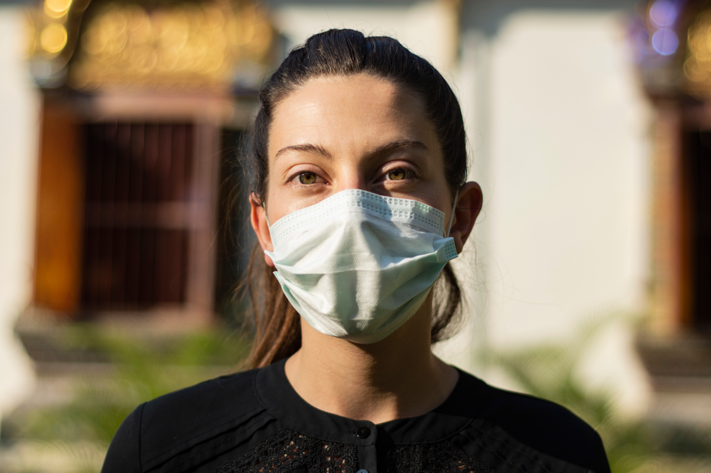
Notes:
Main Point: Much of empathy is conveyed non-verbally.
Sub point: People tend to believe our facial expression and body language over our words
Sub Point: We don't have this ability on the phone (making verbal empathy even more important in this modality), and masks make this more difficult.
TIP: This is a good place to ask participants for an example of when someone's facial expressions or body language didn't match their words.

Slide 21




Eye Contact
Mirroring
Leaning & Touch
Smiling
Notes:
Main Point: These are all well-researched, evidenced-based, and cross cultural.
TIP: This is a good point to ask participants which one is the most important.
Eye contact: This is the most important. Without eye contact, we cannot establish psychological safety with someone, a necessary pre-curser to feeling empathy. Some participants will bring up cultural differences- which is important to acknowledge. Research to date, including with Native Americans and the API population has shown initial eye contact remains incredibly important in conveying initial connection. There are some differences culturally in sustained eye contact.
Mirroring: Mirroring someone's facial expressions comes naturally to most of us- some of us who are neurodivergent might have less of this naturally and need to be more purposeful.
Leaning and Touch: While we aren't touching now during the pandemic, leaning toward someone and making touching gestures 'gesturing towards someone, reaching out a hand, although it doesn't touch) are deeply important to convey empathy. When we lean forward we are literally trying to get our hearts closer to another person's heart.
Smiling is the second most important, after eye contact. Smiling is the only way we can assess whether someone has good will towards us or not.
TIP: Mentioning masks, difficulty in 'mirroring' and in smiling is important. Asking participants about what they notice about makes wearing and empathy conveyance can be a point of engagement.

Slide 22

Eye Contact:
The most important non-verbal communication behavior; necessary for psychological safety
Notes:
Main Point: Slide included because it is so important; you may choose to ask participants which one is most important, go to this slide to discuss, then back to the previous slide to discuss the others.

Slide 23

Verbalizing Empathy
Notes:
Main Point: There are important evidenced based ways to convey empathy verbally. The 5 we are going to talk about today are not the only ones- they were chosen because they are all a 'big bang for your buck' strategies- meaning, they have lots of evidence behind them, most of us have used them and are familiar with them, and most of us know how it feels when others have used them with us.

Slide 24
1
Normalizing & Affirming Strengths
2
Open Ended Questions
3
Empathic Reflection
Notes:
Main Point: This is just an overview slide to forecast the next section.
As you go into the next slides, it is really helpful to have stories and examples (micro stories) for each of these, to illuminate clearly what these are in action.

Slide 25

Communicating that a situation is not uncommon.
  Normalizing
Notes:
Main Point: Define normalizing as letting someone know they are normal- not pathological, not abnormal, not alone in what they are feeling or experiencing.

Slide 26
I would feel the same way…
We all sometimes…
Many people are…
Notes:
Main Point: These are examples of how we might communicate normalizing (have examples ready to finish these sentences). Specifically call out the use of 'us' and 'we' as an example of normalizing.
TIP: This is a good place to ask others for how they might communicate normalizing at the front office, with patients.

Slide 27

Looking for, noticing and verbalizing a person’s strengths
  Affirming Strengths
Notes:
Main Point: Defining Affirming strengths: Noticing and articulating the good things you see about someone. Affirming strengths is a part of 'strength-based philosophy, it is the actual communication of this.
Sub point: Strengths can be someone's effort, intentions, what they care about, what is meaningful to them, what their values are, qualities you see….we can think of it as a compliment, in some ways.
Sub point: In order to fully utilize this communication strategy, we are always 'looking' for strengths, as if we have special strength-finding glasses on. No matter how down someone is, how demoralized, embarrassed, distressed someone is, we can still always see strengths in them.

Slide 28
You are so honest and authentic…
I can see how much you love your son…
You really care about your health….
Notes:
Main point: Examples of 'finding' strengths to share back with people. All of these would work with patients/receptionists.
TIP: This is a good point to ask participants what examples they can think of for patients, and also for their family members!

Slide 29
Normalizing and Affirming Strengths Practice
Step 1
Step 2
Step 3
Pick something real to practice with
Feedback & Switch
In Pairs
Notes:
This is the first practice episode in the workshop, so taking some time here to lay our clearly what the directions are is important. Often people get very nervous around practice sessions and the clearer we can be the better.
TIP: If you are co-facilitating, doing a mini demonstration is usually very well received. Usually doing something spontaneous, to mirror what participants will be doing, is best. Missteps are no problem at all, we can just model taking a pause and starting over.
Main Directions (see guidance on practice episodes in the companion guide for more detail)
In person workshops: Pairs or threes. Avoid ’counting off’, it causes movement, commotion and some chaos which increases people's nervousness. We want people just practicing with those next to them, as they usually are more comfortable with those they sat down by. Go around the room and just dividing people into threes as they are sitting.
Virtual workshops: Use break out rooms. If the group is very large, divide into threes to ensure each group has at least two people who can practice. If the group is smaller, under 20 and everyone is on video and has audio and video merged, pairs are preferred.
Give roles: 1. Person practicing 2. Person being practice with 3. Observer if in threes.
The person being practiced on thinks of something they are willing to share, that they are struggling with. Be very clear that it we are just ourselves, we are not role playing. For this reason, it is important to pick something they feel very comfortable sharing (giving permission for any level of vulnerability).
They share this with their practice partner. Their partner responds with non-verbal empathy, then with normalizing and affirming strengths.
The practicer asks the partner how it felt; after sharing, they switch roles.
The practice is timed, with 3-4 minutes for each person. Call out when it is time to switch in person; virtually chat in the break out rooms when it is time to switch.
Ask people to be very conscious to avoid any advice or questions. Both of these things will take away from practicing the techniques. Advice in particular is problematic and common, and without specific cautioning against it, many people slip into it immediately. It is also important to note to participants, that this practice will feel awkward, not natural. That is because we have to think about it, we have to consider what we are going to say. If it feels awkward or unnatural, it means we are really practicing!
Pause to ask what questions there might be before breaking out.
After participants come back, take 3-5 minutes to ask people who might want to share about their experience. If virtual, take off screen share to discuss.

Slide 30

Open-Ended Questions
Text Here
Text Here
Notes:
Main Point: Define open ended questions. Ask participants to define open ended questions first (can’t answer yes or no). Expand the definition to include any one word or one phrase answer (termed 'narrow questions) , and give examples ‘when did that happen?” ‘where did you go?’ ‘who went with you?’
This is a slide to share research. Looking through the bibliography at some of the open ended question research is useful. Here are a few highlights:
The Institute of Medicine called open ended questions the ‘gold standard’ of communication over 15 years ago, and since then there has only been more research to support this.
Diagnostic accuracy is related to how many open ended questions clinicians (physicians, SUD and BH clinicians) ask. Inaccurate diagnosis is related to the number of closed questions asked.
Open ended questions effectively convey empathy; closed questions do not, they convey an agenda of the asker. Open ended questions demonstrate curiosity, which is commonly felt as empathy.

Slide 31

Stems:
Tell me more (about)….
How (did you/are you)….
What (are your/do you)...
Why…?
Notes:
Main point: Share example stems for open ended questions.
Sub point: bring attention to the problem of 'why' questions, although they are open-ended.
TIP: asking participants about 'why' being problematic before sharing the reasons usually results in others explaining this for us.

Slide 32
Which medications are you taking?
Did you have a good day?
Don't you think you should….?
Do you want to come in tomorrow?
Notes:
Main Point: Asking for participation- ask participants to make each of these open questions. Examples:
Tell me about the medicines you take…
How was your day?
What are your thoughts about….
How is tomorrow for you?
TIP: often participants will change these to another closed question ('do you…') or narrow questions ('how many medications…'). Being able to take what someone has offered and make it correct subtly is an important skill to demonstrate that participation is safe, no one is 'wrong'.

Slide 33

Core IMI Strategies:
Empathic Reflection
Notes:
Main Point: Define empathic reflection. Repeating back important phrases or words; summarizing back what someone has shared with us. Sharing back what we 'felt' others were saying.
Sub point: Many of us avoid this; it takes a fair amount of practice and skill to do well, and many of us have been on the other end of unskillful reflection, that didn't feel empathic.
TIP: asking participants about their experiences with this- on either end usually generates rich discussion.
Sub point: empathic reflection, in addition to conveying empathy when done well, also has been shown to save time on phone calls/
TIP: Ask participants for their thoughts on how empathic reflection saves times (people don't have to repeat themselves because they know you understood them).

Slide 34
Summary: "You've had a lot of loss this year"
Selected exact words: "You just feel done with this"
Reflecting back feelings: "That sounds really hard. I can see you are sad."
Notes:
Main Points: Examples of different ways to reflect.

Slide 35
Time to Practice!
Practice
Practice
Practice
Pair
Up!
OEQ & Empathic Reflection
Feedback & Switch
Notes:
Main Directions (see guidance on practice episodes in the companion guide for more detail)
TIP: If you are co-facilitating, doing a mini demonstration is usually very well received. Usually doing something spontaneous, to mirror what participants will be doing, is best. Missteps are no problem at all, we can just model taking a pause and starting over.
In person Pairs or threes. Avoid ’counting off’, it causes movement, commotion and some chaos which increases people's nervousness. We want people just practicing with those next to them, as they usually are more comfortable with those they sat by. Go around the room and just dividing people into three.
Virtual workshop: Use break out rooms. If the group is very large, divide into threes to ensure each group has at least two people who can practice. If the group is smaller, under 20 and everyone is on video and has audio and video merged, pairs are preferred.
Give roles: 1. Person practicing 2. Person being practice with 3. Observer if in threes.
The person who is practicing asks their partner an open ended question about their family. After their partner shares, they can ask a follow up open ended question, then empathically reflect what they heard, or they can reflect first and see if their partner is continues on naturally, then they reflect again. So either: Open ended question, open ended question and then reflection; or Open ended question to start, reflection, then another reflection.
Be very clear again that it we are just ourselves, we are not role playing. For this reason, again it is important to share only what they feel comfortable sharing (giving permission for any level of vulnerability). CAUTION again, about giving advice! Also say again that this will likely feel unnatural!
The practicer asks the partner how it felt; after sharing, they switch roles.
The practice is timed, with 4-5 minutes for each person. Call out when it is time to switch in person; virtually chat in the break out rooms when it is time to switch.
Ask people again to be very conscious to avoid any advice.
Pause to ask what questions there might be before breaking out.
After participants come back, take 3-5 minutes to ask people who might want to share about their experience. If virtual, take off screen share to discuss.

Slide 36

www.emorrisonconsulting.com
Notes:
After the practice ends, bring folks back to share about their experiences.
This is the end slide. You can share the website if you think your participants want to look at other resources, or you can take it out and just have this as an end slide.

