Slide 1
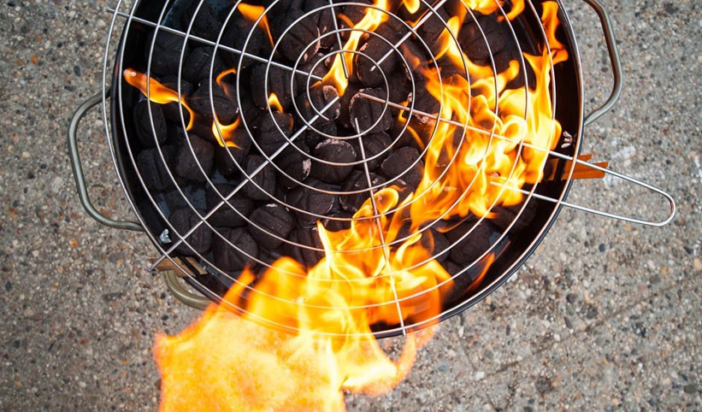
EXTREME HEAT TABLETOP EXERCISE
Date Time
Company/Organization
Disclaimer: These customizable exercise templates were created for the use of private sector organizations by New York City Emergency Management (NYCEM). NYCEM is not responsible for any changes made to exercise materials by participating organizations. The scenarios presented are fictional, and NYCEM cannot guarantee that the City agency actions depicted here will be the City’s response for similar incidents. For more information about the resources NYC Emergency Management has available, please visit us at
NYC.gov/emergencymanagement or email us at publicprivate@oem.nyc.gov.
1

Slide 2
Ground Rules
Don’t fight the scenario! It is a tool to guide the discussion.
This exercise will be held in an open, low-stress, no-fault environment.Varying viewpoints, even disagreements, are expected.
Respond to the scenario using your knowledge of your organization’s current plans and capabilities.
Decisions are not precedent-setting and may not reflect your organization’s final position on a given issue.This exercise is an opportunity to discuss and present multiple options and possible solutions.
Issue identification is not as valuable as suggestions and recommended actions that could improve response efforts. Problem-solving efforts should be the focus.
The Parking Lot: A place to note ideas that can be discussed at a later time.

Slide 3
Background
Wednesday, July 22, 11:30 AM
The summer weather has been especially brutal lately, with temperatures consistently in the high 80s paired with high levels of humidity. Today is expected to be another scorcher.
Local weather forecasters are predicting a sweltering heat wave affecting Montana over the next few days.

Slide 4
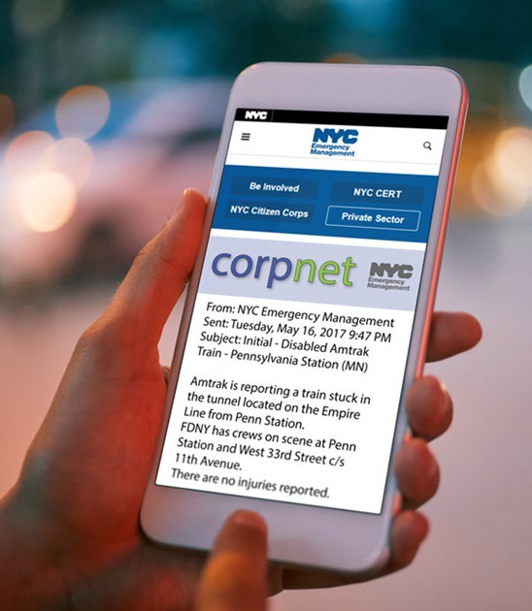
Notification
Wednesday, July 22, 12:30 PM
HEAT ADVISORY IN EFFECT UNTIL 8PM THIS EVENING.
The National Weather Service (NWS) has issued a Heat Advisory:
* HEAT INDEX VALUES: 100 to
104 degrees due to temps. in the low to mid 90s and dewpoints in the mid to upper 70s.
* IMPACTS...Extreme heat can cause illness and death among at-risk populations who cannot stay cool.The heat and humidity may cause heat stress during outdoor exertion or extended exposure.
Considerations:
Introduce yourself and share your role at your entitiy
Choose a spokesperson for your group.

Slide 5
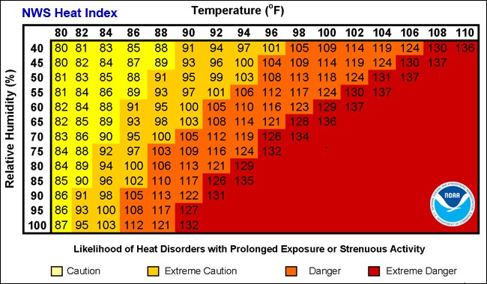
Mayor Declares Heat Emergency
Wednesday, July 22
The National Weather Service has issued an Excessive Heat Watch in effect from Thursday afternoon through Friday evening.
In consultation with MT Department of Emergency Services the Governor activated the state emergency plan.
Considerations:
What impact will this potentially have on the organization and employees?
How would you receive notification of this incident?
What entities in your community would you coordinate with

Slide 6
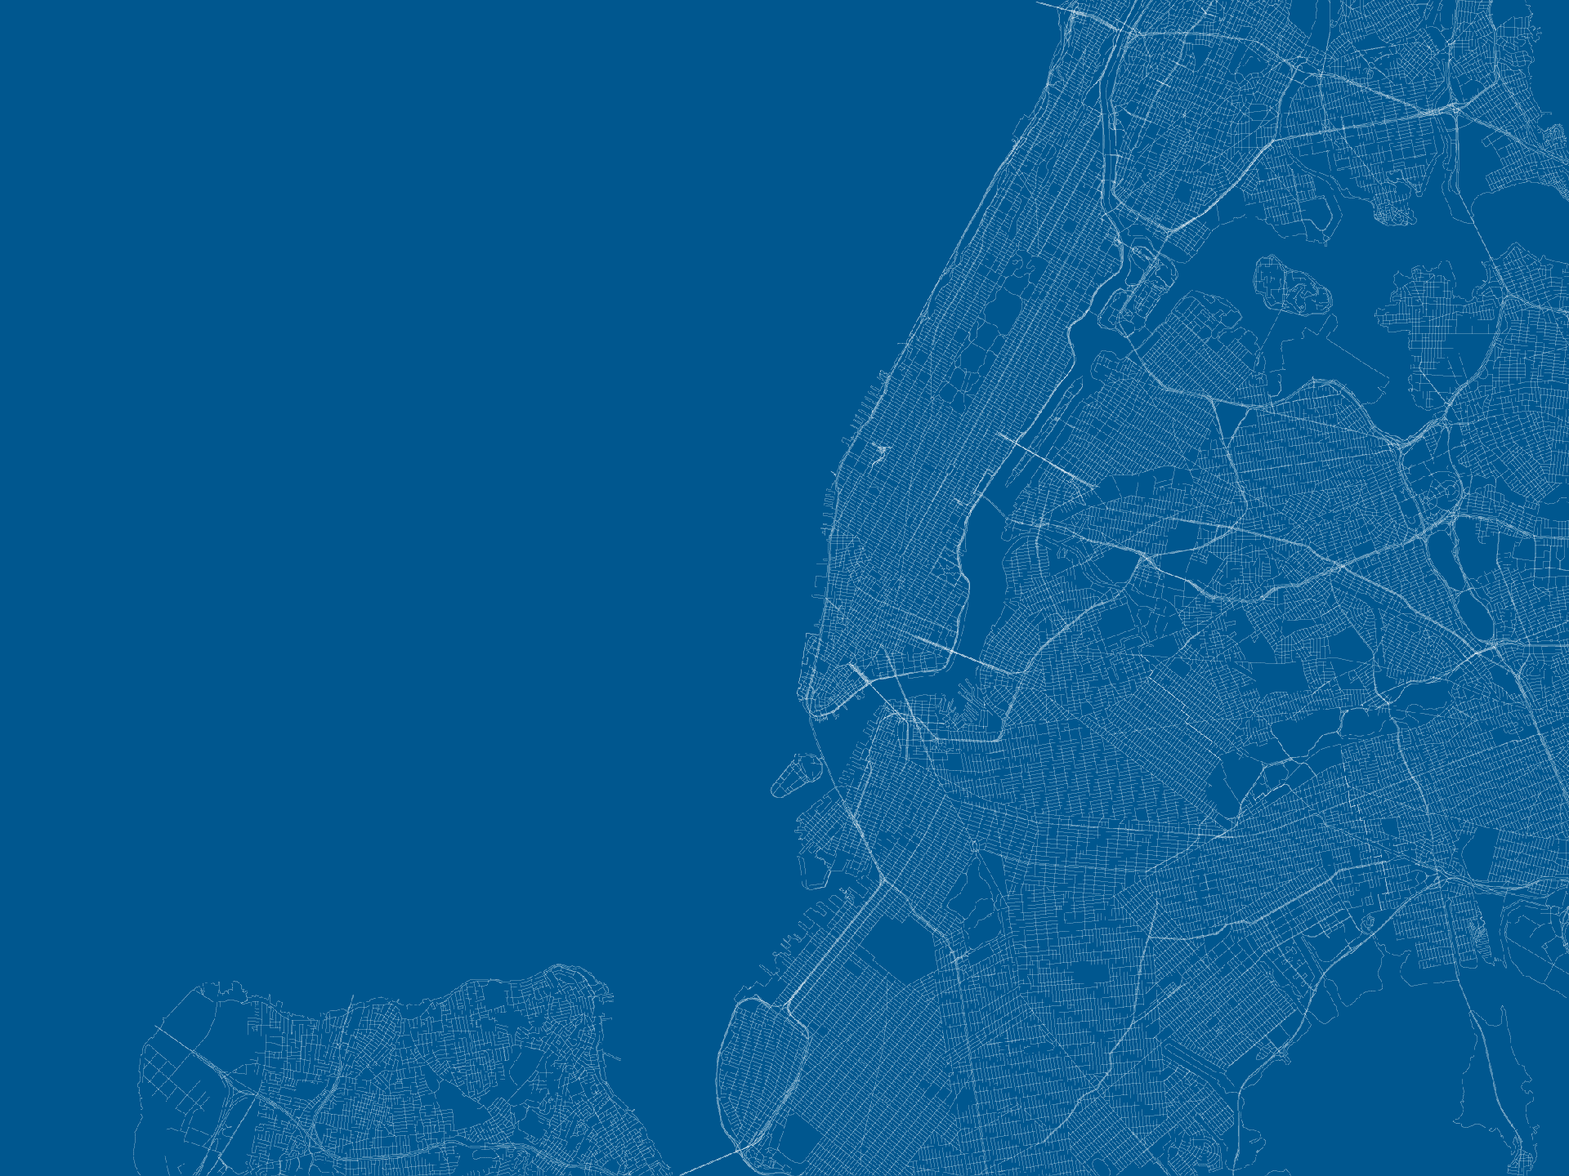
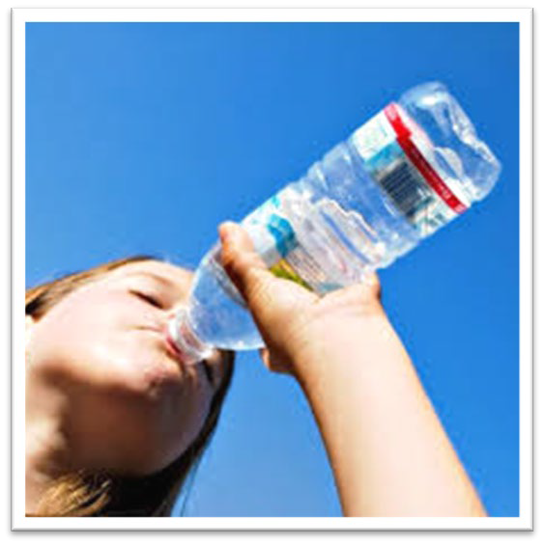
ARE YOU READY?
Stay in a cool place as much as possible. Use air conditioning at home or go to a place that has air conditioning.
Check on vulnerable friends, family members and neighbors.
Drink fluids: particularly water -
-- even if you do not feel thirsty!

Slide 7
Energy Conservation
Thursday, July 23, 11:00 AM
The Mayor in your jurisdiction issues an Executive Order: “Directing Businesses to Conserve Energy” --- requesting thermostatsbe set to 80°F or higher for office buildings
Considerations:
Is there a staff member tasked to manage the building utilities contracts? If you are a tenant, who is responsible for communicating with the building management?
What messaging might you be considering for staff/patients?
Does the organization have means to identify at risk patients?
How will messaging be provided?

Slide 8
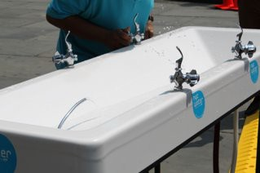
Heat Is Rising
Thursday, July 23, 1:00 PM
Afternoon temperatures have now reached 95° and the NWS forecasts that the heat index tomorrow will reach 105°, with a prediction of 106° the following day.
A pharmaceutical vendor cancels daily shipment of products after experiencing delays in delivery transport.
Considerations:
What disruptions could the organization anticipate based on this prediction?
How will the organization’s vendors be impacted, if at all?

Slide 9
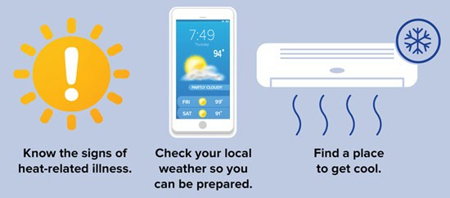
BEAT THE HEAT
REMEMBER: Anyone overcome by heat should be moved to a cool and shaded location. Heat stroke is an emergency! In cases of heat stroke call 911.

Slide 10
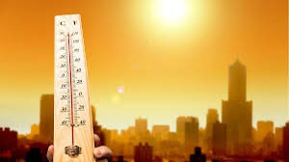
Soaring Demands
Thursday, July 23, 6:00 PM
Energy demands remain high, causing widespread power issues affecting critical infrastructure and key resources throughout the state.
The facilities manager
calls to report that the AC and ventilation system has suddenly lost power.
Considerations:
Does the organization have back-up generators?
Are there any alternative work sites available?

Slide 11
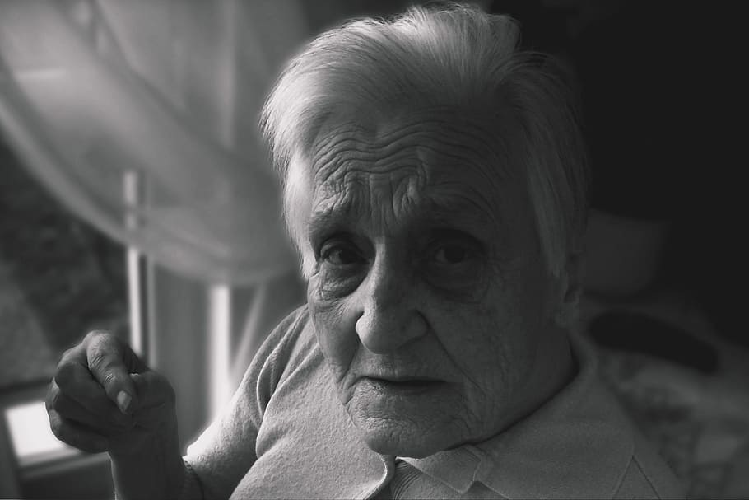
Complicating Matters
Friday, July 24, 9:00 AM
The HR Manager reports an increase in employee callouts related to family/childcare concerns.
The IT Manager reports that several employees working remotely are now experiencing interruptions to their network connectivity.
The call center is receiving multiple calls from patients with no means to regulate home temperatures and an increasing number of people are loitering in you waiting area.
Considerations:
How will these complications impact productivity/safety?
Does the organization have a business continuity plan to prioritize services.
Does the organization have a contingency plan or an IT resolution team?

Slide 12
RECOVERY
Monday , July 27 , 8:00 AM
The NWS indicates that temperatures have returned to seasonal normals.
Mayor’s order and DES emergency status have been lifted.
Scheduled staff are expected to return as regularly scheduled.
Considerations:
What steps will your organization need to take to return to regular operations.
Will additional communications be necessary with vendors, patients, staff…

Slide 13
THANK YOU
For more information about the resources that NYC Emergency Management has available for organizations, please visit us at NYC.gov/emergencymanagement or email us at publicprivate@oem.nyc.gov.

