Slide 1

Living My Best Life (With Diabetes)!
Class One
What is Diabetes? &
The ABCs of Diabetes

Slide 2
Let’s Meet!
Your name
One thing you love about our community
The reason you are here tuned in today!

Slide 3
We are Going to Talk About…
What is diabetes?
The A in the ABCs of diabetes
What does better look like?
Goal Setting

Slide 4
What is diabetes?

Slide 5
What are some of the ways we manage diabetes?
Manage stress
Make and keep appointments with healthcare team
Ask for support from family and friends
Ask questions at healthcare appointments
Healthy food choices
Stay active
Monitor blood sugar

Slide 6
ABCs of Diabetes
A is for A1c
B is for Blood Pressure
C is for Cholesterol

Slide 7
The A of the ABCs
Why do we care about keeping our blood sugar in a healthy range?
Two main ways we monitor blood sugar:
  A1c
  Self monitoring blood sugar

Slide 8
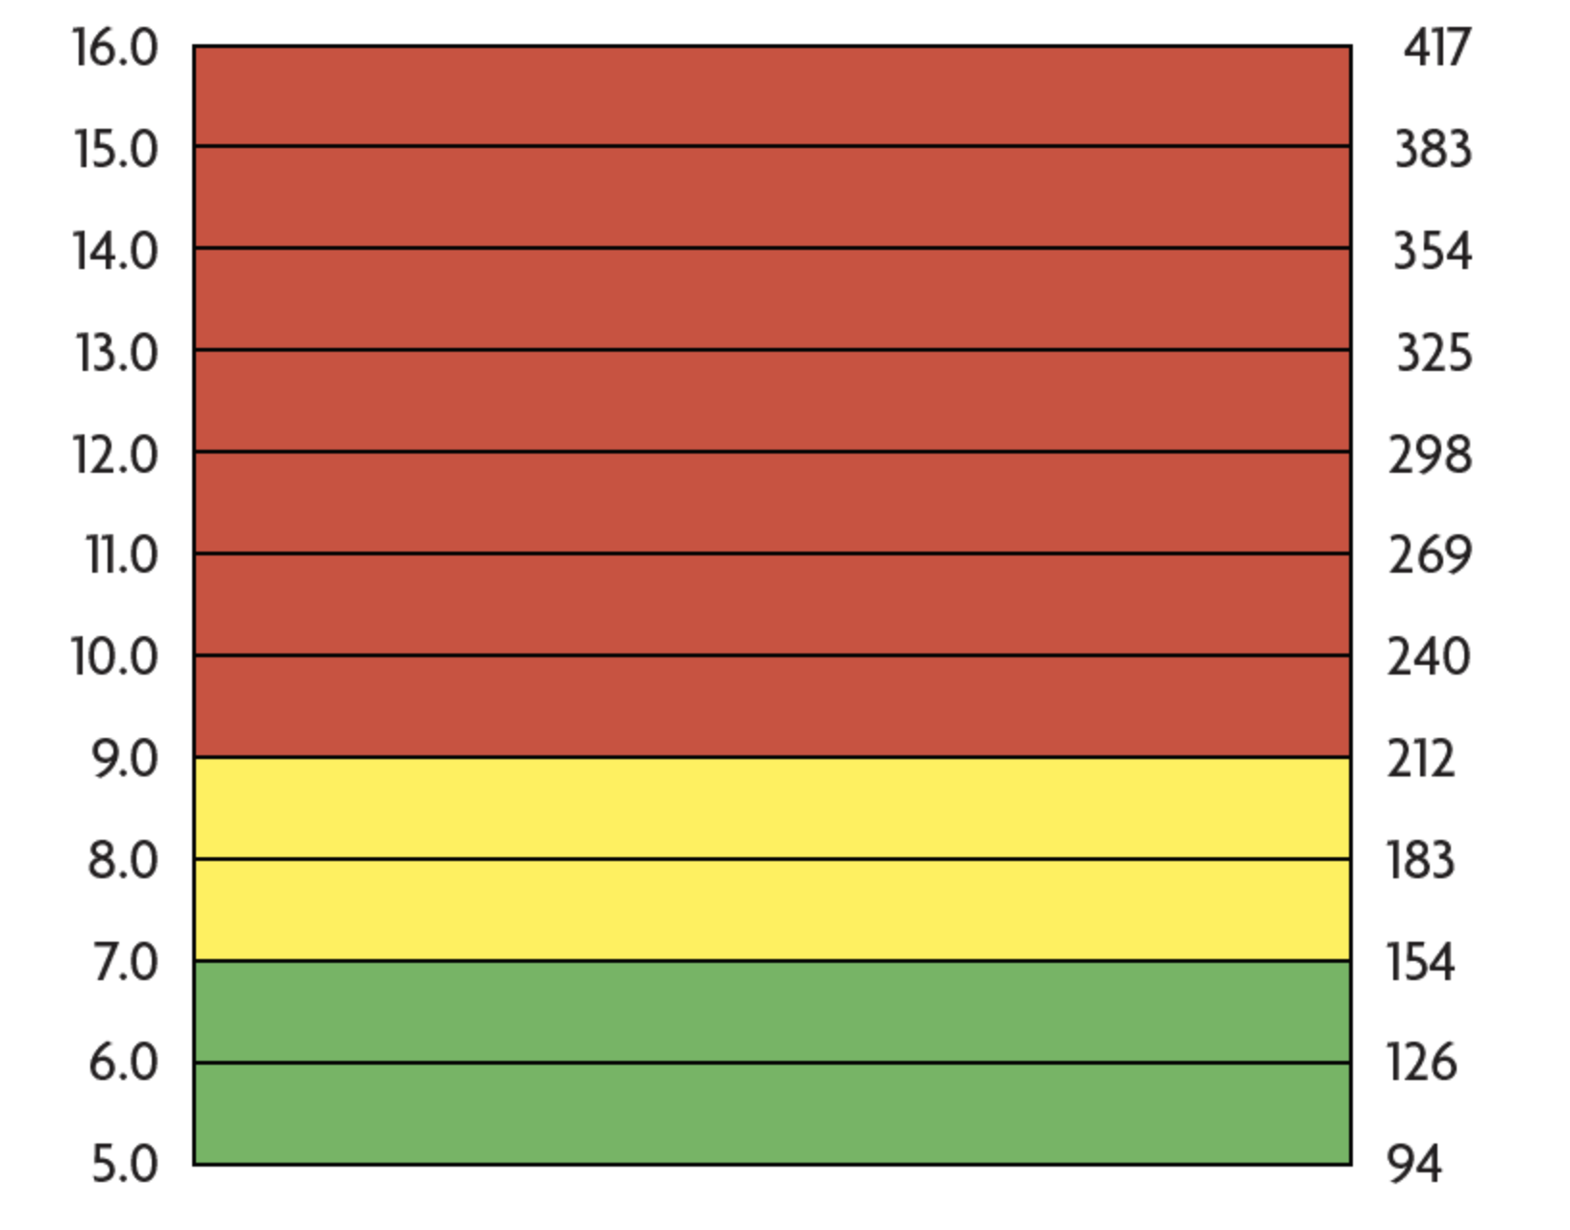
A1c

Slide 9
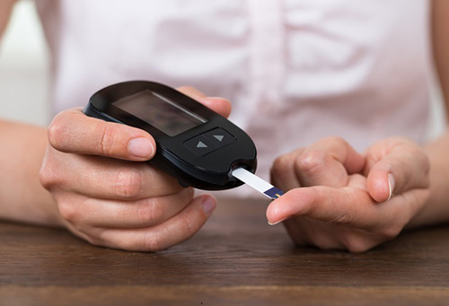
Self Monitoring Blood Glucose
Finger stick monitor
Continuous Glucose Monitor (CGM)

Slide 10
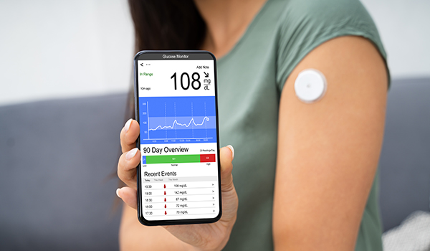
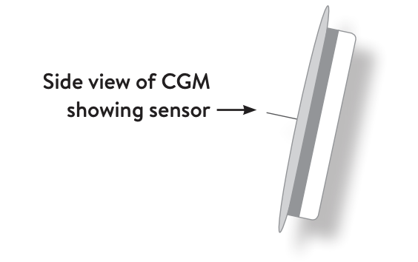
Continuous Glucose Monitor (CGM)

Slide 11
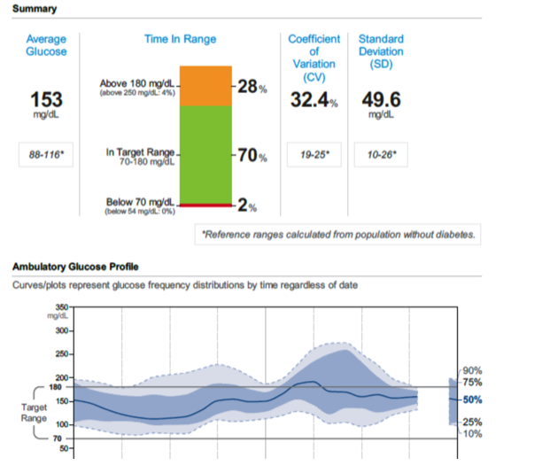

Slide 12
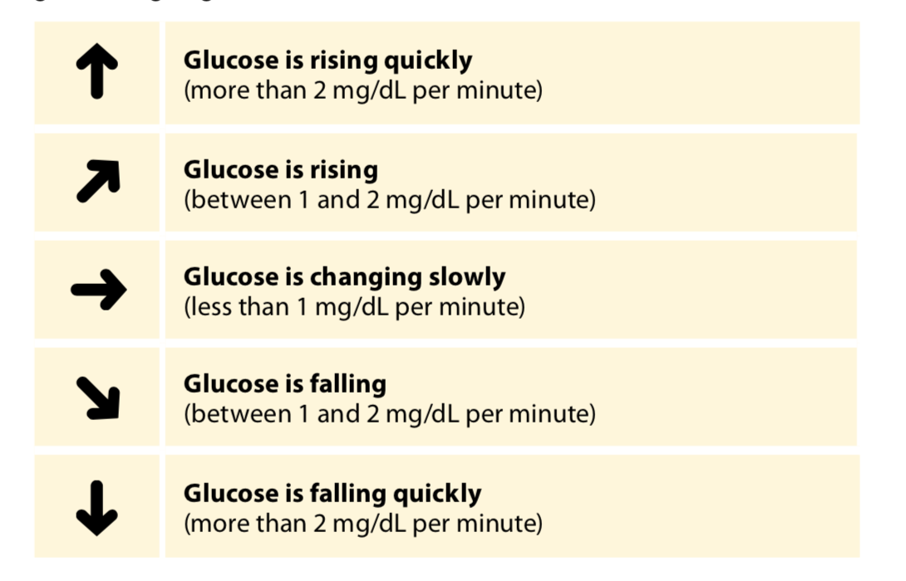

Slide 13
Healthy Blood Sugar Ranges
In the morning before eating?
2 hours after eating a meal?

Slide 14
What if your blood sugar is less than 70?
15 grams of carbohydrate
15 minutes then test again
If still low, repeat steps one and two
If above 80 eat a small meal to refuel
If low after 3 treatments call 911!

Slide 15
What does better look like?

Slide 16
We Talked About…
Three problems in type 2 diabetes:
  The CELL is insulin resistant
  The PANCREAS gets pooped out
  The LIVER is hyperactive
Type 1 diabetes is when the pancreas does not produce insulin

Slide 17
We Talked About…
A1c measures your average blood glucose for the last 3 months.
  Every person with diabetes should have their A1c checked every 6 months, though some may need it tested every 3 months.
Self monitoring of blood sugar with a fingerstick or continuous glucose monitor tells you want your blood sugar is doing at that moment.

Slide 18
We Talked About…
Things that affect blood sugar: food choices, food amounts, exercise, stress, medications

Slide 19
Something I would like to try this week:
  Test blood sugar at another time of day in order to learn more about how my body responds to food, or exercise or my medication
  Make an appointment to get my A1c tested
  Add some exercise to my day
  Other

Slide 20
Next Week….
The B and C of the ABCs of Diabetes!

