Slide 1

Living My Best Life (With Diabetes)!
Class Two
The ABCs of Diabetes

Slide 2
Let’s Catch up!
Did anyone try out their goal from last week?
How did it go?
Did you try any thing else new to help manage your diabetes?

Slide 3
We are Going to Talk About…
The ABCs of diabetes- B and C
Goal Setting

Slide 4
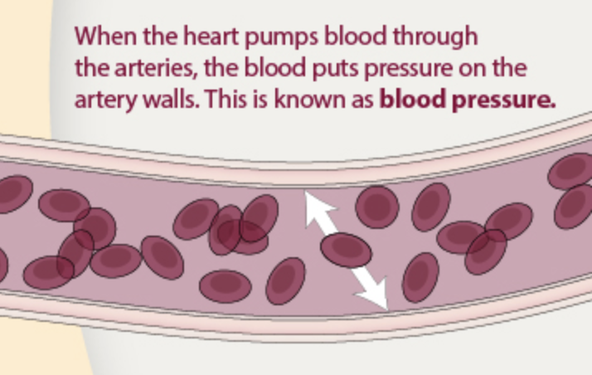
B is for Blood Pressure
Picture of blood pressure.

Slide 5
Ways we can help keep blood pressure in a healthy range
Lose or maintain weight
Stay away from tobacco
Eat whole foods with plenty of fruits and vegetables
Limit sodium and too many processed foods
30 minutes of activity a day

Slide 6
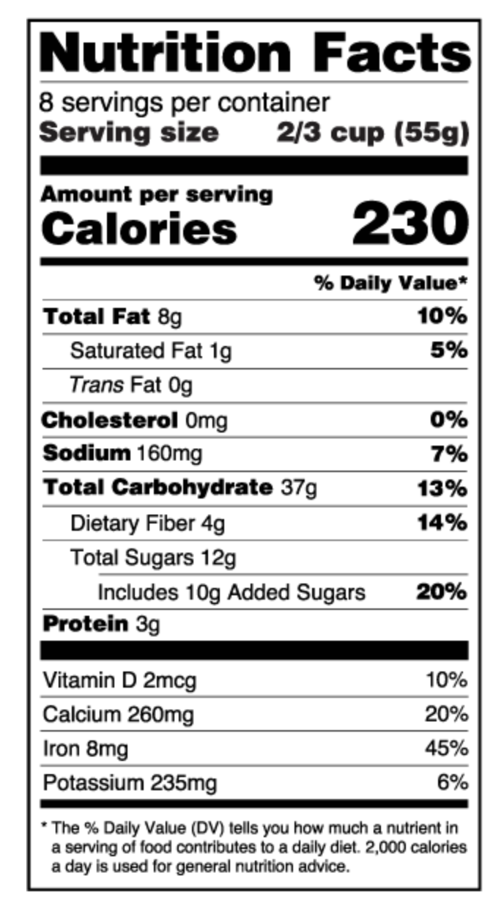
Nutrition Facts Label

Slide 7
What is a good blood pressure number?
120/80 is optimal
130/80 is high blood pressure

Slide 8
C is for Cholesterol
HDL
  Happy! The Higher the better! At least 45
LDL
  Lousy. The lower the better. Less than 100, 70 or 55 (depending on risk)
Triglycerides
  Less than 150

Slide 9
What are some things that keep cholesterol in a healthy range?
Lose or maintain weight
Stay away from tobacco
Eat foods rich in fiber
Eat healthy fats
Avoid too many processed foods
30 minutes of activity a day

Slide 10
We Talked About…
When a person with diabetes’s ABCs of diabetes are in a healthy range, they are at their lowest risk of having a complication related to their diabetes.

Slide 11
We Talked About…
Most people have a blood pressure goal of less than 140/90 or less than 130/80, depending on health conditions
There are many things a person can do to lower their blood pressure or to keep their blood pressure in a healthy range.

Slide 12
We Talked About…
There are many things a person can do to keep their cholesterol in a healthy range.
Most of the lifestyle changes that support a person to have a healthy blood pressure also help a person have a healthy cholesterol.

Slide 13
Goal Setting

Slide 14
Something I would like to try this week:
Read labels for sodium
Try a different seasoning or condiment that is lower salt
Eat one more vegetable a day
Set a quit date
Other?

Slide 15
Next Week….
Diabetes and the body!

