Slide 1

Living My Best Life (With Diabetes)!
Class Three
Diabetes and the Body

Slide 2
Let’s Catch up!
Did anyone try out their goal from last week?
How did it go?
Did you try any thing else new to help manage your diabetes?

Slide 3
We are Going to Talk About…
How diabetes can affect different parts of the body
When (and why!) to get different diabetes screens
Goal setting

Slide 4
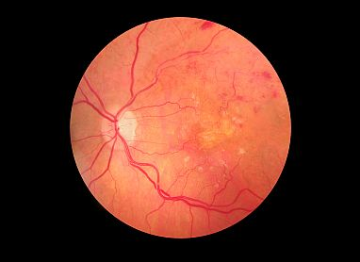
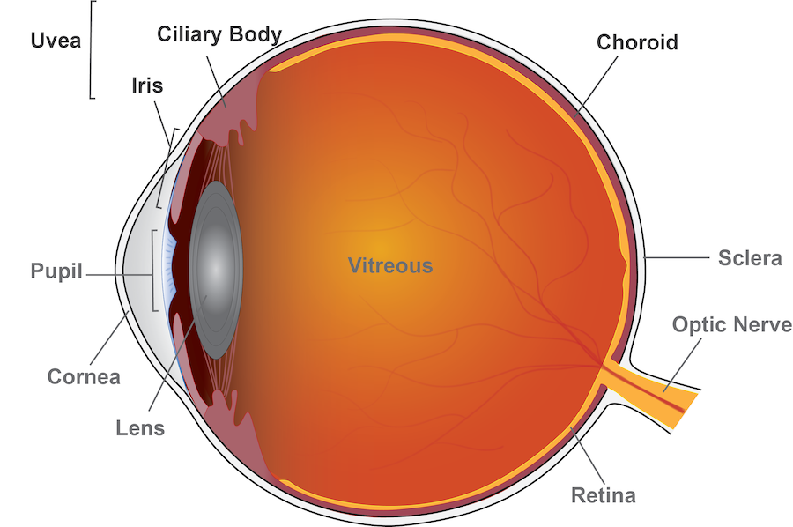
Diabetes Retinopathy

Slide 5
We Talked About…
Diabetes can affect our body in different ways
Keeping our ABCs in a healthy range and keeping up with diabetes screens keeps our risk of developing diabetes complications much lower.

Slide 6
We Talked About…
There are many things we can do to make sure we get the best possible health care from our diabetes healthcare team.

Slide 7
Goal Setting

Slide 8
Something I would like to try this week:
Make an appointment to get one or more needed health screens done
Find out the results of a recent health screen
Write down a question to ask a member of my healthcare team at my next appointment

Slide 9
Next Week….
Eating with Diabetes!

