Slide 1

Living My Best Life (With Diabetes)!
Class Four
Eating with Diabetes

Slide 2
Let’s Catch up!
Did anyone try out their goal from last week?
How did it go?
Did you try any thing else new to help manage your diabetes?

Slide 3
We are Going to Talk About…
Carbohydrate rich foods
Carbohydrate choices per meal
Label reading
The Diabetes Plate Method
Goal Setting

Slide 4
Food Groups
Meat, Cheese, nuts and Eggs
Starchy Vegetables
Fats and Oils
Fruit
Non-starchy Vegetables
Sweets
Grains, Breads and Starches
Milk and Yogurt

Slide 5
1 Carb Choice is….
15 grams of carbohydrate
1 apple, 1/3 cup rice, 1 slice of bread, ¼ cup of raisins, 4 ounces of juice, 1/3 cup of pasta EACH are about 15 grams of carbohydrates

Slide 6
A Good Place to Start
3 choices per meal
1-2 choices per snack

Slide 7
Sample Meal
Sirloin steak
Green salad with carrots, tomatoes and Ranch dressing
1 medium baked potato
Water

Slide 8
Sample Meal
Spaghetti
  2 cups of noodles
  Homemade sauce (tomato sauce from a can, Italian seasonings, hamburger, vegetables)
  1 piece of garlic bread (size of a hamburger bun half)
  Broccoli
  Milk (1 cup)

Slide 9
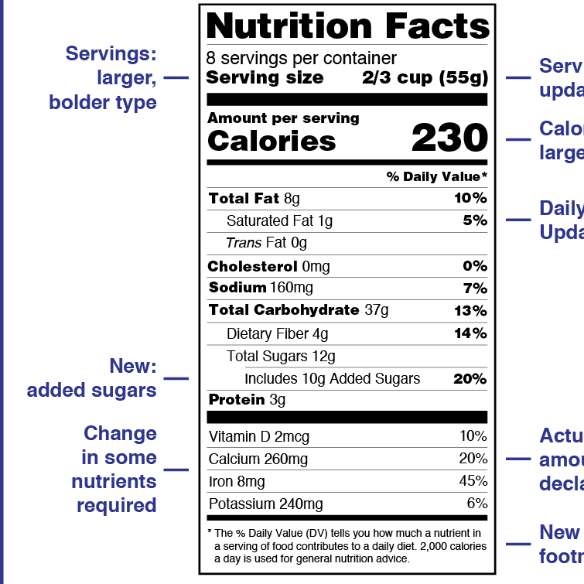
Nutrition Facts Label

Slide 10
Diabetes Plate

Slide 11
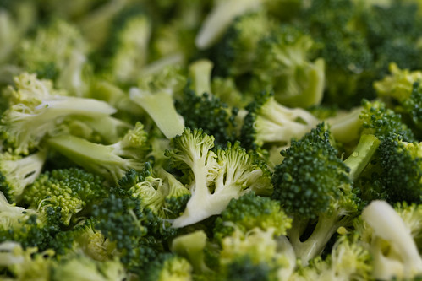
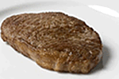
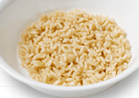
Diabetes Plate

Slide 12
We Talked About…
1 choice of carbohydrate foods is 15 grams
Start with about 3 choices per meal, 1-2 per snack
The Diabetes Plate is another tool to try

Slide 13
Goal Setting

Slide 14
Something I would like to try this week:
Keeping to 3 carb choices per meal
Using the Diabetes Plate at one or two meals a day.
Other

Slide 15
Next Week….
Medications and Diabetes!

