Slide 1

Living My Best Life (With Diabetes)!
Class Five
Diabetes and Medication

Slide 2
Let’s Catch up!
Did anyone try out their goal from last week?
How did it go?
Did you try any thing else new to help manage your diabetes?

Slide 3
We are Going to Talk About…
Diabetes Medications
Insulin
Medication Barriers

Slide 4
What are some of the medication do you take for your diabetes?
Notes:
Type in chat the medications you take.

Slide 5
Why we take Diabetes Medications
Blood Sugar
Blood Pressure
Cholesterol
Another reasons related to diabetes

Slide 6
Give me a thumbs up if one or more of your medications helps keep your blood sugar in a healthy range?

Slide 7
Most Common Medications for Lowering Blood Sugar
Name | How it Works | Causes Low Blood Sugar? | Causes Weight Gain?
Metformin | Tells the liver to stop making so much sugar | X | X
Glyburide, Glipizide (Sulfonuria) | Tells the pancreas to squirt out more insulin | ✔ | ✔
Jardiance, Invokana, Farxiga (SGLT-2) | Causes the kidneys to pee out extra sugar | X | X
Notes:
X is not typical
✓ Is more likely

Slide 8
Most Common Oral Medications for Lowering Blood Sugar
Name | How it Works | Causes Low Blood Sugar? | Causes Weight Gain?
Trulicity, Ozempic, Victoza, Bydureon (GLP-1) | Slows food from leaving the stomach, tells the liver not to make too much sugar, helps the pancreas squirt out more insulin, helps a person feel full. | X | X
Actos (TZDs) | Makes cells more sensitive to insulin | X | ✔
Notes:
X is not typicl
✓ Is more likely

Slide 9
Insulin
The Other Medication that Lowers Blood Sugar

Slide 10

Things to Learn when Starting Insulin
The “type” of insulin
How to inject insulin
When to inject insulin
Syringe or pen?
How food and insulin together affects blood sugar
How to manage a low blood sugar
Who will help you adjust your dosing?
Notes:
Insulin is a hormone our body makes. It allows our body to use blood glucose for energy. It is necessary for life. Sometimes with diabetes a person must inject synethetic, or man made, insulin to live (this is the case for type one diabetes). Sometimes person with diabetes needs to inject synthetic insulin, because their body makes some insulin, but not enough.
The insulin does you start with, probably won’t stay the same over time. Who will help you adjust your insulin? Your diabetes educator? Your provider?

Slide 11
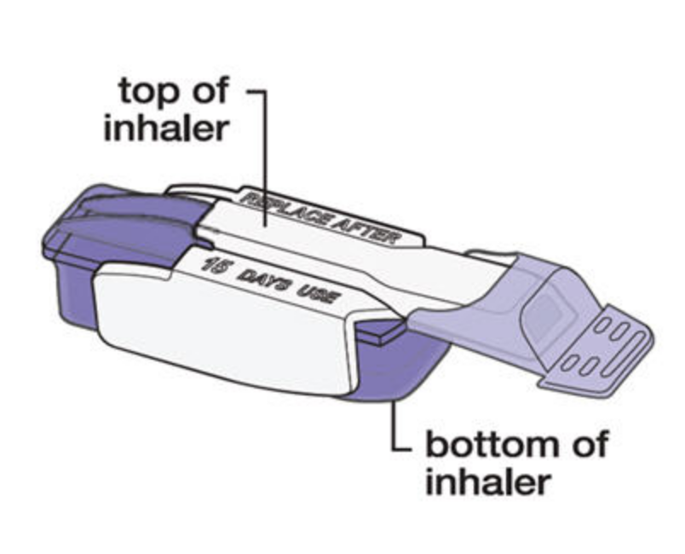
Three Questions to Ask about Each of Your Insulins
1) How soon dose it start working?
2) Does it peak? If so, when?
3) How long does it stick around in the body?

Slide 12
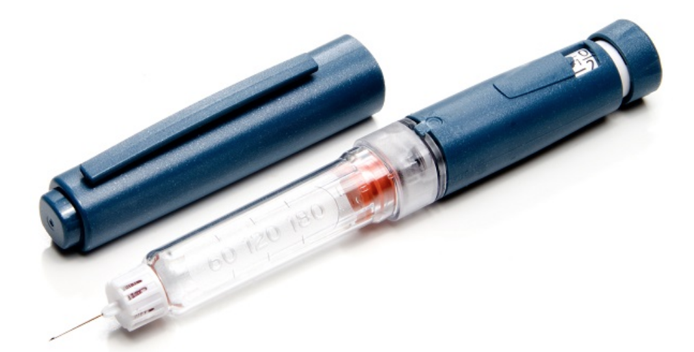
Insulin is Either:
Background (Basal)
Mealtime (Bolus)
Long acting
Short acting

Slide 13
Two types of Insulin at work
Green Line = Mealtime or Bolus Insulin
1
2
3
4
Breakfast
Lunch
Dinner
Red Line = Blood sugar
Blue Line = Basal Insulin

Slide 14
Mealtime Insulin
Ultra rapid acting (Afrezza)
  STARTS working in 12 minutes
  PEAKS in 30 minutes
  DURATION- stays in body about 90 minutes
Rapid acting (Fiasp, Novolog, Apidra, Novolog)
  STARTS working in 15 minutes
  PEAKS- 1-2 hours
  DURATION-stays in body 2-4 hours
Short acting (Humalin, Novolin)
  STARTS working in 30 minutes
  PEAKS- 2 -3 hours
  DURATION- stays in body for 3-6 hours.
Notes:
Every insulin has a 1)START time 2) PEAK time and 3) a DURATION time in the body

Slide 15
Basal Insulin (Background Insulin)
Long acting (Lantus, Levemir, Toujeo)
  STARTS working in a few hours
  PEAKS- no peak
  DURATION- stays in body 18-24 hours
Ultra long acting (Tresiba)
  STARTS working in 6 hours
  PEAKS- no peaks
  DURATION- stays in body up to 42 hours
Premixed insulin- combines a short and long acting insulin

Slide 16
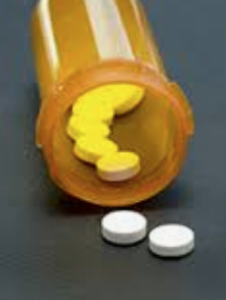
Blood Pressure and
Cholesterol Medication

Slide 17
Barrier Card
I don’t want to take my medication because I don’t know why I need it.

Slide 18
One question you have about your medication

Slide 19
We Talked About…
Different types of diabetes medications
Different types of insulin
Other medications a person with diabetes often takes

Slide 20
We Talked About…
Common medication barriers
The importance of discussing our medication questions and concerns with our healthcare team.

Slide 21
Goal Setting

Slide 22
Something I would like to try this week:
Take my medication as prescribed
Ask my health care provider one question (or more) about my medications
Other?

Slide 23
Next Week…
Diabetes and Exercise!

