Slide 1
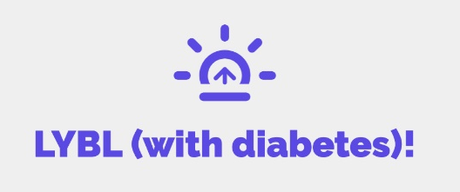
Living My Best Life (With Diabetes)!
Class Seven
Coping with Stress and Self Care

Slide 2
Let’s Catch up!
Did anyone try out their goal from last week?
How did it go?
Did you try any thing else new to help manage your diabetes?

Slide 3
We are Going to Talk About…
What is stress?
Coping with a stress
Problem solving
Making a self care plan

Slide 4
Stress and Coping

Slide 5
What are stressors?
Are stressors always negative?
Are stressors always real?
Can we avoid stressors?
Notes:
Stressors are anything that cause a stress response
No. Change causes stress. Even positive changes, like getting a new job, having a baby, getting a new home, can cause stress.
It is very common for people to have stress and anxiety over what “might” happen.
We cannot avoid stressors. As humans we will encounter stressors, and even need some stressors, what is life if we never have anything happen? How do we grow as humans? Our bodies are built to handle some stressors. Stressors only becomes a problem when they cause chronic stress. And when stress is not being followed by the relaxation response.

Slide 6
How does our body respond to Stress?

Slide 7
Wheel of Stress
Stressor
Stressed Body
Stressed Coping
Stressed thoughts
Notes:
When you are dealing with excessive stress you start to have stressed thoughts- like anxiousness, or obsessive thinking or even despair. Excessive stressed thoughts effect our body negatively and leads to a stressed body. Like we talked about.
Eventually your body will find some way to cope. If you cope in an unhealthy way, like ignoring the problem, withdrawing from social settings, or by losing your temper and screaming and yelling, or by using alcohol, … the more stressed you become. Stressed coping will lead to more stress, which leads to stressed thoughts and a stressed body…. and your wheel of stress will keep spinning, and develops into chronic stress.
We are going to talk about coping. STOPPING the Wheel of Stress, and instead teaching our body how to start the Relaxation Response and stop the production of stress hormones.

Slide 8
Coping practices
Healthy coping practices activate the relaxation response and help stop the stress wheel from turning.
Notes:
As we saw in the Wheel of Stress if you are stressed long enough you are going to put into place some type of coping practice. There are stressed coping practices, which as you recall contribute to the spinning stress wheel.
Or there are healthy coping practices. Healthy coping practices activate your body’s relaxation response. They push the brakes on the car.

Slide 9
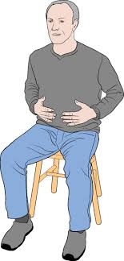
Healthy Coping Tool #1
Abdominal Breathing
  Inhale through your nose for 4 seconds
  Hold for 7 seconds
  Exhale through your mouth for 8 seconds
Notes:
Research tells us that breathing exercises can have immediate effects on the body. Deep breathing is one way you can activate your body’s relaxation response and slow or stop the body’s making of stress hormones. Slow, deep breathing actually stimulates the parasympathetic reaction — the set of nerves that calms us down.
Lets try it.
SAY: Sit comfortably and breath in slowly from your diaphragm (right under your rib cage.) to the count of 4. Hold your breathe for the count of 7 and then exhale slowly for 8 seconds. You breathe, I’ll count.
There are apps for this that will help with timing. “Calm” is a free breathing app.

Slide 10
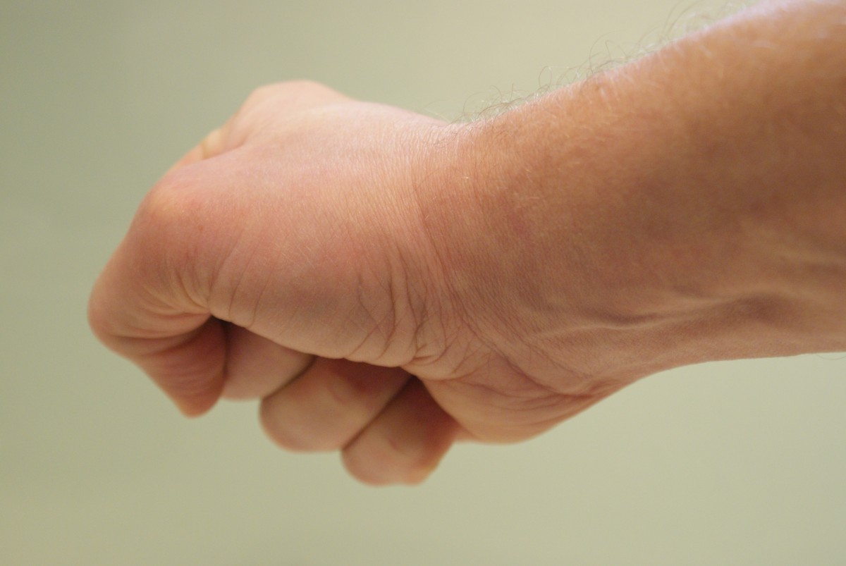
Healthy Coping Tool #2
Progressive Muscle Relaxation
Notes:
The Second healthy coping tool is called progressive muscle relaxation. We hold tension in our body, and this tool helps force our body to relax.
We are going to try it. Sit in your chair comfortably. Put your arms by your side and uncross your legs, if you are a leg crosser. Start by squeezing your eyes tight. Then scrunch up you nose and face as tight as you can. Now smile the biggest, widest smile you can. Not a typical smile, a giant smile, like a cartoon character. Then clench your jaws. Hold this for the count of 8. Then slowly relax your eyes, nose, mouth and jaw. Next move to your neck and shoulders. Tuck your neck into your shoulders like a giant shoulder shrug. Hold for the count of 8. Then relax. Move to your hands and arms. Make tight fists and cross your arms and hug yourself as tight as you can, without letting go of your tight fists. Hold this for 8 seconds. Next, put your arms in front of you as tense as you can. Hold for 8 seconds, then relax. Suck your stomach in as far as you can. Hold it for 8 seconds, then relax. Clench your butt cheeks as tight as you can. Hold and relax. Next put your legs out in front of you. Tense your legs and your feet as tight as you can. Hold for 8 seconds, and relax. Finally, take a deep breathe in, and exhale all the tension. Repeat if needed.

Slide 11
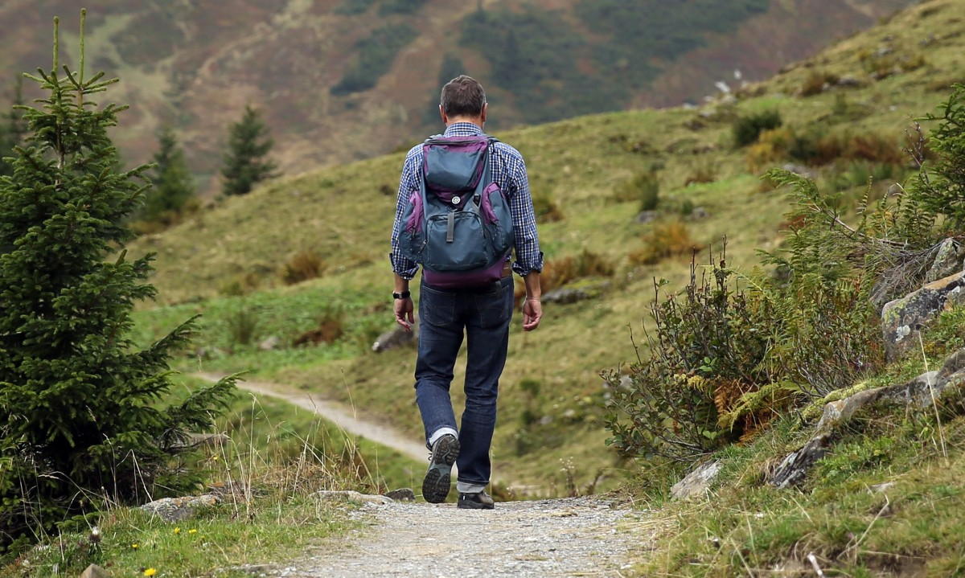

Healthy Coping Tools
Physical Contact
Take a walk
Notes:
Another healthy coping tool you can try, is to ask a person in your life for a hug.
Oxytocin
Physical touch releases the hormone oxytocin. It’s also called the “cuddle hormone”. Oxytocin reduces the production of stress hormones and helps a person to feel more relaxed.

Slide 12
Healthy Coping Tool
What is going on?
How is it effecting me?
Why is this Happening?
What CAN I do to resolve this problem?
Problem solve
Notes:
Problem solving is a stress reduction tool. Problem solving doesn’t sound like a tool. But think of how many issues that have caused you stress over the years, because you ignored the problem.
Problem solving is a LEARNED behavior that you can get better at with practice!
The “four Questions” is a problem solving tool that is been around for a very long time. It helps a person break a problem down, examining the problem, thinking about how the problem is making me feel, why it is happening, and finally what can be done to resolve the problem. Often times when faces with a problem we get stuck in the first three steps. We may think (obsess) over the problem and how its making us feel and the unfairness of it, or unjustness of it, but stop short of taking that final step to resolve the problem.
Let’s try this problem solving tool together.
Problem: Judy plans community functions for her church. She likes to help, BUT its too much work for one person. People tell her they are going to help, they tell her they will show up, but they often bail. Judy finds she often is up until very late baking for events or making decorations. She often doesn’t have time to cook dinner for herself, and she often ends up not doing things she likes that make her feel good- like walking with her friend and going to her relatives for dinner. In fact, more and more, she feels stressed out more days than not
Use your chat

Slide 13
Healthy Coping
Assert yourself!
DEAR
D= Describe the Problem
E= Express how the problem makes you feel
A= Ask for a change (solution)
R= Reinforce your solution by describing how it can make things better for both of you.
Notes:
Assertiveness is another stress busting tool. Assertive can be confused with aggressive, but they are not the same. Assertive means sharing what you need, but still thinking of what others need. Being assertive means forcing your interests on others, regardless of how it might effect them. Others peoples feelings and needs matter, but not more than yours. Being assertive and letting other know what you need is taking care of yourself and your diabetes..
Much of the stress he have, comes from dealing with other people. When we learn to become more assertive, our wants and needs can be heard, and as a result, we can reduce our stress.

Slide 14
Self Care
Making a regular practice of caring for yourself so that you are well and more resistant to stress
Notes:
We’ve been talking about coping and problem solving a stressor to keep the same stressor from reoccurring over and over Coping is what we do to try to help bring about a relaxation response from a stressful situation. It is what we do to keep from becoming chronically stressed.
Self care is what we do to help prevent stressful events from overwhelming us when they do happen. When we are well, we are in a better position to handle a stressful situation that cannot be avoided. Self care practices build resilience against stressors that cannot be eliminated.

Slide 15
Self Care
Physical
Social
Spiritual
Mental
Emotional
Notes:
Social- Having supportive people in your life is key to self care. If you lack emotional support, friendship and meaningful trusting relationships, it is important to focus your energy on finding and making friends.
Maybe reconnect with a family member or distant friend. Or find ways to get to know new people (or better get to know people you know, but not well) by joining an organization, or start volunteering.
Are you getting enough face to face time with friends?
What are you doing to nurture your relationships?
Spiritual- Sprituality is an important piece of our well being. People who think about how they fit into the bigger picture, are generally less stressed, happier people. Spirituality can be religion, but it can also be meditation or walks in nature or anything that helps you give meaning to your life.
Mental self-care includes doing things that keep your mind sharp, like learning about a subject that fascinates you or learning a new skill. It also has to do with gratitude. Are you thankful for what you have and the people in your life? Do you make a practice of taking time to take note of everything you are thankful for? Mental self-care also involves doing things that help you stay mentally healthy.
Emotional self care has to do with your thoughts, your feelings, how you communicate with others. Your thoughts influence your emotions and your behaviors

Slide 16
Develop a self care plan
What area/s could use emphasis?
  Mental (hobbies, learning, gratitude)
  social (making time for friends and nurturing friendships)
  Physical (exercise, sleep, nutrition, etc..)
  spiritual (spending more time focused on the bigger picture)
  Emotional (express emotions in healthy ways, positive self talk)
Notes:
Self-care isn't a one-size-fits-all strategy. Your self-care plan will need to be customized to your needs.
A self-care plan for a new health aide who feels mentally stimulated all the time might need to emphasize physical self-care.
On the other hand, a retired person may need to incorporate more social self-care into their schedule to make sure that their social needs are being met.
Assess which areas of your life need some more attention and self-care. And reassess your life often. As your situation changes, your self-care needs are likely to shift too.
What is one area you could emphasize?

Slide 17
We Talked About…
Techniques for coping with stress
The importance of self care and making a self care plan.

