Slide 1
MOUD in Montana: LAIB Goes the Distance Comparable Efficacy, Social Determinants, Logistics & Treatment Options
Bob Sise, MD, MBA, MPH, FASAM
CEO/Addiction Psychiatrist, 406 Recovery
Consultant, CMS & MPCA
Addiction Medicine Network
June 3, 2025

Slide 2
Why we care about MOUD Access…
80% or more of opioid overdose deaths are preventable with timely access to MOUD
Lack of MOUD: 2–4 times higher risk of overdose death post-detox
Notes:
JAMA Netw Open. 2019;2(1):e187399.
https://jamanetwork.com/journals/jamanetworkopen/fullarticle/2722576
Key Points
Question How are benzodiazepines being prescribed, and how have prescribing patterns changed over time?
Findings In this serial cross-sectional study of 386 457 ambulatory care visits from 2003 through 2015, the use of benzodiazepines in ambulatory care increased substantially from 3.8% to 7.4% of visits, including co-prescribing with other sedating medications. Use among psychiatrists was stable (29.6% vs 30.2%) but increased among all other types of physicians, including primary care physicians (3.6% vs 7.5%), who as a group accounted for about half of all benzodiazepine visits.
Meaning In light of increasing death rates associated with benzodiazepine overdose, addressing prescribing patterns may help curb the growing use of benzodiazepines.

Slide 3
MOUD in Montana: LAIB Goes the Distance Comparable Efficacy, Social Determinants, Logistics & Treatment Options
Bob Sise, MD, MBA, MPH, FASAM
CEO/Addiction Psychiatrist, 406 Recovery
Consultant, CMS & MPCA
Addiction Medicine Network
June 3, 2025

Slide 4
Disclosures:
Nature of Relationship Name of Organization
CEO/Co Founder 406 Recovery (Nonprofit)
Consultant Community Medical Services
Consultant MPCA (Nonprofit)

Slide 5
Objectives
Describe how MOUD options vary pharmacologically
Compare clinical efficacy across MOUD options
Examine clinical considerations for medication selection
Explore the challenges patients face in accessing MOUD in Montana
Acknowledge how collaborative efforts increase access to MOUD

Slide 6
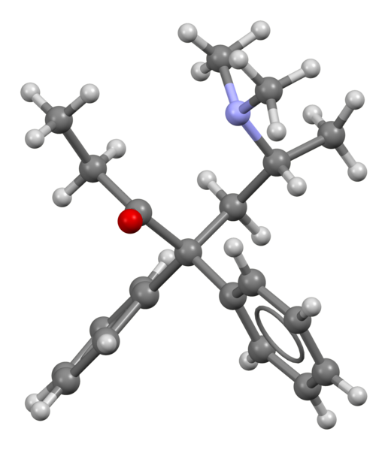
Methadone

Slide 7
Methadone
Full mu-opioid receptor agonist
Half-life (~24–36 hrs)
Efficacy: Highest retention form of MOUD w/ high level of relapse prevention
Risks: QTc prolongation, respiratory depression, higher overdose risk initially in comparison to other forms of MOUD
Requires OTP enrollment with triweekly dosing to start

Slide 8
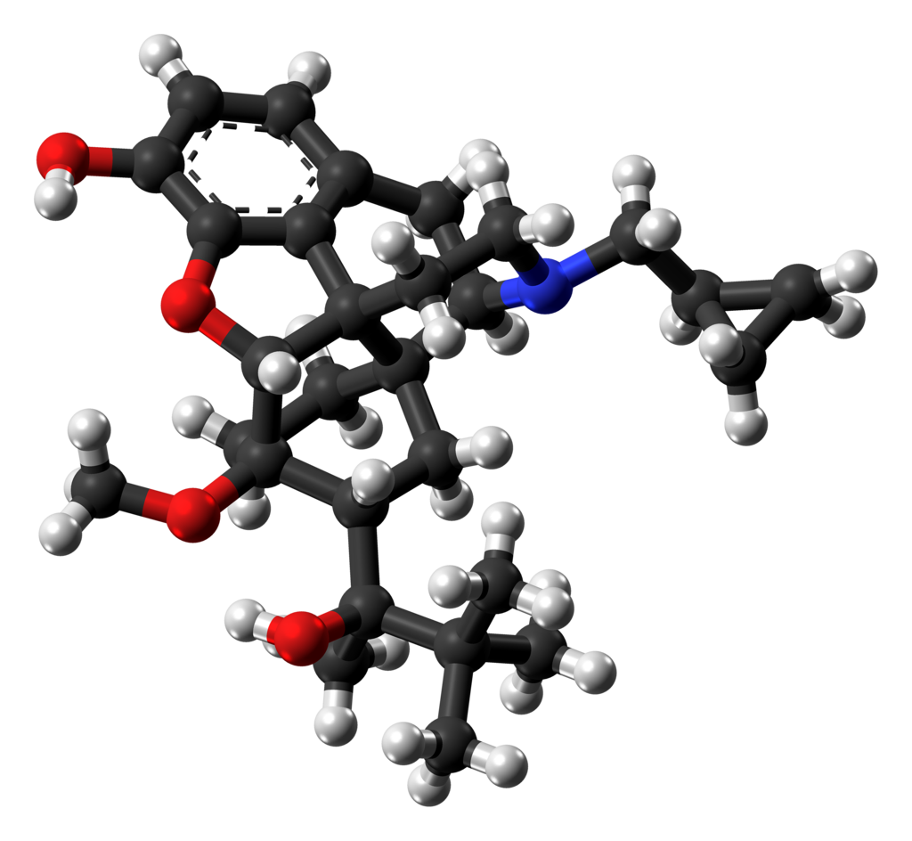
Buprenorphine

Slide 9
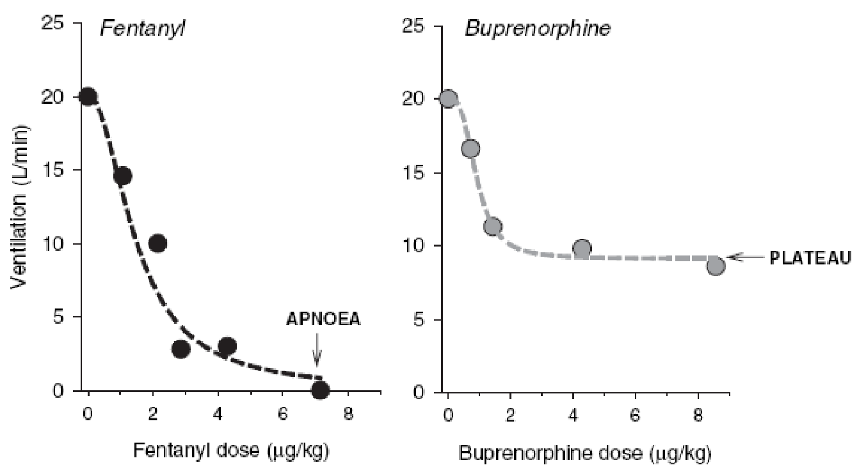
Buprenorphine
Partial agonist at mu-opioid receptor, kappa antagonist w/ high receptor affinity.
Moderate retention, improved with psychosocial support
Ceiling effect: minimal overdose risk

Slide 10
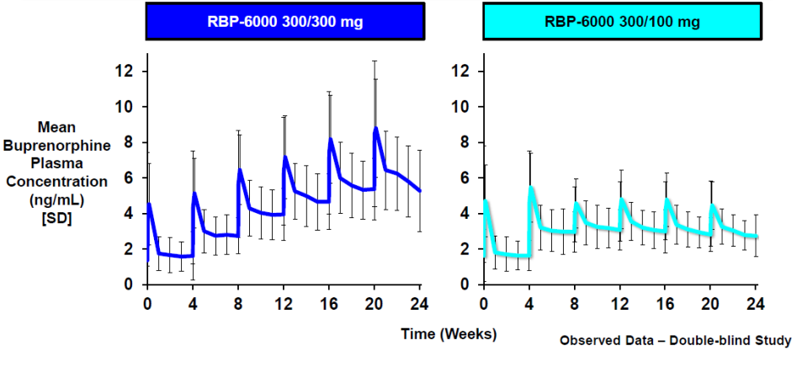
Buprenorphine
Formulations: available both sublingually and subcutaneously
→ Subcutaneous LAIB: (Sublocade & Brixadi): sustained-release partial agonists with variable dosing schedules
Sublocade: monthly subcutaneous injection; steady-state achieved after 2-6 monthly doses; available as 100 mg and 300 mg formulations.
Brixadi: Weekly and monthly subcutaneous injection; flexible dosing from 8 mg to 128 mg per month; weekly dosing allows individualized dose titration.

Slide 11
LAIB Options
Retention and adherence:
Both demonstrate improved retention over sublingual buprenorphine.
Sublocade: simpler dosing schedule, potentially requiring less frequent clinical interactions.
Brixadi’s weekly dosing may offer more flexible titration.
Overdose Risk: Extremely low for both due to consistent opioid receptor occupancy (2/2 stable plasma levels) and relative lack of abuse potential.

Slide 12
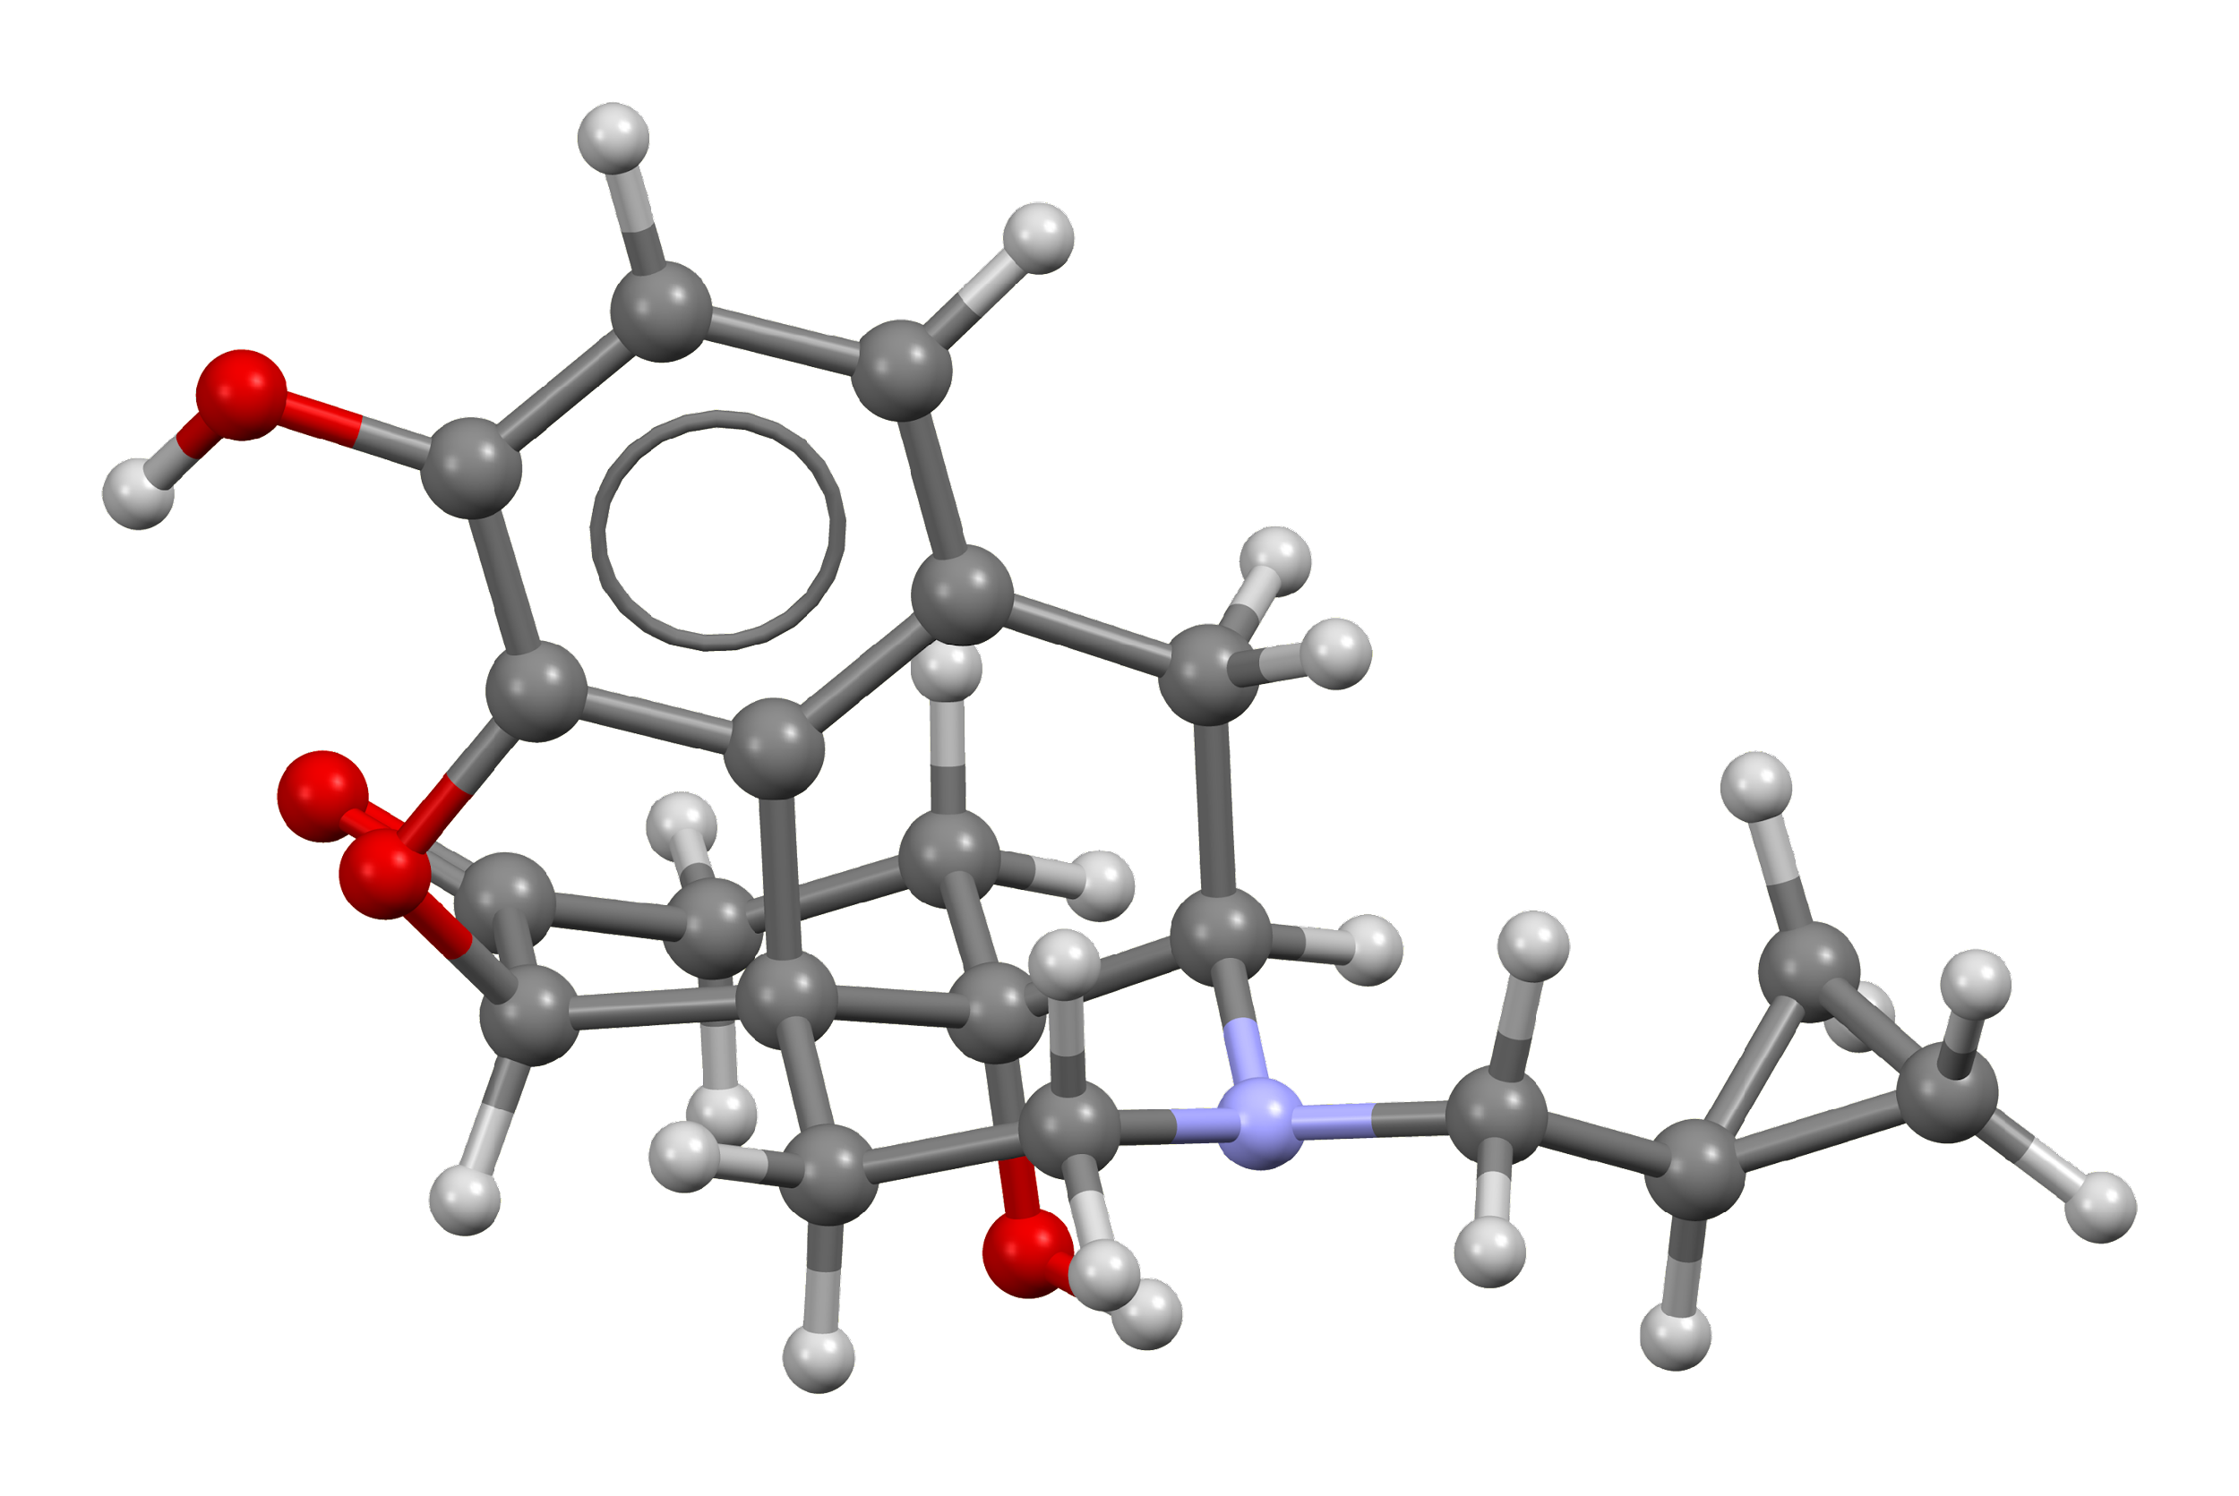
Naltrexone

Slide 13
Naltrexone
Naltrexone HCI (L-isomer) is a pure opioid antagonist
Reversible competitive antagonist at μ, κ and to a lesser extent at Δ opioid receptors
Evidence vastly favors IM Naltrexone (once a month 380 mg gluteal injection) over oral form.

Slide 14
Naltrexone
Effective when initiated, but complicated initiation due to detox requirements
High dropout rate early in treatment = lowest retention
Lack of preserved opioid tolerance → High illicit opioid OD risk
Suitable for highly motivated patients or where agonists are restricted

Slide 15
Comparing forms of MOUD
Notes:
MOUD is essential for treatment of OUD

Slide 16
MOUD: Relative Efficacy
Retention
Strongest predictor of reduced mortality
Methadone > LAIB > Sublingual Buprenorphine > XR-NTX
Relapse Prevention
Methadone and LAIB show most robust real-world protection

Slide 17
MOUD Initiation & Accessibility
Methadone
No risk of precipitated withdrawal
Requires regular visits at an OTP (4 in MT: Kalispell, Missoula, Belgrade and Billings).
LAIB
Access dependent on facilities with injection capability
Expedited initiation now possible per FDA-approved protocol for both Brixadi and Sublocade.
→ Administer a single 4 mg test dose of transmucosal buprenorphine
→ If tolerated, may administer LAIB one hour later

Slide 18
MOUD Initiation & Accessibility
SL Buprenorphine
Widely via telehealth in office-based settings
Requires more frequent visits than LAIB (initially)
XR-Naltrexone
Requires 7–10 days detox, limiting initiation
Access dependent on facilities with injection capability

Slide 19
Patient-Centered Clinical Decision Framework
Assess readiness, medical/psychiatric comorbidities (including other SUDS), and risk environment
Consider prescribing buprenorphine for patients
with benzo/sedative/hypnotic use disorder
Weigh retention likelihood vs. initiation barriers
Support shared decision-making with patient preferences

Slide 20
Long-Acting Injectable Buprenorphine and Social Determinants of Health

Slide 21
Long-acting Injectable Buprenorphine for Opioid Use Disorder: A Systematic Review of Impact on Use on SDOH (2022)
Study Objective:
To assess the impact of Long-Acting Injectable Buprenorphine (LAIB) on SDOH
Methodology:
Systematic review of 15 studies (2010-2020) including 3 RCTs, 1 open label safety study, 2 case series, and 6 qualitative papers examining patient perspectives towards LAIB prior to use
Focus on abstinence, accessibility, employment, forensic issues, gender, and social relationships
Martin E, et al. Long-acting injectable buprenorphine for opioid use disorder: A systematic review of impact of use on social determinants of health.
Journal of Substance Abuse Treatment. 139 (2022) 108776.

Slide 22
Long-acting Injectable Buprenorphine for Opioid Use Disorder: A Systematic Review of Impact on Use on SDOH (2022) - Results
Employment
LAIB demonstrated stable or improved employment rates ranging from 44 to 51% compared to 33% in placebo group
Removed the need for daily pickups from the pharmacy was helpful in engaging in the workforce
LAIB allowed patients to apply themselves at work due to improvement in their mood
Abstinence
LAIB associated with increased abstinence, reduced cravings and high satisfaction rates with treatment
Abstinence rates: 35 to 82% in LAIB group, 28% for sublingual buprenorphine (SLB) intervention, and 5% for placebo
At 24 weeks a significant reduction in illicit opioid use occurred (p < 0.02) in the LAIB arm compared to SLB
LAIB group had high satisfaction rates with the treatment
68.4% of those converted from SLB found LAIB ‘much better’ than their previous treatment
Participants receiving LAIB rated ease of travel, daily adherence, lack of need for daily medication, or regular trips to the pharmacy as ‘extremely important’ to treatment satisfaction
“People wouldn't have to worry about ‘Oh I've got to leave work’ or ‘going to have to tell my manager when needing to access dose’”
Martin E, et al. Long-acting injectable buprenorphine for opioid use disorder: A systematic review of impact of use on social determinants of health.
Journal of Substance Abuse Treatment. 139 (2022) 108776.

Slide 23
Long-acting Injectable Buprenorphine for Opioid Use Disorder: A Systematic Review of Impact on Use on SDOH (2022) - Results
Accessibility
Improved access to treatment, reduced travel burden, and lower risk of medication diversion
Forensic Implications
LAIB-naïve participants indicated LAIB may be beneficial in the prison setting given the potential for withdrawal with short-acting SLB
LAIB treatment reduced active legal issues such as charges, pending trials, and parole (0.017, 95% CI: 0.001, 0.032)
Gender
No study specifically explored the relationship between LAIB and gender equity
Two studies examined gender differences in perceptions of LAIB
Females preferred LAIB as they were ‘discreet’, ‘invisible’, and had ‘less stigma’ associated with them
Females were statistically more likely to believe LAIB was a good treatment (OR = 1.67, 95%CI 1.04–2.69; p = 0.034)
Potential reduction in opioid cravings could reduce the need to commit OUD-related crimes
Martin E, et al. Long-acting injectable buprenorphine for opioid use disorder: A systematic review of impact of use on social determinants of health.
Journal of Substance Abuse Treatment. 139 (2022) 108776.
Notes:
Addiction Severity Index (ASI – Lite) - https://adai.uw.edu/instruments/pdf/addiction_severity_index_lite_baseline_followup_5.pdf

Slide 24
Long-acting Injectable Buprenorphine for Opioid Use Disorder: A Systematic Review of Impact on Use on SDOH (2022) - Results
Social Function
Participants felt that LAIB:
Would offer ‘freedom’ from being ‘chained to services’, allow them to ‘get on with life’, and spend their time on other activities of living
They would be ‘more normal’ when visiting friends, allow them to have a social life, and feel they were being treated as ‘normal’ rather than stigmatized as an ‘addict’
Social functioning showed a statistically significant improvement at 25 weeks in the LAIB group receiving the 300 mg/300 mg dose protocol (p = 0.037) but not the 300 mg/100 mg dose protocol (p = 0.117)
12 months follow-up found statistically significant improvements in the domains of social functioning (95% CI: 2.81, 10.89) and ASI-Lite (p < 0.05) with LAIB
Care of Children
LAIB increased participants’ ability to focus on family responsibilities including childcare, by reducing the burden of pharmacy visits and clinic appointments
Participants believed that the prevention of accidental exposure to children of oral MOUD was an important factor for treatment satisfaction with LAIB
Martin E, et al. Long-acting injectable buprenorphine for opioid use disorder: A systematic review of impact of use on social determinants of health.
Journal of Substance Abuse Treatment. 139 (2022) 108776.
Notes:
Addiction Severity Index (ASI – Lite) - https://adai.uw.edu/instruments/pdf/addiction_severity_index_lite_baseline_followup_5.pdf

Slide 25
Long-acting Injectable Buprenorphine for Opioid Use Disorder: A Systematic Review of Impact on Use on SDOH (2022)
Conclusion:
LAIB shows promise in improving various SDOH aspects and should be considered as part of MOUD
Need for patient-centered approaches and further research on long-term impacts
Recommendations:
LAIB should be offered as part of MOUD in alignment with the recovery model
Future research should evaluate the implementation and longitudinal impacts of LAIB compared to treatment as usual MOUD
Martin E, et al. Long-acting injectable buprenorphine for opioid use disorder: A systematic review of impact of use on social determinants of health. Journal of Substance Abuse Treatment. 139 (2022) 108776.

Slide 26
What are the Drivers of Health?
Socioeconomic
Factors
Education
Employment
Income
Family/social support
Community safety
Health Care
Access to care
Quality of care
Health Behaviors
Tobacco use
Diet & exercise
Alcohol use
Unsafe sex
Physical Environment
Environmental quality
Built environment
Adapted from: American Hospital Association – Addressing Social Determinants of Health, 2018
Notes:
The Drivers of Health
Social and Economic Environment: Non-medical conditions that significantly impact health and quality of life.
Health Behavior: Daily habits, actions, and attitudes that influence health and quality of life.
Clinical Care: Any evidence-based medical treatment provided by health professionals.
Physical Environment: External surroundings and conditions in which we live that influence health and quality of life.
SDOH Impact
20% of a person’s health and well-being is related to access to care and quality of services
The physical environment, social determinants and behavioral factors drive 80% of health outcomes

Slide 27
What are Social Determinants of Health?
SDOH are the conditions in the environments where people are born, live, learn, work, play, worship, and age that affect a wide range of health, functioning, and quality-of-life outcomes and risks
Healthy People 2030, U.S. Department of Health and Human Services, Office of Disease Prevention and Health Promotion. Retrieved March 22, 2024, from https://health.gov/healthypeople/objectives-and-data/social-determinants-health; Photo: Photo by Fibonacci Blue (via flickr.com)
Notes:
Healthy People 2030 sets data-driven national objectives in five key areas of SDOH: healthcare access and quality, education access and quality, social and community context, economic stability, and neighborhood and built environment. Some examples of SDOH included in Healthy People 2030 are safe housing, transportation, and neighborhoods; polluted air and water; and access to nutritious foods and physical health opportunities.

Slide 28
Social Determinants of Health
Economic Stability
Education Access and Quality
Health Care Access and Quality
Social and Community Context
Neighborhood and Built Environment
Healthy People 2030, U.S. Department of Health and Human Services, Office of Disease Prevention and Health Promotion. Retrieved March 22, 2024, from https://health.gov/healthypeople/objectives-and-data/social-determinants-health
Notes:
Healthy People 2030 sets data-driven national objectives in five key areas of SDOH: healthcare access and quality, education access and quality, social and community context, economic stability, and neighborhood and built environment. Some examples of SDOH included in Healthy People 2030 are safe housing, transportation, and neighborhoods; polluted air and water; and access to nutritious foods and physical health opportunities.

Slide 29
Partnering to Improve Access to LAIs for OUD: a Montana Story

Slide 30
406 Clinic Pharmacy + 406 Recovery
Located at 406 Clinic Pharmacy in Missoula, Montana
Addiction Medicine Physician + Pharmacist partnership for MOUD
Buprenorphine extended-release (Sublocade®)
Physician meets patients at 406 Clinic Pharmacy
Appointment takes place at the pharmacy
Physician administers LAIB +/- lidocaine
8 patients seen monthly
406 Clinic Pharmacy creates an environment for patients to receive their medications without stigma or bias, which has led to high patient satisfaction. This collaboration has also reduced no show rates and eliminated medication waste.
Adapted Image Source: Google Maps

Slide 31
Albertsons Company + 406 Recovery
Albertsons & Safeway Pharmacies across the entire state of Montana
CPA allows pharmacists to administer psychotropic LAIs at the pharmacy
Physician/APP prescribes LAI and completes prior authorization (PA)
Albertsons Specialty Pharmacy Team
Certified Pharmacy Technician Care Coordinator
Assures medication arrives at local pharmacy
Collects copay from patient
Coordinates patient appointments for psychotropic LAI administration
Communicates step by step process to prescriber via Albertsons Kordinator portal
Pharmacist Educator
Education to community pharmacists on proper psychotropic LAI administration

Slide 32
Albertsons Company + 406 Recovery
The CPA allows pharmacists to administer the following LAIs
Medications hereby approved to be administered to eligible minors and adult patients aged 18 and older with a patient-specific prescription to administer, including the following:
Aripiprazole (Abilify Maintena® / Abilify Asimtufii®) | Paliperidone palmitate (Invega Trinza®)
Aripiprazole lauroxil (Aristada® / Aristada Initio®) | Paliperidone palmitate (Invega Hafyera®)
Buprenorphine extended-release (Sublocade®, Brixadi®) | Paliperidone palmitate (Invega Sustenna®)
Fluphenazine decanoate (Prolixin®) | Risperidone (Perseris®)
Haloperidol deaconate (Haldol®) | Risperidone (Risperdal Consta®)
Naltrexone (Vivitrol®) | Risperidone (Uzedy®)

Slide 33
Albertsons Company + 406 Recovery
First injection given on August 11th, 2023
2023:
33 injections
2024:
107 injections

Slide 34
Albertsons Company + 406 Recovery

Slide 35
Albertsons Company + 406 Recovery (October 2024 Data)
Kalispell
3
Great Falls
3
Lewistown
2
Helena
3
Miles City
18
Missoula
2
Belgrade
2
Billings
100
Bozeman
7
Adapted Image Source: Google Maps

Slide 36
Montana Access to Treatment Program
Goal: Expand access to MOUD, particularly for uninsured, post-incarceration individuals in Yellowstone County.
Target Population: Individuals recently released from prison, uninsured, and at high risk for opioid relapse.
Services: Monthly long-acting injectable buprenorphine, counseling and behavioral therapy via telehealth, distribution of naloxone kits to all participants.
Reach across the state: leveraging telehealth, in-person and partnerships with local pharmacies for MAT administration.

Slide 37
How MTAP Benefits Yellowstone County
Yellowstone County has the highest projected need in Montana for opioid-related services, with 16.44% of the state’s treatment funding.
The program will directly serve 20 patients over 3 years with comprehensive MAT, behavioral health services & SUD counseling.
Addresses the critical gap in care for uninsured and high-risk individuals post-incarceration, both reducing potential for opioid-related deaths and improving function.

Slide 38
Overview of 406 Recovery
Founded in 2022, 406 Recovery is a Montana-based nonprofit providing SUD treatment across the state featuring:
-several addictions board-certified physicians and NPs
-the greater MT region’s most experienced board-certified psychopharmacologist
-state-certified outpatient SUD treatment facility
Mission: To offer comprehensive, integrated care for substance use and mental health, focusing on evidence-based treatments.
Services include telehealth and in-person care in Billings, Bozeman & Missoula.
→ Medication for opioid use disorder (MOUD), psychiatric care non-SUD mental health disorders and SUD counseling.

Slide 39
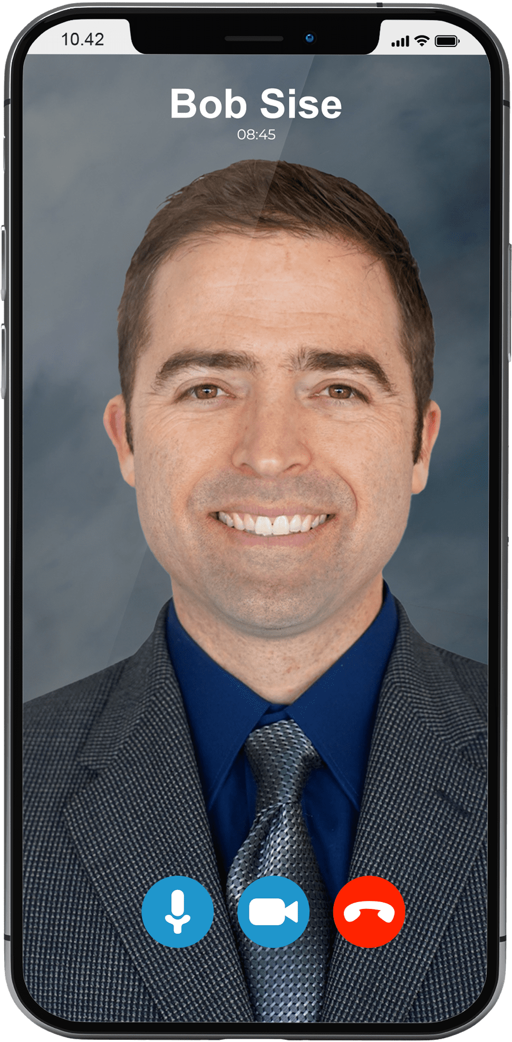
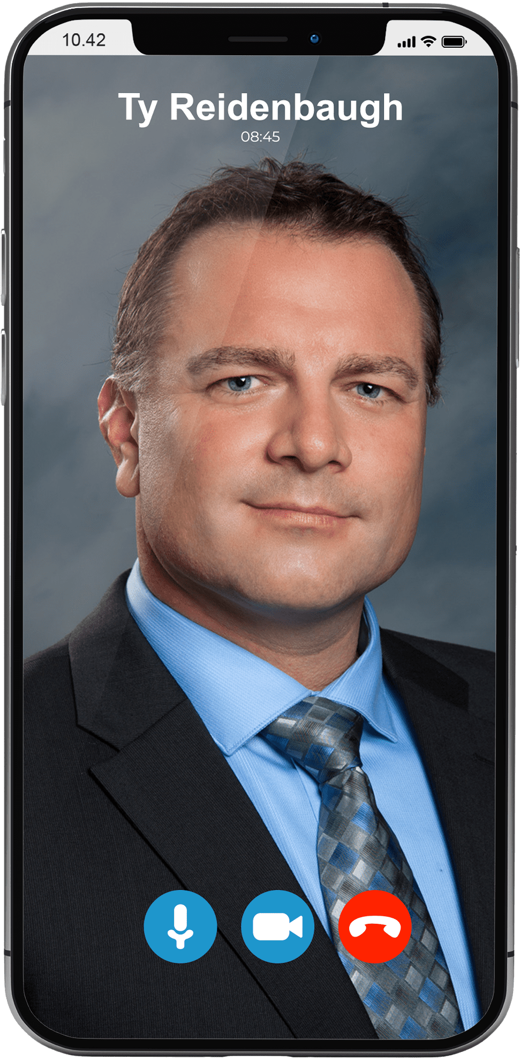
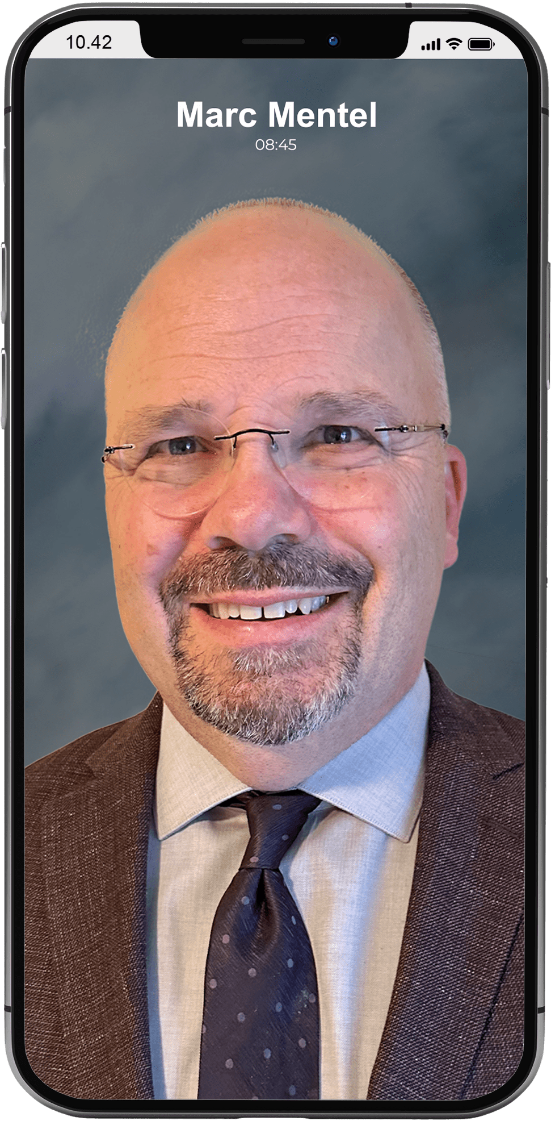
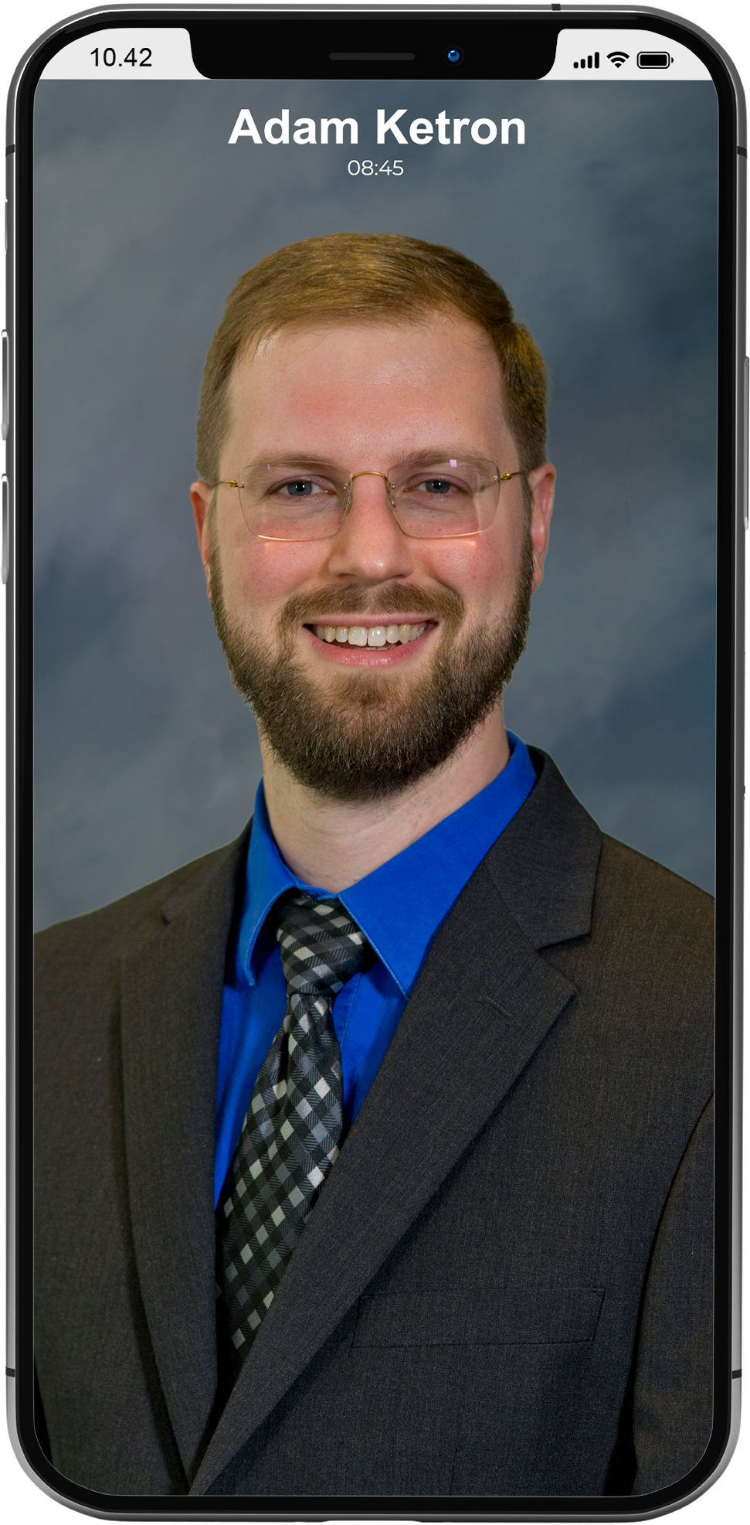
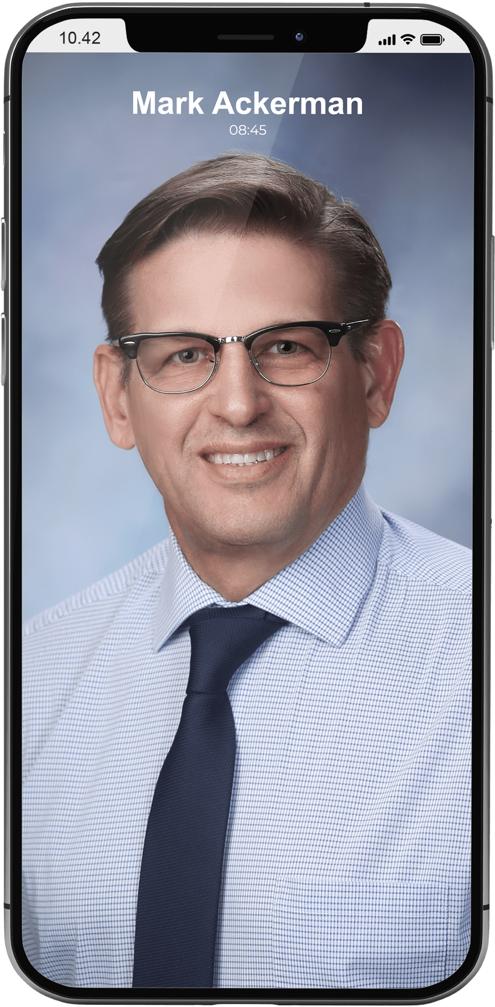
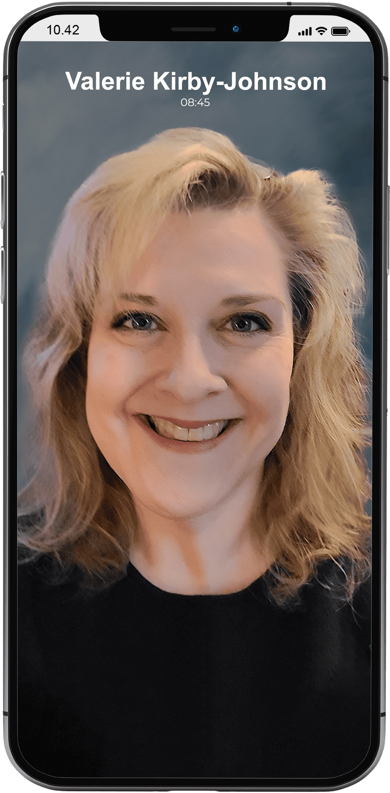
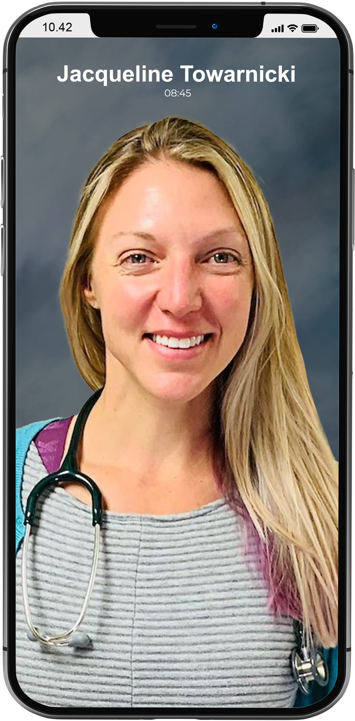
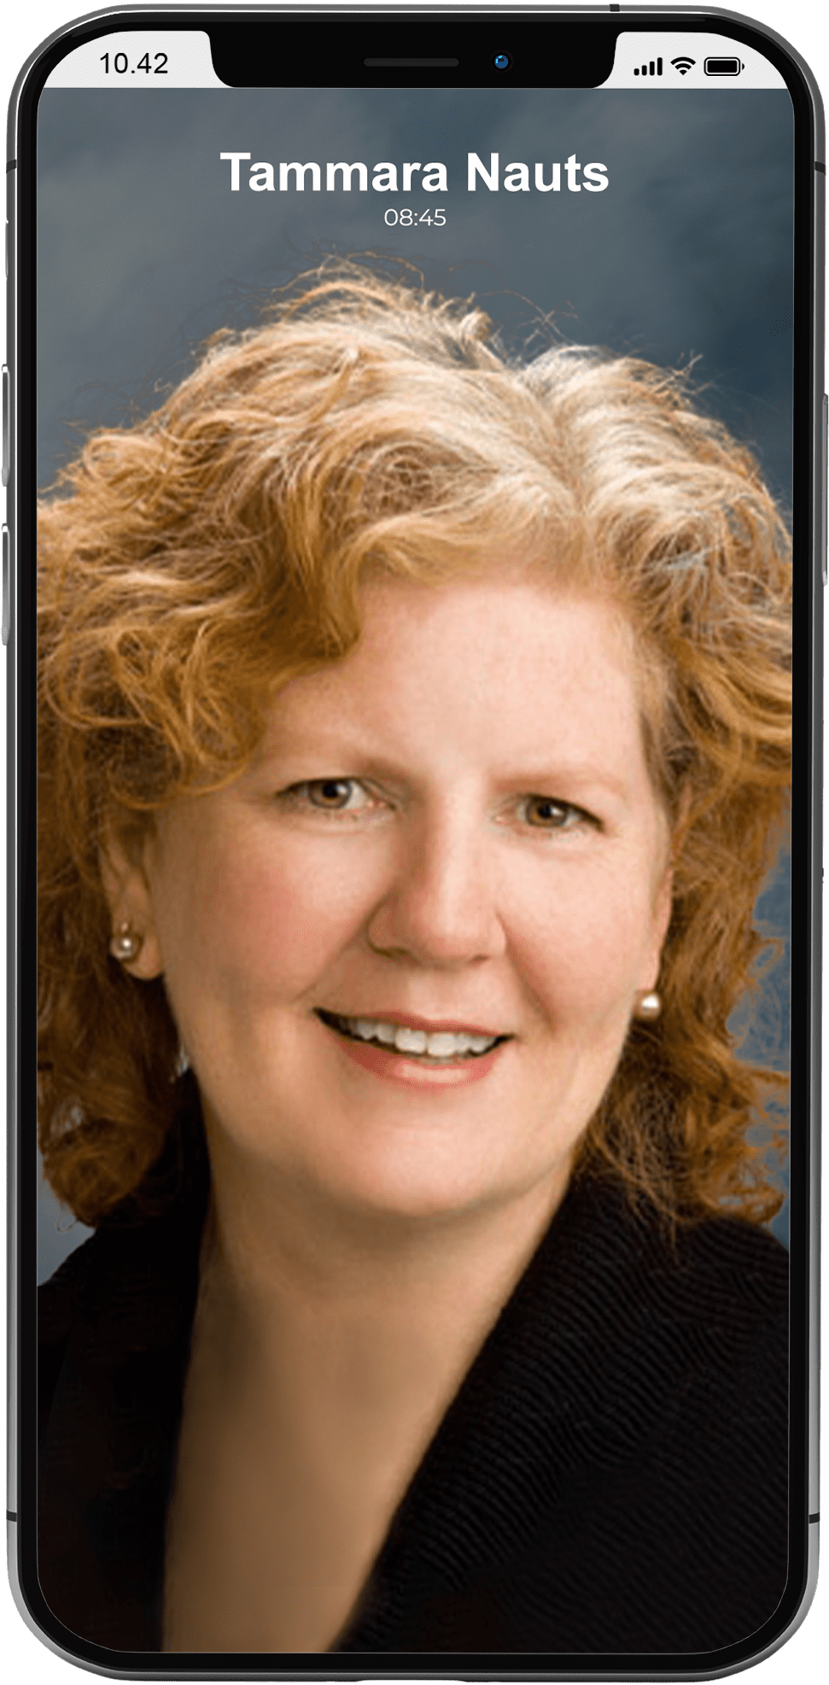
406 Recovery Team
Robert G Sise
MD, MBA, MPH, FASAM
CHIEF EXECUTIVE OFFICER
Ty Reidenbaugh
MD, FASAM
CHIEF MEDICAL OFFICER
Michelle B Reinhardt
PHARMD, BCPP
CHIEF SCIENTIFIC OFFICER
Marc Mentel
DO
PERINATAL SUD DIRECTOR
Adam Ketron
MD, PhD
Kristin Baumert
PA-C, MPAS, CAQ-PSY
Mark Ackerman
MSN, PMHNP-BC, CARN-AP
Valerie Kirby-Johnson
DNP, PMHNP-BC
Mike Benke
MD, JD
Heather Judkins
DNP, PMHNP-BC, CARN-AP
Jacqueline Towarnicki
MSN, WHNP, ANP
Emily Bodner
PMHNP-BC
Kindra Parks
PMHNP-BC
Tammera V Nauts
LCSW, LAC
CLINICAL DIRECTOR
Morgan Thayer
BS
Outreach Coordinator
Cyndi Becker
MEDICAL OFFICE ADMIN
Outreach Coordinator
Cassandra Sparks
CNA
Clinical Assistant

Slide 40
Organization Capacity & Implementation Plan
Capacity: 406 Recovery has the largest network of addiction-boarded providers in Montana.
Partnerships with Albertsons Pharmacies ensure statewide access to long-acting injectable buprenorphine.
Our team includes experts in addiction medicine, psychiatry, and behavioral health.
Implementation: Streamlined access to MOUD through telehealth and physical locations.
Coordination with local Albertsons pharmacies and correctional facilities for post-incarceration care.

Slide 41
Evaluation and Outcomes Measurement Strategy
Enrollment Metrics: Track patient enrollment and engagement in MAT programs.
Health Outcomes: Regular assessments of social determinants of health and reductions in opioid use.
Retention Rates: Measure long-term patient retention and continued engagement with treatment.
Patient Satisfaction: Periodic patient surveys to gauge program effectiveness and areas for improvement.

Slide 42
Objectives
Describe how MOUD options vary pharmacologically
Compare clinical efficacy across MOUD options
Examine clinical considerations for medication selection
Explore the challenges patients face in accessing MOUD in Montana
Acknowledge how collaborative efforts increase access to MOUD

Slide 43
Objectives → Takeaways
Describe how MOUD options vary pharmacologically
Level of agonism vs. antagonism and drastically diff. pharmacokinetics
Compare clinical efficacy across MOUD options
Methadone: greatest retention
Methadone/LAIB: best for relapse prevention
Examine clinical considerations for medication selection
Shared decision making that accounts for comorbidities and logistics
Explore the challenges patients face in accessing MOUD in Montana
Rural setting with long distances from OTPs and traditional clinic settings
Acknowledge how collaborative efforts increase access to MOUD
Availablility when and where many patients access other medications

Slide 44
Sources
Lim, Jihoon, et al. "Relative effectiveness of medications for opioid-related disorders: a systematic review and network meta-analysis of randomized controlled trials." PLoS One 17.3 (2022): e0266142.
Wakeman SE, Larochelle MR, Ameli O, et al. JAMA Netw Open. 2020;3(2):e1920622.
Lim J, Farhat I, Douros A, Panagiotoglou D. PLOS ONE. 2022;17(3):e0266142.
Haight BR, Learned SM, Laffont CM, et al. Efficacy and safety of a monthly buprenorphine depot injection for opioid use disorder: a multicentre, randomised, double-blind, placebo-controlled, phase 3 trial. Lancet. 2019;393(10173):778-790.
Nasser AF, Heidbreder C, Gomis P, Fudala PJ. Safety and pharmacokinetics of repeated subcutaneous injections of RBP-6000 (Brixadi), a sustained-release formulation of buprenorphine, in opioid-dependent patients. J Clin Psychopharmacol. 2016;36(3):242-251.

Slide 45
Sources Continued
Sordo L, Barrio G, Bravo MJ, et al. Mortality risk during and after opioid substitution treatment: systematic review and meta-analysis of cohort studies. BMJ. 2017;357:j1550.
Hickman M, Steer C, Tilling K, et al. Impact of methadone dose on heroin use, overdose risk, and retention in treatment: systematic review. Addiction. 2008;103(3):314-324.
Lee JD, Nunes EV Jr, Novo P, et al. Comparative effectiveness of extended-release naltrexone vs buprenorphine-naloxone for opioid relapse prevention (X:BOT): a multicenter, open-label, randomized controlled trial. JAMA Psychiatry. 2018;75(2):108-115.
Pierce M, Bird SM, Hickman M, et al. Impact of treatment for opioid dependence on fatal drug-related poisoning: a national cohort study in England. Addiction. 2016;111(2):298-308.

Slide 46
Sources Continued
Larochelle MR, Bernson D, Land T, et al. Medication for opioid use disorder after nonfatal opioid overdose and association with mortality: a cohort study. Ann Intern Med. 2018;169(3):137-145.
Substance Abuse and Mental Health Services Administration (SAMHSA). TIP 63: Medications for Opioid Use Disorder. Updated 2021.
American Society of Addiction Medicine (ASAM). National Practice Guideline for the Treatment of Opioid Use Disorder – 2020 Focused Update.
Martin E, et al. Long-acting injectable buprenorphine for opioid use disorder: A systematic review of impact of use on social determinants of health. Journal of Substance Abuse Treatment. 139 (2022) 108776.

Slide 47
Questions?
Contact :
www.406Recovery.Care
Robert.Sise@406Recovery.Care
406-219-7233

