Slide 1
In-House Referral Capture

Slide 2
340B Referral Capture
What is it?
340B referral capture is a program that helps covered entities expand their 340B drug discount program by identifying and capturing prescriptions for patients of a covered entity from external providers/specialists. This can lead to increased access to otherwise unaffordable medications for patients as well as increases “savings” to the covered entity.
What are the requirements?
The covered entity must remain responsible for the care of the patient
There must be an order for referral in the covered entity’s owned medical record for the patient
There must be a summary of the referred provider’s care maintained in the covered entity’s medical record for the patient, and this summary should include any prescriptions provided to the patient, which will allow for auditing
The referred specialist does not need to be a member of the covered entity’s medical staff if all the above criteria are met

Slide 3
In-House Referral Capture
Patient Eligibility- the patient must meet all criteria outlined by 340B policies and procedures in compliance with HRSA.
SWMTCHC must be able to show “responsibility of care”
Patient must have had an office visit or telemedicine visit with a SWMTCHC provider or clinical pharmacist (a nurse visit or office visit with a nurse or care manager does NOT qualify) within 2 years of the written date of the prescription.

Slide 4
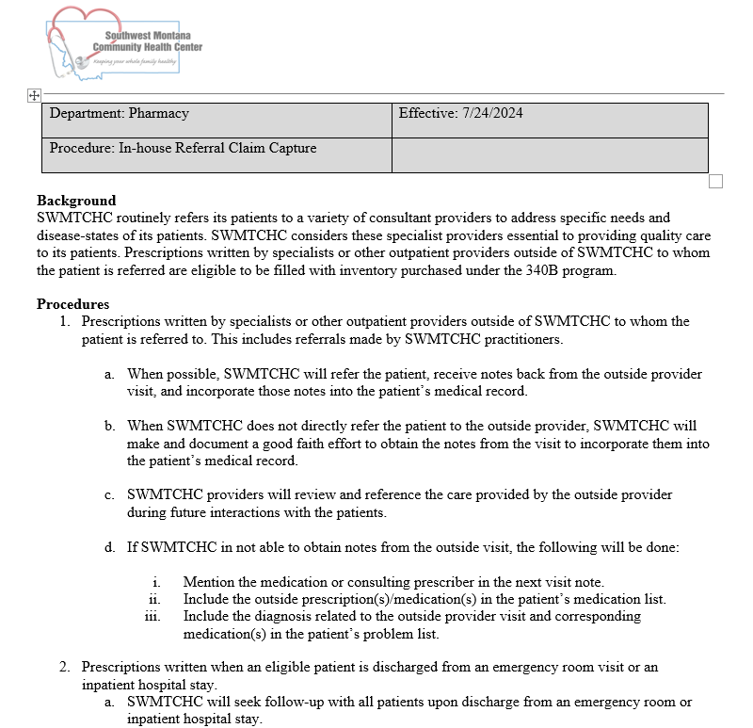
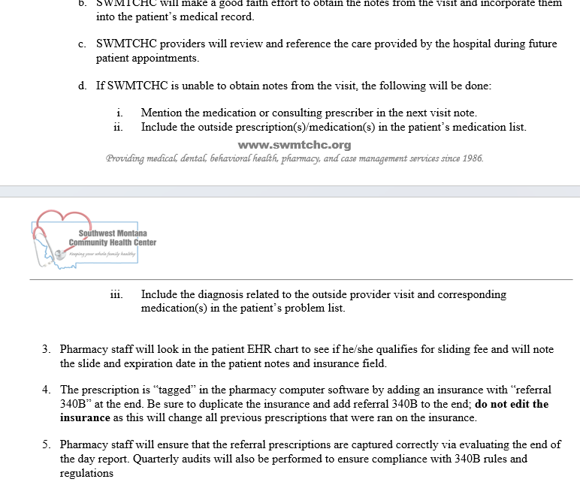

Slide 5
In-House Referral Capture
Documentation
Is the drug on the patient’s SWMTCHC med list?
Is the diagnosis associated with the medication on the SWMTCHC problem list?
Are the consult notes from the “referred to” provider visible?
Is there a formal referral in place or does the provider acknowledge the specialist care in the SWMTCHC chart?

Slide 6
In-House Referral Capture
Procedure
All 340B eligible patients are tagged by adding “swmtchc patient” in the email field of their CRx profile. This is done on a weekly basis in Blacktail and Butte.
A retrospective report is run weekly including the above tag, filtering the 340B doctor to false, and filtering out MMT claims. This reports shows all prescriptions that may be eligible for 340B referral capture.
The 340B coordinator does a thorough chart review in Epic and looks for all the required documentation. If all documentation is found, a note is placed in the prescription notes in the pharmacy software. The note will be time stamped and initialed. Also, a detailed spreadsheet of all information found in the EHR is completed and saved.
The 340B coordinator adds a “new insurance” tagging it as “REFERRAL 340B” to the correct insurance in the patient’s insurance list. She then sends an excel report to the pharmacies asking for the claims to be rebilled utilizing 340B pricing.

Slide 7
In-House Referral Capture- EHR Documentation

Slide 8
In-House Referral Capture-Computer Rx Documentation

Slide 9
