Slide 1
Tapering and Stopping Medication for Opioid Use Disorder
Robert Sherrick, MD, DFASAM
Chief Science Officer
Addiction Medicine Network
Pain and Addiction Conference
June 2025

Slide 2
Outline
Basic concepts about tapering off MOUD
What are good reasons to taper off medication?
What are good reasons to continue medication?
How to decide when/whether to taper.
What to expect during an opioid taper.
Adjunctive treatments – medications, counseling.
Long-term outcomes and monitoring.

Slide 3
Important things to know about MOUD
Opioids are not toxic (except for overdose situations).
They have no long-term toxic effects on heart, lungs, liver, kidneys, brain, etc.
This is not true of most drugs that cause SUDs (alcohol, tobacco, methamphetamine, cannabis).
People who use opioids are normal unless they are in withdrawal or have excessive drug on board.
You can’t necessarily tell which people have opioids in their system.
Most of the adverse consequences of OUDs comes from the fact that they are illegal, the supply is unreliable, or because of using unsterile equipment – not from the drugs themselves.

Slide 4
The benefits of MOUD
Decreased mortality
Overdose deaths decrease by 50-70%
Decreased risk of infectious diseases
Decreased risk of HIV, HBV, HCV, STI, skin infections, endocarditis, sepsis
Improved SDOH
More like to be employed, have stable housing, less depression/anxiety
Less criminal activity, more likely to have custody of children

Slide 5
The negatives of MOUD
Need for daily medication
Can be an issue - vacations, emergencies, incarceration, etc.
Going without medication even for one day can be uncomfortable
Inconvenience and cost of follow up medical visits
Stigma
Patients on MOUD are “not in recovery”
Pressure from family, friends, to stop medication
Patient self-stigma

Slide 6
Balancing benefits and negatives for MOUD
There is no medical reason or urgency to taper or stop MOUD
All the reasons to taper/stop are due to stigma, inconvenience, and cost
Return to using illegal opioids can lead to overdose death
Risk of death increases for a period of time after cessation of MOUD
There is no reason that a counselor or medical provider should push someone into tapering or stopping MOUD - it should be the patient’s decision

Slide 7
Things to know about tapering
Getting off opioids is hard
No matter which one(s) - oxycodone, heroin, fentanyl, buprenorphine, methadone
Potentially risky - for return to use, overdose, etc.
There is no way to get off opioids without experiencing at least some withdrawal symptoms
Some people tolerate opioid withdrawal more easily than others
Withdrawal symptoms, while uncomfortable, are not dangerous
Most people who try to taper or stop MOUD will fail
Up to 80-90% failure rates - but also some successes
The best approach is a slow taper using small dose changes
Months to years

Slide 8
Tapering vs. weight loss
Stopping opioids can be compared to losing weight
Tapering off 16 mg of buprenorphine or 60 mg of methadone is similar to trying to lose 60 pounds
Weight loss requires long-term adherence to a diet regimen (excepting GLP1 drugs)
Weight comes off slowly, a pound or two per week
Most weight loss diets are unsuccessful
It is easy to gain the weight back after a successful diet program

Slide 9
Opioid withdrawal symptoms - acute
Nausea, vomiting, diarrhea, stomach cramps
Sweats, chills, diaphoresis
Generalized achiness, muscle cramps, and an increase in any preexisting pain
Severe fatigue, malaise
Agitation, restless legs symptoms, insomnia, irritability
Usual duration – 5-7 days
Can be extremely dysphoric but are rarely medically serious

Slide 10
Opioid withdrawal symptoms - chronic
Lack of energy or motivation
Fatigue, malaise, depression, anxiety, irritability
Agitation, restless legs symptoms, insomnia
Symptoms can last for months

Slide 11
Shared decision making
Primary decision must come from your patient
Ask non-leading questions about tapering without implying judgment
Assess the patient’s readiness, stability, recovery capital
Only bring up the topic in stable patients who have been doing well for a while
“Don’t you think it is about time to taper off?”
“When do you think you will be ready to start tapering?”
vs.
“What are your longer-term goals or plans around your medication?”

Slide 12
Good candidates for tapering
Dose of medication has been regular and stable for a while
How long is “a while”?
No active SUDs
Household income and housing stable
Supportive relationships, no major stressors
Adequate work and leisure activities
No significant psychiatric or medical comorbidities

Slide 13
Not so good candidates for tapering
Dose of medication has been irregular or changing
Continuing active SUDs
Unstable housing and inadequate household income
Unstable relationships, significant major stressors
Unemployed and/or no work/leisure activities
Significant psychiatric or medical comorbidities

Slide 14
Your patient says she wants to stop her MOUD
What are the reasons? Are they important?
Outside pressure from people with limited knowledge
What are the patient’s plans - are they realistic?
Patients may underestimate the difficulty of stopping opioids
How much “recovery capital” does this patient have?
Are they still using illicit drugs or alcohol?
Social support, employment, housing, etc.
Medical and psychiatric stability

Slide 15
Developing a tapering plan
Your role is to give information and advice and to help your patient understand their own motivations.
Your role is not to make decisions for your patient.
Even if you think your patient is not making good decisions, you should support them in their goals.
We should never be in the position of requiring patients to take more medication than they wish to.
“That provider wouldn’t let me taper my dose . . . “

Slide 16
What does a taper plan look like?
“This is not rocket science, and everyone is different, but what works best for most people is to slowly cut back on their dose when they feel ready.”
Choose an initial dose decrease – best to start with a small change.
Suggest waiting at least a week between dose changes – it may take a few days for a dose change to be felt fully.
Going back up on the dose is not a failure, it is only part of the learning process and revising the plan.
Recommend taking the same dose at the same time(s) every day – don’t vary depending on stress, pain, perceived withdrawals, etc.
Anticipate low level withdrawal symptoms.
Recommend continuation of SUD counseling and other recovery-oriented activities.

Slide 17
Adjuvant medications
May not be necessary if the taper is slow enough.
Can help with some of the low-level withdrawal symptoms.
Avoid benzodiazepines, barbiturates (or use only temporarily)
Clonidine – insomnia, agitation
Hydroxyzine – anxiety
Trazodone, doxepin – insomnia
Ibuprofen – achiness
Ropinirole, pramipexole, rotigotine - RLS
Gabapentin, baclofen, oxybutynin – less commonly used

Slide 18
Tapering can lead to return to use
Although most patients think it won’t happen to them, return to use is common.
Risk of overdose is high due to decreased opioid tolerance.
Patients must be informed of this higher risk.
Make sure patient has naloxone, urge them never to use alone, use a test dose, avoid intravenous administration.
Higher risk that patients will try to hide their use.
Let them know that it is OK to talk about using, cravings, or concerns about their tapering plan.

Slide 19
Fixed vs. open-ended tapers
Fixed tapers are a set up for failure.
Each time the dose is decreased, it is impossible to predict how difficult the transition to the lower dose will be.
Fixed tapers will most likely require a patient to decrease their dose when they are not ready.
Open ended tapers are generally preferred – the patient decides when it is time to decrease the dose again.

Slide 20
“Blind” tapers
Patients occasionally request “blind” tapers - where the provider determines the dose and the patient does not know what the dose is.
For safety, methadone patients must verify their dose at the window, and all take-home doses must have the dose printed on the label.
Impossible to arrange for patients on buprenorphine (maybe Brixadi®?)
Paternalistic and violates principles of MI and shared decision making
Historically, patients usually knew their dose and were no more likely to succeed.

Slide 21
Failed tapering plans
What represents a tapering failure?
Return to use
Serious cravings and concern of return to use
Unacceptable withdrawal symptoms
Increase in the use of other substances
Inability to take medication per the tapering plan
Increase in psychiatric or medical symptoms
“Failed” is not the best description
Each tapering attempt is a learning process
Patients may need to back up, take some time off tapering
When ready, they can use the experience from this attempt to make a plan that will be more likely to work for them

Slide 22
Tapering buprenorphine/naloxone
Strips can be cut into pieces, allowing for small dose adjustments
Using the 2/0.5 mg strips allows for smaller dose increments
Can be cut up into fourths, eighths, or even smaller
Prepare away from water or air drafts
Patients can do this at home on their own
Regular follow up visits to assess their progress
Be supportive of their goals and efforts no matter whether they are successful or not
Assess regularly for risk of return to use
Cover aspects of safe use – naloxone rescue kits, don’t use alone, etc.
Most people can taper down to 8 mg or less with little difficulty

Slide 23
Completing a taper of buprenorphine
Many patients struggle with the last few milligrams.
Going from 24 to 2 mg is about half of the work – getting off 2 mg is the other half.
Tiny dose adjustments are usually possible by cutting up the 2 mg strips.
Psychological adjustment to not taking any medication can be a challenge.
Continued support once off medication should be offered.
Consider injectable naltrexone once the patient has been off buprenorphine for 2 weeks or longer.

Slide 24
Alternative – using injectables
Injectable buprenorphine has a long half-life and self-tapers over time.
Sublocade® may taper over several months.
Less experience with Brixadi® but more dose options available.
Patients may elect to taper the injection dose and then stop, letting their serum buprenorphine level decrease slowly over time.
Continued support, adjuvant medications.

Slide 25
After a taper
Congratulations on achieving a long-term personal goal!
Risk for return to use or development of a new SUD remains elevated.
Remind patients about safe use and make sure they have naloxone rescue kits.
Consider injectable naltrexone once adequate time has passed to prevent precipitated withdrawal upon initiation.
Having some adjuvant medication on hand may help in cases of stress, cravings, etc.
Offer continued support. Recommend patient take advantage of their own support resources.

Slide 26
Most people who need OUD treatment do not get it
Liu L, Zhang C, Nahata MC. Trends in Treatment Need and Receipt for Substance Use Disorders in the US. JAMA Netw Open. 2025;8(1):e2453317. doi:10.1001/jamanetworkopen.2024.53317
Notes:
Summary of our current experience with XTHs

Slide 27
Most people who need OUD treatment do not get it
For all SUDs, prevalence increased from 8.2% to 17.1% from 2013 to 2023.
OUD prevalence more than doubled from 0.8% to 2.0%
AUD from 6.6% to 10.2%
DUD from 2.6% to 9.6%
Only 18.3% of PWOUD received treatment in 2022.
AUD treatment rate was 7.6% and DUD was 13.1% in 2022.
Of those who did not receive treatment, only 5.7% perceived a need for it.
Of these less than half made efforts to seek treatment
Liu L, Zhang C, Nahata MC. Trends in Treatment Need and Receipt for Substance Use Disorders in the US. JAMA Netw Open. 2025;8(1):e2453317. doi:10.1001/jamanetworkopen.2024.53317
Notes:
Summary of our current experience with XTHs

Slide 28
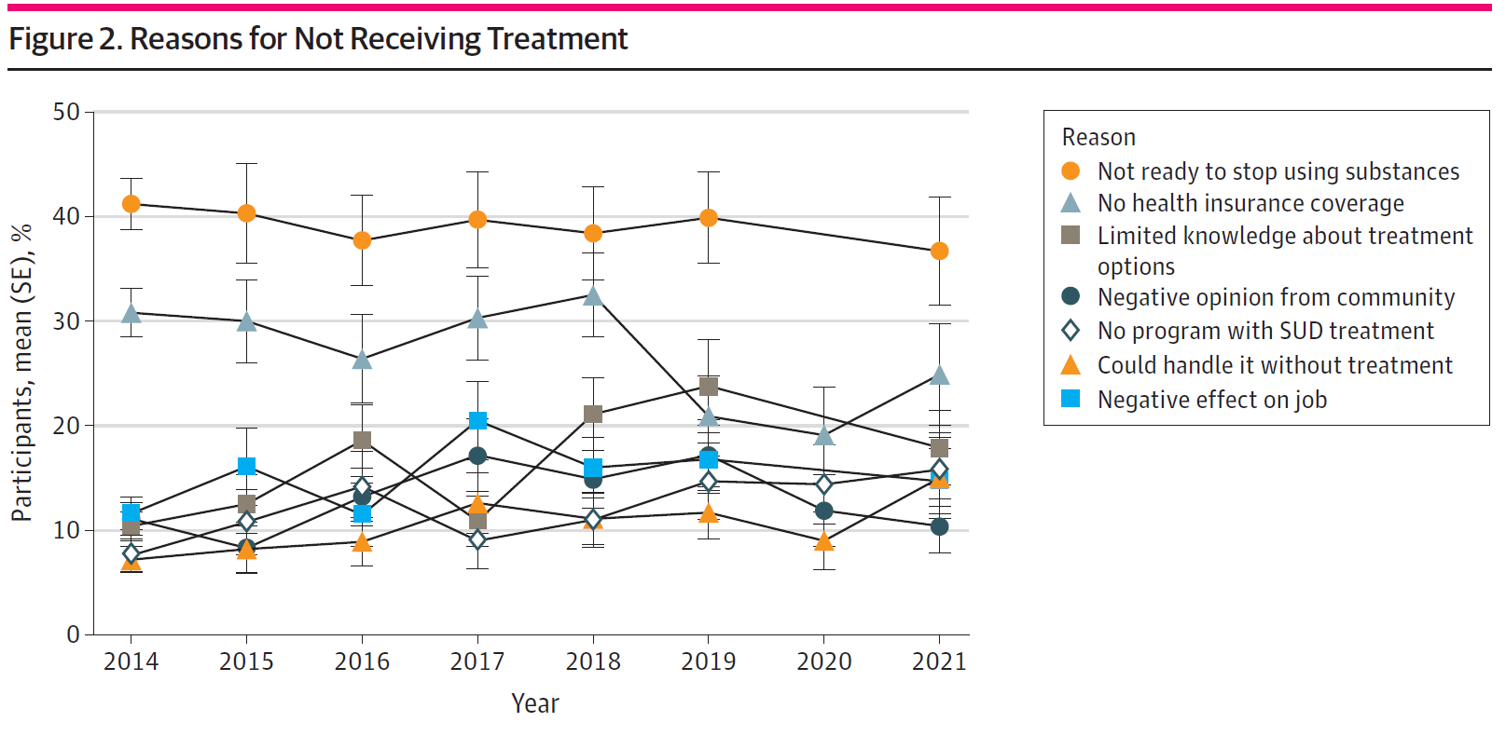
Why do people who need SUD treatment not ask for it?
Most of these issues can be addressed by education and outreach.
Liu L, Zhang C, Nahata MC. Trends in Treatment Need and Receipt for Substance Use Disorders in the US. JAMA Netw Open. 2025;8(1):e2453317. doi:10.1001/jamanetworkopen.2024.53317
Notes:
Summary of our current experience with XTHs

Slide 29
What people need to know about low barrier MOUD
While abstinence may be a final goal, it is not required, and everyone is welcome whether they are ready to stop using or not.
Do not discharge patients on the basis of UDS results
For methadone, most patients only need to come to the clinic 3 days a week to start out.
Patients can move to weekly clinic visits after 2 weeks if doing well
Clinic hours are designed to allow people to continue with work and other normal activities
Wait times for dosing are usually < 5 minutes
Financial issues should not be a barrier
Many patients are on or eligible for Medicaid (note: Medicaid continuation critical to maintain access)
Out-of-pocket cost is much less than obtaining street drugs
MOUD is still not widely understood and remains stigmatized - even among PWOUDs.
Much more public outreach and education needed
Notes:
Summary of our current experience with XTHs

Slide 30
The importance of providing MOUD
“Everything is going great - methadone has helped me to be a functioning member of society. I got full custody of my kid, an apartment, and a full-time job.”
“This makes me feel normal, not like a criminal having to ‘check in’ even when I was doing good.”
“Fentanyl is a horrible drug and methadone saved my life.”
“Can I just say…Thank you!! You don’t know what this has done for my life.”
Notes:
Summary of our current experience with XTHs

