Slide 1
Where AUD, OUD and Chronic Pain Intersect
Pamela Pentin, MD, FAAFP, FASAM
Associate Professor, Family Medicine
University of Washington School of Medicine

Slide 2
No conflicts of interest or financial disclosures
But I come bearing gifts….

Slide 3
UW TelePain for Montana
Weekly pain and addiction webinar every Wednesday11am-12:30pm MT, 12-1:30pm PT
Sponsored for the State of Montana by a grant from the Office for the Advancement of Telehealth, Health Resources and Services Administration (HRSA), U.S. Department of Health and Human Services
25-minute live pain and/or addiction-related didactic followed by real case presentations from providers across NW with advice from a multi-disciplinary expert panel
Anesthesia/Pain Management, Psychiatry, Rehabilitation Medicine, Addiction Medicine, Integrative Medicine, Family Medicine, Pain Psychology, Pain Pharmacology
Register for session links: https://redcap.iths.org/surveys/?s=PL8YLL7JL8
telepain@uw.edu

Slide 4
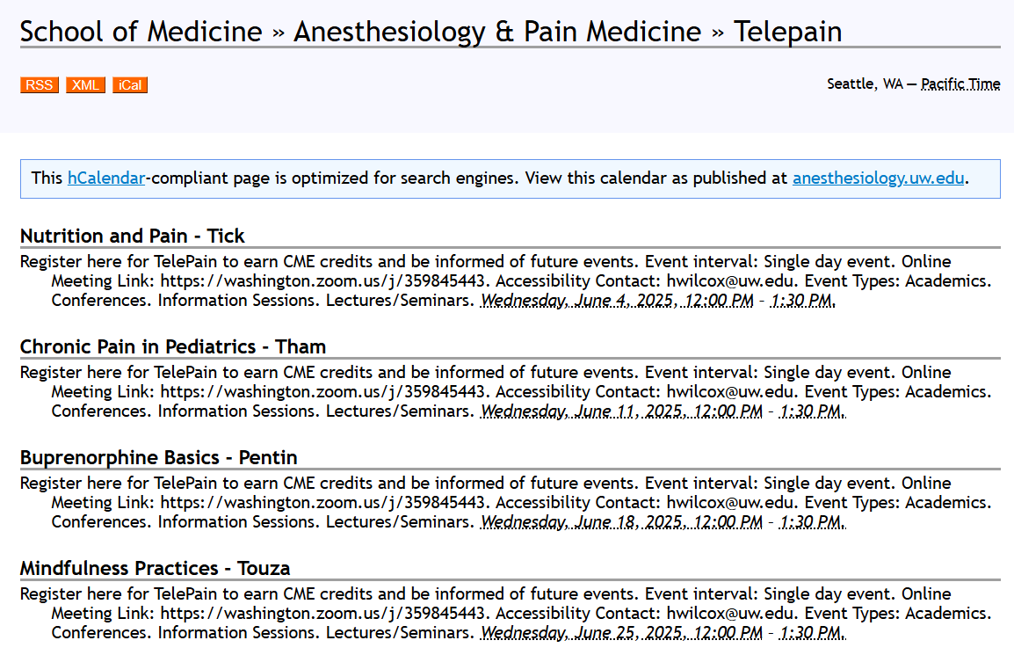

Slide 5
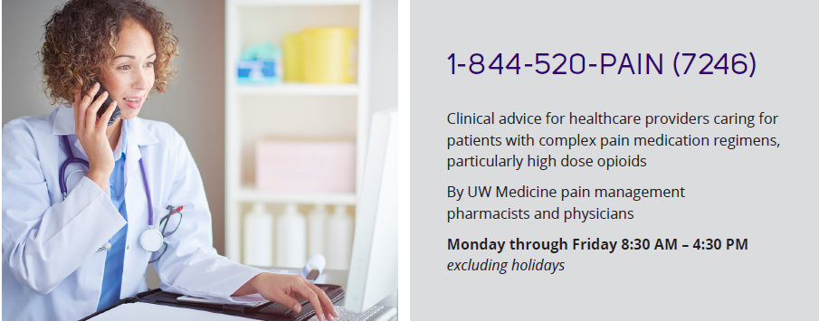
UW PAIN + OPIOID HOTLINE FOR MONTANA
Email: painhotline@uw.edu

Slide 6
But first, let me give you something for the pain…

Slide 7
The Lens
258 million adults
52 million adults with chronic pain
29 million adults with AUD
10 million adults with OUD

Slide 8
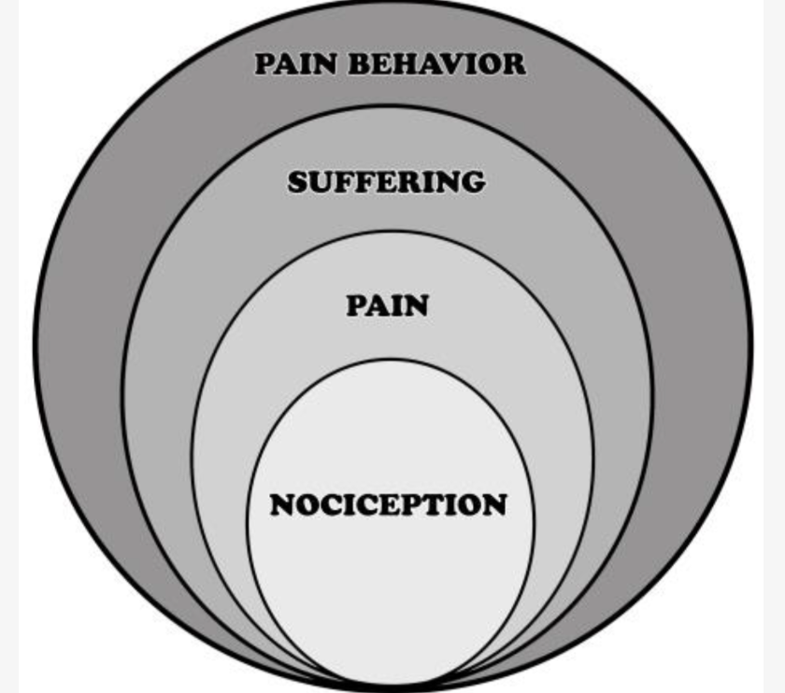
Loeser’s Onion

Slide 9
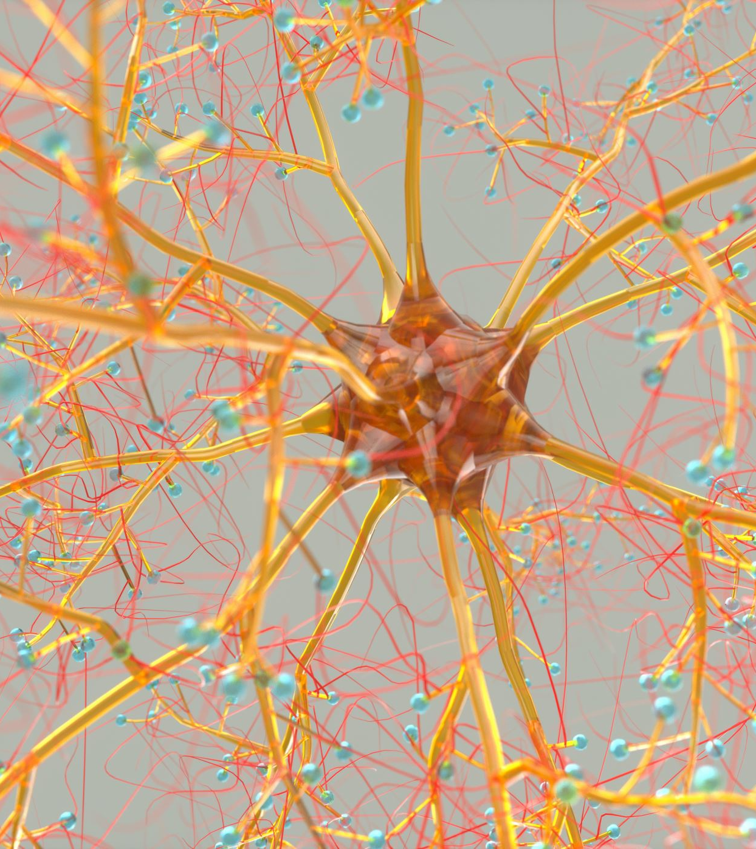
Three Neural Bases of Pain
Nociceptive -
Neuropathic -
- Nociplastic -

Slide 10
So why not simply prescribe opioids for chronic pain?

Slide 11
Concerning Behaviors for OUD
Early refills
“Lost” prescriptions
Multiple source CS prescriptions
Impaired or “stuck” function vs improved
Requests for escalating doses
“Splitting” providers
Polysubstance use

Slide 12
Diagnostic Elements for OUD
Larger doses than originally intended
Unsuccessful attempts or desire to cut back
Great deal of time expended in using/getting
Strong desire to use
Failure to fulfill major role obligations
Continued use despite problems
Important social, occup, rec activities given up
Recurrent use in physically hazardous situations
Continued use despite knowing probs caused
[Tolerance]
[Withdrawal]

Slide 13
Patient Risk Assessment
Opioids may be contraindicated due to risk if:
Prior history SUD (including alcohol and nicotine)
Family hx SUD
Any MH disorder, including depression/anxiety
Age < 40-45
Hx childhood abuse or neglect
Hx legal trouble/incarceration

Slide 14
Risk Assessment
1. Take full substance use history
2. Thorough mental health history
3. Family and social history
4. Physical exam to assess for signs of substance abuse
5. Review old records, maybe communicate with previous prescribers
6. Check MPDR
7. Conduct periodic urine tox screening

Slide 15
Opioid Risk Tool
0-3 - Low risk
4-7 - Mod Risk
8+ - High Risk

Slide 16
Safety Before Prescribing
Establish and communicate a treatment plan, including when and how you will taper
Risk/benefit discussion
Obtain informed consent
Treatment agreement
Limit dose
Compared to an MED of 20, OD risk 4X MED 50-100
7X MED > 100 MED

Slide 17
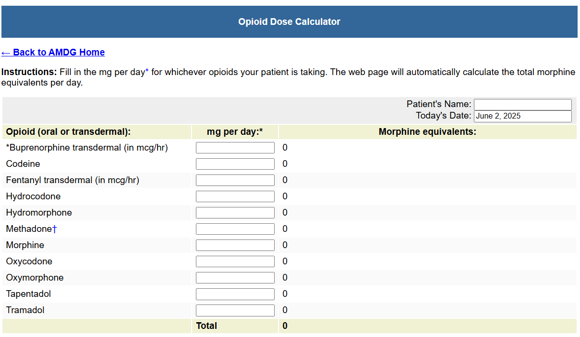

Slide 18
Safety During Prescribing
*Regular visits – office or telehealth
*Assess for efficacy with focus on improved function – if not improving don’t keep escalating
*Perform periodic physical exams for underlying pain dx and document findings
*Urine toxicology – consider sample every visit or dyssynchronous
*Check MPDR
*Document your medical decision-making
“I am continuing to prescribe this 43 yo F with treatment refractory diabetic neuropathy Oxycodone @ 15 mg/day, because her function as bakery manager and community pickleball organizer remains excellent and she has minimal adverse effects (constipation managed with stool softener). We continue to discuss dose taper over time with possible transition to Buprenorphine for better long-term safety.”
Patients with OUD may feel difficult to justify continued prescribing

Slide 19
Address Aberrant Behaviors Directly
Some behaviors may not necessitate cessation of prescribing
Communicate your plan of when/how to stop prescribing when you initiate treatment
Taper - if possible - instead of stopping abruptly
Don’t fire the patient – fire the dangerous medication!

Slide 20
Safety While Prescribing - Risk Mitigation
“This 78 yo M legacy opioid dependent pt with chronic functional abdominal pain taking prescribed Oxycodone 60 mg/day clearly also has moderate OUD based on …..
I’ve offered him a tapering schedule of Oxycodone to zero mg over 4 weeks to minimize suffering from withdrawal and OD risk, or a transition to SL Buprenorphine/Naloxone. As a life preserving risk-mitigation strategy I’ve prescribed 5 days of Oxycodone at current dose and he will return within 5 days with his decision from the 2 options.”

Slide 21
When It’s a Close Call Between Chronic Pain and SUDs
Verbalize your concerns to the patient
Document your concerns in the medical record and IF you choose to prescribe anyway, document WHY
Our medical licensing boards understand the conundrum of the “legacy” opioid patient
Consider slow, slow taper of opioid
May need to stop at several points to level off;
May take years
May never be able to taper to zero
Goal is just to get patient safer

Slide 22
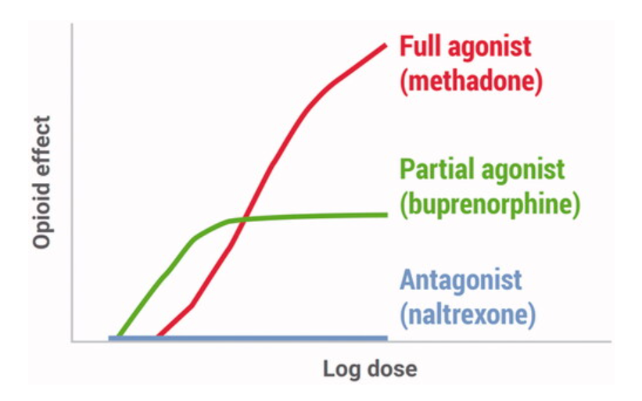
The Magic of Buprenorphine

Slide 23
Butrans Transdermal Patch
Changed every 7 days
5, 7.5, 10, 15 or 20 mcg/hr delivery
5 mcg/hr patch opioid naïve or < 30 MED
7.5 mcg/hr patch MED 30-80
Withdrawal not needed to start

Slide 24
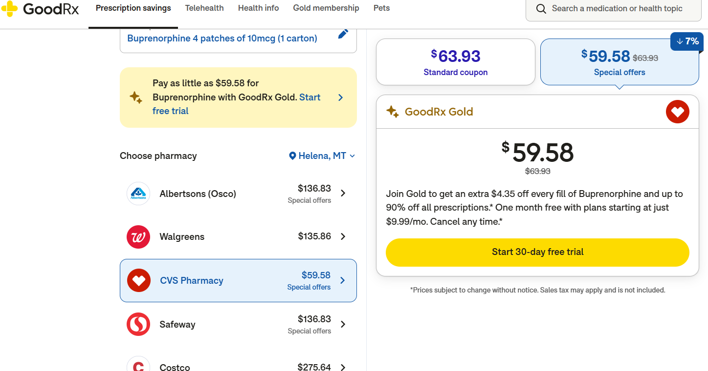

Slide 25
Belbuca Buccal Films
Usually dosed BID
75, 150, 300, 450, 600, 750, 900 mcg buccal films
Start 75 mcg films opioid naïve or MED < 30
150 mcg films MED 30-90
300 mcg films MED 90-160

Slide 26
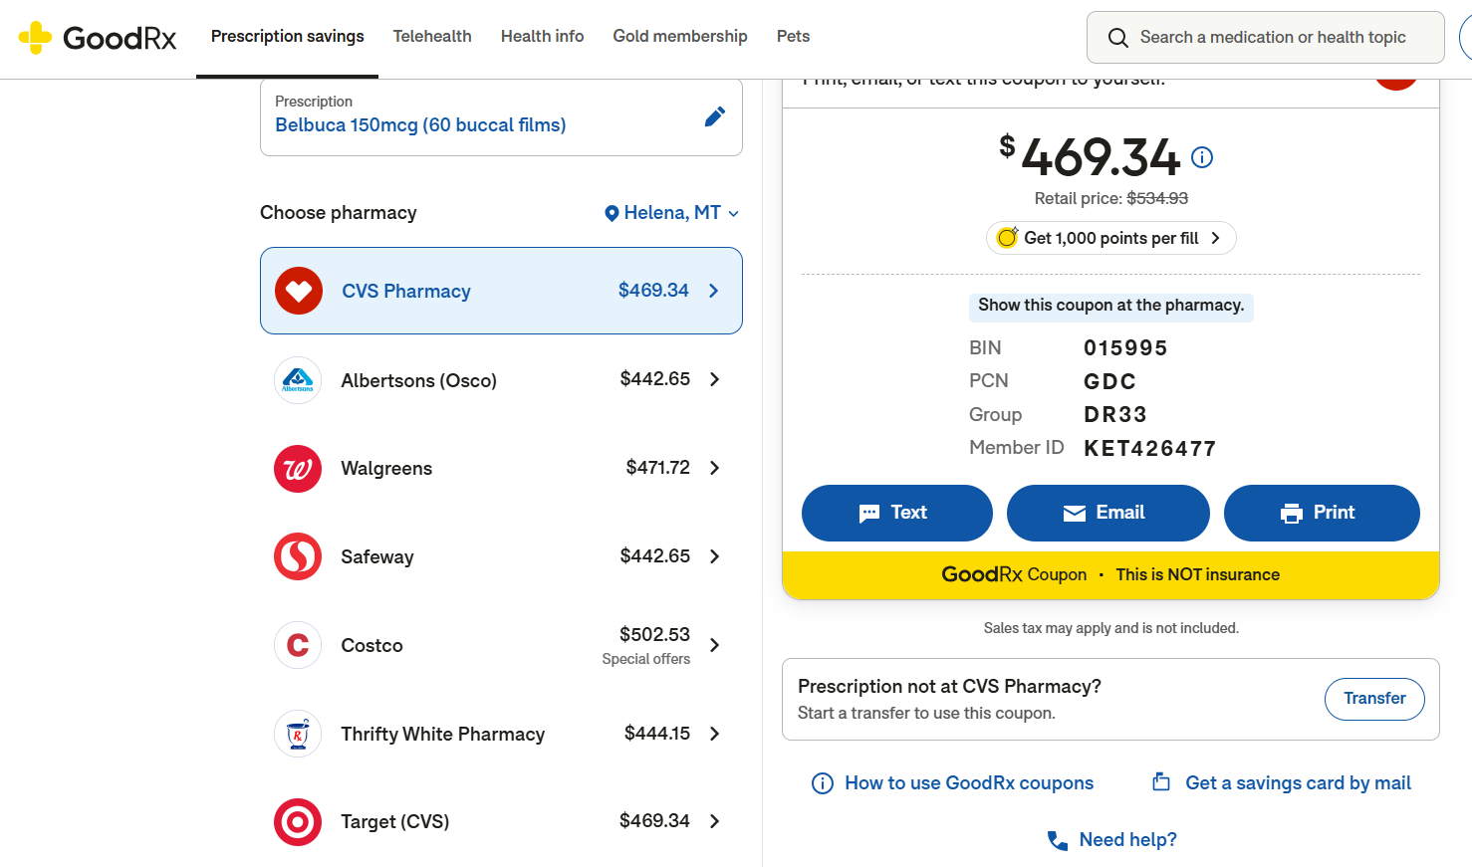

Slide 27
Buprenorphine SL
Dosed daily or BID
2, 4, 8 mg SL films or tabs
Can start with ¼ of 2 mg (OK to cut) via microtitration
$40-50 for #60 8 mg tabs

Slide 28
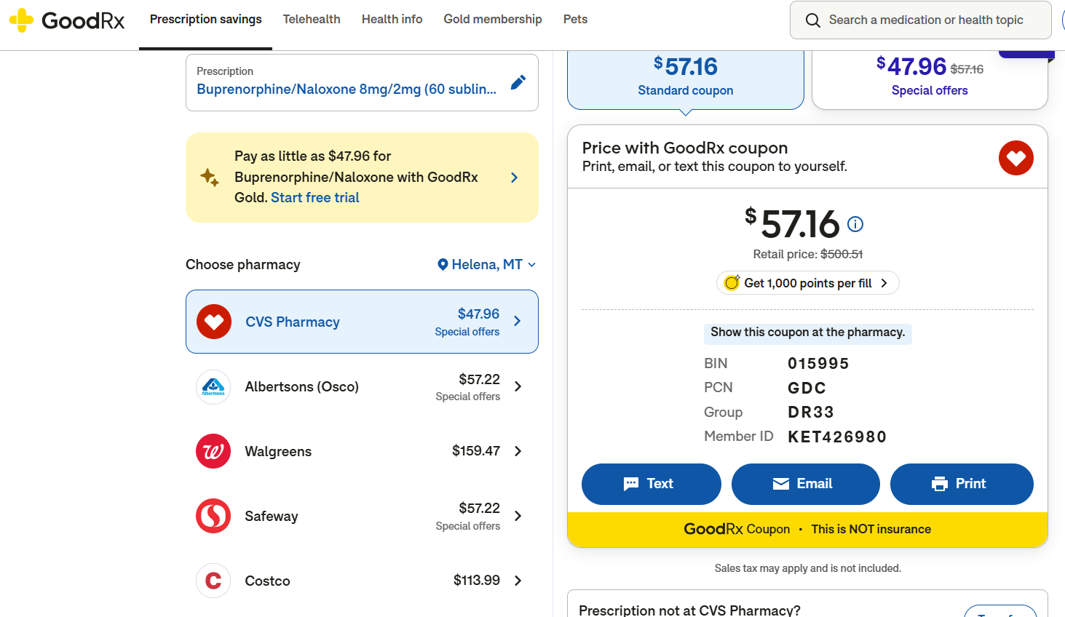

Slide 29
Buprenorphine Microdosing
Frequent administration of small doses Buprenorphine while pt remains on full mu agonist
Can use Butrans, Belbuca or Bupe SL
For SL start with a quarter or half snip of a 2 mg film or tab
Typically avoids precipitated withdrawal
May be useful for high levels of physical dependence (Fentanyl) or very long-acting full mu (Methadone)
No large studies yet but growing literature
*Also aggressive high-dose induction, up to 32 mg rapidly, but for ED setting only

Slide 30
Naltrexone
Blocks pleasurable effects of opioids, powerful opioid antagonist
Prevents user from experiencing opioid intoxication or dependence with subsequent use, reinforcing abstinence
Can cause severe, prolonged precipitated withdrawal so MUST be abstinent from opioids for 7-10 days before use
Daily dose for AUD/OUD 50 mg orally or monthly IM injection
Most effective in patients who are highly motivated or legally mandated into treatment

Slide 31
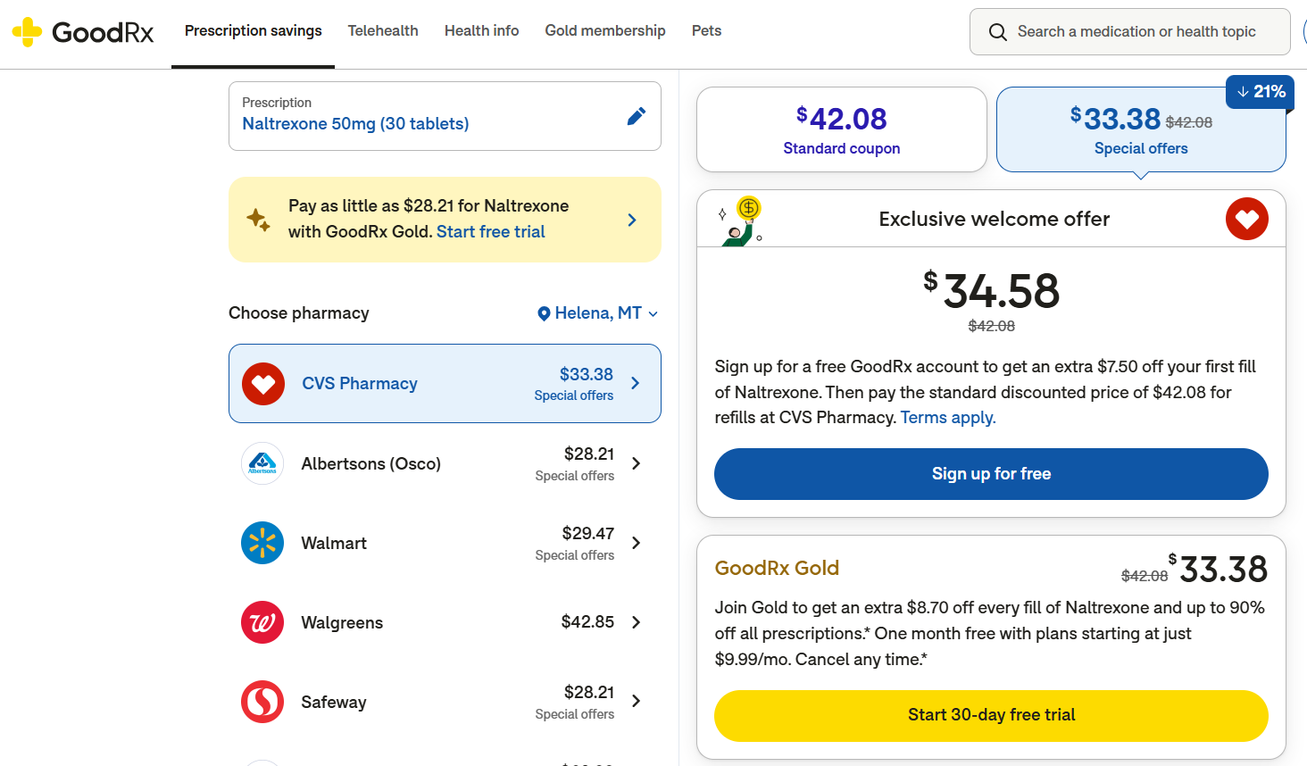

Slide 32
Methadone
Caution prescribing for dual dx if not a licensed dispensing clinic
Daily (OUD) vs BID/TID (chronic pain)
Many potential risks, especially aging and medical comorbidities
Very long half-life
Can be difficult to transition to Bupe

Slide 33
Alcohol Use and Chronic Pain
Scarce research thus far
Fleeting analgesic properties
Inhibits glutamine transmission and increases GABA transmission
Induces release of endogenous opioids as BAL rises
But reduction in analgesic effect as BAL falls
Animal studies show increase in pain threshold with acute intoxication, but hyperalgesia with cessation of alcohol
Tolerance develops quickly, we need increasing amounts to experience same analgesia
Heavy alcohol consumption increases risk of developing chronic pain following injury
Chronic pancreatitis and alcohol-related peripheral neuropathy

Slide 34
Alcohol Use and Chronic Pain
Pain may increase drinking behaviors
People who drink socially, drink more and more rapidly when exposed to an experimentally induced pain
People who drink randomly (not regularly) have greater urge and intention to drink when exposed to pain vs a control condition
Patients with AUD and chronic pain may experience more cravings, and consume more alcohol to achieve additional pain relief
Mice undergoing alcohol withdrawal experience increased nociception
Altered pain responses during alcohol withdrawal like hyperalgesia, may increase the risk of relapse

Slide 35
Central Sensitization
Chronic pain changes the way the brain responds to pain
Brain activates new circuitry of neurons
Activation of new circuitry may lead to heightened anticipation of pain, negative emotions and intensified pain perception
As the brain’s reward system shifts, pain relief and alcohol use together become prioritized
Brain imaging data suggests that some aspects of the pain experience, like pain catastrophizing, correlate with alcohol cravings
Alcohol withdrawal seems to correlate to hyperalgesia

Slide 36
Dual Action Pharmacotherapy – Naltrexone?
Mu-opioid receptor antagonist, FDA approved for AUD (50 mg/day or monthly injection)
Low doses (1-5 mg/day) associated with analgesic and anti-inflammatory qualities
Fibromyalgia, IBD, PASC, complex regional pain syndrome, pain associated with MS
Proposed mechanism is reduction of central sensitization and neuroinflammation
But low doses may not be effective for AUD

Slide 37
Dual Action Pharmacotherapy – Topiramate?
Anticonvulsive used as first-line therapy for migraine prevention
Effective to relieve chronic LBP
Was shown in a meta-analysis to significantly reduce heavy drinking days and alcohol cravings in patients with AUD
Prolongs periods of abstinence and reduces GGT levels, an indicator of alcohol consumption

Slide 38
Dual Action Pharmacotherapy – Gabapentinoids?
First line treatments for peripheral neuropathic pain
Analgesic, anti-craving, anxiolytic and anti-drinking qualities in patients with AUD
Some trials have shown reductions in drinking outcomes in AUD
However, recent meta-analysis found that Gabapentin was not associated with lower rates of return to drinking or heavy drinking compared to placebo

Slide 39
Other Dual Action Pharmacotherapy?
Baclofen
Psychedelics – LSD
Ketamine
Cannabinoids – probably not beneficial

Slide 40
12-Step Programs
2020 Cochrane Review clearly established evidence supporting AA
NA seems to mirror AA’s efficacy
12-step meetings more effective than psychotherapy to achieve sobriety
AA participation lowers healthcare costs
Clinicians’ beliefs regarding 12-step programs matter to patients and influence their participation and outcomes
Successful active linkage is critical

Slide 41
UW PAIN + OPIOID HOTLINE FOR MONTANA
Email: painhotline@uw.edu

Slide 42
UW TelePain for Montana
Weekly pain and addiction webinar every Wednesday11am-12:30pm MT, 12-1:30pm PT
Sponsored for the State of Montana by a grant from the Office for the Advancement of Telehealth, Health Resources and Services Administration (HRSA), U.S. Department of Health and Human Services
25-minute live pain and/or addiction-related didactic followed by real case presentations with advice from a multi-disciplinary expert panel
Anesthesia/Pain Management, Psychiatry, Rehabilitation Medicine, Addiction Medicine, Integrative Medicine, Family Medicine, Pain Psychology, Pain Pharmacology
Register for session links: https://redcap.iths.org/surveys/?s=PL8YLL7JL8
telepain@uw.edu

Slide 43
Where AUD, OUD and Chronic Pain Intersect
Questions?
Thank you for listening!
**References available upon request**

