Slide 1
Federal Updates on 340B Ohio Association of CHCs July 12, 2024 Colleen Meiman State Associations of Community Health Centers

Slide 2
Operational Updates
Strategies
State bills
Federal Bills

Slide 3
Operational Updates
on 340B

Slide 4
Contract Pharmacy Restrictions:
New Variations on an Old Theme
Alkermes is limiting CHCs to one type of pharmacy (local/ retail, and remote specialty) even though their drug Vivitrol must be purchased at both.
BMS changed the fine print of its Terms and Conditions – without pointing out the changes.
CHCs how have 14 days (post-dispense) to report data to ESP
The report for each claim must include 16 points of data – “practically impossible.”
Requires CHCs to report to ESP on their single contract pharmacy site.
Sanofi is trying a new legal argument to kill contract pharmacies – claiming that the replenishment model is illegal.
Sanofi has expressly prohibited the one-pharmacy-per-CHC-site approach.

Slide 5
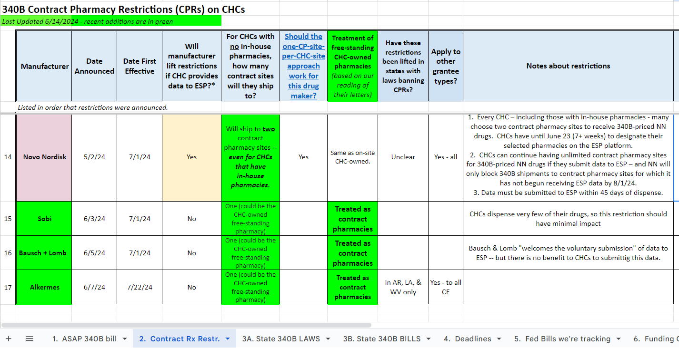
For a current list of CP restrictions
See Tab 2 of the Resource Spread-sheet.

Slide 6
July 1
New or updated restrictions went into effect from Sanofi, BMS, Bausch & Long, Sobi, and Novo-Nordisk*.
CHCs must start reporting data to BMS, via ESP, on 340 drugs dispensed at their single designated contract pharmacy site (assuming they have no in-house sites) within 14 days of dispense.
The 340B price for many insulin & inhaler products (particularly those that have long been penny-priced) increased noticeably, reflecting the significant decrease in the official prices for these products that went into effect on January 1, 2024.
CHCs can incur a loss every time they dispense certain insulins or inhalers starting 7/1/24.

Slide 7
A Real-World Example
Humalog (an insulin) | Policy/ Market changes | CHC #1 |  |  | CHC #2
 |  | Typical Commercial Reimburse- ment | 340B price | Typical 340B savings for commercial patient | Typical Commercial Reimburse-ment | 340B price | Typical 340B savings for commercial patient
2023 | None | $510 | $0.15 | $510 | $740 | $0.15 | $740
January 2024 | AMP cap lifted; payers begin lowering reimbursement in response to lower prices | $150 | $0.15 | $150 | $180 | $0.15 | $180
July 2024 (Humalog 75/25 Kwikpen) | 340B price lowered in response to Jan. 2024 change in market price | $75 (Estimate) | $51 | $24 (estimate) | $75 (Estimate) | $51 | $24 (estimate)

Slide 8
ESP
Which ones still allow the ESP “workaround”? – aka access to multiple contract pharmacies in exchange for submitting data to ESP?
Gilead
Amgen – A CHC with both CHC-owned and contract pharmacies can have a single CP site if it submit data to ESO on both the CE-owned and CP site.
Novo – see discussion below.
Bristol Myers Squibb flips the system on its head.
Effective July 1, CHCs with a single CP site must submit data to ESP for that site in order to receive 340B pricing there.
For your own protection, please make sure you are not submitting data to ESP for any manufacturers other these!

Slide 9
Novo Nordisk – The best of the worst?
The first manufacturer to exempt “grantees” from contract pharmacies imposed on hospitals.
The last of the insulin manufacturers to impose contract pharmacy restrictions on CHCs.
Effective 7/1/24, Novo Nordisk will:
Ship to two contract pharmacy sites -- even for CHCs that have in-house pharmacies – with no ESP reporting requirement.
Allow CHCs to continue having unlimited contract pharmacy sites if they submit data to ESP
NN will only block 340B shipments to contract pharmacy sites for which it has not begun receiving ESP data by 8/1/24 – a month after the restrictions start.

Slide 10
Changes in Drug Prices –
& what they mean for CHCs

Slide 11
An unprecedented level of change
Several new policies to lower drug prices are being phased in from 2024 to 2028. They include:
Lifting the “AMP cap” on rebates that drug makers must pay Medicaid.
Medicare Parts B & D penalizing manufacturers for raising prices faster than inflation.
Medicare negotiating the prices of some drugs.
These policies are already leading to some
lower drug prices.
Other likely changes could include:
Federal regulation of PBMs
Further changes to 340B.
There is no precedent to suggest how all these changes will impact CHCs – or drug prices generally.

Slide 12
A new 2024 policy: Lifting the AMP cap
A wonky -- & little-noticed -- policy change occurred on Jan. 1, 2024 & is already having significant (negative) impact on CHCs’ 340B savings.
It’s called “lifting the Medicaid AMP cap.”
Background: Medicaid drug rebates (& 340B discounts) consist of one -- & possibly two – parts:
Basic discount: All drugs are subject to a basic discount (23.1% for brand names, 13.1% for generic)
Inflationary discount: If the drug’s price has risen faster than inflation, then there is a second discount. The faster the price rose, the larger the inflationary discount.

Slide 13
A hypothetical example
A drug’s Average Manufacturer Price (AMP) is $100.
It’s a brand-name drug, so the basic 23.1% discount is $23.
The manufacturer raised the drug’s price much faster than inflation, resulting in an inflationary discount of $150.
Thus, total statutory discounts on the drug equal $173 ($23 + $150).
With the AMP cap- 2023 & earlier:
Discounts are “capped” at the AMP amount of $100.
State pays $100 for the drug.
Manufacturer pays $100 in rebate.
Both the state and the manufacturer break even. ($100 purchase price minus $100 rebate)
Without the AMP cap – 2024 on
State pays $100 for the drug.
Manufacturer pays $173 rebate.
The drug maker loses Medicaid $73 on the drug.
The state earns $73 for dispensing the drug.

Slide 14
Impact: Lower 340B savings - particularly on penny-priced drugs.
Overall, the lifting of the AMP cap is expected to cause drug makers to:
slow the rate of price increases for many drugs, and
drop the AMP of some.
This will lead to fewer penny-priced drugs, lower PBM reimbursement, and lower 340B savings.
Due to lags in data reporting, the impact of drug price changes initiated on Jan. 1 will be phased in between January 1 and late summer 2024.

Slide 15
“Saving millions in Medicaid rebates”
“These moves were carefully timed and will save the companies hundreds of millions of dollars a year, experts said. That’s because the 2021 American Rescue Plan Act made a major change to the rebates that drug manufacturers pay annually to state Medicaid programs – a change that kicked in on January 1.
“By cutting the list prices for Humalog and Humulin, Eli Lilly could avoid having to pay an additional $430 million in Medicaid rebates in 2024, said…a consulting group that provides policy analysis to institutional investors. Plus, Eli Lilly could earn an additional $85 million in profits from Medicaid because of the way the rebate formula is designed.”
SOURCE: CNN article, Jan. 2, 2024

Slide 16
A Real-World Example
Humalog (an insulin) | Policy/ Market changes | CHC #1 |  |  | CHC #2
 |  | Typical Commercial Reimburse- ment | 340B price | Typical 340B savings for commercial patient | Typical Commercial Reimburse-ment | 340B price | Typical 340B savings for commercial patient
2023 | None | $510 | $0.15 | $510 | $740 | $0.15 | $740
January 2024 | AMP cap lifted; payers begin lowering reimbursement in response to lower prices | $150 | $0.15 | $150 | $180 | $0.15 | $180
July 2024 (Humalog 75/25 Kwikpen) | 340B price lowered in response to Jan. 2024 change in market price | $75 (Estimate) | $51 | $24 (estimate) | $75 (Estimate) | $51 | $24 (estimate)

Slide 17
Strategies & reminders for moving forward

Slide 18
Some 340B strategies to consider
Consider opening an in-house pharmacy, if you don’t have one yet.
Keep an eye on changes in insulin and inhalers prices, and adjust as appropriate/ feasible. See attachment.
Give another look at Patient Assistance Programs – particularly for insulin.
Make sure your CFOs are aware of changes to 340B savings.
For drugs makers with restrictions, sign up for one pharmacy per delivery site. See instructions at https://shorturl.at/anzO4
Reexamine your rules re: referral prescriptions.
Advocate for Congressional action THIS YEAR!

Slide 19
Patient Assistance Programs for Insulin
Eli Lilly allows uninsured person to download the Lilly Insulin Value Program savings card, which allows them to get any Lilly insulin for $35 a month.
Novo Nordisk’s MyInsulinRx program provides a 30-day supply of insulin for $35 to eligible patients, including the uninsured.
Sanofi has the Sanofi Insulins Valyou Savings Program which enables uninsured patients to pay $35* per 30 Day Supply of any one or combination of Sanofi Insulins, including Lantus.

Slide 20
Getting a little relief from contract pharmacy restrictions
There is a compliant method for multi-site CHCs (including look-alikes) to expand the number of pharmacy sites where they receive 340B-priced drugs from most manufacturers with contract pharmacy (CP) restrictions.
These manufacturers allow covered entities to receive 340B pricing only at their in-house pharmacy, or if they don’t have one, a “single CP site”.
To date, that “single site” limit has generally been implemented at the organizational level -- meaning that each CHC could designate only its in-house pharmacy(s) or one CP site for its entire organization (for each manufacturer.)
However, all manufacturers except Eli Lilly & BMS allow CHCs to have one site for each CHC care delivery site, increasing the number of pharmacy sites where a multi-site CHC can can access 340B-priced drugs from other manufacturers (e.g., Merck, GSK.)
For detailed instructions on this process, see https://shorturl.at/anzO4

Slide 21
Draft P&P available for CHCs to reflect potential changes due to Genesis
This P&P lays out:
How your CHC defines a “patient” (e.g., services received, how recently)
Which prescriptions you will fill for patients
How your CHC will seek to retain responsibility for the care that generated the prescriptions written by outside providers that you fill with 340B drugs.
The P&P will also help identify what issues you should think through.
The template P&P is available at shorturl.at/fpqFP

Slide 22
Operational Reminders
Be sure you are NOT submitting any more data to ESP than you are required to.
Make a conscious decision about whether to submit data to Novo Nordisk via ESP within the next few days.
Medicare is going to switch PrEP to a Part B drug starting Jan. 1. Check if your pharmacy(ies) can dispense Part B drugs, and adjust as needed.

Slide 23
State Legislative Action
on 340B

Slide 24
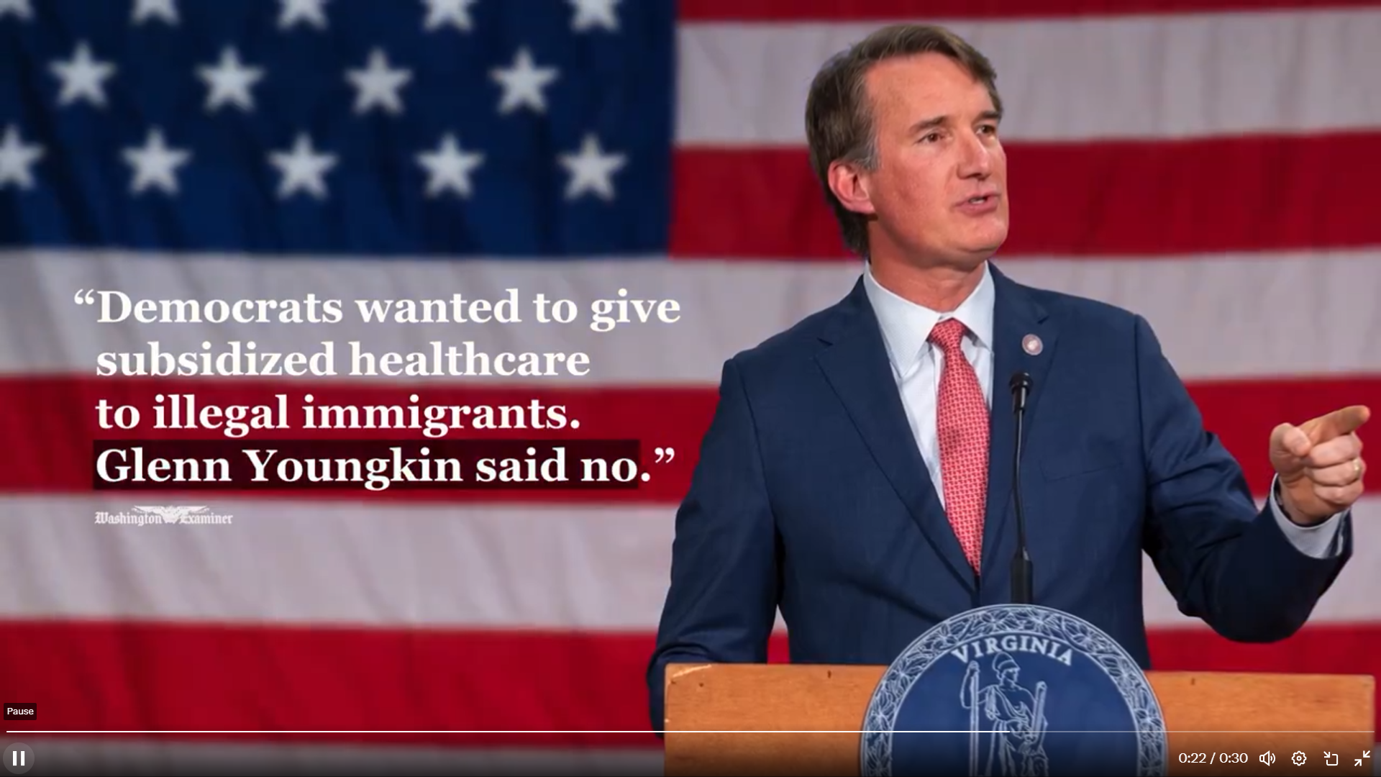
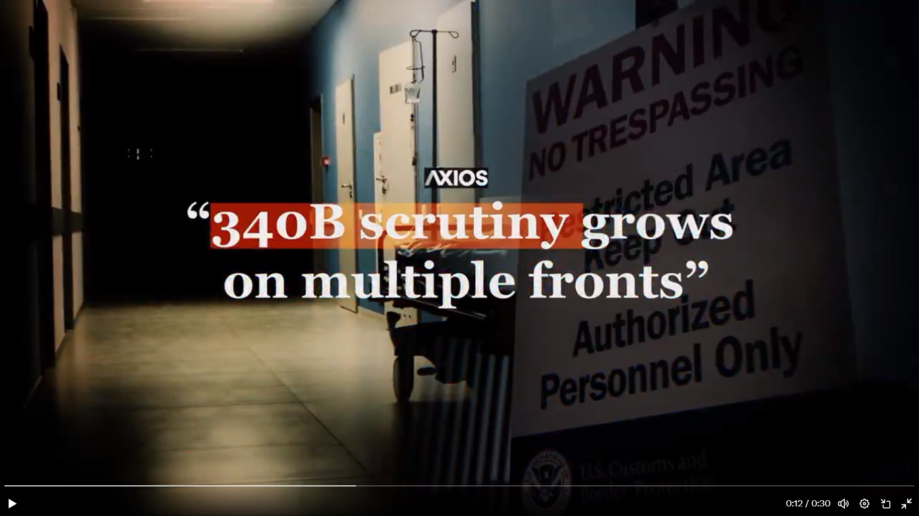
Overall, it keeps getting uglier…
Contention around the program keep growing.
Being blamed for illegal immigration, abortion, failure of small businesses, increases in state budgets.
Banning contract pharmacy restrictions being framed as an expansion.
Some House GOP members say 340B should fund only discounts on medications, not other services.
Contract pharmacy restrictions keep increasing.
Now 17 companies with restrictions on CHCs, 30+ on hospitals. See Tab 2 on PCA Resource Spreadsheet.
Rules are getting tighter, eliminating option to report to ESP.
PhRMA is fighting hard – and ugly – at the state level.
No hope from the courts – at least re: Federal law.

Slide 25
State legislative activity - Pickpocketing
The lack of Federal action is causing states to take matters into their own hands.
Over 30 states have enacted laws to stop PBMs from “pick-pocketing” 340B savings intended for safety net providers.
See Tabs
3A & 3B on PCA Resource Spreadsheet for details on state 340B bills & laws.

Slide 26
State Contract Pharmacy Bills/ Laws
Almost half of states introduced bills to ban contract pharmacy restrictions this year.
Eight states now have enacted them: Arkansas, Kansas, Louisiana, Maryland, Minnesota, Mississippi, Missouri, West Virginia
Virginia’s bill sailed through the legislature, but the governor killed it for political reasons.
Oregon’s bill was killed at the last moment due to reports of NACHC opposition.
Several other states faced fierce PhRMA pushback (with questionable ethics…)

Slide 27
In states that have banned contract pharmacy restrictions
CHCs are getting relief from some – but not yet all –manufacturers with restrictions.
The states are all getting sued by PhRMA and/or individual manufacturers.
The PCA/ CHCs are acting as “intervenors” in these cases.
So far, the laws are holding up in court!
Arkansas’ law was upheld by both the District and Appeals Courts.
PhRMA keeps litigating nonetheless, using a very creative range of justifications.

Slide 28
Considerations when deciding whether to advance a state CPR bill
State legislative environment:
What other bills are you advocating for in that session? How will advancing a CPR bill impact your energy and likelihood of success for those other bills?
How much does your legislature know about 340B?
How “spooked” would your legislature be about being sued?
Do your current state lobbyists have any conflicts of interest?
Other 340B providers:
Could they be effective partners in advancing the bill?
If not, would your bill get further if it exempted some types of covered entities (e.g., DSH hospitals)?

Slide 29
Considerations when deciding whether to advance a state CPR bill
Enforcement:
Which arm of state government should be charged with enforcing the law?
Would they actually enforce it if they were sued?
Are the penalties for violating the law large enough to be a deterrent?
Could you structure the ban on CPRs as a requirement for a drug manufacturer to be licensed in the state? (This is what Virginia did)
State pharmacy association: Please reach out to them proactively, to ensure they are not “mis-educated” about the bill’s impact.

Slide 30
Federal Legislative Action
on 340B

Slide 31
Outlook for Federal 340B Legislation
Everyone except the six “G6” Senators think there’s no chance of passing comprehensive 340B reform this year.
But the G6 is doubling down on working to pass the SUSTAIN Act in the Lame Duck package.
What if 340B legislation waits until next year?
Sen. Bill Cassidy (R-LA) will chair HELP - the most important Senate committee for CHCs.
He is not always favorable towards either CHCs or 340B.
Lots of 340B investigations…
“Ranking Member Cassidy, Chair Rodgers on GAO Report Finding 60% Increase in Community Health Center Revenue Since 2017”

Slide 32
Three major 340B bills in Congress
The PATIENTS Act – bans contract pharmacy restrictions; advanced by 340B hospitals. Purely Democratic & covered entity support.
The 340B ACCESS Act – comprehensive reform bill introduced by PhRMA and NACHC. Widely viewed as very pro-PhRMA. Purely Republican support.
The SUSTAIN 340B Act – comprehensive bill being written by 6 bipartisan Senators. Discussion draft (incomplete) and RFI released 2/2. Complete bill to be released on Aug. 1. Represents input from PhRMA, hospitals, CHCs, and both current & former Hill staff.

Slide 33
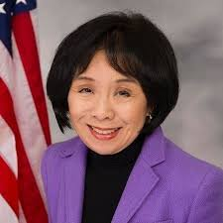
PATIENTS Act
Introduced by Rep. Doris Matsui (D-CA)
Bans all contract pharmacy restrictions.
340B Health (the 340B hospital group) was the lead advocate for this bill. It’s their “marker bill.”
Considered DOA on the Hill due to:
Inability to get any Republican cosponsors, despite months of trying.
Massive opposition by PhRMA.

Slide 34
ASAP Bill – the “ACCESS Act”
ASAP is a joint effort of NACHC and PhRMA.
Bill has been under development since winter/spring 2023.
Initial hopes of having other groups join the discussion never panned out.
Bill introduced May 28 by three House Republicans.
NACHC press release entitled “Landmark Legislation Protects 340B for Community Health Center Patients”
NACHC accepting feedback on the bill for the next several weeks.
Feedback falling into 3 buckets: policy, political, process.

Slide 35
ASAP Bill Policy: 5 Positive Aspects
Explicitly adds program intent to the statute.
Bans TPA and contract pharmacies from basing fees on a percentage of 340B savings.
Makes Rural Emergency Hospitals eligible for 340B.
Strong pick-pocketing language (copied PROTECT 340B).
Creates a clearinghouse for 340B claims data*.

Slide 36
ASAP Bill Policy: 5 Concerns
Effectively ends 99%+ of contract pharmacy arrangements, by making outside pharmacies unwilling to contract with us.
Dramatically increased workload due to modifier requirements
Significant reductions in payment
Massive fines for a single error.
Limits which Rx would be 340B-eligible. Examples include
Prescriptions written by non-CHC specialists if:
The CHC did not refer the patient to that specific type of specialist, or
The CHC provider referred the patient to the specialist during a telehealth visit, or
The specialist did not send written notes back to the CHC.

Slide 37
ASAP Bill Policy: 5 Concerns
2. Limits on which Rx would be 340B-eligible. Another example:
Prescriptions written when a patient is discharged from an inpatient hospital stay, emergency room, or urgent care (with a few exceptions)
3. Unclear if CHCs would be able to retain 340B savings on specialty drugs.
4. Supersedes all state laws re: 340B – current or future.
5. Detailed and restrictive reporting requirements

Slide 38
ASAP Bill: Political Concerns
Weakens CHCs’ bargaining position and credibility going forward?
Going forward, 340B stakeholders will point to the policies in the ASAP bill as being the official CHC position – at least when doing so supports their goals.
NACHC refers to the bill as a “necessary starting point” and are asking PCAs/ CHCs to help them advocate for changes.
Alienates key partners/ allies for no discernible benefit.
Breaks with CHCs’ long history of bipartisanship.
Notes:
Would be unlikely to succeed, as PhRMA will oppose any changes, pointing out that CHCs’ national organization already agreed to them.
Will be perceived as poor form in the eyes of negotiators
Will distract valuable CHC advocacy efforts from other critical initiatives – e.g., increasing Section 330 funding.

Slide 39
Status of the SUSTAIN 340B Act
(comprehensive reform bill from the Group of 6 bipartisan Senators)
See https://shorturl.at/BnRZQ for a summary of the Feb. 2 draft, and expect a final draft by August 1.

Slide 40
Key Provisions in the SUSTAIN Act
Codifies the purpose of 340B Program
Contract Pharmacy- Requires:
Manufacturers to ship to contract pharmacies w/o restrictions
Contract pharmacies to offer discounted fees to low-income self-pay patients.
Contract pharmacies to have agreements with Medicaid agencies to avoid duplicate discounts
Patient Definition – placeholder section
Referral prescriptions are the toughest issue in negotiations.
Hospital Child Sites (aka off-campus outpatient departments)
Ensures that child sites are wholly-owned by and financially and clinically integrated into the CE hospital
Final bill text to be released Aug. 1; Senators are doubling-down to get it passed it during the Lame Duck session.

Slide 41
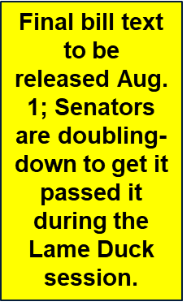
SUSTAIN Act, continued
Annual public reporting – data will be posted on HHS website
Expands audit authority and requirements
Bans discrimination/pick-pocketing by PBMs and payers
Creates a national data clearinghouse
Requires covered entities to work with manufacturers on repaying duplicate discounts
Imposes a user fee on CEs that would cover the program administration costs

Slide 42
Colleen Meiman
National Policy Advisor for State Associations of Community Health Centers
colleen@fachc.org
301-906-5958

Slide 43
Recommended Action Items
Consider opening an in-house pharmacy, if you don’t have one yet.
Keep an eye on changes in insulin and inhalers prices, and adjust as appropriate/ feasible. See attachment.
Give another look at Patient Assistance Programs – particularly for insulin.
Make sure your CFOs are aware of changes to 340B savings.
Be sure you are NOT submitting any more data to ESP than you are required to.
Make a conscious decision about whether to submit data to Novo Nordisk via ESP within the next few days.
Medicare is going to switch PrEP to a Part B drug starting Jan. 1. Check if your pharmacy(ies) can dispense Part B drugs, and adjust as needed.
For drugs makers with restrictions, sign up for one pharmacy per delivery site. See instructions at https://shorturl.at/anzO4
Reexamine your rules re: referral prescriptions.
Advocate for Congressional action THIS YEAR!

