Slide 1


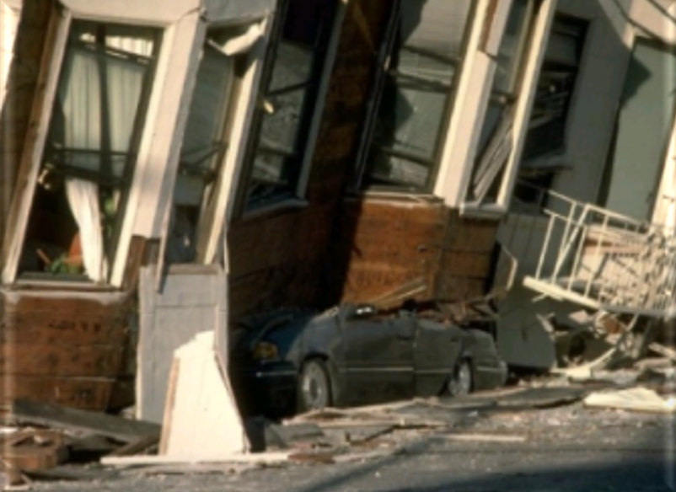
Understand your Organization’s Risks:
The Design and Use of a Hazard Vulnerability Analysis (HVA)
Presented by:
Karen Garrison, Vice President of Operations

Slide 2


Bio: Karen Garrison, Vice President of Operations
Karen Garrison has directed a many programs and services that support seniors and disabled adults in community based and clinical settings in the San Francisco Bay Area. Programs include, skilled nursing, residential dementia care, adult day health centers, supportive senior housing, clinical case management services, and national service programs.
She joined Connect Consulting 4 years ago and specializes in CMS EP compliance by developing comprehensive emergency management programs, CMS provider emergency and business continuity plans and facilitating training to ensure contract and regulatory compliance and build EP infrastructure.
She leads our team of emergency management Planners, trainers and exercise professionals and manages most of the emergency management and business continuity projects.

Slide 3


About Connect Consulting Services
Woman-Owned Small Business established in 2009, headquartered in Sacramento, CA
Serves Public, Private and Tribal clients throughout the continental U.S. and Alaska
Woman-Owned Small Business of the Year (2018) by the Sacramento SBA
Specialized services:
  Business Continuity Planning
  Emergency Operation Management Planning
  Pandemic Response and Recovery Planning
  Alternate Care Site and Evacuation Planning
  Incident Command System Support
  Training Development and Delivery
  Active Shooter and Workplace Violence
  Drills and Exercises (HSEEP Compliant)
  Compliance Audit and Improvement Planning
Woman-Owned Small Business of the Year Award (2018)
Issued by the Sacramento Small Business Administration (SBA)

Slide 4

Training Objectives
Discuss key Emergency Management Definitions
Risk Assessment / Hazard Vulnerability Analysis (HVA)
How to complete a Hazard Vulnerability Analysis (HVA)
Concreate Steps to Conduct an HVA

Slide 5
Business Continuity Planning Series
DATE | PART | WEBINAR TITTLE | DURATION
TODAY | 1 | HOW TO DESIGN AND CONDUCT A RISK ASSESSMENT / HAZARD VULNERABILITY ANALYSIS (HVA) | 60 MINUTES
AUGUST 8TH | 2 | HOW TO DEVELOP AND FACILITATE BUSINESS IMPACT ANALYSIS (BIA) SESSIONS | 90 MINUTES
SEPTEMBER 8TH | 3 | HOW TO PLAN, COLLABORATE AND WRITE A BUSINESS CONTINUITY PLAN | 60 MINUTES

Slide 6

1.Key Emergency Management Definitions

Slide 7
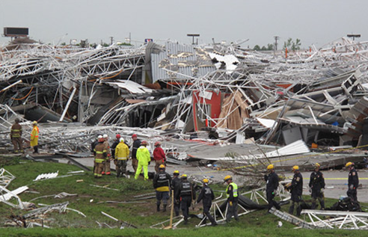
Key Emergency Management Definitions
Activation: To begin the process of mobilizing a response team, or to set in motion an emergency operations (response) or recovery plan, process, or procedure in response to incident or exercise. An activation may be partial or in full.
Disaster: A sudden, calamitous event that seriously disrupts the functioning of a community or society and causes human, material and economic losses that exceed the community’s or society’s ability to cope using its own resources.

Slide 8
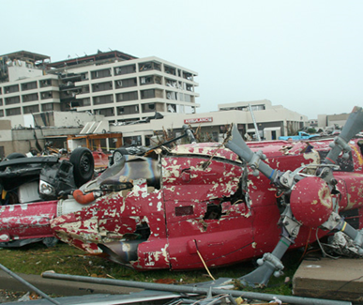
Key Emergency Management Definitions
Hazard Vulnerability Analysis (HVA): A systematic approach to identifying all hazards that may affect an organization and/or its community, assessing the risk (probability of hazard occurrence and the consequence for the organization) associated with each hazard and analyzing the findings to create a prioritized comparison of hazard vulnerabilities. The consequence, or “vulnerability,” is related to both the impact on organizational function and the likely service demands created by the hazard impact. (See section 1.6 of this Emergency Response Plan for LifeMoves most recent HVA.)
Incident Command: ICS organizational element responsible for overall management of the incident and consisting of the Incident Commander (either single or unified command structure) and any assigned supporting staff.

Slide 9
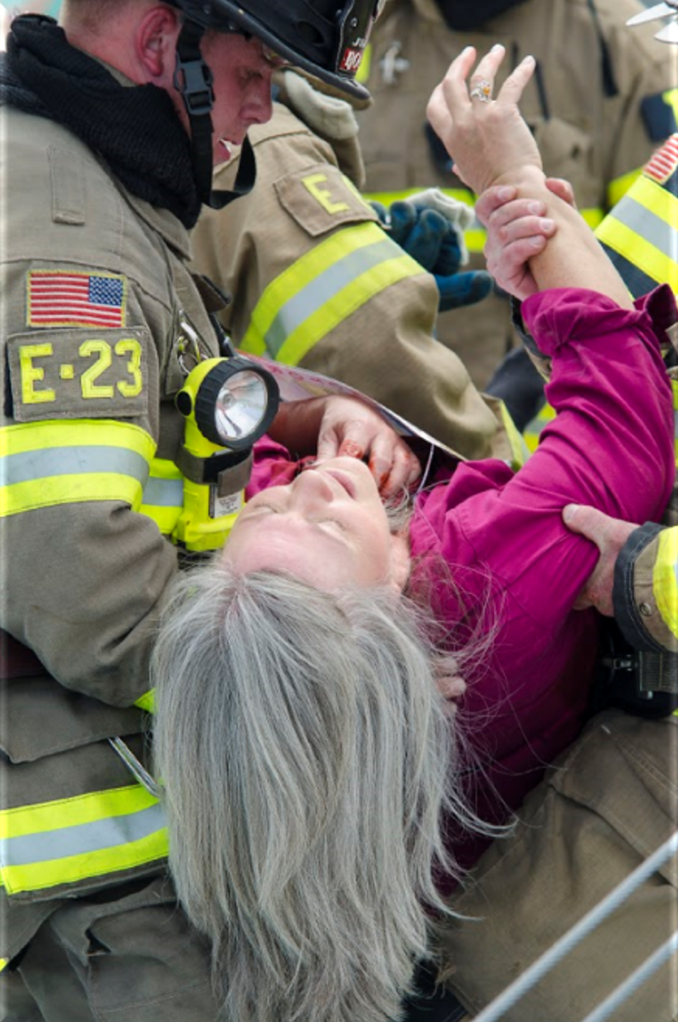
Key Emergency Management Definitions
Hazard: A hazard is related to the probability that a natural event, or one caused by human activity, may occur in the facility or region.
Risk: A risk is related to the probability, based on history, that certain identified Hazards will occur. These circumstances are closely related not only history and to the level of exposure and impact of an event, but to the vulnerability to the effects of the event.
Vulnerability: Can be defined as the diminished capacity of an individual or group to anticipate, cope with, and recover from the impact of a natural, human-caused or technological event. For human-caused events, it is a weakness that can be exploited by bad actors.

Slide 10
2.Risk Assessment / Hazard Vulnerability Analysis (HVA)

Slide 11
Risk Assessment- Hazard Vulnerability Assessment
  Risk assessment to identify and minimize key risks/threats
  Identifies weaknesses and/or points of failure
  Develops mitigation/corrective(s) measure to address
  Selects, implements, and documents mitigation/corrective measure(s)
  Ensures facility personnel awareness of risks
  FQHC’s are required by CMS and Joint Commision Requirements to conduct a HVA annually

Slide 12
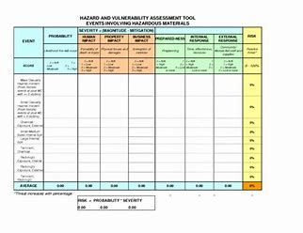
Poll: When was the last time that your health center completed a Hazard Vulnerability Analysis?
❑ Within the past 12 months
❑ Within the past 18 months
❑ More than 24 months

Slide 13
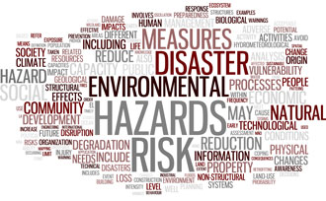
Hazard Vulnerability Analysis (HVA) - Risk Assessment
Emergency Operations Plans and Business Continuity Plans must assess facility and community-based risks.
These plans should utilize an all-hazards approach and updated on annually for each site.
The Kaiser Permanente Hazard Vulnerability Analysis (HVA) tool uses a mathematical formula to assess hazards and the probability that it will likely occur.
Note: The Joint Commission (TJC) and CMS require all Federally Qualified Healthcare Centers (HQHC) must identify risks and vulnerabilities via a Hazard Vulnerability Analysis process annually.
Notes:
The tool pinpoints:
Hazards and/or vulnerabilities that need your attention;
Actions that might be taken to reduce the impact of those hazards;
What resources are likely to be needed to mitigate and prepare for hazards.

Slide 14
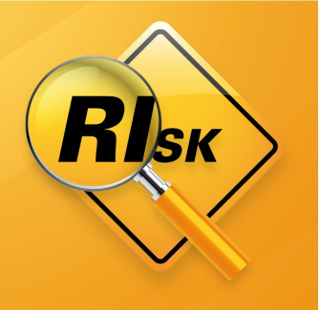
Hazard Vulnerability Analysis (HVA) - Purpose
The purpose of conducting an HVA is to enable your organization to make risk-based choices.
With the tools output, your organization can:
  Address identified vulnerabilities;
  Develop response plans for identified hazards;
  Mitigate Hazards;
  Create robust Emergency Operations Plans, and Business Continuity Plans to address greatest risks.

Slide 15
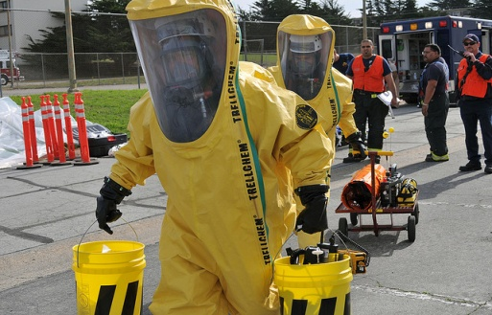

Hazard Vulnerability Analysis (HVA) - Purpose
HVAs are a formal process to evaluate organizational risk based on the local data, past activations in your health centers to evaluate an organization’s ability to mitigate risks.
Assists organizations evaluate their vulnerabilities for specific hazards
Risk assessments include:
  Hazard specific to your location
  Probability of the hazard occurring
  Impact of the hazard
    Human Impact
    Property Impact
    Business Impact
  Preparedness of your organization
  Ability to respond to the hazard
Notes:
HVAs can be broken down into categories of incidents for the organization to evaluate: Technological, Man Made & Naturally occurring incidents/hazards. • Technological Examples: IT Failure, HVAC failure, Electrical Failure, Supply Shortage , etc. • Man Made Examples: Active Shooter, Hazmat Incident, Building Fire, Planned Events, etc. • Naturally Occurring Examples: Tornado, Snow Storm, Pandemic, Ice Storm, Earthquake, etc.

Slide 16
3.How to Complete a Hazard Vulnerability Analysis (HVA)

Slide 17
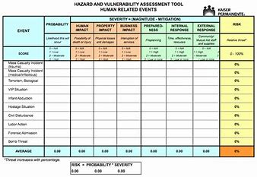
Steps to conduct a HVA
Identify potential hazards relevant to where your health centers sites are located using county, local hospital or healthcare coalition data
Evaluate current ability of your health center to mitigate the impacts of each hazard (How prepared is your health center?)
Assign a probability rating to each listed hazard
Identify the number of times an alert or activation has occurred in the past year for each hazard
Enter data into the HVA tool
Identify the top risks that should be addressed in your Emergency Operations Plan
Notes:
HVA Team
Identify a responsible party to coordinate this process.
Administration/Senior Leadership Rep.
Facilities/Engineering/Infrastructure Rep. •
Supply Chain Rep.
Frontline Staff Rep.
Risk/Legal Rep.
Financial Rep.
IT/Technology Rep.

Slide 18

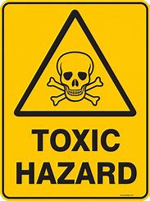
Types of Hazards

Slide 19
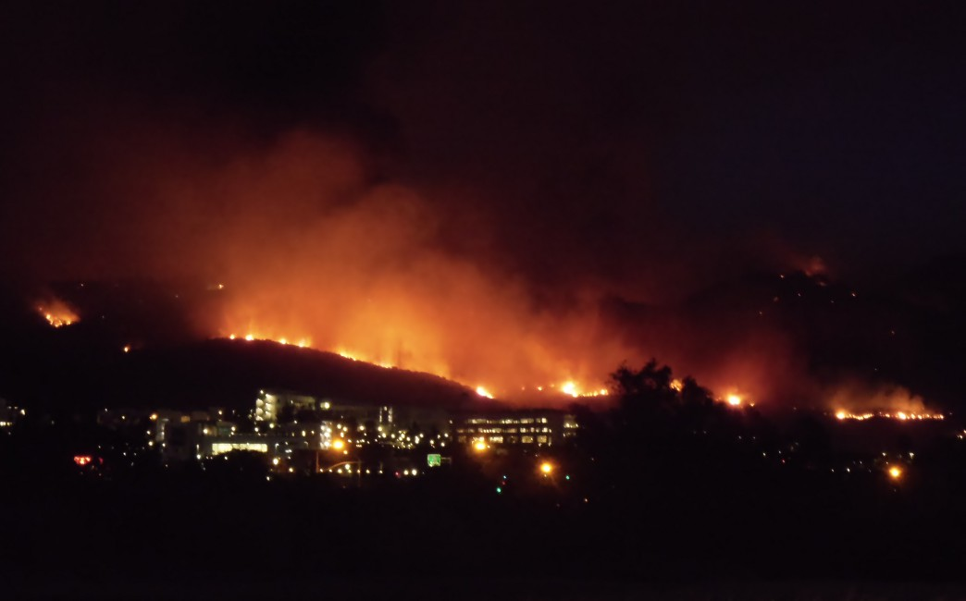

Hazard Vulnerability Analysis (HVA)
Natural Disasters
Wildfire
Earthquake
Landslide
Tsunami
Hurricane
Drought
Severe Thunderstorm
Tornado
Blizzard
Ice Storm
Extreme Temperatures
Flood

Slide 20


Hazard Vulnerability Analysis (HVA)
Human-Caused Disasters
Active Shooter
Epidemic/Pandemic
Mass Casualty Incident
Environmental Incident
Terrorism (CBRNE)
Active Shooter
Epidemic/Pandemic
Mass Casualty Incident
Environmental Incident

Slide 21

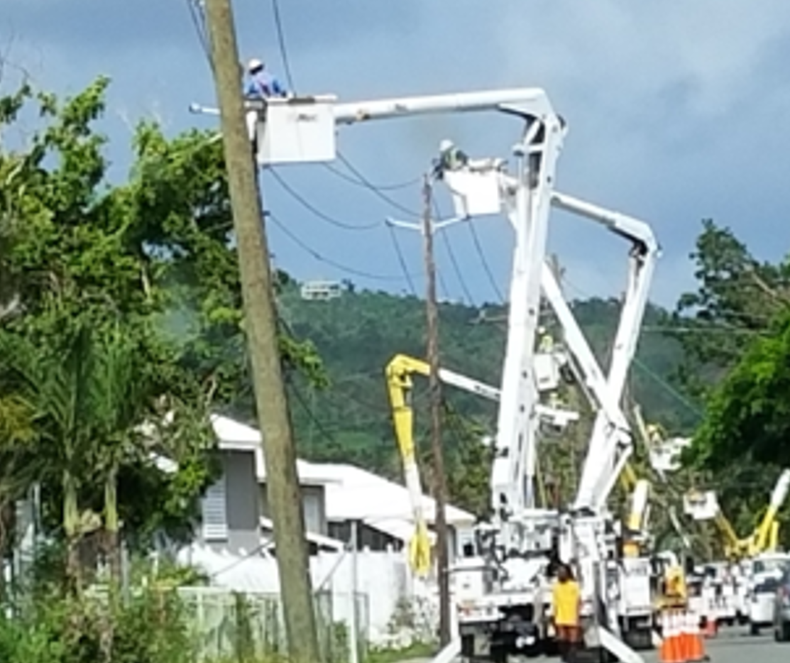
Hazard Vulnerability Analysis (HVA)
Technological Disasters
Water Supply Failure
Information Systems Failure
Communications Failure
Electrical Outage
Onsite Generator Failure
Natural Gas Failure
Electrical Outage
Fuel Shortage
Fire Alarm Failure
HVAC Failure
Network Loss
Data Compromise

Slide 22
Hazard Vulnerability Analysis (HVA) Tool
CMS doesn’t require a mandated format an HVA must be documented in.
There are best practices and commonly used formats that are available.
The Kaiser Permanente HVA tool (2021 version) is a commonly publicly available format.
Organizations must demonstrate how the analysis was conducted, who participated, and show how it was conducted.
Needs to include of consideration of the Community’s identified hazards and risk.

Slide 23
4.Concreate Steps to Conduct an HVA

Slide 24
Hazard Vulnerability Analysis (HVA) Tool
Healthcare Sector Calculation of Risk
Probability x Severity* = Risk
 |  | SEVERITY = (MAGNITUDE - MITIGATION)
EVENT | PROBABILITY | HUMAN IMPACT | PROPERTY IMPACT | BUSINESS IMPACT | PREPARED-NESS | INTERNAL RESPONSE | EXTERNAL RESPONSE | RISK
 | Likelihood this will occur | Possibility of death or injury | Physical losses and damages | Interuption of services | Preplanning | Time, effectiveness, resources | Community/ Mutual Aid staff and supplies | Relative threat*
*Severity = Magnitude (Impact) – Mitigation (Preparedness + Response)

Slide 25
1. Identify potential hazards relevant to where your health centers sites are located using county data where your health center is located
Use local county data such as Hazard Mitigation Plans to create a “hazard baseline”
Use county data where program sites are located
If there a health center has 3 health centers in 3 counties, they must conduct 3 HVAs.
By using county data, you can document the most pressing hazards that affect your local area
Hazards always start at the local level and so it important to understand this local perspective

Slide 26
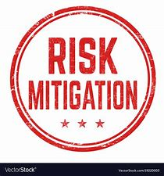
2. Evaluate your organization’s current ability of a health center to mitigate the impacts of hazard
Elements of mitigation and preparedness:
How prepared is your health center for any hazard?
Have you been updating your emergency preparedness documents and infrastructure?
Has your organization conducted exercises and staff training regularly?

Slide 27
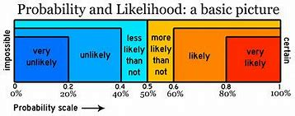
3. Assign a probability rating to each listed hazard Factors for Determining Probability
Review the following:
Physical Environment – Location, construction, redundancy, age of your building
Social Environment – Demographics, population, crime rates
Government - partnerships, government services, publicly available resources
History – Historical data from a health center and community partners (HCC, other hospitals, etc.) from previous 1- 2 years

Slide 28
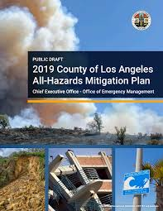
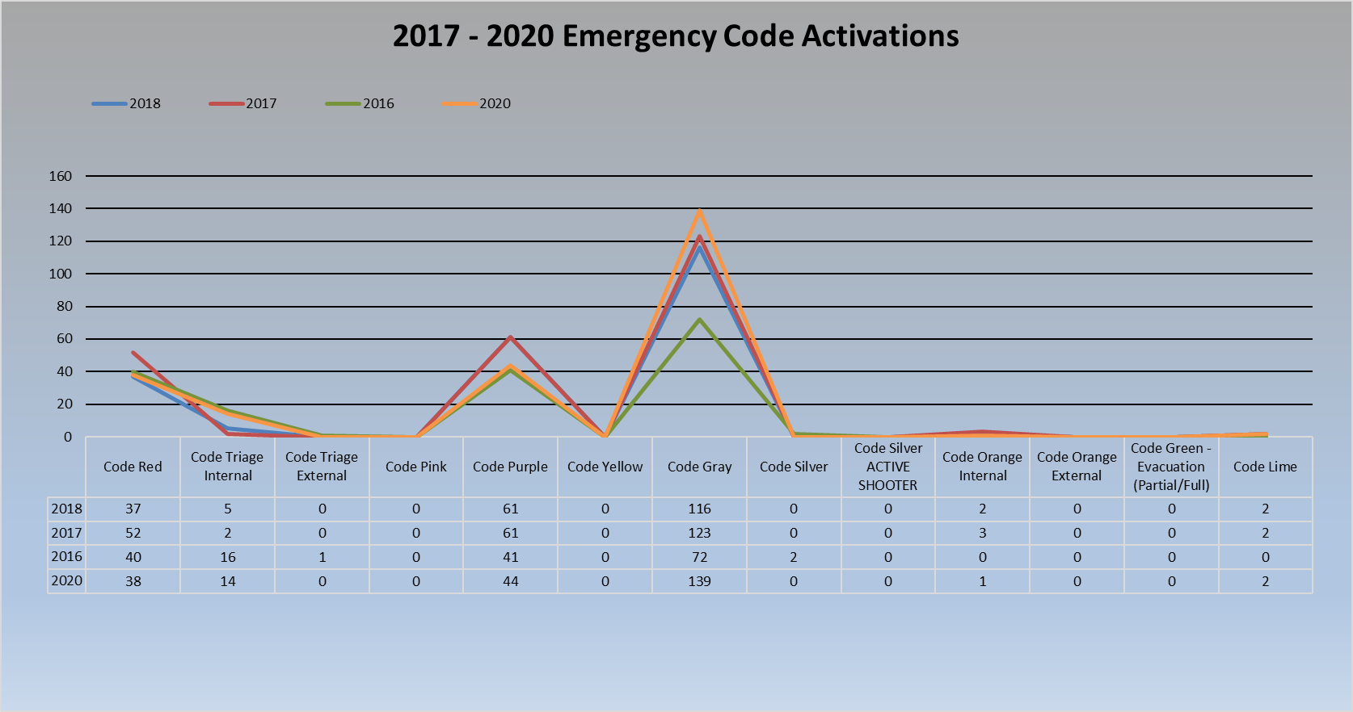
Sources for Determining HVA Data
Local Agencies – EMA, Police, Fire, Emergency Services, etc.
Historical data – Internal alerts, weather data, industry trends, crime statistics, etc.
County Data – Where program sites are located
News outlets - Identify local, national and international trends
Open sources – Research open sources
Intelligence – Industry and partnership sharing
Activations in your health center in the past

Slide 29
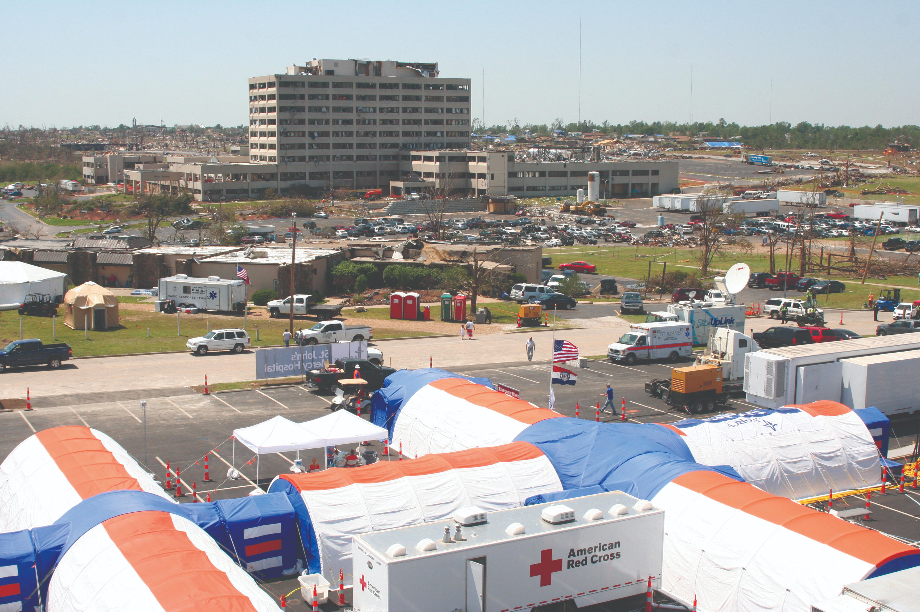
Severity Impact Factors
Severity is divided into multiple subsets:
Human Impact:
  Potential for staff, volunteer, patient and/or visitor death or injury
Property Impact:
  Cost to replace
  Cost to set up temporary replacement
  Cost to repair
  Time to recover

Slide 30
Severity - Impact
Severity is calculated by determining the magnitude and mitigation efforts an event has on your personnel, facility and operation. For this HVA tool, Severity (Impact) is ranked on a four-point scale (quantitative):
0 - Not Applicable (n/a)
1 - Low impact, reasonable simple to recover
2 Moderate impact, some delay in recovery
3 - High impact, extended delay to recover,
if recovery is even possible

Slide 31
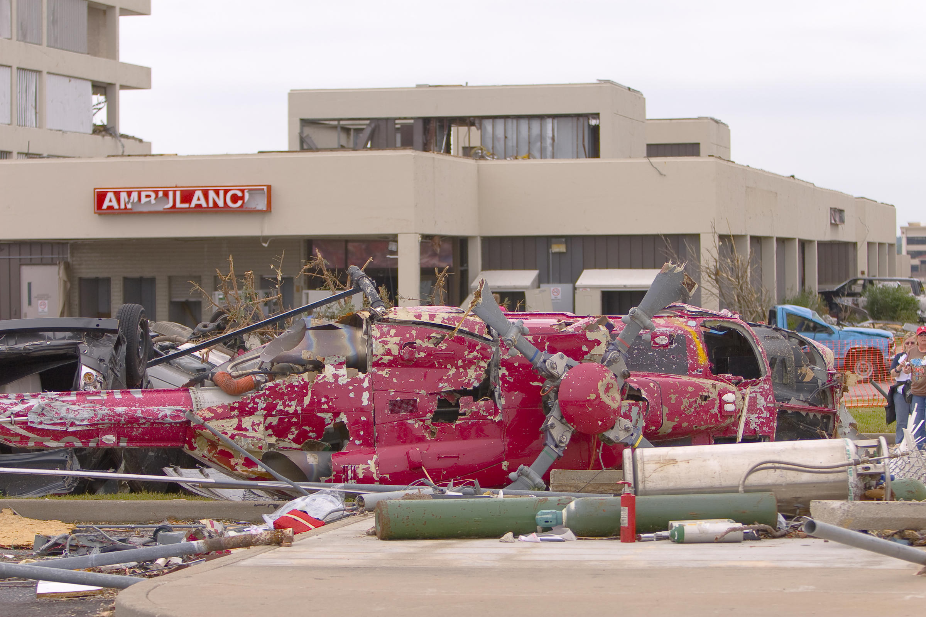
Severity Impact Factors
Business Impact:
  Business interruption
  Employees unable to report to work
  Patients/customers unable to reach facility
  Company in violation of contractual agreements
  Imposition of fines and penalties or legal costs
  Interruption of supply chain
  Reputation and public image damage
  Financial impact/burden

Slide 32

4.Identify the number of times an alert or activation has occurred in the past year for each hazard
Activations are when an emergency incident pushes an organization to “activate” their emergency plans, process and protocols.
The number of emergency activations an organizations had over the past 12-24 months will have an effect on the final hazard summary
It is important that multiple staff participate in the HVA as not everyone may know about specific activations

Slide 33
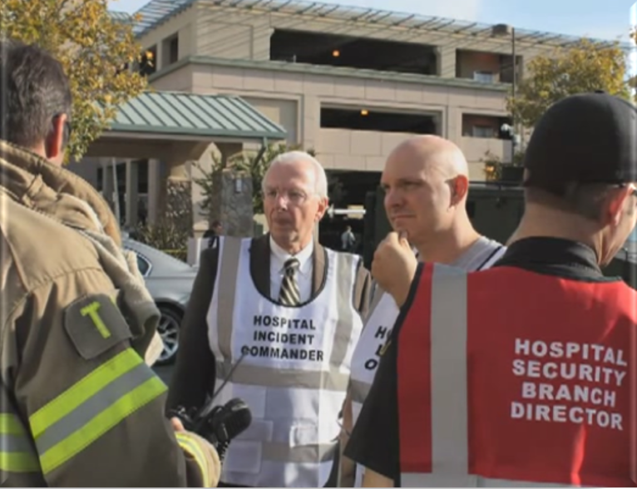
Severity Preparedness/Response Factors
External Response:
  Types of agreements/MOUs with community agencies/drills?
  Coordination with local and state agencies
  Coordination/MOUs with proximal health care facilities/HCC
  Coordination/MOUs with treatment specific facilities

Slide 34
5. Enter data into the HVA tool
Predetermine your HVA tool prior to completing your HVA
The Kaiser Permante HVA tool (i.e., 2014, 2017 and 2021 versions) is publicly available, easy to download and commonly known
CMS does not require providers to use a specific HVA format
Review the HVA tool, past activations, and EP documents prior to conducting HVA with your EP committee
Entering data in a tool takes 90-120 minutes to complete
After you complete the HVA, the tool will give your organization 7-10 top potential hazards

Slide 35
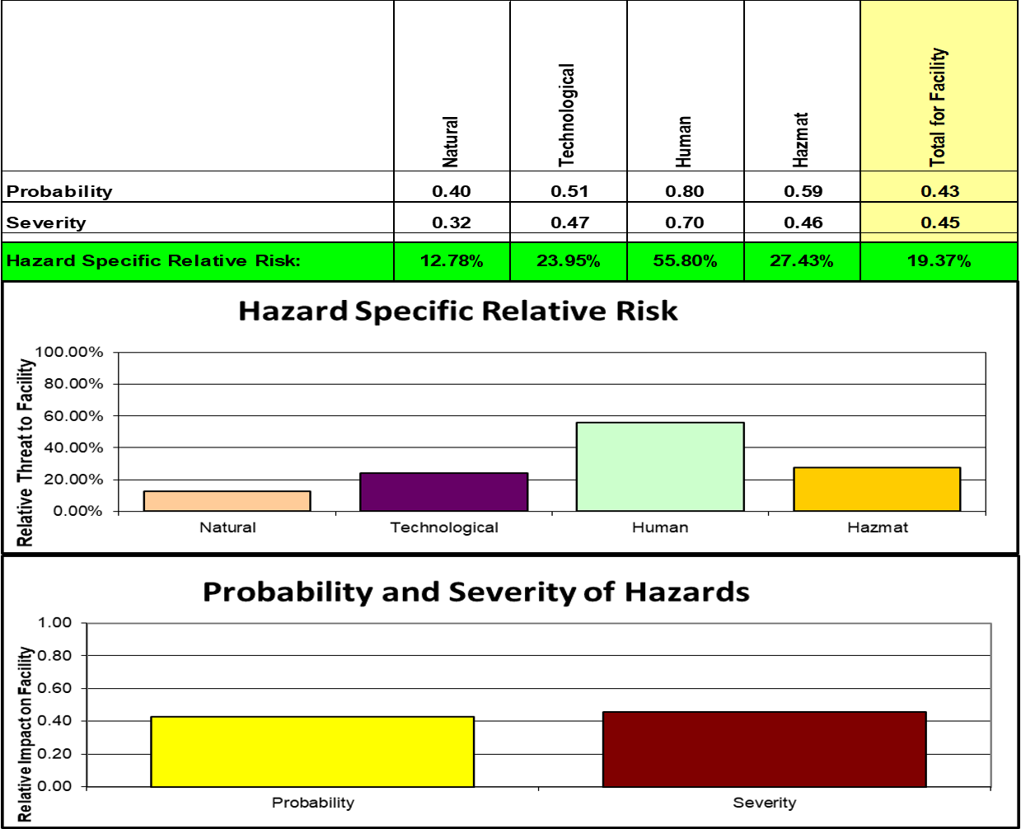
Hazard Vulnerability Analysis (HVA) Summary Results
The HVA tool will produce a summary that identifies a prioritized list of hazards that may impact your organization.
This list can be used to develop emergency and business continuity plans and associated training to ensure preparedness for these hazards.
This will also serve as a prioritization list to develop and propose mitigation projects.
11

Slide 36
Always incorporate results of the HVA in your organization’s Emergency Operations Plan.
XYZ Community Health Center May 9, 2021
TOP 10 HVA | RANK | OCCURRENCE
Bomb Threat | 1 | 0
Pandemic | 2 | 0
Earthquake | 3 | 0
Communication / Telephony Failure | 4 | 0
Drought | 5 | 0
HVAC Failure | 6 | 0
Inclement Weather | 7 | 0
Explosion | 8 | 0
Chemical Exposure, External | 9 | 0
Chemical Exposure, Internal | 10 | 0
Source Document Link: Insert source link for this complete HVA

Slide 37
6. Incorporate response plans and guides into your Emergency Preparedness Program documentation
Once the top risks have been identified for your health center through the HVA, it is important to be able to incorporate these findings into your emergency preparedness program:
Add response plans or guides to your emergency operations plan to match your identified risks
Response plans and guides give an organization detailed instructions for specific hazards so that staff can understand next steps
HVA summary's allow organizations to plan mitigation strategies, increase resilience and preparedness

Slide 38

Questions?

