Slide 1


PART 2:
How to Plan and Conduct Business Impact Analysis (BIA) Workshops
Presented by:
Karen Garrison, Vice President of Operations
and Rebekah Kines, Planning Specialist

Slide 2


Bio: Karen Garrison, Vice President of Operations
Karen Garrison has directed a many programs and services that support seniors and disabled adults in community based and clinical settings in the San Francisco Bay Area. Programs include, skilled nursing, residential dementia care, adult day health centers, supportive senior housing, clinical case management services, and national service programs.
She joined Connect Consulting 4 years ago and specializes in CMS EP compliance by developing comprehensive emergency management programs, CMS provider emergency and business continuity plans and facilitating training to ensure contract and regulatory compliance and build EP infrastructure.
She leads our team of emergency management Planners, trainers and exercise professionals and manages most of the emergency management and business continuity projects.

Slide 3

Bio: Rebekah Kines, Planning Specialist
Rebekah Kines has over 10 years of Emergency Management and served as the Emergency Management Coordinator for the City of Arlington, TX as well as Homeland Security Planner with the Permian Basin Regional Planning Commission servicing 27 West Texas counties.
Rebekah’s work focused has included planning for mass gathering events, pandemic planning and continuity of operations planning. In addition, she has worked closely with multiple agencies planning for events such as Super Bowl XLV, NBA All Star events as well as working activations for flooding, hurricanes and other weather-related events. Rebekah has a Bachelor of Science in Criminal Justice from Sul Ross State University in Alpine, TX.

Slide 4

Introductions
Name
Role at your Health Center
What is your favorite sport to watch or play?

Slide 5

Training Objectives
What are Business Impact Analysis (BIA) Workshops
Some Business Continuity Planning Terms
Preparing for Business Impact Analysis Workshops
Conducting a Business Impact Analysis Workshops
Develop your methodology for Collecting your Data

Slide 6
Business Continuity Planning Series
DATE | PART | WEBINAR TITTLE | COMPLETED
July 11th | 1 | HOW TO DESIGN AND CONDUCT A RISK ASSESSMENT / HAZARD VULNERABILITY ANALYSIS (HVA) | ✓
TODAY | 2 | HOW TO PLAN AND CONDUCT BUSINESS IMPACT ANALYSIS (BIA) WORKSHOPS | 90 MINUTES
September 8th | 3 | HOW TO PLAN, COLLABORATE AND WRITE A BUSINESS CONTINUITY PLAN | 60 MINUTES

Slide 7
The Three Elements to Developing a Business Continuity Plan
1. Conducting a Hazard Vulnerability Analysis / Risk Assessment
allows an organization to understand their potential hazards
informs both the Emergency Operations and Business Continuity Plans
is a CMS and Joint Commission Requirement
2. Conducting Business Impact Analysis (BIA) Workshops
allows an organization to identify their core services and functions
identifies internal staff that Subject Matter Experts for their departments
3. Writing the Business Continuity Plan
Build the BCP team, gather the data, and write your BC Plan

Slide 8
1.What are Business Impact Analysis Workshops

Slide 9

Please use the Chat Function or Unmute Yourself to comment on this question:
Does anyone have a Business Continuity Plan for their organization?
If so, have you had to activate your BCP Plan during a disaster?
❑ Yes
❑ No

Slide 10
Business Impact Analysis (BIA) Workshops
BIA Workshops are facilitated, standardized interviews to:
determine the mission essential services and resource requirements for an organization to ensure operational resilience and continuity of operations during and after an emergency
identifies potential service delivery disruptions, mission essential functions and their dependencies, recovery times and impacts scores
data collected from BIA’s are used to develop mitigation strategies, solutions and plans
BIAs are the most labor intensive and significant part of developing a Business Continuity Plan

Slide 11
Why is it important for organizations to have a Business Continuity Plan?
Business continuity planning allows organizations to:
  Allows organizations to continue to provide mission essential functions and services post disaster
  Builds patient, staff and community confidence
  Identifies your supply chains and back up plans
  Mitigate financial and cybersecurity risks
  Identifies internal staff to carry out the recovery activates
Notes:
Business continuity planning is more than a nice-to-have; it is an essential piece to every health center.
There are many benefits to having a BCP in place:
Maintain business operations. Maintaining essential business functions during a disruption can greatly mitigate financial loss as well as continue to support the communities our health centers serve.
Build patient confidence. Our patients need to know that we can respond to disruptions while maintaining services. During all types of disasters, including those that affect the health of those we serve (e.g., pandemics, etc.), our patients need to know that we can still serve them in the safest way possible.
Protect our supply chain. Planning allows us to build relationships with multiple vendors, thus protecting our supply chains during a disruption. A good BCP will include previously vetted options for navigating supply chain issues.
Mitigate financial risk. Planning allows us to identify the steps that need to be taken during a disruption. This will allow us to seamlessly maintain operations, thus protecting our health centers from prolonged downtown which creates more potential for financial loss.
Mitigate cybersecurity risk. Data breaches and security exploitation affect not only large corporations, but small organizations as well. Our health centers are not immune to cyber-attacks. Due to increased recognition in the value of health data, it is vital that our health centers mitigate cybersecurity risks and protect all sensitive health data.

Slide 12
2. Some Business Continuity Planning Terms

Slide 13
Business Continuity Planning Key Terms
Business Continuity Planning: tools, processes and procedures to identify core Mission Essential Functions and their elements so that an organization can resume back to normal operations following an emergency
Business Continuity Planning Team: Internal organizational team that leads and participates in the BCP process to develop and organization’s Business Continuity Plan
Business Continuity Plan: Comprehensive plan to help organization to prepare and prioritize post disaster recovery activities, develop mitigation strategies and identify staff to implement the BC Plan
Business Impact Analysis (BIA) Workshops 90 to 120 minute facilitated BIA Workshops with key departments (i.e., clinical, administration, finance, etc.,) to gather data regarding recovery activities post disaster

Slide 14
Business Continuity Planning Key Terms
The Information that is identified through a Business Impact Analysis Session:
Mission Essential Functions (MEFs): Functions or activities that must always continue. They typically reflect only a subset of a business' normal operating functions
Dependencies: Identify Staffing, Space, Equipment, and Systems that are elements necessary so that essential functions can continue
Recovery Time Objectives: Amount of time a Mission Essential Function n can be disrupted without adverse impact to the organization
Impact Scores: Severity of impact to the organization if a Mission Essential Function is not restored within the recovery time; impact categories include legal/compliance, brand/reputation, financial/revenue loss, and compliance

Slide 15
3. Preparing for Business Impact Analysis Workshops

Slide 16
Please use the Chat Function or Unmute Yourself to comment on this question:
Has anyone participated in in a Business Impact Analysis (BIA) Workgroup before?
If yes, what was your experience?
❑ Yes
❑ No

Slide 17

Identify your Cohorts/ Groups that will Participate in BIA Sessions
Choose the core departments within your organization that provide the most critical services (i.e., administration, finance, operations)
Determine if you will keep BIAs to internal only to add community stakeholders
Use your BCP Team to coordinate interview schedules, select BIA participants and cohorts
Identify the staff that have the best institutional or operational knowledge to be interviewed
Determine if the BIA workshops will be virtual or in person
Send invites out early to be able to block staff’s schedules

Slide 18

Use your Business Continuity Team to develop the BIA sessions
Your BCP Team is often your internal Safety Committee
By developing your BC Plan, it is an opportunity to expand your internal team across your organization
Gather team members from multiple disciplines (i.e., clinical, operations, facilities, administration)
Your Business Continuity Team should mirror who will be interviewed through BIA sessions
Meet regularly to plan elements of the BIA workshops

Slide 19

Your BCP Implementation Team should:
This internal team are responsible for populating the plan, coordinating BIA Workshops with departments and will implement all aspects of the new business continuity plan
There is often crossover between the BCP Implementation Team, Senior Leadership and Incident Command Team
Members of the BCP team need the authority to act and authorize BCP resources and actions

Slide 20

BIA Surveys
Develop a survey with the questions that you will be asking BIA participants during the workshops
Send the survey out 1-2 weeks prior to the BIA workshops
The BCP team will review the information (data) from the surveys prior to the workshops
Surveys can easily be conducted using Survey Monkey, Microsoft Forms, Google Sheets, etc.

Slide 21
BIA Surveys (continued)
5. By gathering information through the surveys, participants can have time to answer all the questions in greater detail
6. It is crucial for BIA participants to complete the survey prior to the BIA sessions
7. Because we have survey responses, we can use the BIA workshops to validate the data in greater detail
8. This survey process will make BIA workshops more effective, at gathering accurate data and requires less time per session

Slide 22
How many BIA’s Workshops to have?
This depends largely on the size and complexity of your organization
It is important to capture data from those departments / groups that provide the most critical services within your organization
It is common to have between 5-10 BIA sessions per organization
Many times, departments can be bundled into one BIA workshop with similar functions (i.e., combining finance, payroll and vendor payments into one group)

Slide 23
4. Conducting Business Impact Analysis Workshops

Slide 24
Now you are ready to start…
You have:
Built and activated your internal BCP Team
Identified your BIA cohorts / departments and staff to Interview
Disseminated Pre-BIA Surveys to participants
Analyzed Survey Results
Sent invites to BIA participants
You are READY!!!

Slide 25
What will BIA Participants be asked in the Workshops?
We will review their survey results with each cohort
We will validate that the survey results are accurate with participants
We can drill down to gather more details about mission essential functions and their dependencies, recovery times and impact scores
It is an opportunity for BIA participants to add MEF’s and give clarifying data

Slide 26
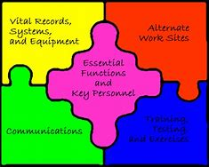
1.Mission Essential Functions (MEF)
Mission Essential Functions are services or tasks that must always continue even after disaster.
These core functions are a subset of an organization’s normal operating functions but are key to maintaining an organization’s mission and core services to their respective communities.

Slide 27
Mission Essential Functions
Department | Mission Essential Function | Maximum Tolerable Downtime
Finance | Payroll | 48 hours
IT | Server updates | 4 hours
Clinic | Scheduling | 24 hours
Notes:
Here you’ll see an example of the essential business functions/critical processes that were identified during the business impact analysis.
Each department identified their essential business functions/critical processes as well as the maximum amount of time a function can be down before it negatively impacts their operations. We’ll discuss this in more detail on our next slide.

Slide 28

2. Dependencies for Essential Functions
Each Essential Function depends on critical things that make them possible:
Staff
  i.e., Internal or external department staff
Equipment
  i.e., Laptops, cell phones
Systems
  i.e., Online appointment scheduler, internet access, or payroll software
Space
  i.e., office, working remotely at home or another location
Notes:
Lauri
A dependency is a task, process, or resource that a business relies on in order to perform their operations. Identified dependencies include the 4 S’s: Staff, Stuff, Systems, and Space.
[Ask: What dependencies does your department rely on?]
Example: One of your essential functions is to ensure staff are paid correctly and on time. In this case, your dependencies would include your business process and technology. If either your business process (how you input hours and create direct deposits) or your technology (software you use to process paychecks) fails, you would experience difficulty in paying your staff on time.
Probing Questions:
What dependencies does your department rely on?
Can you think of examples of how dependencies may impact your department’s operations?
Another factor to consider with respect to dependencies is whether any of your department's essential functions cross over to another department or department? If so, what essential function crosses over and to what department of department does it cross over to?
[Ask: do any of your department’s essential functions cross over to another department?]

Slide 29
Dependencies
Mission Essential Functions | Staff and Vendors | Equipment Related Requirements | Systems | Space Requirements
Finance: Payroll | Payroll Director, accounts Payable, program managers | Laptops, printer, scanner | Online payroll system, electronic timesheets | Can be done remotely
IT: Server Updates | Health Center IT Director, Outside IT Vendor | Laptops | Microsoft Suite 365, Cybersecurity Software | Can be done remotely
Notes:
During the business impact analysis, department leadership will document Mission – Essential Equipment and Supplies. This will require you to:
Document status of major equipment or critical supplies, both on hand and in use, and how long they can operate with present supply of vital consumable materials.
Take inventory of current equipment and supplies and create a resupply list.
Check condition of storage or onsite stockpiles to determine the level of damage to equipment and goods after incident occurs.
If it becomes necessary to relocate services to another facility, this list can be used as a starting point to ensure resources will be available.
Walk through chart

Slide 30

3. Recovery Time Objectives
Amount of time a Mission Essential Function n can be disrupted without adverse impact to the organization

Slide 31
3. For each Mission Essential Function: what is its Recovery Time Objective?
0 - 4 HOURS
4 - 12 HOURS
12 - 24 HOURS
24 HOURS - 3 DAYS
3 DAYS - 1 WEEK
1 - 3 WEEKS
3+ WEEKS
PHASE 0
PHASE 1
PHASE 2
PHASE 3
PHASE 4
PHASE 5
PHASE 6
Notes:
Lauri
[RTO Scoring]
Now that we have identified the essential functions, core capabilities, and dependencies, we need to know WHEN those functions need to be resumed. Ranging in timeframes from within hours of the disasters to months later, the RTOs give us your priorities for resuming your essential functions.

Slide 32
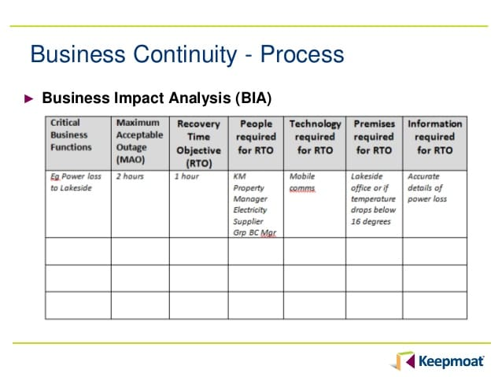
4.Impact Scores
The severity of impact to the organization if an essential business function is not restored within the recovery time objective (#3);
Impact categories include legal/compliance, brand/reputation, financial/revenue loss, and life safety

Slide 33
5. Develop your methodology for Collecting your Data

Slide 34

Validate your Data
Once the BIA Workshops are complete, it is important to validate the information that you gathered throughout the BIA Workshops
It is important that the data such as essential business functions, RTO’s, etc. are captured correctly and reflect the “voice” of each cohort/ department
Refer to BIA session notes or recordings to clean up the BIA data
Send BIA participants final notes if needed to clarify information or corrections
Determine a deadline to return validated BIA information from participating department staff
Once validated, the data is ready for analysis

Slide 35
What is a Data Rollup?
The Data Rollup is one of the most significant part of Business Continuity Plan
BIA Workshop data creates the Data Rollup
Mission Essential Functions, Dependencies, Recovery Times and Impact scores are ranked in order of importance to create a periodized list of mission essential functions

Slide 36
Data Rollup
Prioritizes all identified essential business functions
Creates a “task list” of the most pressing functions post disaster
Data is departmental information gathered from the BIA workshops
Takes time and methodical skills to create the data rollup
Department | Essential Function | Staff Dependencies | Stuff Dependencies | Systems Dependencies | Space Dependencies | Business Impact Score
Tier 1: 0 hours (immediately)
IT | Ensure desk phones are operational | · Craig · Ralph · All staff (enter hours) · Operations team · Facilities team · Comcast (desk phones) · T-Mobile and ATT (cell phones) · Team Logic (vendor) | · Cell phone · Laptop · Power · IT policies and procedures | · Wifi/internet · Microsoft 365 · Teleconferencing capabilities (Zoom, Teams) · AlertMedia · Team Logic | · Remote if power is running | 3
Tier 2: 0 - 2 hours
CEO | Crisis communications/internal communications and coordination with staff, Board of Directors, etc. | · Senior Leadership Team · VP of Programs · VP of Operations · VP of Human Resources · IT · Board Leadership (Board Chair, Executive Committee) | · Cell phones · Sat phones · Laptops | · AlertMedia · Teleconferencing capabilities (Zoom, Teams) · Wifi/internet · Microsoft 365 | · Remote | 3
Finance | Accounts payable (payroll, vendors, etc.) | · CFO · Financial Controller · Staff accountant | · Cell phone · Laptop | · Wifi/internet · Cell service · PayCom | · Remote (with cell phone signal or internet) | 3
Finance | File/initiate insurance claim | · CFO · Financial Controller | · Cell phone · Laptop | · Wifi/internet · Cell service | · Remote (with cell phone signal or internet) | 3

Slide 37
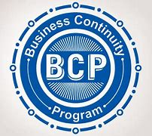
How to create a Data Rollup
BIA Session Pointers
Using the BIA survey data, make sure to take great notes detailing essential business
Record the BIA Workshops if possible so that you can go back and capture more details
All recordings are confidential and used only for capturing BIA information.
How create a Data Rollup
Excel spreadsheets work well to capture BIA Workshops
Once BIA information are populated and validated, you can transfer the information into the Data Rollup
Rank all essential business functions by recovery time objectives and impact scores from the smallest time frame (i.e., 0-2 hours) and the largest impact score (i.e., 3) hours)
The completed Data Rollup will show a prioritization of the most important essential functions by time and importance for all departments

Slide 38
Data Rollup including: MEFs, Dependencies, RTOs and Impact Scores
Mission Essential Functions | Dependencies | Department Responsible | Recovery Time Objectives | Impact Score
Utilities | Electricity | Facilities | 0 - 2 hours | 15
EMR, orders, lab results | Computers | IT | 2 - 12 hours | 12
Desk Phones | Communication Devices | Telecommunications | 12 - 24 hours | 11
Notes:
To perform mission critical services, the department depends on the following internal and external dependencies or needs.
The Maximum Tolerable Downtime, also known as recovery time, is the maximum length of time (in hours or days) that the service or function can be discontinued without causing irreparable harm to people (staff, patients, visitors) or operations.
Leadership can capture essential services and their MTD like the example on the screen.
What I like about this chart is that it includes a manual workaround should the primary dependency be unavailable.

Slide 39

Any Questions?

Slide 40

Part 3: Writing Your Business Continuity Plan
September 8th
You will learn the critical steps to develop your organization’s Business Continuity Plan

Slide 41
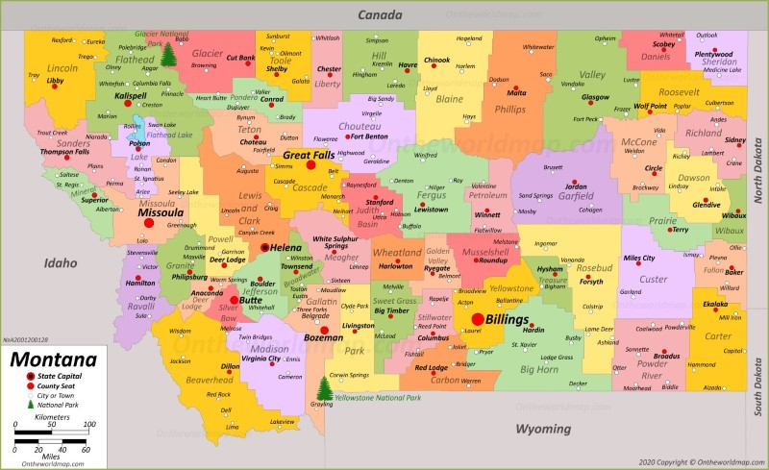
Thank you for your time today and what you do for your communities!
Thank you for taking the time to join us today and for what you do for your communities!

Slide 42
About Connect Consulting Services
Woman-Owned Small Business established in 2009, headquartered in Sacramento, CA
Serves Public, Private and Tribal clients throughout the continental U.S. and Alaska
Woman-Owned Small Business of the Year (2018) by the Sacramento SBA
Specialized services:
  Business Continuity Planning
  Emergency Operation Management Planning
  Pandemic Response and Recovery Planning
  Alternate Care Site and Evacuation Planning
  Incident Command System Support
  Training Development and Delivery
  Active Shooter and Workplace Violence
  Drills and Exercises (HSEEP Compliant)
  Compliance Audit and Improvement Planning

