Slide 1
Rural Health Transformation
Updates
April 10th, 2026

Slide 2
Clarifying the Confusion
What $$ available this year? Soon!
  Remember – work this year impacts future $$
Community vs. Ind CHC vs. Network

Slide 3
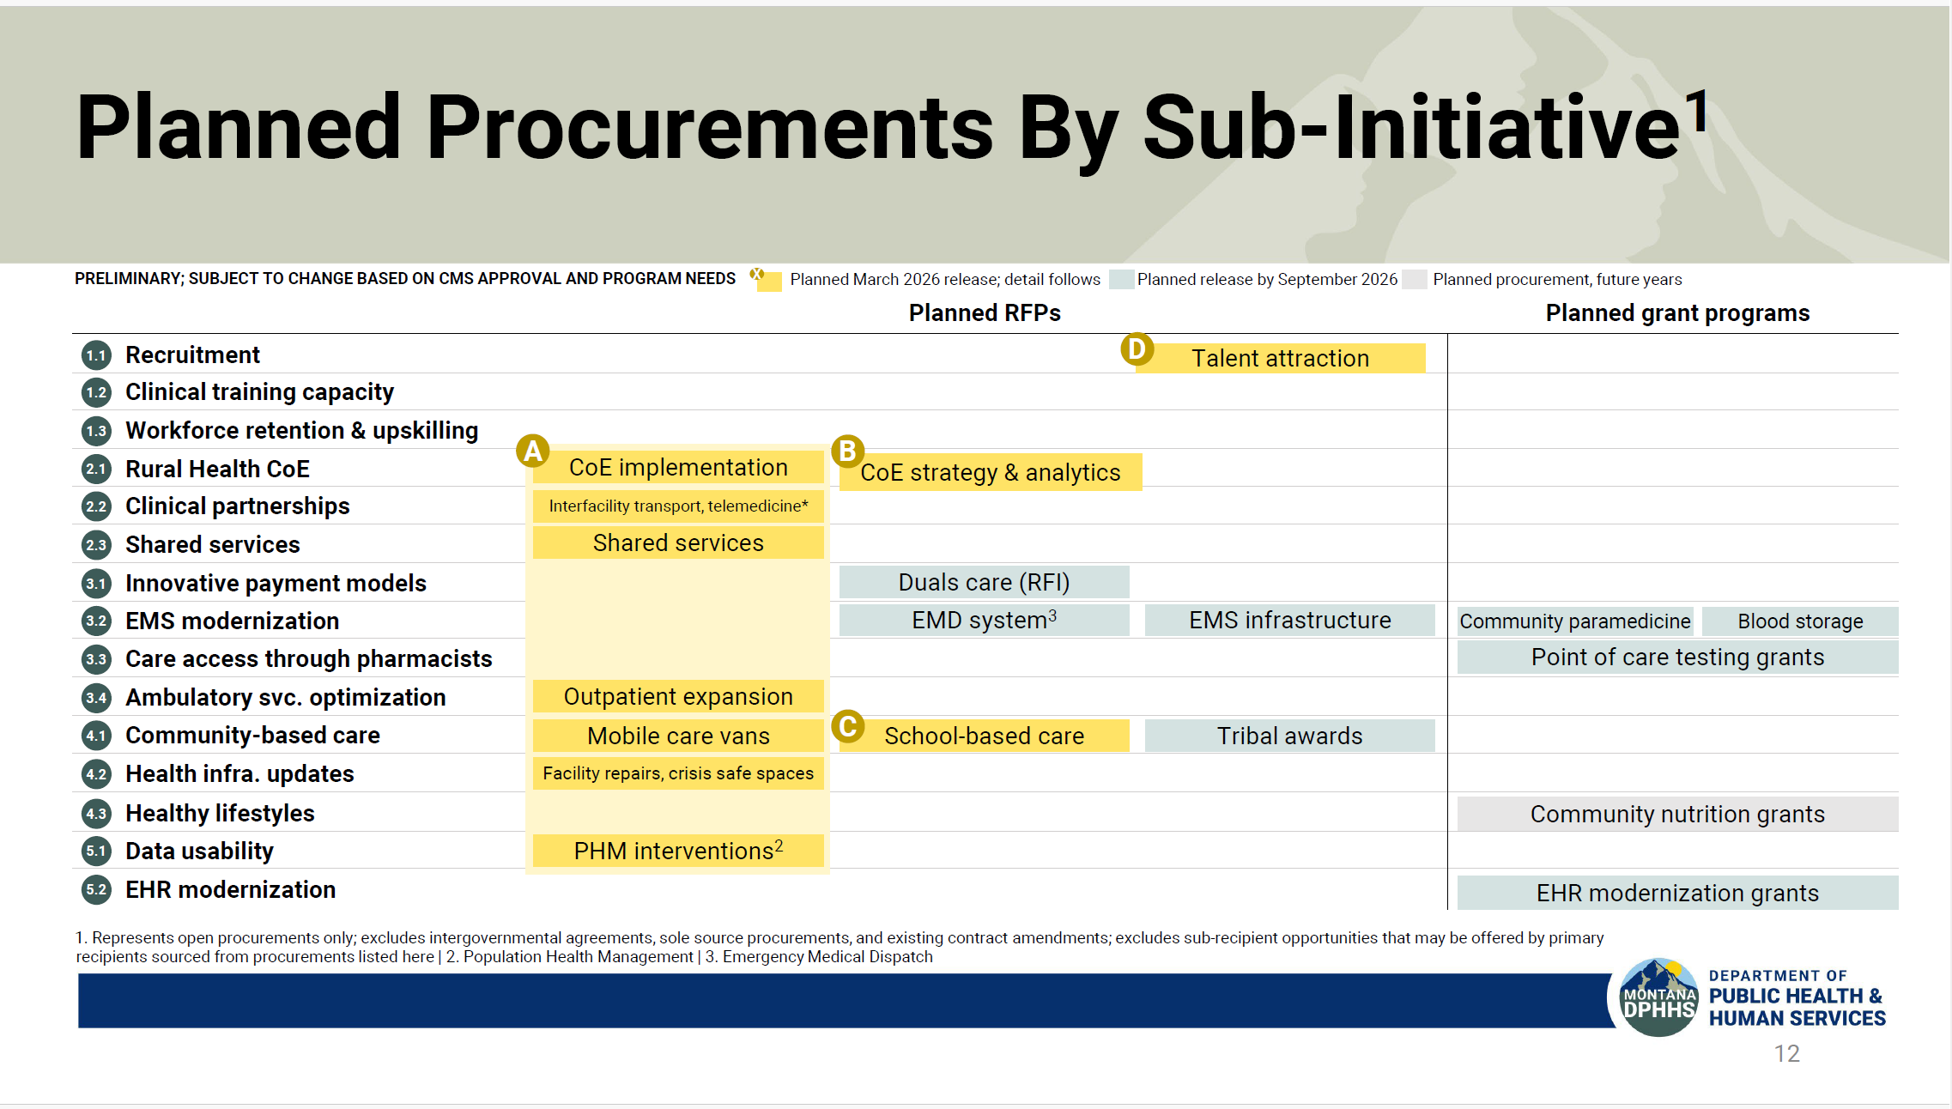

Slide 4
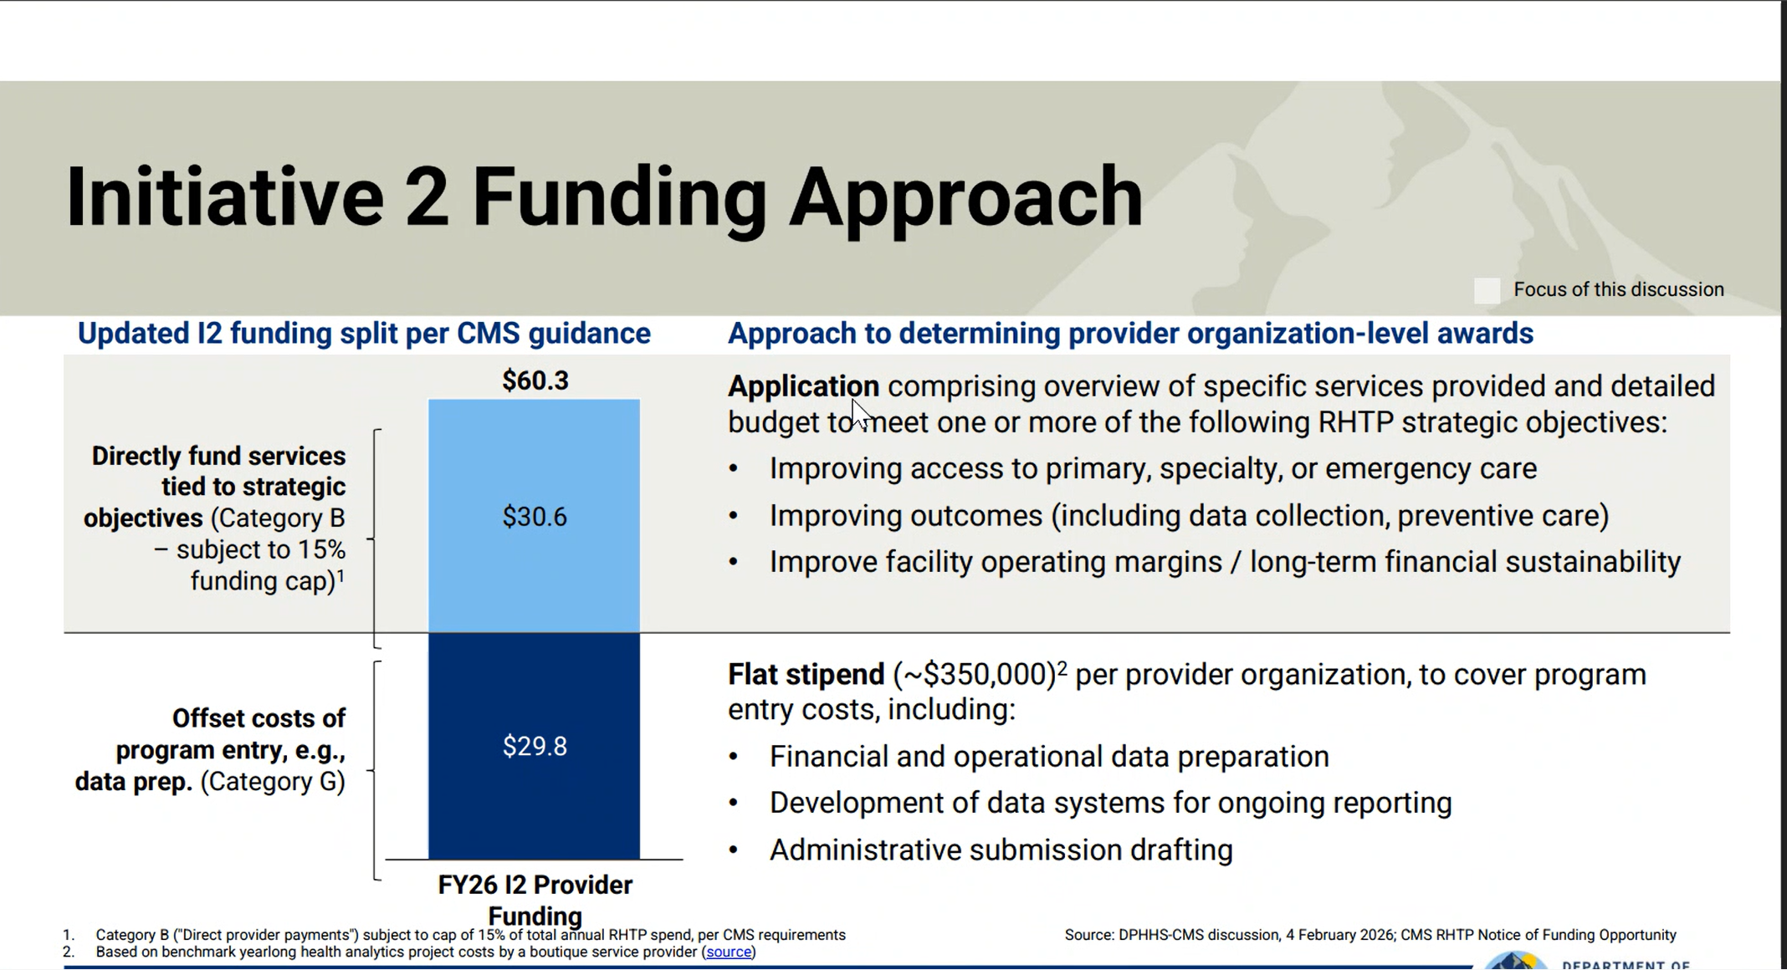
Light Blue – Application for $$ Pick 2

Slide 5
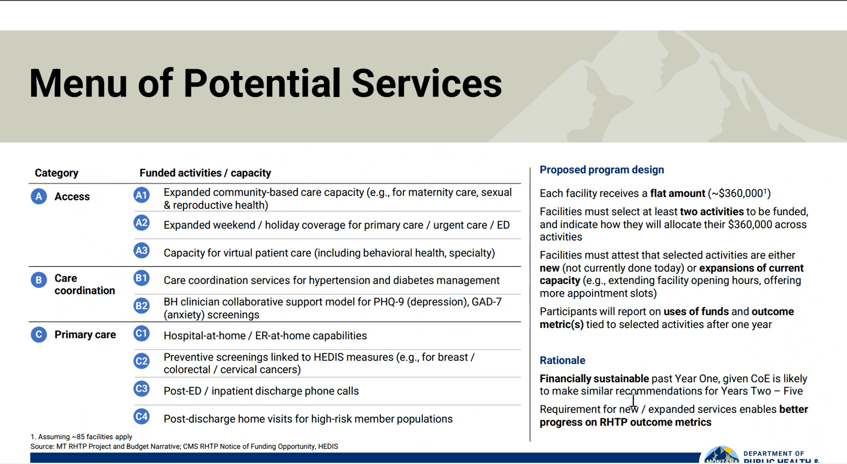
Together as FQHCS or Separately??

Slide 6
Put it All Together
*Care Management/Care Coordination*
No $$ for CM – included in PMPM (Medicaid)
Staffing Gaps across FQHCs
Medicare CM is revenue generating
  CCM, ToC, & APCM
The MT RHCs are doing it
Trained FQHC staff vs. Contractor
DM & HTN in every contract
  *Medicaid 10% improvement

Slide 7
How Support?
Traditional
CHC $$ - MPCA TTA
FQHC Applies for $$ Contracts to MTH+
MPCA/MTH+ Applies??

Slide 8
Updates This Week
A new RFI to be released
Medicaid chose TA Vendor – Townhall 4/13 – VBC Peer Group Tuesday
Tara report out
CEO Peer group meeting April 13 at 4:00

