Slide 1
Shifting Tides: The Continued Evolution of the “Fourth Wave” of America’s Overdose Crisis Millennium Health Signals Report™
Kelly L. Olson, Ph.D.
Director, Clinical Affairs
Millennium Health

Slide 2
Polysubstance Use
Polysubstance use involves the simultaneous and/or sequential use of multiple psychoactive substances¹
Produce a unique drug effect
Counterbalance the effects of two drugs
Polysubstance use is very common but may be unintentional^{1,2}
Contaminated drugs or counterfeit tablets
Most opioid-related overdose deaths involve multiple substances (e.g., fentanyl and a stimulant drug) ¹
Naloxone is less effective for overdoses involving multiple drugs³
Compton WM, Valentino RJ, DuPont RL. Polysubstance use in the U.S. opioid crisis. Mol Psychiatry. 2021;26(1):41-50. doi:10.1038/s41380-020-00949-3\.
2020 Drug Enforcement Administration National Drug Threat Assessment. U.S. Department of Justice, Drug Enforcement Administration. Published March 2021.
Smart R, Kim JY, Kennedy S, et al. Association of polysubstance use disorder with treatment quality among Medicaid beneficiaries with opioid use disorder. J Subst Abuse Treat. 2023;144:108921. doi:10.1016/j.jsat.2022.108921.
Notes:
*Previously approved slide from Signals Vol. 5*

Slide 3
THE “FOURTH WAVE”
Increasing co-involvement of synthetic opioids (fentanyl) and
stimulants (methamphetamine and/or cocaine) in overdose deaths
Percentage of Fentanyl Overdose Deaths Involving Stimulants
2013
2023
12%
57%
Co-Involved Stimulants
Co-Involved Stimulants
CDCWONDER. Centers for Disease Control and Prevention. Accessed January 14, 2025. https://wonder.cdc.gov/
Notes:
This represents a 375% increase in 11 years
Further details from Penn:
All data in CDC wonder are final thru 2023.
The percent of total overdose deaths involving a synthetic opioid (fentanyl) went from 7.1% in 2013 to 18.3% in 2015 to 69.3% in 2023.
The percent of synthetic opioid deaths that also involved either methamphetamine and/or cocaine went from 12% in 2013 to 20.6% in 2015 (“start” of 4th wave) to 57.1% in 2023

Slide 4
PRIMARY AIMS
Extend our previous work by assessing current, national trends in:
Non-prescribed fentanyl detection
Co-detection of heroin, prescription opioids, and stimulants in urine drug testing specimens that were positive for fentanyl
1
Evaluate regional and state-level variability in these trends
2
Provide insight into:
National trends in fentanyl-associated polysubstance use in 2024 across a wide range of drugs
Highlight regional variations in polysubstance use among people who use fentanyl
3

Slide 5
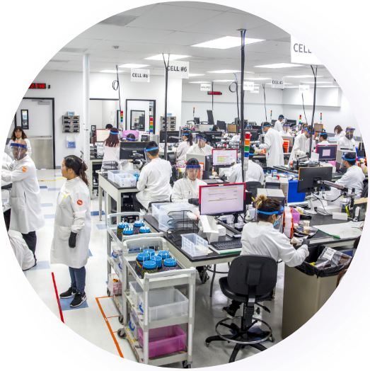
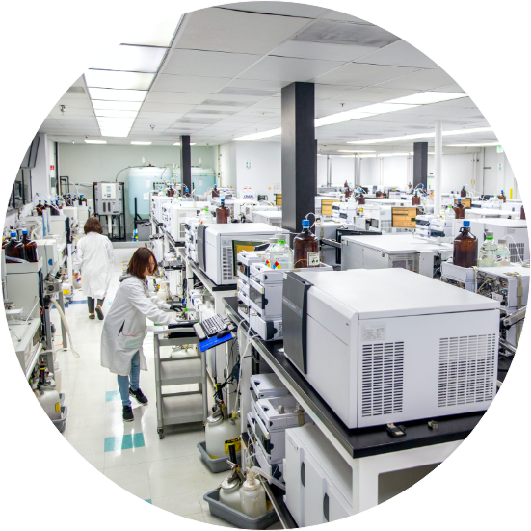
Methods: UDT Data & Sample Population
Retrospective, cross-sectional analysis of definitive urine drug testing (UDT) results from over 1.4 million specimens representing nearly 458,000 unique patients
Collected from patients aged 18 years or older in health care practices in all 50 U.S. states between January 1, 2016, and November 30, 2024
Specimens were selected based on the presence of a substance use disorder (SUD) diagnosis code provided by the ordering physician
Specimens collected within 30 days of a prior specimen for the same patient were excluded from analysis
Specimens with reported prescriptions for any of the drugs or drug categories evaluated were excluded from all analyses
Fentanyl analogue testing began in July 2019, except parafluorofentanyl which began in August 2022, testing for novel illicit opioids and illicit benzodiazepines began in August 2022, and xylazine testing began in April 2023
Millennium Health, LLC. Millennium Health Signals Report, Volume 7. Shifting Tides – The Continued Evolution of the “Fourth Wave” of America’s Overdose Crisis. Published: February 2025. Available at: https://www.millenniumhealth.com/signalsreport/
Notes:
We’re working to be more consistent and this particular dataset correlates best with overdose mortality data.

Slide 6
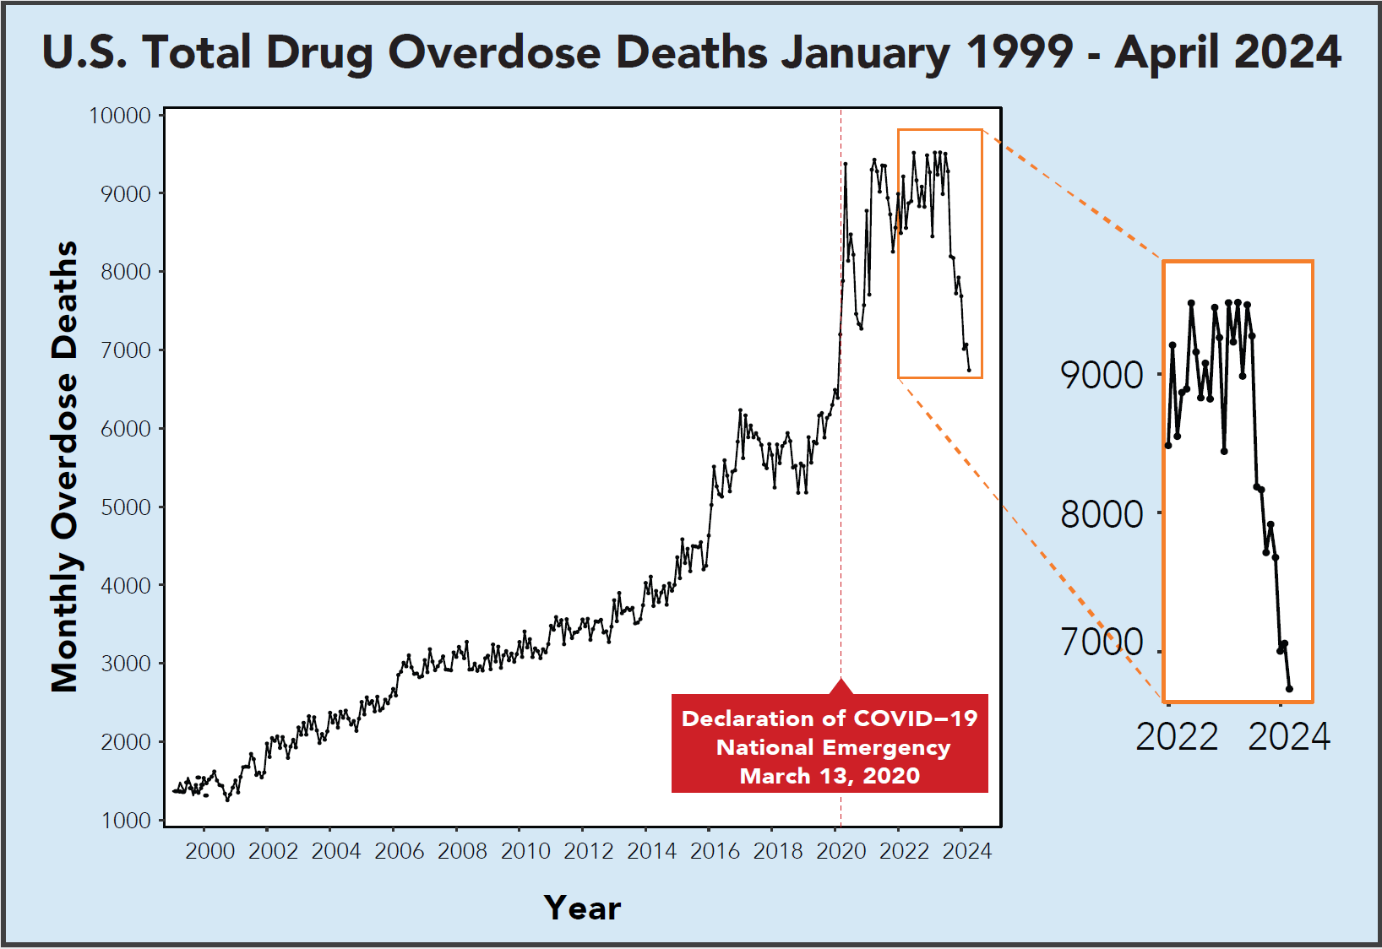
CDCWONDER. Centers for Disease Control and Prevention. Accessed December 2, 2024. https://wonder.cdc.gov/
Notes:
Tie more directly to lives lost every month (people not at the dinner table, not around for Christmas, etc.). Mention/recognize that the reps ultimately play a role in these changes… Provide context (e.g., still over 105,000 people died, we’ve seen decreases in the past like in 2018) and emphasize that much work remains and we must remain committed.

Slide 7
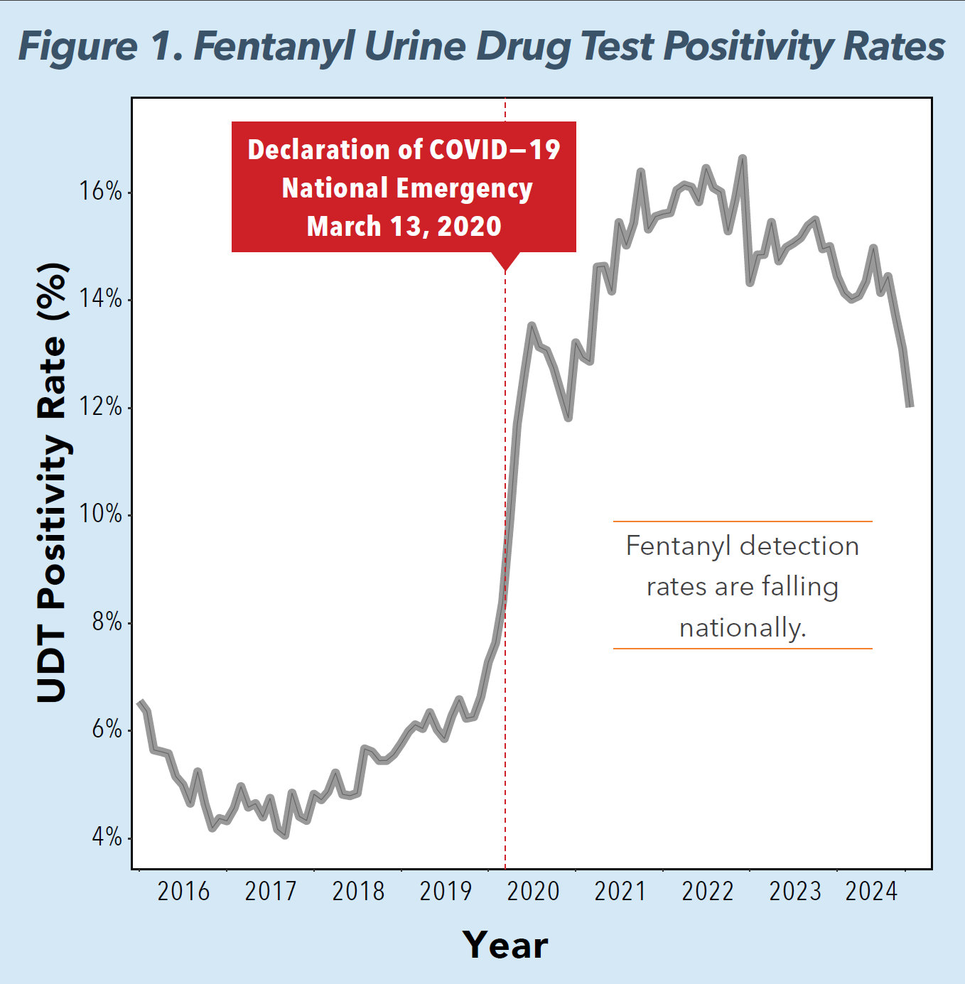
Down more than
12%
since 2022
Millennium Health, LLC. Millennium Health Signals Report, Volume 7. Shifting Tides – The Continued Evolution of the “Fourth Wave” of America’s Overdose Crisis. Published: February 2025. Available at: https://www.millenniumhealth.com/signalsreport/
Notes:
Ask “Why shouldn’t we be surprised to see that fentanyl detections are falling at a time when overdoses are decreasing?” Point out that more than 1 in 10 specimens from this group are positive for fentanyl. Changes in fentanyl or illicit opioid supplies? Disruptions…

Slide 8
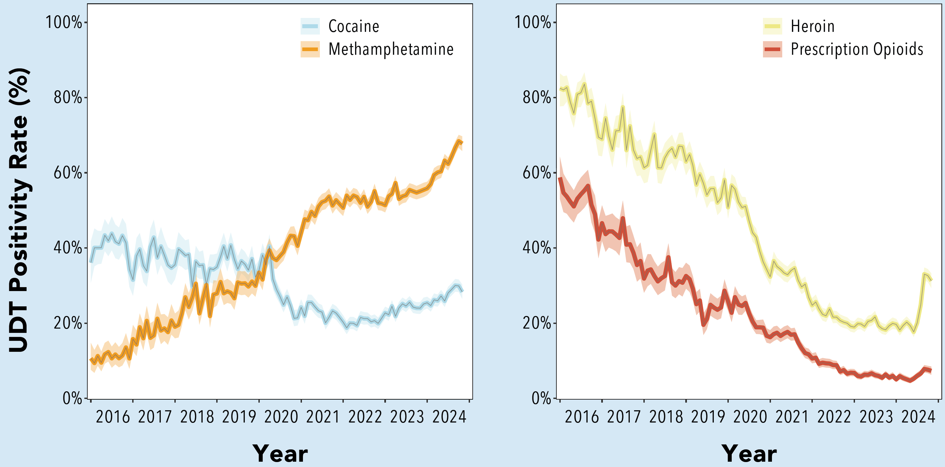
Figure 2. Co-Detection of Methamphetamine and Cocaine
in the Population Using Fentanyl
Up approximately
14%
each since 2023
>62%
>27%
Millennium Health, LLC. Millennium Health Signals Report, Volume 7. Shifting Tides – The Continued Evolution of the “Fourth Wave” of America’s Overdose Crisis. Published: February 2025. Available at: https://www.millenniumhealth.com/signalsreport/

Slide 9
Millennium Health, LLC. Millennium Health Signals Report, Volume 7. Shifting Tides – The Continued Evolution of the “Fourth Wave” of America’s Overdose Crisis. Published: February 2025. Available at: https://www.millenniumhealth.com/signalsreport/

Slide 10
Stimulant Co-Use: Consequences and Clinical Challenges
Stimulant use is associated with many negative health consequences^{1,2}
Cardiovascular events (stroke, heart attack)
Psychiatric symptoms (mood disturbances, psychosis)³
Increased infectious disease risk (HIV, hepatitis C)⁴
Increased ED and acute care utilization⁵
There are no FDA-approved medications for stimulant use disorder and no overdose reversal agents⁶
We’ve seen recent progress on contingency management,⁷ but implementation and reimbursement challenges remain
Coffin PO, Suen LW. Methamphetamine Toxicities and Clinical Management. NEJM Evidence. 2023;2:12. doi:10.1056/EVIDra2300160
Rubin RB, Neugarten J. Medical complications of cocaine: changes in pattern of use and spectrum of complications. J Toxicol Clin Toxicol. 1992;30(1):1-12. doi:10.3109/15563659208994441
Yang M, Yang C, Liu T, London ED. Methamphetamine-associated psychosis: links to drug use characteristics and similarity to primary psychosis. Int J Psychiatry Clin Pract. 2020;24(1):31-37. doi:10.1080/13651501.2019.1676451
Bach P, Ti L. Hepatitis C and Stimulant Use Disorder: Challenges and Opportunities. Clin Infect Dis. 2020;71(11):3009. doi:10.1093/cid/ciaa249
Zito MF, Fei Z, Zhu Y, Clingan SE, Marder SR, Mooney LJ. Psychosis among individuals with methamphetamine use disorder is associated with elevated rates of hospitalizations and emergency department visits across an academic health care system. J Subst Use Addict Treat. 2023;151:209033. doi:10.1016/j.josat.2023.209033
Liu MT. Pharmacotherapy treatment of stimulant use disorder. Ment Health Clin. 2021;11(6):347-357. Published 2021 Nov 8. doi:10.9740/mhc.2021.11.347
Substance Abuse and Mental Health Services Administration (2025). Using SAMHSA Funds to Implement Evidence-Based Contingency Management Services (HHS Publication No. PEP24 06 001). https://www.samhsa.gov/resource/ebp/using-samhsa-funds-implement-evidence-based-contingency-management-services

Slide 11
Figure 2. Co-Detection of Heroin and Prescription Opioids
in the Population Using Fentanyl
Heroin co-use grew by almost
18%
from 2023 to 2024
>23%
Millennium Health, LLC. Millennium Health Signals Report, Volume 7. Shifting Tides – The Continued Evolution of the “Fourth Wave” of America’s Overdose Crisis. Published: February 2025. Available at: https://www.millenniumhealth.com/signalsreport/

Slide 12
Heroin (6-MAM) Positivity Rate and Concentration in the West

Slide 13
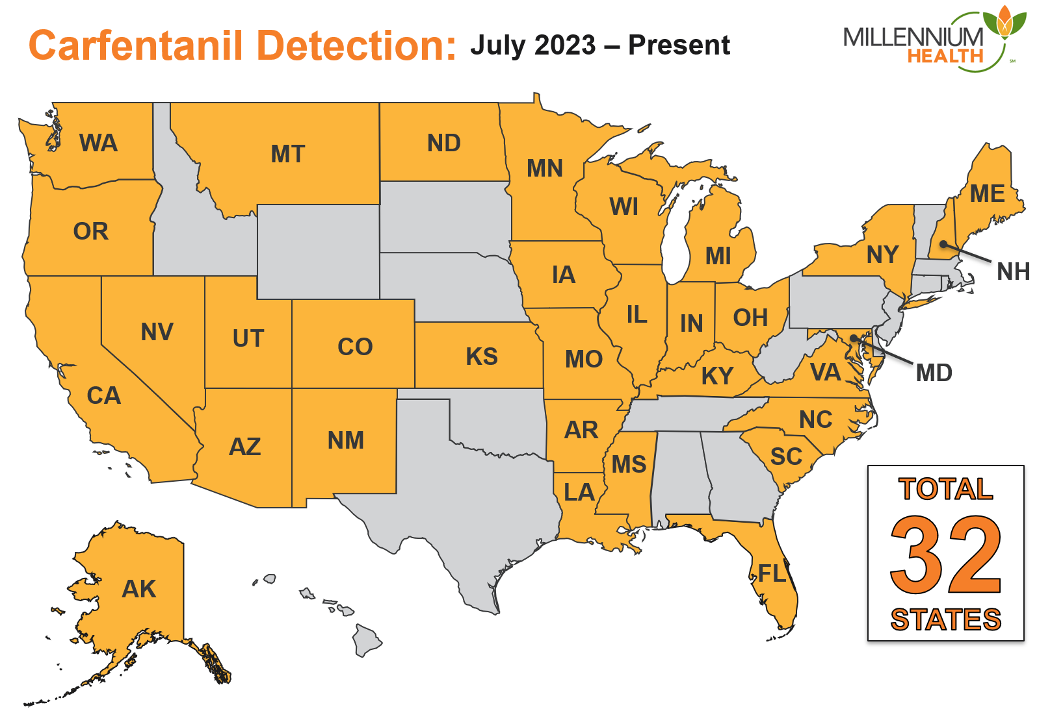
Implications for Overdose?
Will illicit opioid supplies shift toward other drugs that are potentially more (e.g., nitazene analogues, carfentanil) or less (e.g., heroin) dangerous than fentanyl?
?
Notes:
Updated 11/6/24 to add ND and SC
Updated 12/19/24 to add IA
Updated 1/2/25 to add AR and NM
Updated 2/25/25 to add UT
Updated 3/10/25 to add MS

Slide 14
CARFENTANIL
10,000x
FENTANYL
100x
HEROIN
2x
MORPHINE
1x
Note: Relative scale is approximate. All drugs are shown as capsules for relative scaling purposes (e.g., heroin is typically found in brown/white powder form).
Notes:
*Previously Approved Slide*

Slide 15
Fentanyl Positivity Rate and Concentration in the West

Slide 16
Methamphetamine Detection Rate and Concentration in the Population Using Fentanyl in the West

Slide 17
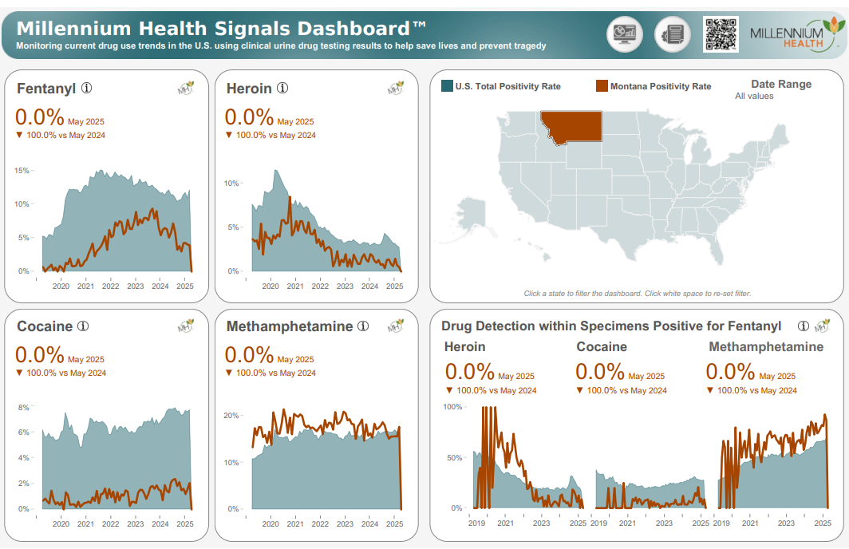

Slide 18
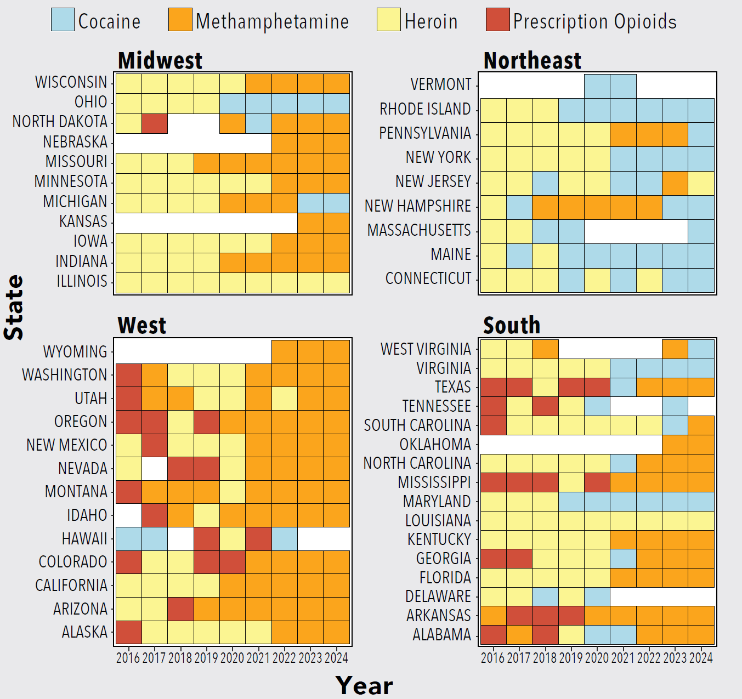
Millennium Health, LLC. Millennium Health Signals Report, Volume 7. Shifting Tides – The Continued Evolution of the “Fourth Wave” of America’s Overdose Crisis. Published: February 2025. Available at: https://www.millenniumhealth.com/signalsreport/

Slide 19
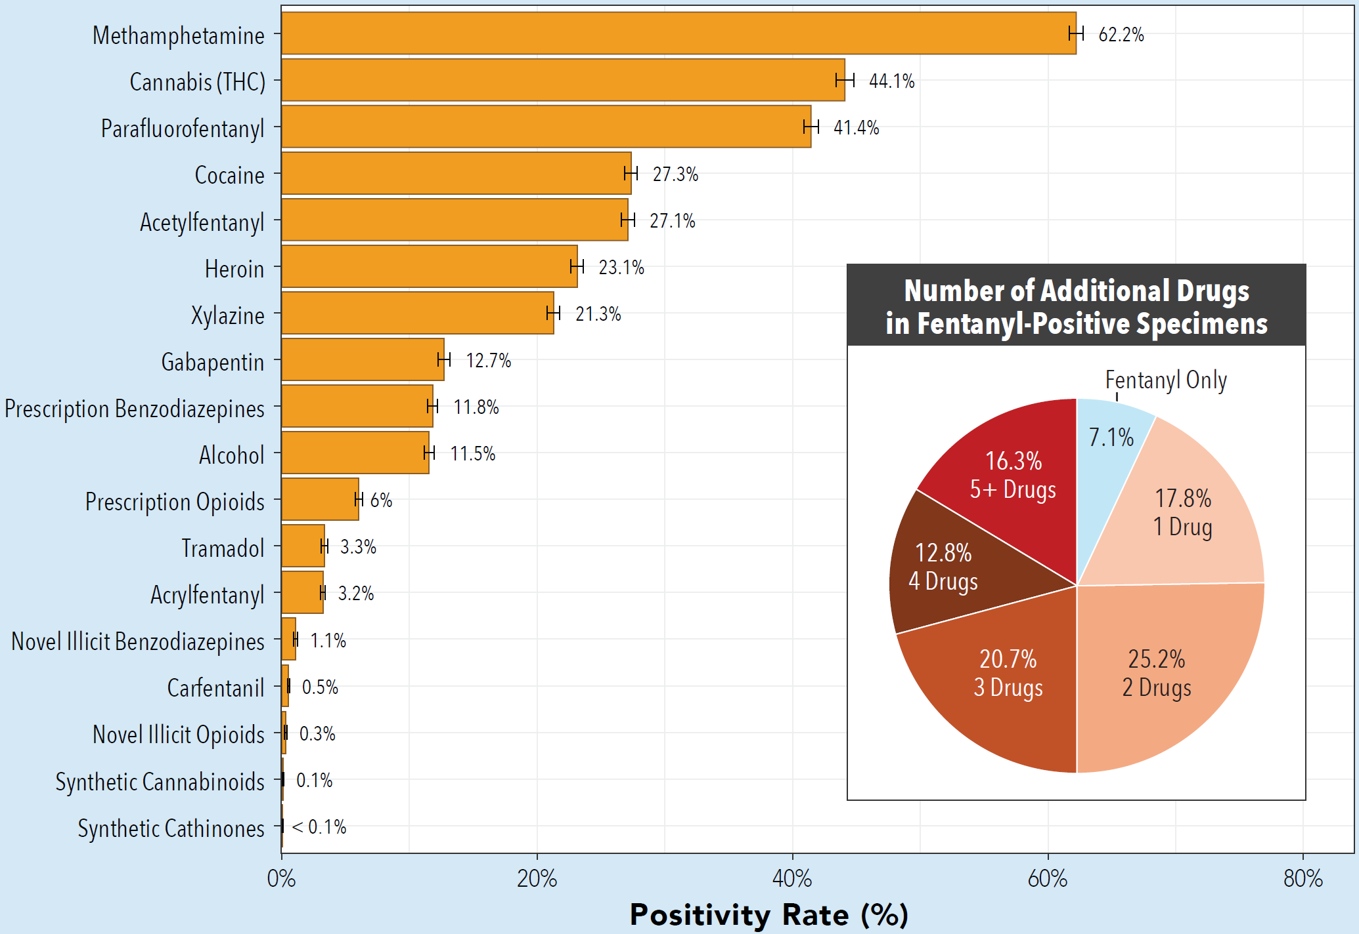
Millennium Health, LLC. Millennium Health Signals Report, Volume 7. Shifting Tides – The Continued Evolution of the “Fourth Wave” of America’s Overdose Crisis. Published: February 2025. Available at: https://www.millenniumhealth.com/signalsreport/

Slide 20
Thank you

