Slide 1
The First Step to Recovery -
Staying Alive
Robert Sherrick, MD, DFASAM
Chief Science Officer
Addiction Medicine Network
Pain and Addiction Conference
June 2025

Slide 2
Educational Objectives
At the conclusion of this activity participants should be able to:
Recognize the broad definition of Harm Reduction/Outcome Directed Treatment and how it applies in medicine and to patients with SUDs.
Identify multiple possible Harm Reduction interventions.
Identify practical steps to take in their practice situations to implement and expand Harm Reduction interventions for people with SUDs.

Slide 3
Which Side Are You On?
“Decisions about treatment should be based on science and evidence.”
“Decisions about treatment should be based on opinion and bias.”

Slide 4
What is Harm Reduction?
"Harm reduction is a set of practical strategies and ideas aimed at reducing negative consequences associated with drug use. Harm reduction is also a movement for social justice built on a belief in, and respect for, the rights of people who use drugs.“
- National Harm Reduction Coalition- https://harmreduction.org/about-us/principles-of-harm-reduction/
“Harm reduction is a practical and transformative approach that incorporates community-driven public health strategies — including prevention, risk reduction, and health promotion — to empower people who use drugs (and their families) with the choice to live healthy, self-directed, and purpose-filled lives. Harm reduction centers the lived and living experience of people who use drugs, especially those in underserved communities, in these strategies and the practices that flow from them.”
- SAMHSA - https://www.samhsa.gov/find-help/harm-reduction
“ . . . a set of activities that are intended to minimize the negative physical and social impact, including the transmission of HIV, incurred by the behaviours related to drug use.”
- WHO - https://www.emro.who.int/asd/health-topics/drug-related-harm-reduction.html

Slide 5
What Characterizes Harm Reduction?
The aim is to decrease the adverse effects of a disorder without directly targeting the disorder itself.
Most often applied to substance use disorders but can be used with other biomedical conditions. Many chronic health conditions are addressed using harm reduction
Diabetes mellitus
Hypertension
COPD
Palliative care
Alternative terminology – “Outcome Directed Treatment (ODT)”

Slide 6
What Characterizes Harm Reduction?
Health Condition
Curative Interventions
Harm Reduction
Adverse Effects

Slide 7
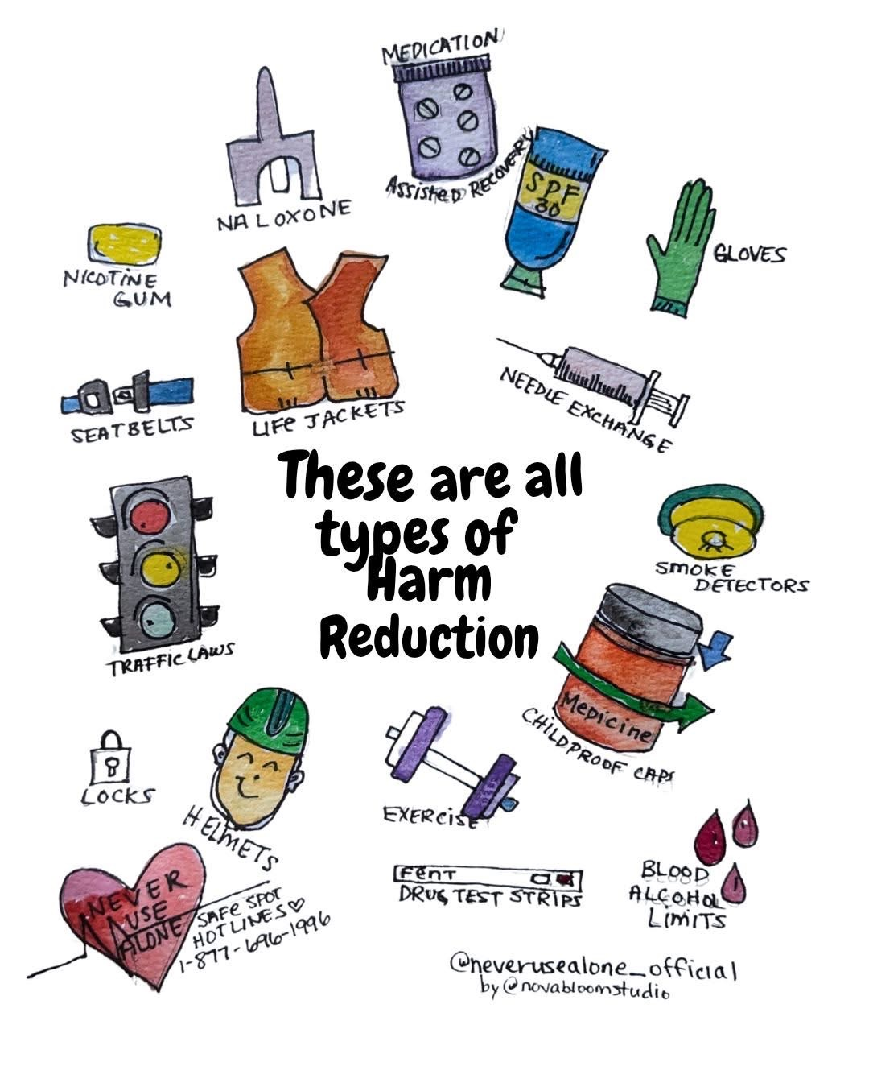
Harm Reduction is Everywhere

Slide 8
Primary Goals of Outcome Directed Treatment
Three Primary Outcome Areas to Consider:
Decreasing mortality (keeping the patient alive)
Decreasing morbidity (improving the patient’s life)
Societal impact
Cost
Diversion
Crime
Social services

Slide 9
Outcome Directed Treatment Components:
Outcome Directed Treatment (harm reduction) is science-based and judgement free.
Outcomes are considered regardless of whether the underlying condition is legal or socially condoned.
People are entitled to high quality treatment no matter what they are doing.
Example – smoking cigarettes and COPD
Treatment for COPD is never withheld because patients continue to smoke

Slide 10
harm reduction vs. Harm Reduction
“Harm Reduction was designed and created by drug users, sex workers, feminists, trans activists, people with chronic illness and disabilities.”
“It is a practice steeped in joy, in living into the beauty of our lives no matter how messy they may (appear to) be.”
“Harm Reductionists support each other and our communities without judgment, stigma, or coercion, and we do not force others to change.”
Healing Justice Lineages by Cara Page and Erica Woodland, published by North Atlantic Books.

Slide 11
harm reduction vs. Harm Reduction
Harm Reduction is a way of looking at the world .
It recognizes that drug use or high-risk behavior of any kind is inherent among humans AND that we can take steps to reduce risk without judgement.
With help, people identify their own risks and develop plans to reduce harm to self and community.
https://www.openaidalliance.org/

Slide 12
History of the Harm Reduction Movement
There is a long tradition of moralistic condemnation of illegal drug use - “just say no.”
Methadone was piloted for treating heroin users in the US in the 1960s.
The modern harm reduction movement was a response to the HIV-AIDS crisis in the 1980s and grew out of civil disobedience and grassroots advocacy among communities of people who used drugs.
Syringe access programs started in the Netherlands in the 1980s. Informal (illegal) programs started in the US in late 1980s. The first comprehensive SAP opened in US in Tacoma, WA in 1988.
Politically controversial - US banned using federal funds for SAPs in 1988. Ban was lifted in 1998 but ban on federal funds for supplies has remained in place.
Marlatt, G. A. (1996). Harm reduction: Come as you are. Addictive Behaviors, 21(6), 779–788. doi.org/10.1016/0306-4603(96)00042-1
https://prevention.ucsf.edu/sites/prevention.ucsf.edu/files/uploads/pubs/reports/pdf/NEPReportSummary1993.pdf

Slide 13
Legal Status of SSPs
Since 2016, federal funds can be used to support certain aspects of syringe service programs (SSPs), such as substance use disorder treatment, linkage to care, and education on safer injection practices.
However, federal funds cannot be used to purchase needles or syringes for illegal drug use.
These policies are under review by the current administration.
https://www.cdc.gov/syringe-services-programs/media/pdfs/2024/04/cdc-hiv-syringe-exchange-services.pdf

Slide 14
6 Pillars of Harm Reduction (SAMHSA)
Is led by people who use drugs (PWUD) and with lived experience of drug use.
Embraces the inherent value of people.
Commits to deep community engagement and community building.
Promotes equity, rights, and reparative social justice.
Offers most accessible and noncoercive support.
Focuses on any positive change, as defined by the person.
Substance Abuse and Mental Health Services Administration: Harm Reduction Framework. Center for Substance Abuse Prevention, Substance Abuse and Mental Health Services Administration, 2023.

Slide 15
Harm Reduction - Users Movement
Harm Reduction is more than a philosophy - it is a movement started by and for PWUDs
Founded on principles of social justice and respect for the rights of people who use drugs
“Nothing About Us Without Us”
PWUDs have a right to compassionate, quality care
National Survivors Union - https://www.nationalsurvivorsunion.com/
International Network of People who Use Drugs - https://inpud.net/
National Harm Reduction Coalition - https://harmreduction.org/
Drug Policy Alliance - https://drugpolicy.org/
Never Use Alone - https://neverusealone.com/
Next Distro - https://nextdistro.org/

Slide 16
Users Unions - Organizing for Better Treatment
https://www.opensocietyfoundations.org/uploads/b4f8fd79-25a5-46d7-99ab-b51b4563f980/nothing-about-us-without-us-manifesto-20080501.pdf

Slide 17
The Science Behind Harm Reduction
SSPs -
decrease transmission of HIV and HCV
do not increase drug use
do not increase local crime in neighborhood
PWUDs who access SSPs are more likely to accept treatment
OPCs –
reduce risk of overdose deaths
Naloxone rescue –
prevents overdoses
does not lead to increased drug use
Fernandes RM, Cary M, Duarte G, et al. BMC Public Health. 2017;17(1):309.
Surratt HL, Otachi JK, Williams T, et al. The Journal of Rural Health. 2020;36(2):224-233.
Trends in crime and the introduction of a needle exchange program. American Journal of Public Health. 2000;90(12):1933-1936.
Levengood TW, Yoon GH, Davoust MJ, et al. Am J Prev Med. 2021;61(5):738-749.
Wai Chung Tse, Filip Djordjevic, Viandro Borja, et al. International Journal of Drug Policy, 2022;100, 103513

Slide 18
Not Everyone Agrees
“I get it that these people have an addiction that they need help with. However, it is a personal choice to not only use but to do it with a dirty or used rig. On a professional level the Police Department will in no way, shape, or form support such a program. On a personal level I can not support such a program either.”
“Such a program condones the use of illegal drugs in the manner that the stigma of drug use being a dirty, unhealthy habit is taken away. It is acceptable to do drugs as long as you do it in a clean healthy manner. This is not the message we should be pushing out to addicts. Drug use is NOT acceptable in society.”

Slide 19
Stigma
Is stigma always bad?
Does taking away the stigma of illegal drug use encourage people to do it?
Does stigma directed at PWUDs decrease illegal drug use?
Does stigma help motivate people to change?

Slide 20
Is Using Drugs a “Choice”?
Many people consider that using drugs is a choice but having a medical condition is not.
However -
70% of diabetes is related to diet and exercise and nearly 100% of COPD is related to smoking.
While initiating drug use is a choice, once an addiction has been established, most people are no longer capable of stopping without treatment.
No one initiates drug use with the intention of becoming addicted.
Addiction has been associated with specific alterations in brain function and structure.

Slide 21
Enabling
Isn’t Harm Reduction just enabling people to keep using drugs?
Enabling occurs when your interventions serve to decrease a patient’s motivation for positive change without providing significant benefit.*
However:
“Merely” keeping a patient alive is a major benefit, even if they aren’t ready to commit to abstinence.
Interventions that are not “enabling” by this definition:
Distributing naloxone rescue kits
Giving out sterile supplies to IV users
Dispensing or prescribing doses of MOUD
*Personal quote by presenter

Slide 22
Elements of Harm Reduction
Sterile supply programs (SSPs)
Distribution and training for naloxone overdose rescue kits
Safer use – don’t use alone, avoidance of IV use, using a test dose, drug checking
Overdose Prevention Centers (OPCs)
Low Barrier Medication for Opioid Use Disorder (MOUD) and Alcohol Use Disorder (MAUD)
Involving peers and PWUD in your program development and implementation
Community outreach - Open houses, neighborhood clean up campaigns, mobile treatment units
STI, HCV, HBV, and HIV testing, counselling, and treatment
PREP
Wound care
Vaccinations – HAV, HBV, influenza, CV19
Screening and treatment of TB
Smoking cessation medication and counseling
Lifestyle counseling – diet, exercise, sleep hygiene, mindfulness/meditation, etc.
Dental care
Psychiatric co-management
Becoming skilled in understanding and using Motivational Interviewing principles and techniques
Facilitating transportation, housing, employment
Facilitating insurance coverage
Screening for depression/anxiety
Trauma Informed Care
Not using UDS results punitively
Addiction Medicine Consult services

Slide 23
Naloxone Distribution
Now available OTC without prescription (approximate cost $50).
May be covered by insurance with prescription.
Much more likely to get to patients when supplies are on hand that can be distributed.
How to obtain naloxone supplies:
Local health departments
Local Harm Reduction agencies
Grants
https://nextdistro.org/

Slide 24
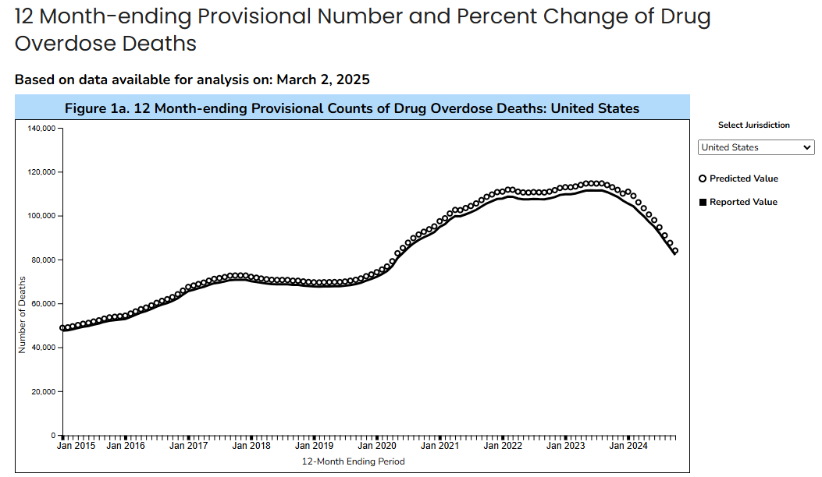
https://www.cdc.gov/nchs/nvss/vsrr/drug-overdose-data.htm, accessed March 20, 2025

Slide 25
Naloxone - More Work to be Done
Median monthly overdose deaths among persons aged 10–19 years (adolescents) increased 109% from July–December 2019 to July–December 2021
Two thirds of decedents had one or more potential bystanders present, but most provided no overdose response.
Tanz LJ, Dinwiddie AT, Mattson CL, O'Donnell J, Davis NL. Drug Overdose Deaths Among Persons Aged 10-19 Years - United States, July 2019-December 2021. MMWR Morb Mortal Wkly Rep. 2022 Dec 16;71(50):1576-1582. doi: 10.15585/mmwr.mm7150a2. PMID: 36520659; PMCID: PMC9762908.

Slide 26
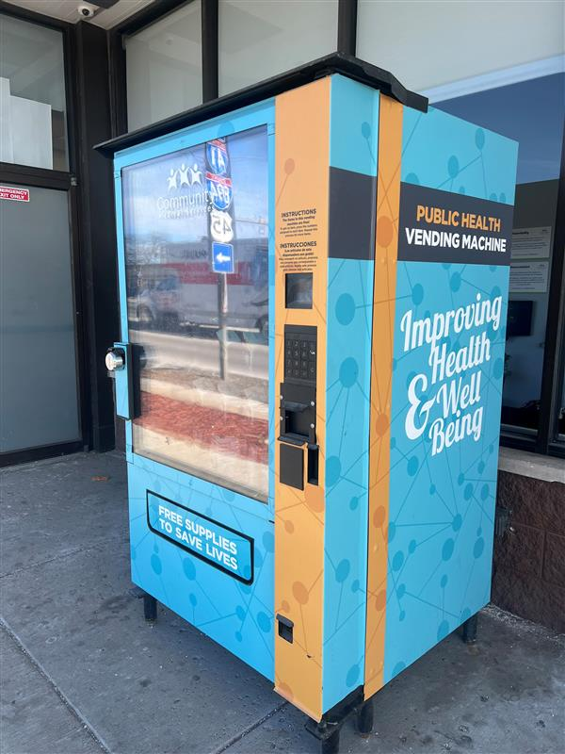
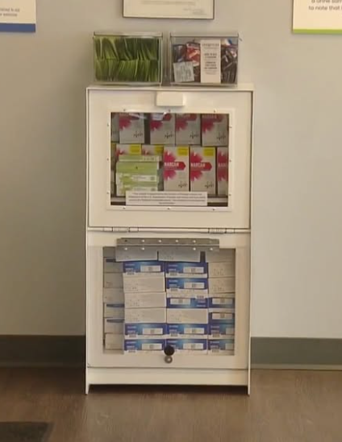
Harm Reduction Kiosks

Slide 27
Harm Reduction in Your Practice
Practical steps to take for increasing the implementation of Harm Reduction practices in your treatment setting.

Slide 28
HR Opportunities in the ER
Screening for alcohol and drug use for all patients (SBIRT).
Offering buprenorphine for patients with OUD and “warm handoff” to a community treatment provider.
Offering referrals to local HR agencies - SSPs, OPCs, etc.
Naloxone distribution and training, safer use recommendations.
Having SW and/or peers available to help patients with referrals, food, clothing, housing, etc.
Understanding that your patient is highly motivated to avoid opioid withdrawal.
Not obtaining urine drug screens without patient consent.
Trauma Informed and Harm Reduction training for all staff.

Slide 29
HR Opportunities in the Hospital
All those available in the ER. In addition:
Instituting an Addiction Medicine consult service that can induce patients on buprenorphine, methadone, or naltrexone.
Aggressively treating and preventing opioid withdrawal symptoms.
Offering screening and intervention for HIV, HBV, HCV, and STIs.
Offering smoking cessation counseling and medication.
Screening for co-occurring psychiatric conditions and arrange treatment and/or referral.
SW and/or SUD counselor consults for all patients with OUDs

Slide 30
HR Opportunities in the Office Setting
All those available in the ER and hospital. In addition:
Offering low-barrier MOUD with buprenorphine.
Offering education and referral for methadone for patients not responsive to buprenorphine.
Offering vaccinations - HAV, HBV, CV19, influenza, etc.
Offering smoking and lifestyle counseling and education.
Facilitating dental care/referral.
Develop liaisons with local Harm Reduction agencies.

Slide 31
Elements of Low-Barrier MOUD
- Trauma informed, culturally sensitive, accessible, comprehensive, flexible, shared decision making, anti-stigma
- SSP, naloxone, peer support, CM
- Same day/walk in/extended hours/telehealth
- Medication at first visit
- No engagement conditions
- Multiple treatment options
- Home initiation
- Individualized dosing
- Counseling offered but not required
- Visit frequency based on clinical need/stability
- Ongoing substance use is not a reason for discharge
- Attempts to manage difficult/challenging behaviors
- Do not require stopping other meds – BZs, AAPs, stimulants
- Acceptance of patient goals
- Peer outreach
- Family involvement per patient’s preferences
- Collaborative with other social services/referral services/warm handoffs
- Involve PWUD
- Lab testing not a basis for discharge – patients may opt out of lab testing – not used punitively

Slide 32
Resources for Low Barrier MOUD
CA Bridge Program - https://bridgetotreatment.org/
SAMHSA Advisory - https://library.samhsa.gov/sites/default/files/advisory-low-barrier-models-of-care-pep23-02-00-005.pdf
Defining low-threshold buprenorphine treatment - https://pmc.ncbi.nlm.nih.gov/articles/PMC7075734/
AHRQ - https://integrationacademy.ahrq.gov/products/playbooks/opioid-use-disorder/implement-mat-for-oud/delivering-effective-low-barrier-treatment

Slide 33
Harm Reduction Opportunities in the SUD Treatment Setting
All those available in the ER, hospital, and office. In addition:
Allowing expanded take-home doses allowed under the SAMHSA Final Rule when appropriate (OTPs).
Using medication doses that are high enough to be effective and induce patients on medication as fast as safely possible (buprenorphine and methadone).
Not discharging patients on the basis of urine drug screen results.
Not assuming or requiring that your patients have a goal of abstinence.
Offering extended office hours, telemedicine.
Offering as many services on-site as feasible.
Community outreach programs.
Using peers in your clinics and seeking involvement from PWLE and patients.

Slide 34
Errors in Applying HR Principles
Negative attitudes towards people who use drugs – stigma, judgment, condemnation, contempt.
Implicit Attributions - https://implicit.harvard.edu/implicit/takeatest.html
It is important to move beyond these barriers when thinking about harm reduction and focus on science and data.
Negative attitudes only increase feelings of shame and guilt and do not improve outcomes.
People who use illegal drugs do not lose their right to the best quality health care.

Slide 35
References
Cara Page and Erica Woodland, Healing Justice Lineages, published by North Atlantic Books.
Des Jarlais, D.C. Harm reduction in the USA: the research perspective and an archive to David Purchase. Harm Reduct J 14, 51 (2017). https://doi.org/10.1186/s12954-017-0178-6.
Fernandes RM, Cary M, Duarte G, et al. BMC Public Health. 2017;17(1):309.
Jakubowski A, Fox A. Defining Low-threshold Buprenorphine Treatment. J Addict Med. 2020 Mar/Apr;14(2):95-98. doi: 10.1097/ADM.0000000000000555. PMID: 31567596; PMCID: PMC7075734.
Levengood TW, Yoon GH, Davoust MJ, et al. Am J Prev Med. 2021;61(5):738-749.
Marlatt, G. A. (1996). Harm reduction: Come as you are. Addictive Behaviors, 21(6), 779–788. doi.org/10.1016/0306-4603(96)00042-1.
Marx MA, Crape B, Brookmeyer RS, Junge B, Latkin C, Vlahov D, Strathdee SA. Trends in crime and the introduction of a needle exchange program. Am J Public Health. 2000 Dec;90(12):1933-6. doi: 10.2105/ajph.90.12.1933. PMID: 11111271; PMCID: PMC1446444. Surratt HL, Otachi JK, Williams T, et al. The Journal of Rural Health. 2020;36(2):224-233.
Substance Abuse and Mental Health Services Administration: Harm Reduction Framework. Center for Substance Abuse Prevention, Substance Abuse and Mental Health Services Administration, 2023.
Szalavitz, M. (2021). Undoing drugs: the untold story of harm reduction and the future of addiction. First edition. New York, Hachette Go.
Tanz LJ, Dinwiddie AT, Mattson CL, O'Donnell J, Davis NL. Drug Overdose Deaths Among Persons Aged 10-19 Years - United States, July 2019-December 2021. MMWR Morb Mortal Wkly Rep. 2022 Dec 16;71(50):1576-1582. doi: 10.15585/mmwr.mm7150a2. PMID: 36520659; PMCID: PMC9762908.
Wai Chung Tse, Filip Djordjevic, Viandro Borja, et al. International Journal of Drug Policy, 2022;100, 103513.

Slide 36
Reading List for Harm Reduction
Readings:
“Undoing Drugs: How Harm Reduction is Changing the Future of Drugs and Addiction” by Maia Szalavitz.
“Harm Reduction Psychotherapy” Andrew Tatarsky PhD
“Drug, Set and Setting” Norman Zinberg
“Drug Use for Grownups” Carl Hart
“Coming to Harm Reduction Kicking and Screaming” Dee Dee Stout

Slide 37
Case Presentation - 1
This patient is a 24-year-old female who presents to the emergency room after having been dropped off by friends who then left. Initially her respiratory rate and O2 saturation were low. She was administered naloxone, after which she promptly became alert and agitated. She demanded to leave the ER. The staff told her she should stay, because the naloxone could wear off and she could overdose again. They also told her she should stop using drugs. She promptly left against medical advice.
What harm reduction measures were taken?
What additional harm reduction measures could be considered?

Slide 38
Case Presentation - 2
Several weeks later, she comes to the ER again, this time with an infection in her antecubital fossa that has progressed to lymphangitis and sepsis. She is admitted, her abscess is surgically drained, and she is place on antibiotics.
She is argumentative with the staff. The nurses suspect she is using her IV access to inject illegal drugs.
On hospital day 3 she disappears.
What harm reduction measures were taken?
What additional harm reduction measures could be considered?

Slide 39
Case Presentation - 3
She comes to an appointment at a primary care clinic. She requests treatment for a vaginal discharge. She receives an exam and prescription for treatment of an STI.
She is screened for drug and alcohol use disorders. She admits to using fentanyl powder she obtains on the streets, but says she is not ready for treatment.
What harm reduction measures were taken?
What additional harm reduction measures could be considered?

Slide 40
Case Presentation - 4
She subsequently presents to an Opioid Treatment Program requesting to be started on methadone. She reports using 1-2 grams of fentanyl powder per day along with methamphetamine.
She is started on methadone but is inconsistent in coming to the clinic for daily dosing. Her dose eventually is increased to 120 mg per day. She continues to test positive for fentanyl, amphetamine, and benzodiazepines on her urine screens.
What harm reduction measures were taken?
What additional harm reduction measures could be considered?

Slide 41
Case Presentation - 5
She remains in the OTP for a year. As her treatment progresses, she is more regular in methadone dosing. She continues to test positive for fentanyl and amphetamines.
How comfortable would you be discussing her continuing drug use with her?
How would you approach this discussion?
What Harm Reduction principles apply in this situation?

